Slide 1

Introduction to
HBase

Slide 2
Outline
What is NoSql?
RDBMS vs NoSql
HBase
HBase Components
Architecture
HBase Cluster
HBase Data Model
Key -> Value
Region

Slide 3
NoSQL is acronym for Not Only SQL. These databases are
non-relational. This term was coined in 1998.
They do not use SQL as their primary language.
NoSQL is not a replacement of Relational
Database.
NoSQL is designed for distributed data stores
NoSQL was designed to store semi-structured
and sparse data

Slide 4
NoSQL
RDBMS
Hardware
Farm of Commodity(upto
several thousand)
1-3 High End or
Proprietary(costly)
Data Type
Semi-structured and
Sparse
Structured and dense
Data Size
PetaBytes(10 )
TeraBytes(10
bytes)
15
12
Auto-Sharding
Yes
No
Flexible Schema
Yes
No
Referential Integrity
No
Yes
Support for Joins
No
Yes
Support for Aggregations
Basic
Advance

Slide 5



HBase is an open-source, distributed, versioned,
key-value database modeled after Google's
Bigtable.
=
+
Random Read/Write
access
Apache
+ Zookeeper
is optional for
HBase has real-time read/writes(in milliseconds)
HBase is highly fault tolerant(HA) and scalable

Slide 6
Selling Points of HBase
Highly Scalable
Auto-sharding
Strongly Consistent
Out of the box support for Historical Data
Very high read throughput
Readily compatible with Hadoop
Highly Fault-tolerant(HA)

Slide 7
HBase Components
1. HBase Master(HMaster): HMaster is the
Master Server.
➢ HMaster is responsible for monitoring all
RegionServers
➢ Performs load balancing a.k.a sharding
➢ Assigns regions to RegionServers
➢ All the metadata changes go through Master
➢ Periodically checks and cleans up the .META.
table
➢ Multiple HMaster can run in cluster but only one
HMaster will be active at any time.

Slide 8
HBase Components(cont.)
2. RegionServer(HRegionServer):
HRegionServer is the implementation of the
worker module.
➢ Runs as Java Service on worker nodes.
➢ Machine running a RegionServer is considered
a worker node.
➢ Serves get/put/scan requests
➢ Responsible for splitting and compacting regions
➢ Runs on DataNode
➢ Multiple RegionServers run in a cluster

Slide 9
Zookeeper in HBase
ZooKeeper: It allows distributed processes to
coordinate with each other through a shared
hierarchical name space. It is distributed and
highly reliable service.
In HBase it is responsible for following:
➢ Provide availability status of RegionServers
➢ To ensure single active HMaster in the cluster
➢ Provide location of “-ROOT-” table
➢ Selection of new HMaster in case of failure of
an active HMaster

Slide 10
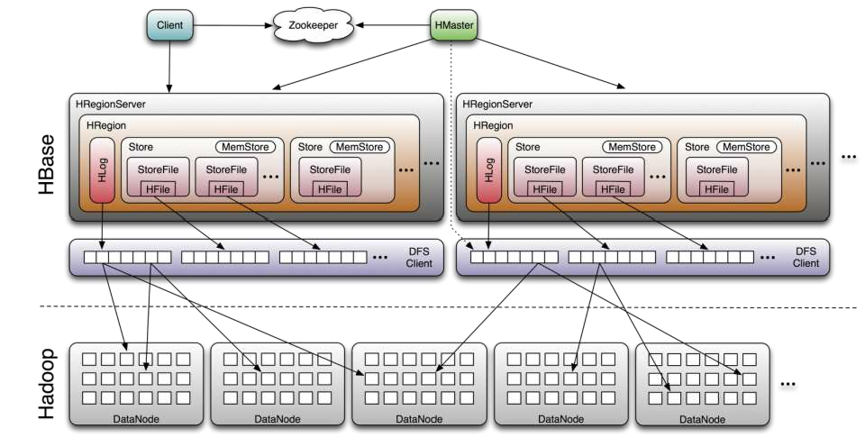
HBase Architecture

Slide 11





HBase
Cluster
HMaster
Name
Node
Zoo
keeper
HMaster
Name
Node
TaskTracker
HRegionServe
r
RegionServer
RegionServer
DataNode
DataNode
DataNode
Worker
Node
Worker Node
Worker Node
TaskTracker
HRegionServe
r
RegionServer
RegionServer
DataNode
DataNode
DataNode
Worker
Node
Worker Node
Worker Node
RegionServer
RegionServer
RegionServer
DataNode
DataNode
DataNode
Worker Node
Worker Node
Worker Node

Slide 12
Column Family and Column Qualifier
Column Family: Columns Qualifiers in HBase are grouped
into column families.
The colon character (:) delimits the column qualifier family
from the column family.
Combination of <Column Family>: <Column Qualifier> is
equivalent to a Column name.
Physically, all column qualifiers of a column family are stored
together on the file system.
•
Column Qualifiers
within a family
are sorted lexicographically and
stored together
Example: txn:amt , Here “txn” is the Column Family and “amt” is
the Column Qualifier.

Slide 13
HBase Data Model
• Table maintains data in lexicographic order by RowKey.
•
Everything except table names are stored as byte array
Only column families
time of table
➢ Each family can have any number of columns(to a
maximum of few millions)
➢ Each row can have different columns in a column family
➢ Each column consists of any number of versions
➢ Columns only exist when inserted because HBase does
not have NULL values
•
are defined at the creation

Slide 14
Key -> Value in HBase
(RowKey, Column Family:Column Qualifier,
Timestamp) is a “Key” in HBase.
“Value” is stored corresponding to a “Key”
Timestamp is used to support storing of Historical
Data
Table is always indexed on RowKey

Slide 15
Region
Tables in HBase are divided into multiple Regions.
1 Region = 1 Partition of Table
Regions are hosted by RegionServers
1 RegionServer can host 100’s of Regions
RegionServer can host Regions from multiple
tables.
After a major compaction, every region has 1 HFile
for each column family.

Slide 16
Random Facts About
HBase
Data in HBase is stored in HFile Format
Values are stored as Byte Array in HFiles
HLog is the file format used for storing “Write
Ahead Logging” in HBase.

