Slide 1
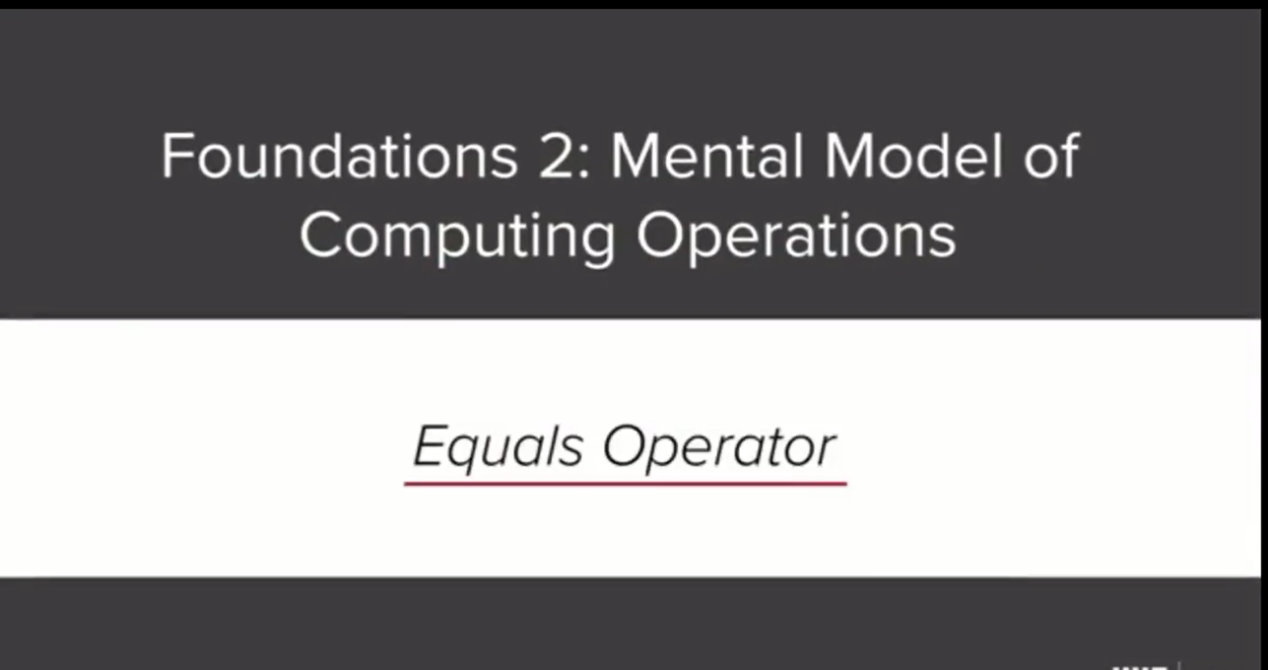

Slide 2
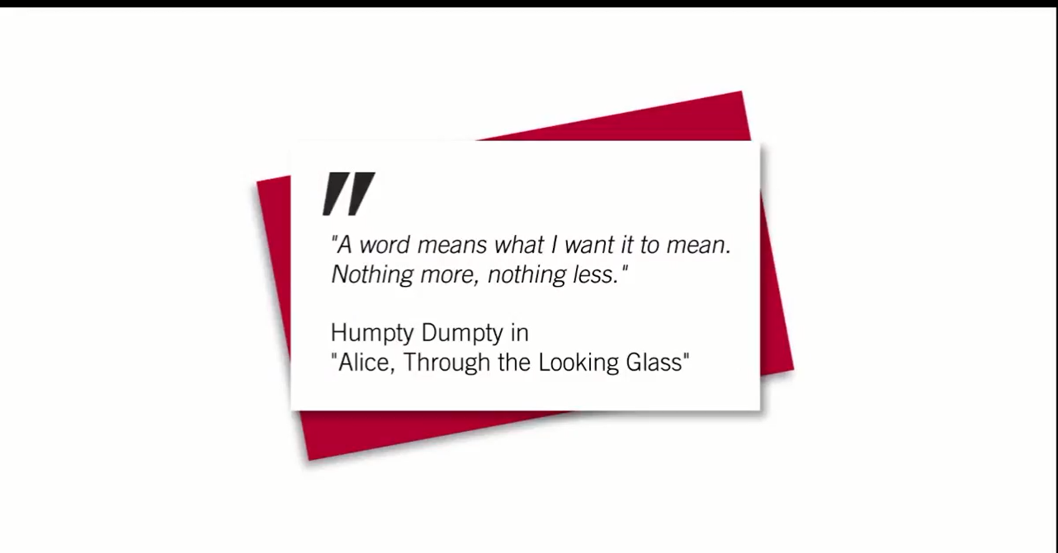

Slide 3
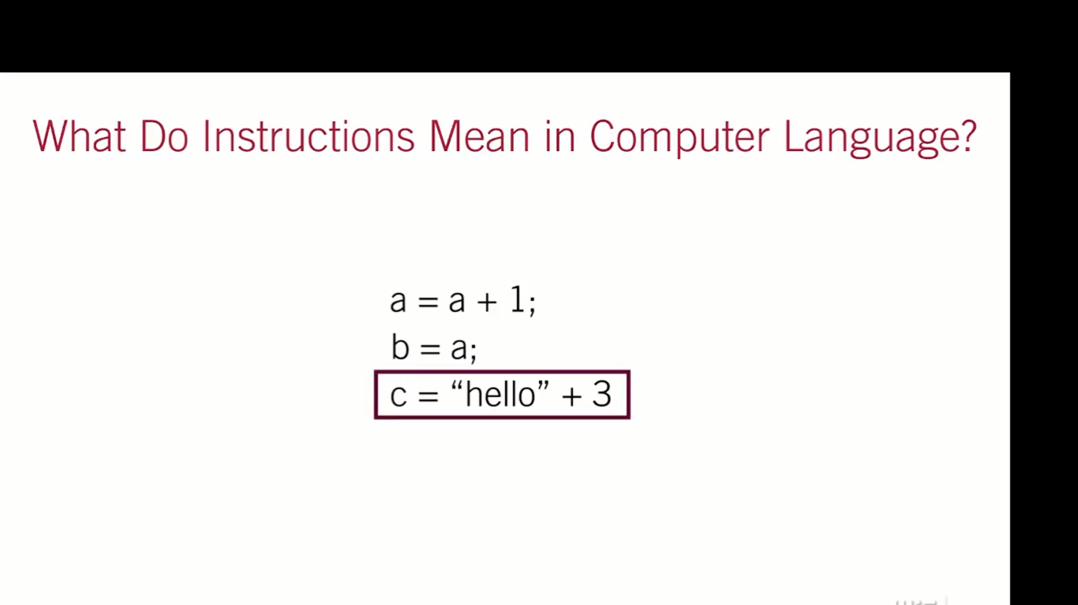

Slide 5
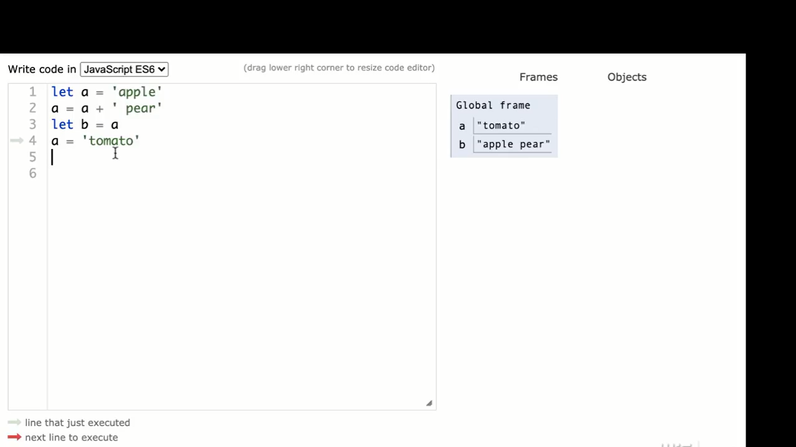

Slide 6
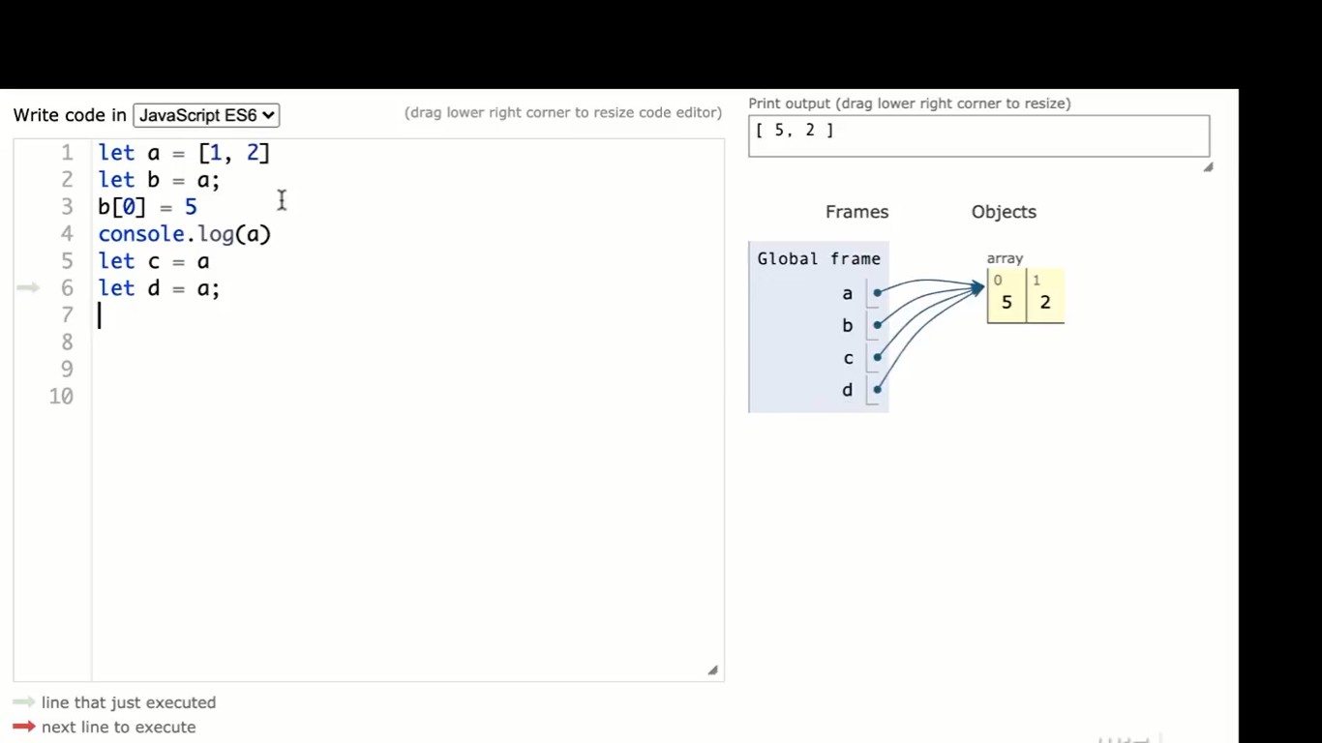

Slide 7
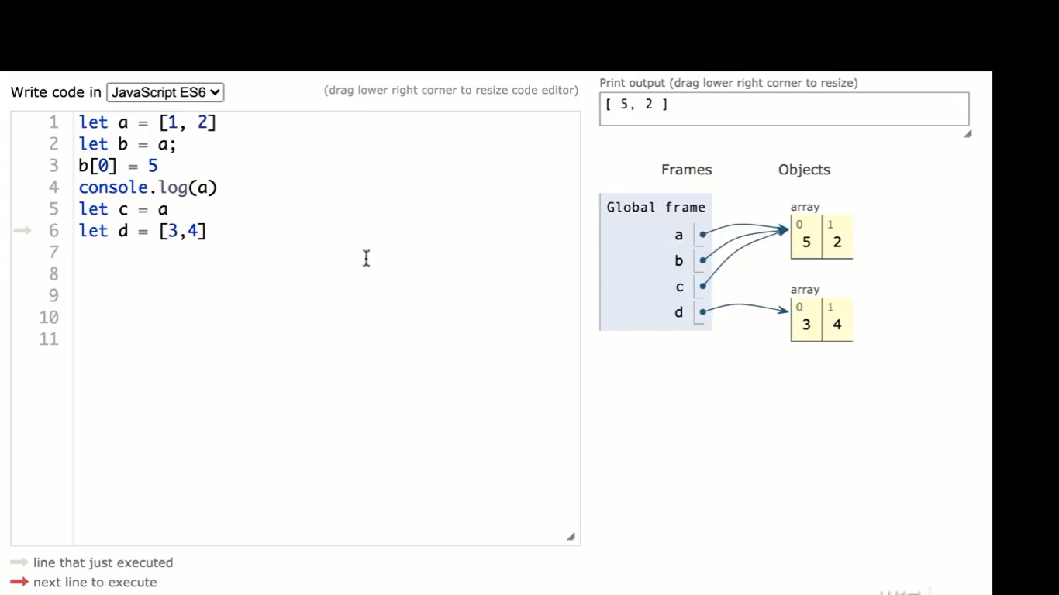

Slide 8


Slide 9
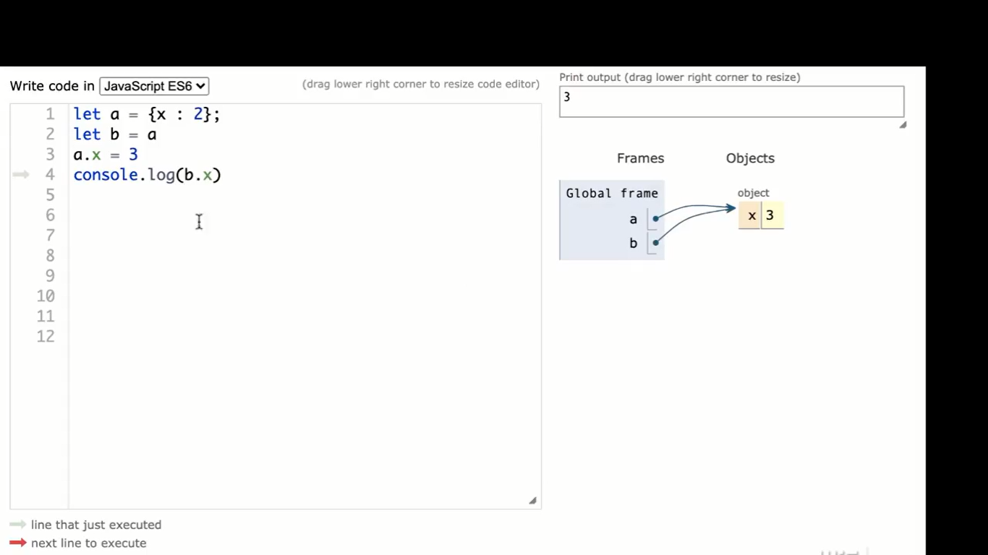

Slide 10
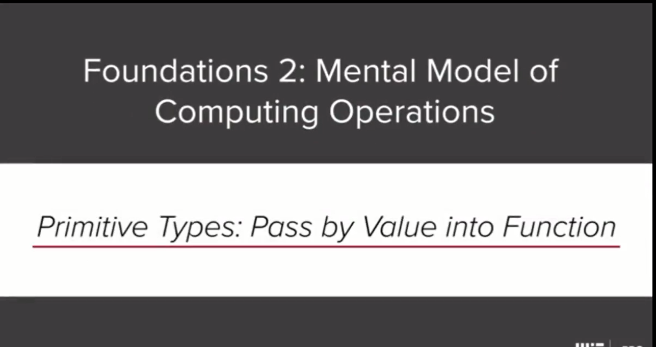

Slide 11
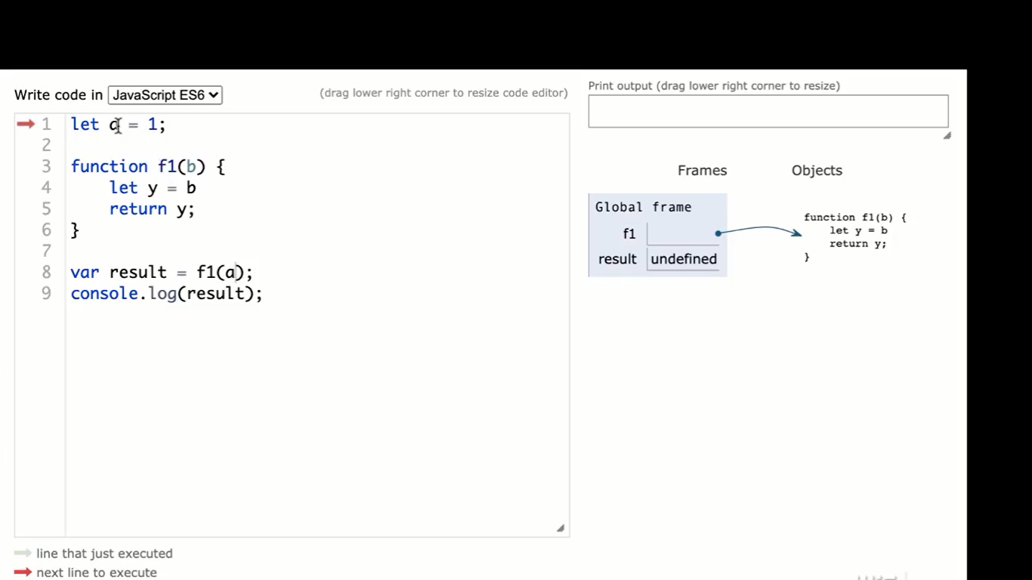

Slide 12
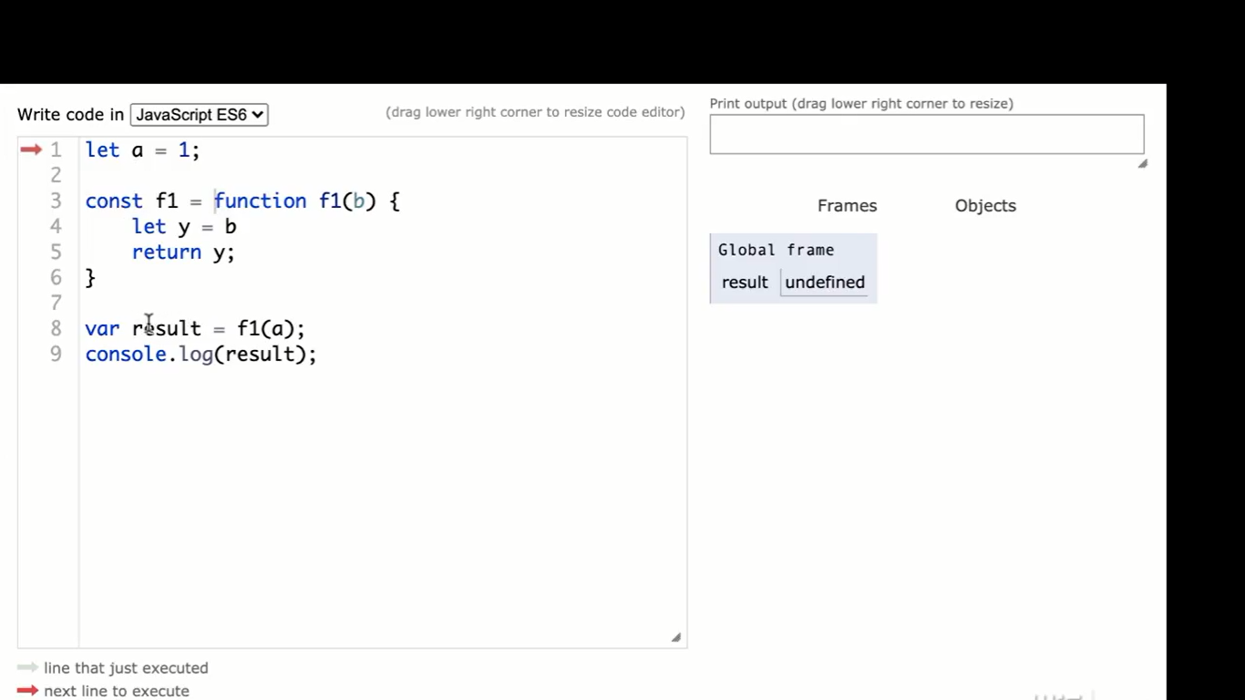

Slide 13
https://developer.mozilla.org/en-US/docs/Glossary/Hoisting

Slide 14
Primitive Types: Pass By Value Into Function.
This will help you recognize that the number is copied into the function, rather than referenced.

Slide 15
Objects And Arrays Passed By Objects Into Function Next, you will pass objects into functions. This allows you to manipulate the value of the object inside the function, in order to get different results.
Why Arrays And Objects Are Passed By Reference : Arrays and objects are passed into functions by reference. This means that instead of being duplicated, they point to a separate value.

Slide 16
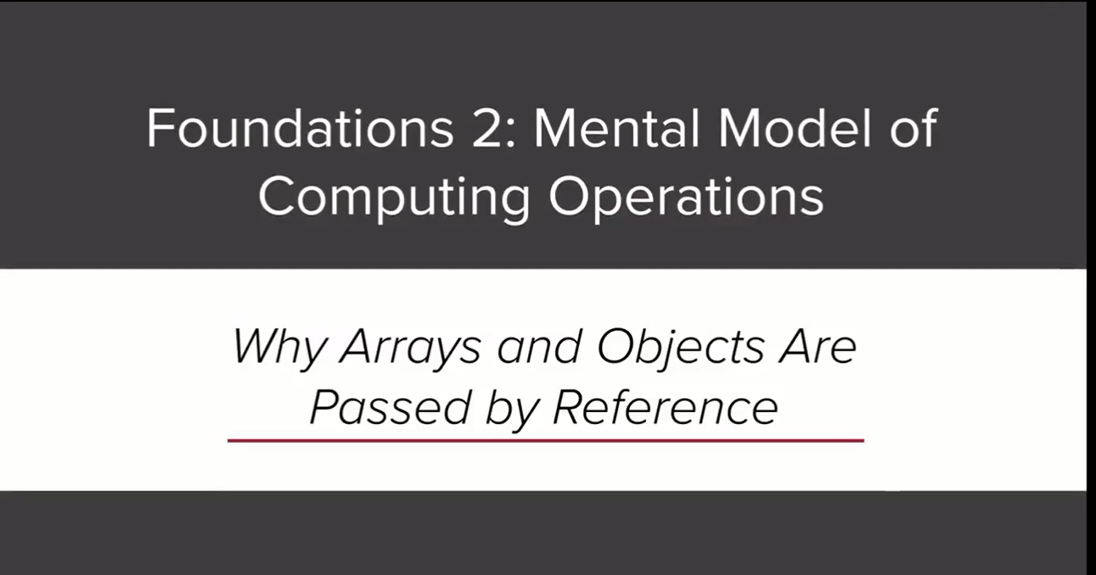

Slide 17
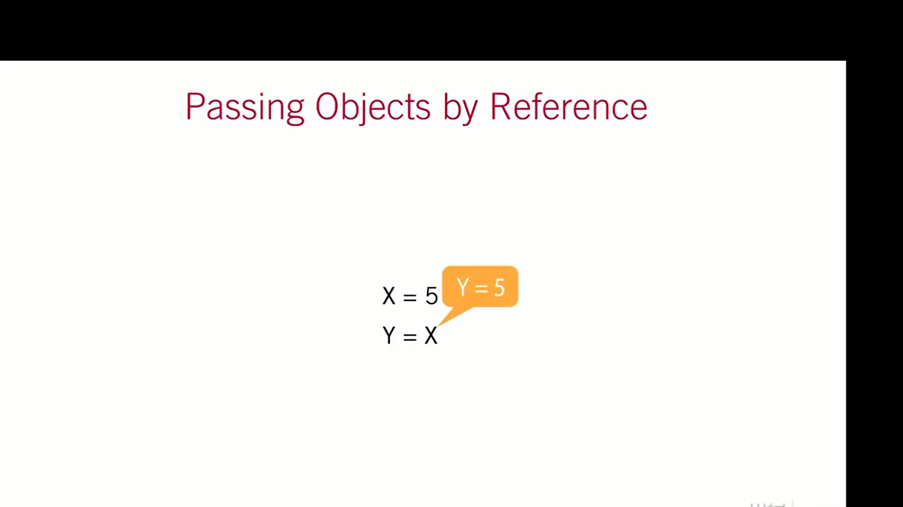

Slide 18
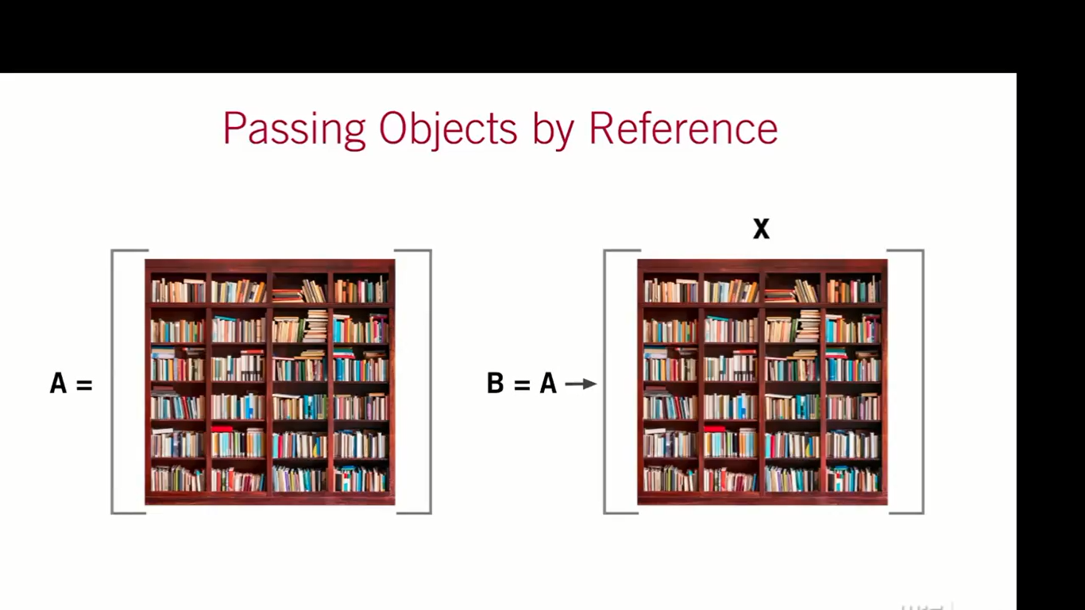

Slide 19
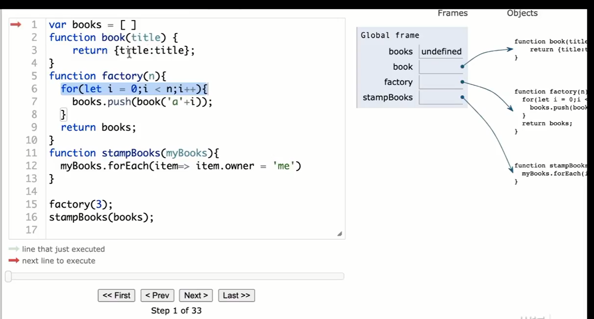

Slide 20
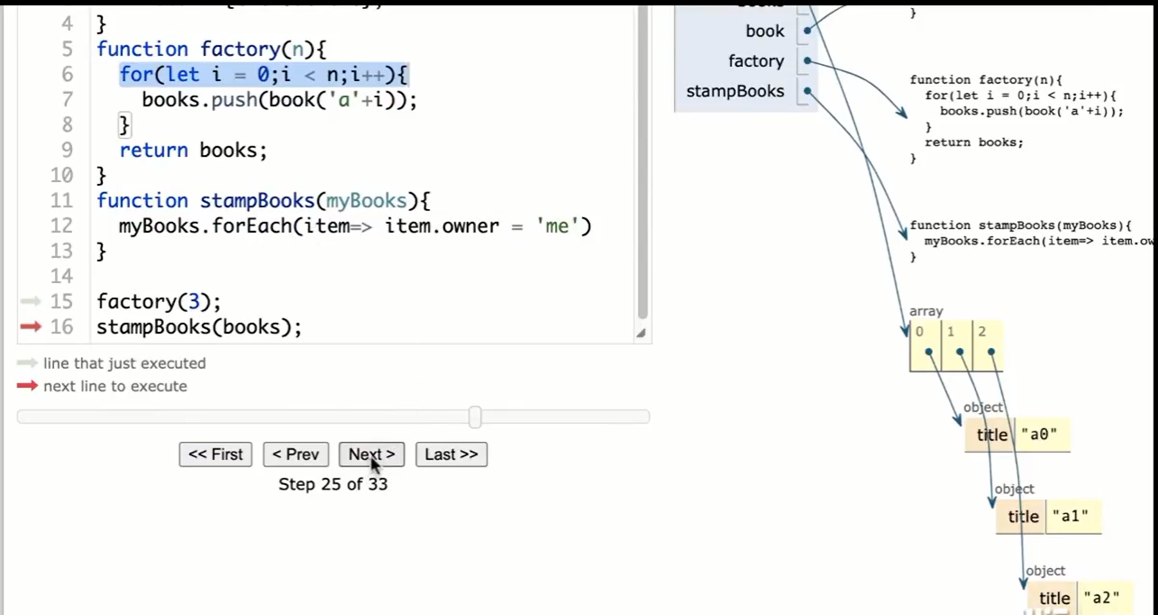

Slide 21
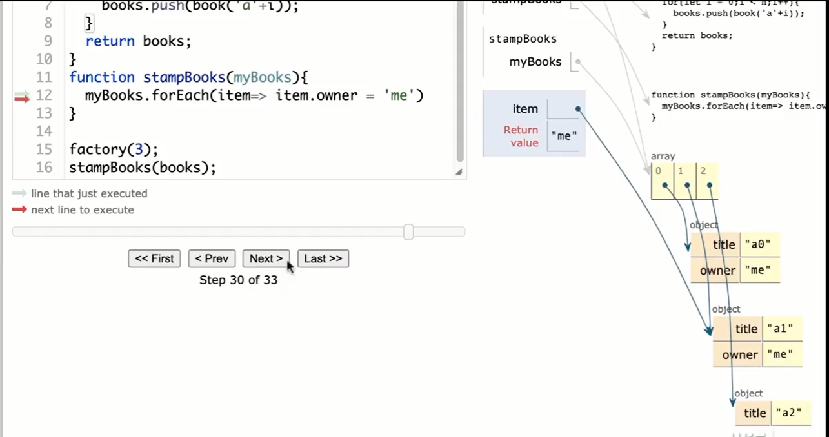

Slide 22
