Slide 1


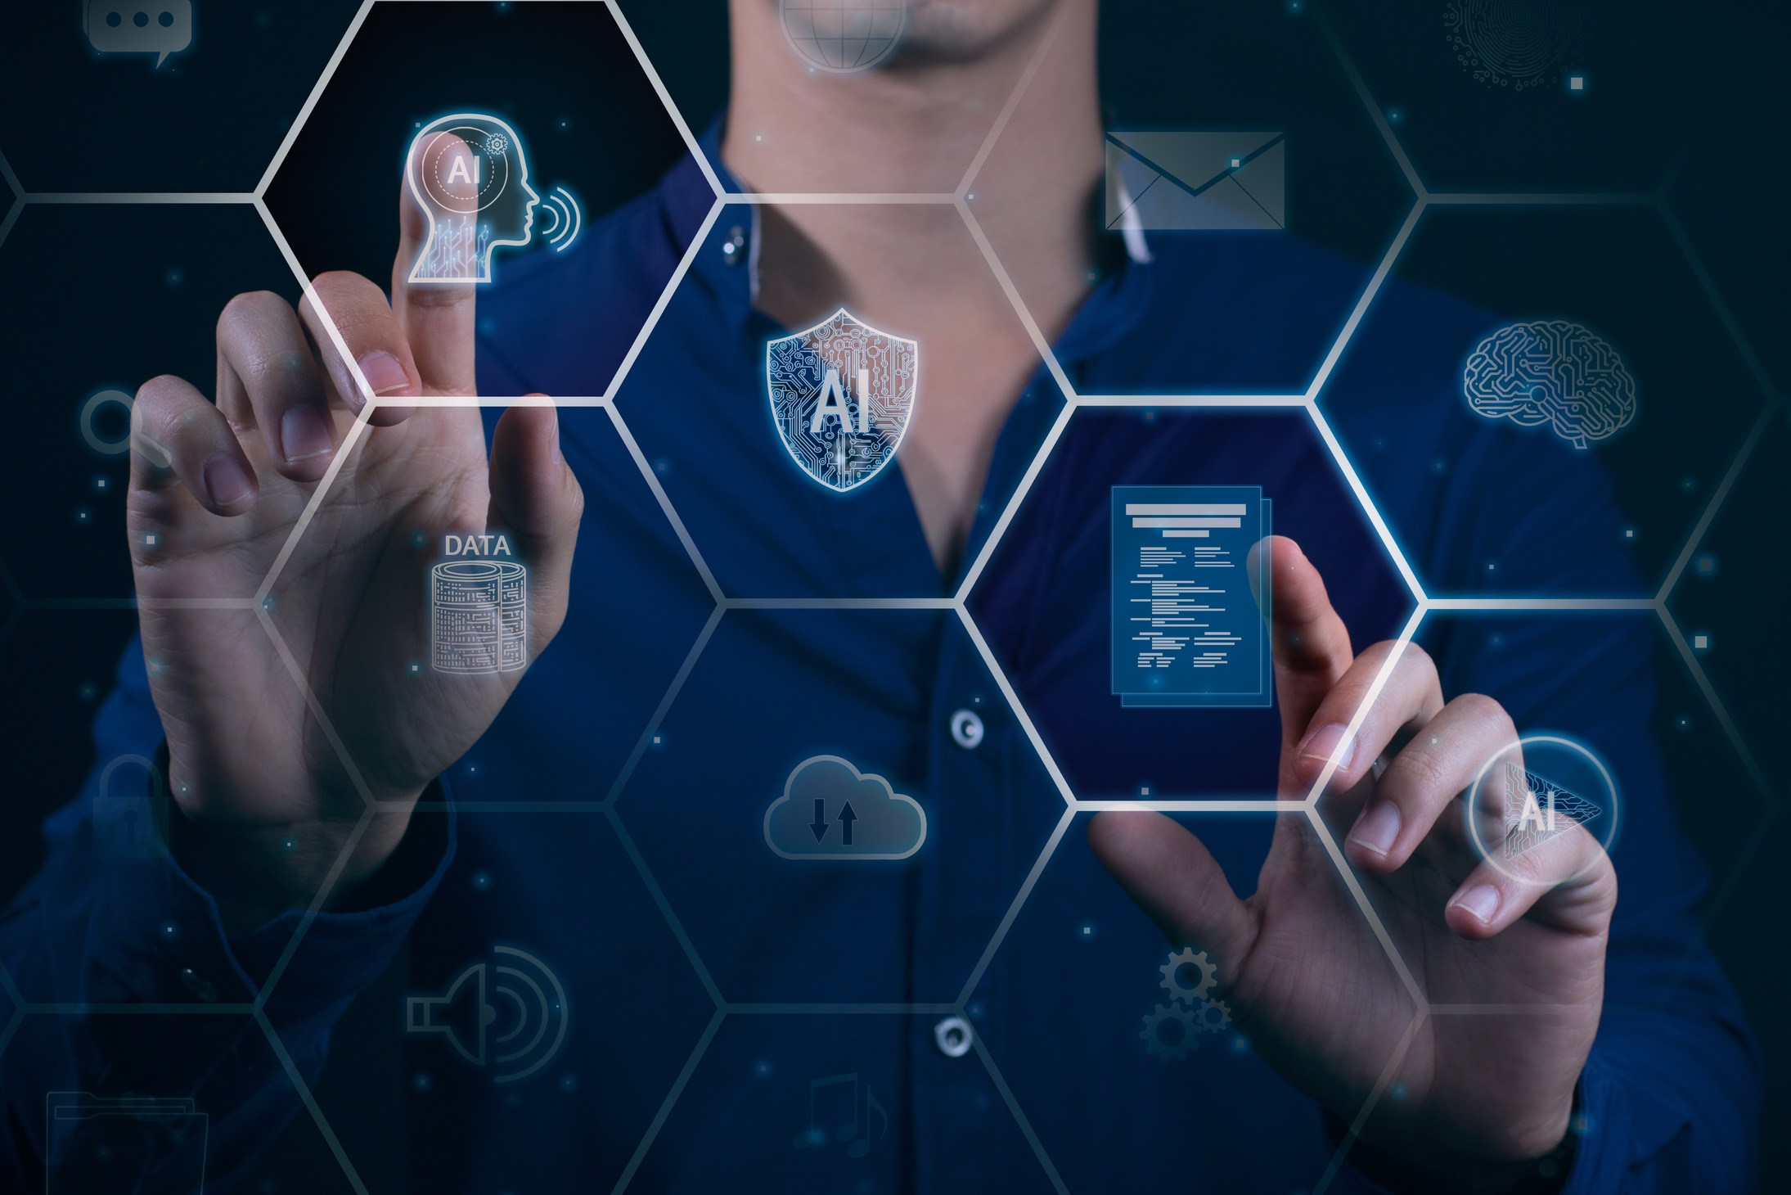
AVATAR AI
Avatar Lab is an AI-driven platform that swiftly converts text into realistic talking avatars. By leveraging DiffTalk for facial animation and SMALL-E for speech synthesis, our system generates avatars that not only speak but also convey emotions naturally.
L.HINDHUJA
23BD1A0545
G-362

Slide 2
PROJECT OVERVIEW
Web Interface
Users engage with a simple and user-friendly web platform to create AI-powered talking avatars. They enter sample text, adjust avatar settings, and submit their request. The backend handles all processing automatically, ensuring a seamless experience.
Speech Synthesis
Our TTS model transforms text into high-quality speech with natural tone, pitch, and expression. It guarantees human-like pronunciation and includes a zero-shot voice cloning feature for added flexibility.
Video Synthesis
An additional model synchronizes speech with precise lip movements. AI-driven facial expressions and head motions enhance realism, ensuring the avatar's speech and expressions align perfectly for a lifelike effect.
Output
The AI generates a high-quality, smooth video of the avatar speaking with perfect lip-sync. Users can preview, download, or share the video effortlessly.

Slide 3
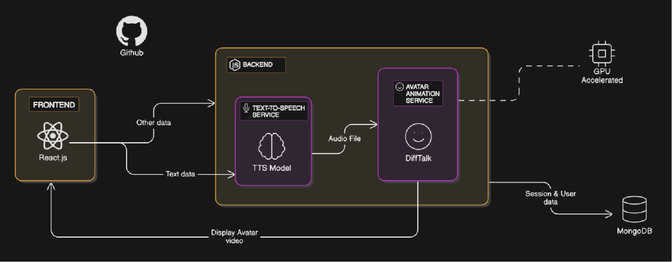
ARCHITECTURE DIAGRAM

Slide 4
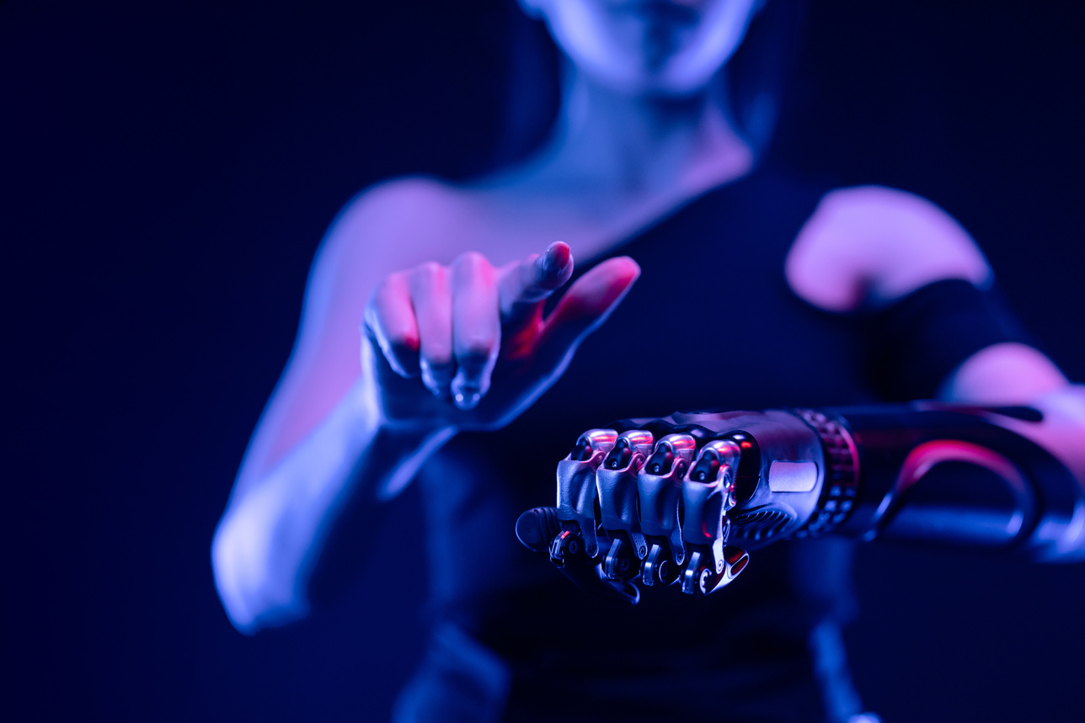
Virtual Personal Assistant
AI avatars can serve as a digital companion, helping users schedule tasks, set reminders, or provide weather updates with a human-like touch.
TARGET USERS AND THEIR ROLES
AI-Powered Storytelling for Kids
Parents can use AI avatars to create and narrate bedtime stories with engaging facial expressions and voices.
Language Learning & Practice
AI avatars can act as language tutors, helping users practice pronunciation, conversation skills, and grammar with real-time feedback.
Digital News Anchors
Personalized AI avatars can deliver daily news updates, summarizing headlines in a natural, engaging way.

Slide 5
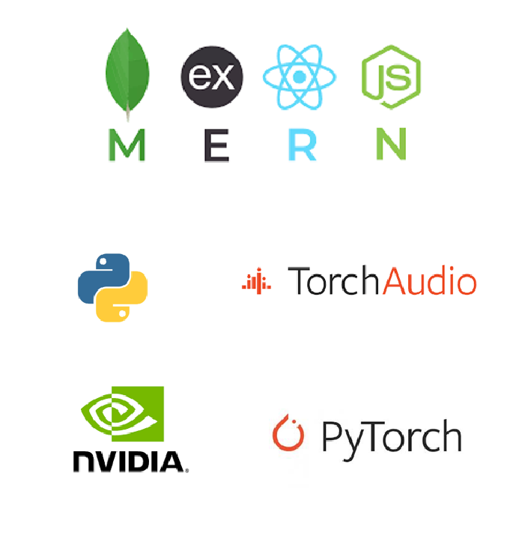
MERN Stack – React.js/Next.js for frontend, Node.js & Express.js for backend logic and API handling.
Python – The core AI processing language, integrating various models and libraries.
Flask API – Acts as a bridge between the MERN stack and AI models, managing speech synthesis and video processing.
Performance Enhancements – Utilizes NVIDIA GPUs for rapid AI inference and rendering, along with cloud integration for scalability.

