Slide 1
Avatar AI: Lifelike Talking Avatars
Avatar Lab: AI-powered system for converting text to talking avatars.
Combines DiffTalk & SMALL-E tech to create realistic and expressive avatars in seconds.
Group No: G362
Name: Vivek kumar
Roll No:23BD1A055B
Vk

Slide 2
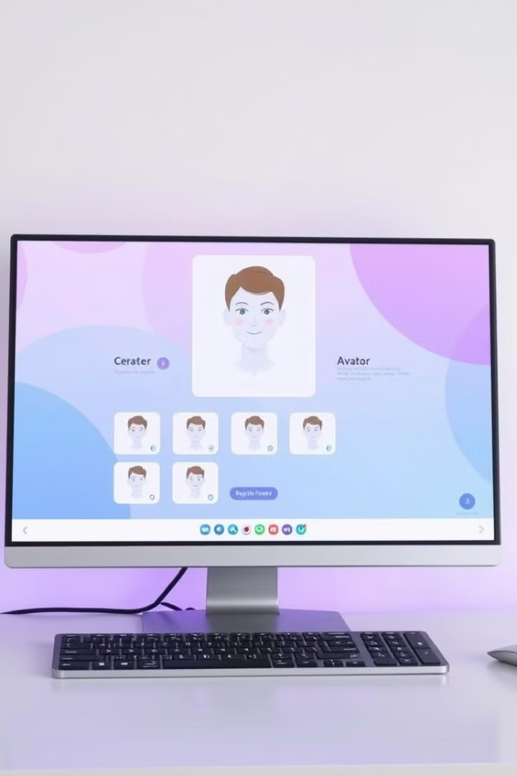
Project Overview
Web Interface
Speech Synthesis
Type text, adjust settings, submit for avatar generation.
TTS Model: realistic tone, pitch, and expression.
Video Synthesis
Processes speech, synchronizes lip movements, enhances realism.

Slide 3
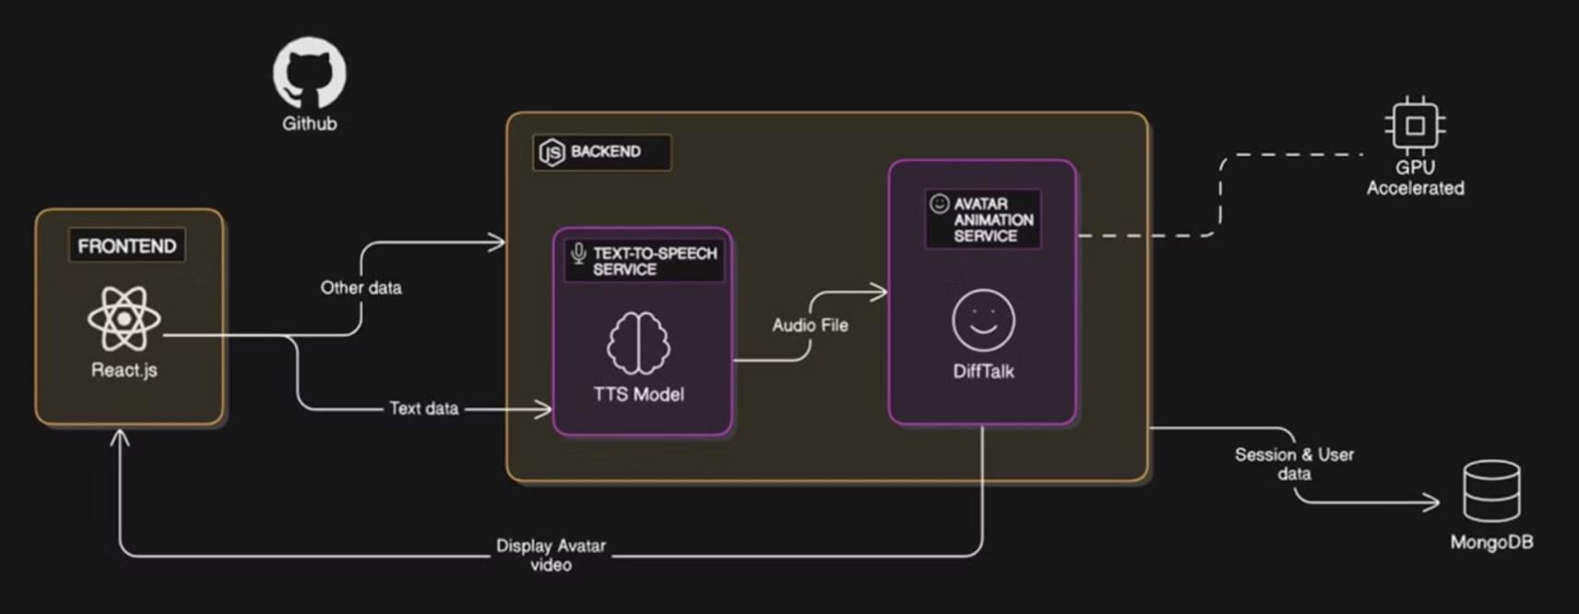
Architecture Diagram

Slide 4
DiffTalk Model
Diffusion
Reference image, masked image output
C = {a, zr, zm, l}
Image
Image
Image
Image
Input(X)
Audio Sample
UNetbased backbone M with the cross-attention mechanism
Concat
Output(X’)
MLP based Encoder(LandMarks)
Denoising

Slide 5




Target Users
Education
Content Creators
Enterprise
Customer Support
Educators creating interactive lessons with virtual instructors, ideal for online classes and accessibility.
Videographers and influencers producing professional videos with realistic avatars to save time and reduce costs.
Businesses using AI avatars for customer support, employee training, and internal communications.
AI-powered chatbots with lip-synced avatars for realistic interactions.
Notes:
Additional User Groups Marketing teams requiring human-like content creation for explainer videos and product demos without live recording.

Slide 6
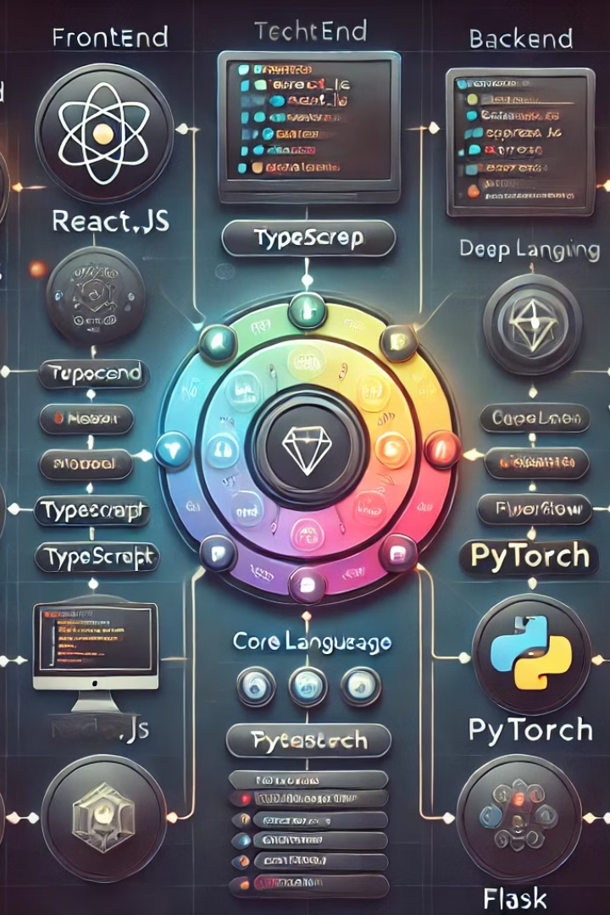
Tech Stack
MERN
Python
Flask API
React.js / Next.js, Node.js & Express.js with modern TypeScript implementation
Core language with PyTorch for deep learning processing
High-performance API layer connecting MERN stack with AI models through gRPC

