Slide 1
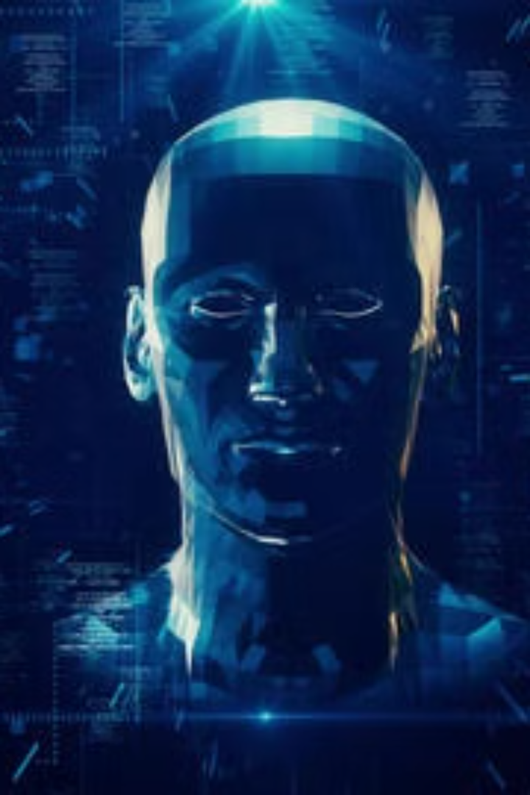
Avatar AI
Avatar Lab is an AI-powered system that transforms text into lifelike talking avatars in seconds. By combining DiffTalk for facial animation and SMALL-E for speech synthesis, our project creates avatars that not only speak but also express emotions naturally.
P. Apuroop Reddy
23BD1A055C
G-362

Slide 2
Project Overview:
Web Interface
Speech Synthesis
Video Synthesis
Output
Users interact with a clean and intuitive web interface to create AI-driven talking avatars. They simply type sample text, adjust avatar settings and submit it for processing. The system handles everything seamlessly in the backend making it easy for anyone to use.
We use a TTS Model which converts text into high-quality speech with realistic tone, pitch, and expression and ensures natural pronunciation, human-like speech with the extra function of zero shot voice cloning.
Another model processes speech and synchronizes lip movements with extreme accuracy. AI-generated facial expressions and head movements enhance realism and emotion. The system ensures the avatar’s speech and expressions match naturally, creating a lifelike effect.
The AI renders a smooth, high-quality video of the avatar speaking with perfect lip-sync. Users can preview, download, or share the video.

Slide 3
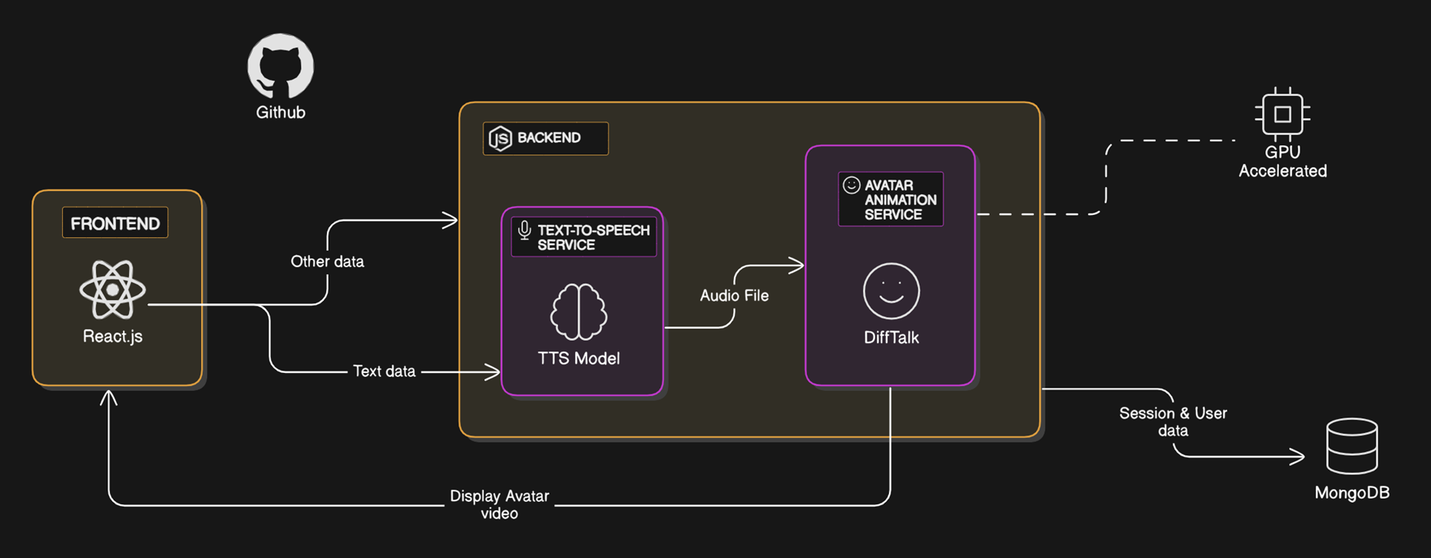
Architecture Diagram

Slide 4





Target Users and Their Roles
Education Sectors
Content Creators
Teachers and trainers can use AI avatars to create interactive lessons that explain concepts without needing pre-recorded videos. This makes online learning more engaging and accessible.
AI avatars eliminate the need for actors, allowing YouTubers and marketers to generate talking videos with natural narration. This saves time and also reduces production costs.
Virtual Assistants
Gaming
AI avatars can provide realistic, human-like interactions for customer support and chatbots which can answer queries and also guide the users.
AI avatars bring NPCs to life with realistic dialogues and facial expressions. Developers can use them to create immersive game experiences.

Slide 5
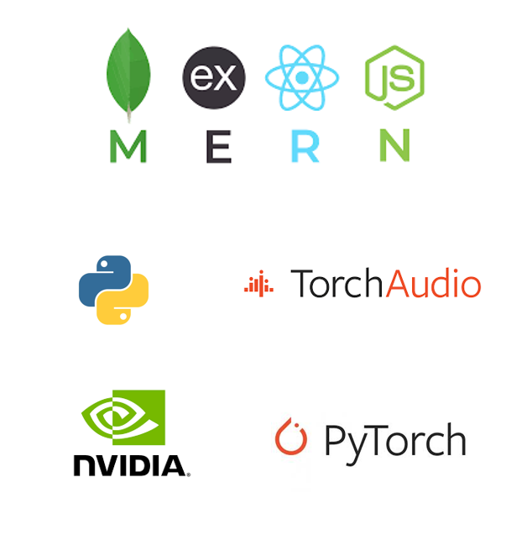
Tech Stack
MERN
Python
Powers the web interface, with React.js / Next.js for a smooth user experience and Node.js & Express.js handling backend logic and API requests.
Python serves as the core language for AI processing, integrating the models and providing various libraries.
Flask API
Miscellaneous
Connects the MERN stack with AI models, managing speech generation and video processing.
To ensure high performance, we use NVIDIA GPUs for fast AI inference and rendering along with cloud integration.

