Slide 1
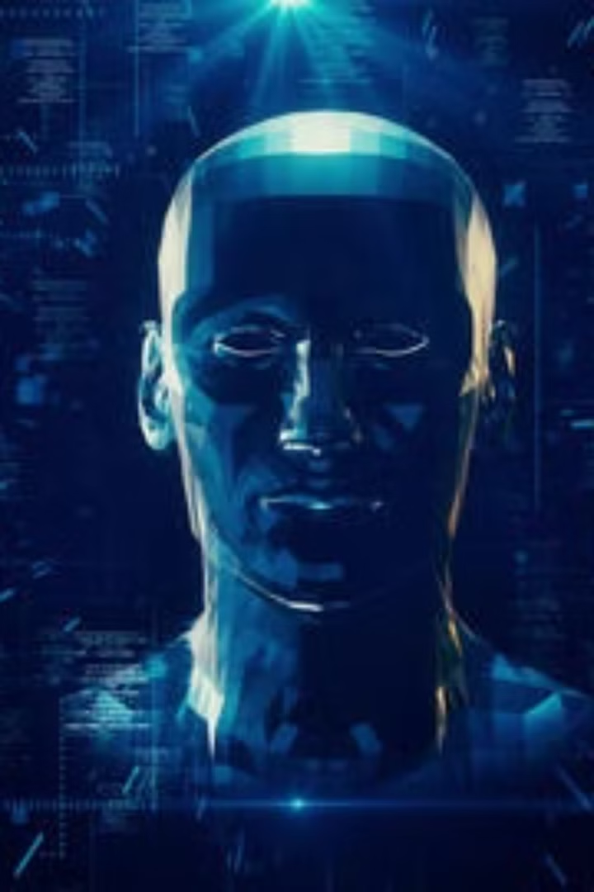
Avatar AI
Avatar Lab is an AI-powered system that transforms text into lifelike talking avatars in seconds. By combining DiffTalk for facial animation and SMALL-E for speech synthesis, our project creates avatars that not only speak but also express emotions naturally.

Slide 2




Project Overview:
Web Interface
Users interact with a clean and intuitive web interface to create AI-driven talking avatars. They simply type sample text, adjust avatar settings and submit it for processing. The system handles everything seamlessly in the backend making it easy for anyone to use.
Speech Synthesis
We use a TTS Model which converts text into high-quality speech with realistic tone, pitch, and expression and ensures natural pronunciation, human-like speech with the extra function of zero shot voice cloning.
Video Synthesis
Another model processes speech and synchronizes lip movements with extreme accuracy. AI-generated facial expressions and head movements enhance realism and emotion. The system ensures the avatar's speech and expressions match naturally, creating a lifelike effect.
Output
The AI renders a smooth, high-quality video of the avatar speaking with perfect lip-sync. Users can preview, download, or share the video.

Slide 3
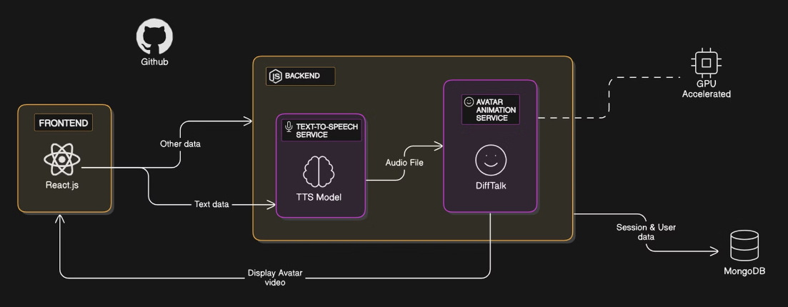




Architecture Diagram
User Input
Processing
Text submission and avatar configuration
AI models generate speech and facial animations
Delivery
Rendering
Final avatar video ready for user download
System combines elements into seamless video

Slide 4




Target Users and Their Roles
Education Sectors
Content Creators
Virtual Assistants
Gaming
Teachers and trainers can use AI avatars to create interactive lessons that explain concepts without needing pre-recorded videos. This makes online learning more engaging and accessible.
AI avatars eliminate the need for actors, allowing YouTubers and marketers to generate talking videos with natural narration. This saves time and also reduces production costs.
AI avatars can provide realistic, human-like interactions for customer support and chatbots which can answer queries and also guide the users.
AI avatars bring NPCs to life with realistic dialogues and facial expressions. Developers can use them to create immersive game experiences.

Slide 5

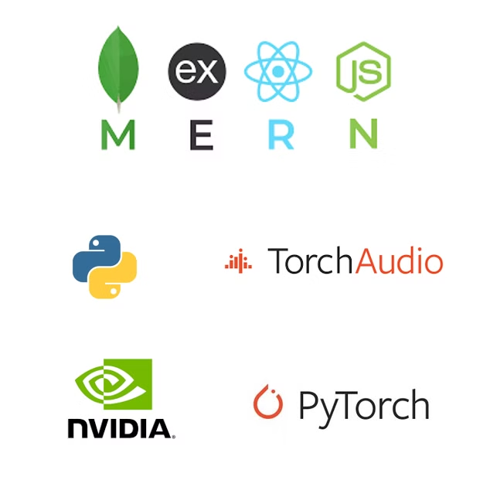
Tech Stack
MERN
Powers the web interface, with React.js / Next.js for a smooth user experience and Node.js & Express.js handling backend logic and API requests.
Python
Python serves as the core language for AI processing, integrating the models and providing various libraries.
Flask API
Connects the MERN stack with AI models, managing speech generation and video processing.
Miscellaneous
To ensure high performance, we use NVIDIA GPUs for fast AI inference and rendering along with cloud integration.

