Slide 1
Avatar AI Lifelike talking avatars

Slide 2
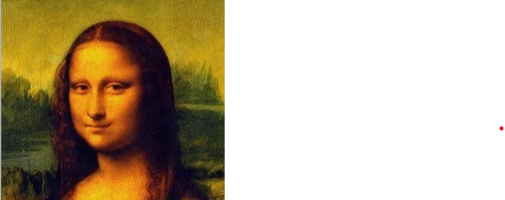
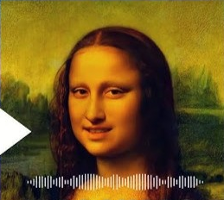
PROJECT OBJECTIVE Avatar is an AI-powered system that transforms text into lifelike talking avatars. By combining DiffTalk for facial animation and SMALL-E for speech synthesis, our project creates avatars that not only speak but also express emotions naturally.
IMAGE
TALKING VIDEO

Slide 3




Project Overview
Web Interface
Users interact with a clean and intuitive web interface to create AI-driven talking avatars. They simply type sample text, adjust avatar settings and submit it for processing.
Speech Synthesis (SMALL E)
We use a TTS Model which converts text into high-quality speech with realistic tone, pitch, and expression
Video Synthesis (DIFFTALK)
Another model processes speech and synchronizes lip movements with extreme accuracy. AI-generated facial expressions and head movements enhance realism and emotion. The system ensures the avatar's speech and expressions match naturally, creating a lifelike effect.
Output
The AI renders a smooth, high-quality video of the avatar speaking with perfect lip-sync. Users can preview, download, or share the video.

Slide 4
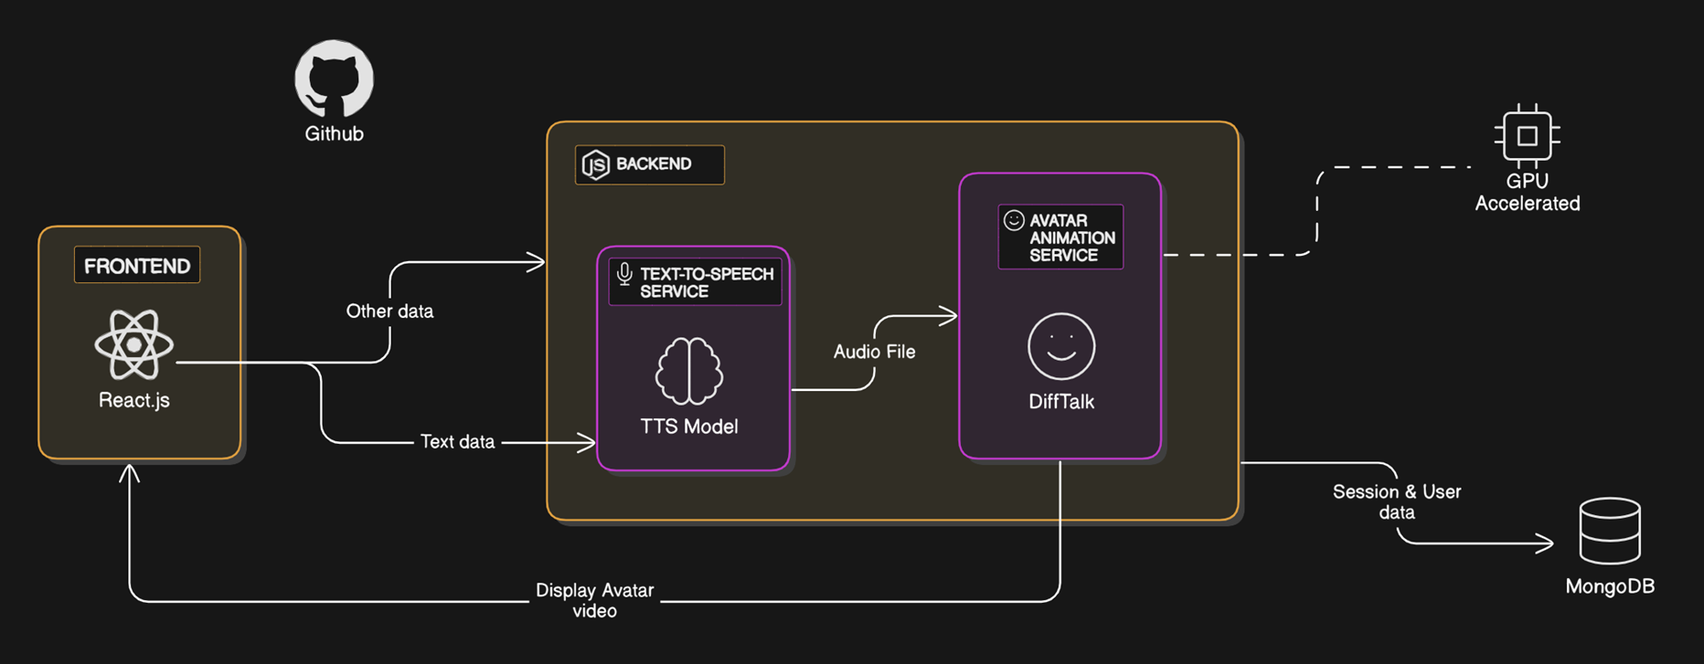
PROJECT ARCHITECTURE

Slide 5
Target Users
Education Sector
Customer Service
Media & Entertainment
Content Creators
Healthcare & therapy
Marketing & Sales

Slide 6
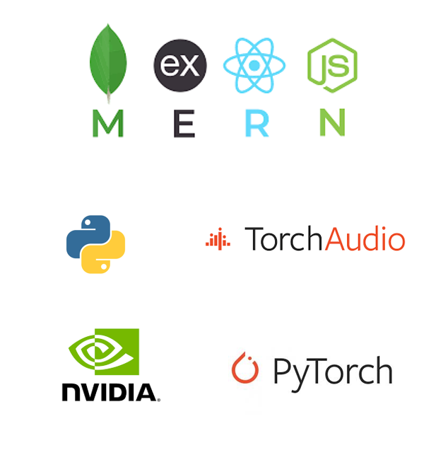
TECH STACK
MERN
Powers the web interface, with React.js / Next.js for a smooth user experience and Node.js & Express.js handling backend logic and API requests.
FLASK API
Connects the MERN stack with AI models, managing speech generation and video processing.
PYTHON
Python serves as the core language for AI processing, integrating the models and providing various libraries.
MISCELLANEOUS
To ensure high performance, we use NVIDIA GPUs for fast AI inference and rendering along with cloud integration.

Slide 7
OUTCOME OF THE PROJECT
The AVATAR will :
Converts the text input into talking head video of the reference image
Capable of expressing emotions and syncing lip movements

Slide 8
Thank you
P. Aswath rEddy
23BD1A055N

