Slide 1
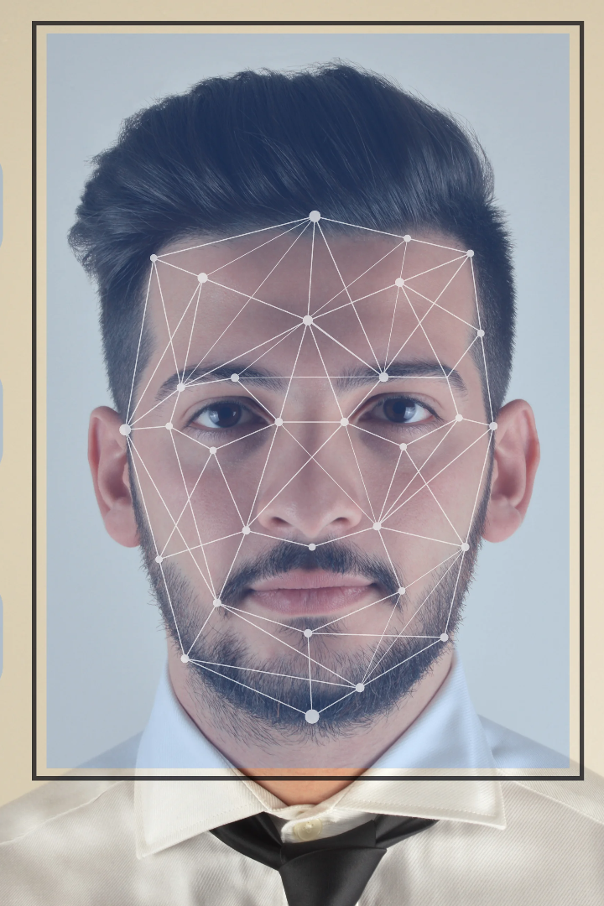


Face Detection System
A face detection system is an advanced technology that detects and recognizes human faces in images or videos. It plays a crucial role in various domains, from security to entertainment and beyond.
by Vivek Sharma

Slide 2
Importance of Face Detection Systems
Face detection systems offer numerous benefits, including enhanced security, seamless user experiences, and efficient data analysis. They have become increasingly vital in today's digital age.

Slide 3

Definition and Brief Overview
Face detection is the process of identifying and localizing human faces within images or videos. It involves analyzing patterns and features to distinguish faces from other objects.

Slide 4

How Face Detection Works
1
Detection Algorithms
Various algorithms, such as Viola-Jones and Histogram of Oriented Gradients, are used to identify facial features and detect faces accurately.
Techniques
2
Face detection techniques include Haar cascades, convolutional neural networks (CNNs), and deep learning models trained on large face datasets.
3
Challenges and Limitations
Despite advancements, face detection can be affected by factors like lighting conditions, occlusions, and pose variations, posing challenges to accurate detection in certain scenarios.

Slide 5

Applications of Face Detection
Biometric Identification and Authentication
Face detection enables secure and convenient biometric authentication methods, such as unlocking devices and granting access to restricted areas.
Surveillance and Security Systems
By detecting faces in surveillance footage, facial recognition systems can support law enforcement, enhance security measures, and assist in public safety.
Emotion Recognition and Analysis
Face detection algorithms can analyze facial expressions and emotions, making them valuable tools for research, marketing, and personalized user experiences.

Slide 6

Benefits and Considerations
1
Enhanced Security and Convenience
Face detection systems provide both heightened security measures and convenient user experiences by replacing traditional authentication methods.
2
Privacy Concerns and Ethical Implications
The use of face detection technology raises concerns about privacy, personal data protection, and potential misuse, demanding careful consideration and regulation.

Slide 7
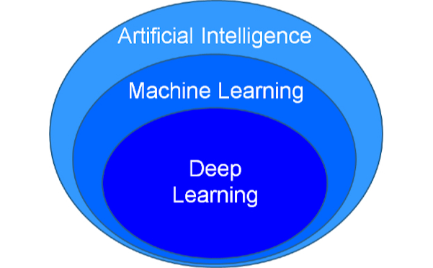
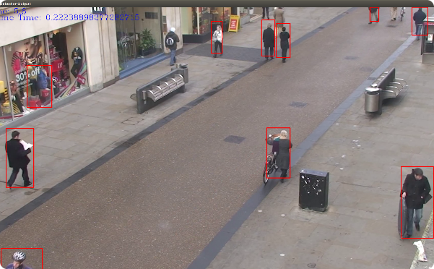
Current Advancements and Future Trends
Deep Learning and Artificial Intelligence
Real-Time Detection and Improved Accuracy
Advancements in deep learning algorithms, coupled with artificial intelligence, are significantly improving face detection accuracy and enabling more robust systems.
Real-time face detection systems, capable of processing vast amounts of data quickly, are paving the way for enhanced surveillance, interactive applications, and seamless user experiences.

Slide 8

Conclusion
1
Recap of Key Points
Face detection systems enable various applications, enhance security measures, and offer convenience while raising privacy concerns.
2
Potential Future Developments and Impact on Society
Continued advancements in face detection technology may reshape various industries, influence societal norms, and require careful ethical considerations.

