Slide 1
AI-Driven Dynamic Congestion Pricing Framework for Auckland
Master of Applied Technologies
Unitec (Te Pūkenga), Auckland
Supervisor: [Dr. Prakash Karn]
Student:Vivek Tollawala - 1597483
Notes:
Good afternoon. Today I will present my MSc project on an AI-driven dynamic congestion pricing framework for Auckland. This work integrates traffic simulation, forecasting models, and economic pricing mechanisms into a unified decision-support framework

Slide 2
Research Motivation
Recurring congestion in Auckland corridors (SH1, SH16)
Static peak/off-peak tolling is inefficient
Need predictive and adaptive congestion pricing
AI-enabled traffic forecasting approach
Notes:
Auckland experiences recurring congestion, particularly on major corridors such as SH1 and SH16. Traditional tolling systems use fixed peak periods, which do not respond to real-time traffic conditions. My goal was to develop a predictive congestion pricing mechanism that adjusts tolls dynamically based on forecasted travel time

Slide 3
Research Objectives
Simulate corridor traffic using SUMO
Forecast 10-minute travel time (ARIMA, XGBoost, LSTM)
Design dynamic pricing rule
Model behavioural demand response
Evaluate congestion feedback effects
Notes:
This project had five objectives: first, simulate corridor traffic; second, forecast short-term travel time; third, design a pricing rule; fourth, estimate behavioural demand response; and finally, evaluate congestion feedback effects

Slide 4
System Architecture
SUMO Simulation (48 hours)
10-minute travel time aggregation
Forecasting models
Dynamic toll computation
Demand response and feedback
Notes:
This slide shows the full framework. We begin with SUMO simulation, aggregate travel time at 10-minute intervals, apply forecasting models, compute a congestion index, generate dynamic tolls, model demand response, and finally evaluate congestion feedback. This creates a complete predictive-to-policy loop. “I simulated a 48-hour corridor-level network using SUMO. Travel time was aggregated at 10-minute resolution, resulting in 287 intervals. A free-flow baseline was estimated using the 5th percentile of travel time.

Slide 5
Forecasting Model Performance
ARIMA – MAE: 0.19 sec | RMSE: 0.25 sec
XGBoost – MAE: 0.25 sec | RMSE: 0.33 sec
LSTM – MAE: 0.19 sec | RMSE: 0.25 sec
ARIMA and LSTM performed equally best
Notes:
I compared ARIMA, XGBoost, and LSTM. ARIMA and LSTM achieved identical performance with MAE of 0.19 seconds. XGBoost performed slightly worse. This suggests corridor-level aggregation produces a smooth signal well captured by statistical models

Slide 6
Dynamic Pricing Mechanism
Congestion Index = TT_pred / TT_free
Free-flow baseline = 5th percentile
Toll activates when CI > 1.10
Capped at NZD 6
Notes:
The congestion index is defined as predicted travel time divided by free-flow travel time. A piecewise toll function activates when congestion exceeds 10% above free-flow and is capped at NZD 6. This ensures fairness and smooth variation

Slide 7
Pricing Results
69.6% intervals tolled
Average toll: NZD 2.66
Revenue proxy: NZD 529.47
Adaptive rather than static peak pricing
Notes:
Tolls were applied in approximately 70% of intervals, with an average toll of NZD 2.66. The pricing pattern varied dynamically based on congestion rather than fixed time-of-day definitions.

Slide 8
Behavioural Demand Response
Elasticity assumed: −0.10
Average demand reduction: 3.70%
Maximum reduction: 12.00%
Demand shifts rather than disappears
Notes:
Using a conservative elasticity of −0.10, we estimated an average demand reduction of 3.7%, with a maximum of 12%. This indicates pricing primarily shifts demand rather than eliminating trips.

Slide 9
Congestion Feedback Effect
Average travel time reduction: 2.96%
Maximum reduction: 9.60%
Small demand changes → measurable relief
Notes:
When demand reductions were fed back into the congestion model, travel time decreased by an average of 2.96%, with peaks reaching 9.6%. This demonstrates that modest behavioural changes can produce measurable system-level improvements

Slide 10
Key Insights
Classical models remain competitive
Dynamic pricing > static pricing
Elasticity-driven feedback improves system efficiency
Integrated AI-policy framework feasible
Notes:
When demand reductions were fed back into the congestion model, travel time decreased by an average of 2.96%, with peaks reaching 9.6%. This demonstrates that modest behavioural changes can produce measurable system-level improvements

Slide 11
Limitations & Future Work
Simulation-based environment
Assumed elasticity parameter
Corridor-level aggregation
Future: real-world calibration, RL optimisation
Notes:
This study is simulation-based, uses assumed elasticity, and models aggregate corridor behaviour rather than heterogeneous users. Future research can integrate real-world data and advanced behavioural modelling

Slide 12
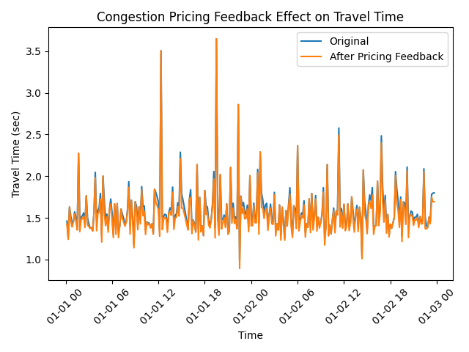
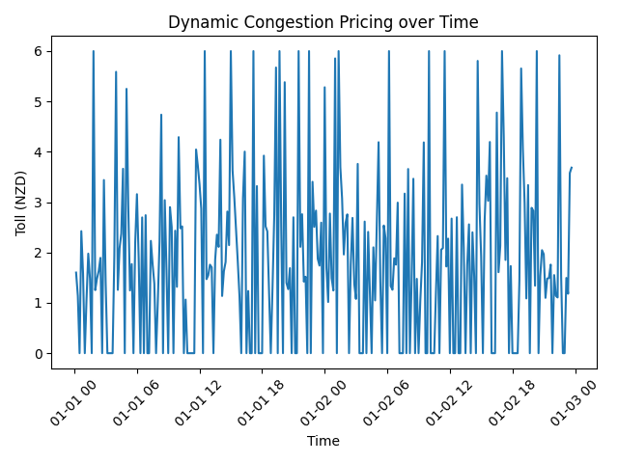
Figures
Notes:
This figure shows dynamic toll variation over time based on predicted congestion levels.

Slide 13

GitHub Repository
https://github.com/Vivek31041126
Notes:
The full project including code, simulation setup, forecasting models, and pricing engine is available on GitHub.

