Slide 1
Olist E-Commerce: Sales, Customers and Delivery
Analysis of 99K orders using SQL, Python, Excel and Tableau

Slide 2
Key numbers
Period : 2016-09 to 2018-10
Total revenue (BRL) : 13,221,498
Delivered orders : 96,478
Unique customers : 93,358
Average order value : 137.04
Repeat customer rate : 3.00%
Top 20% customers : 56.6% of revenue
Month-1 retention : 0.48%
Late delivery rate : 8.11%

Slide 3
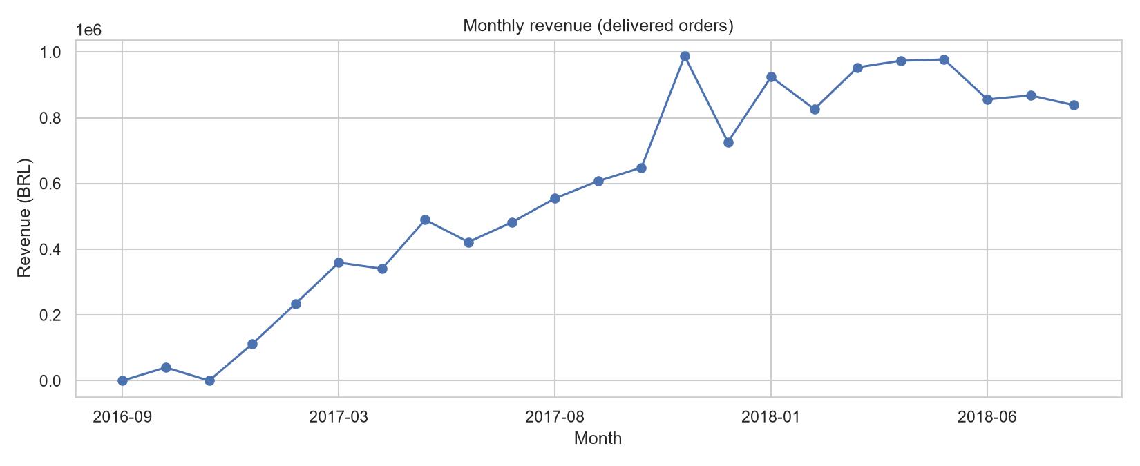
Where does revenue come from?
Revenue grew through 2017 and levelled off in 2018. Three states (SP, RJ, MG) drive 63% of revenue.

Slide 4
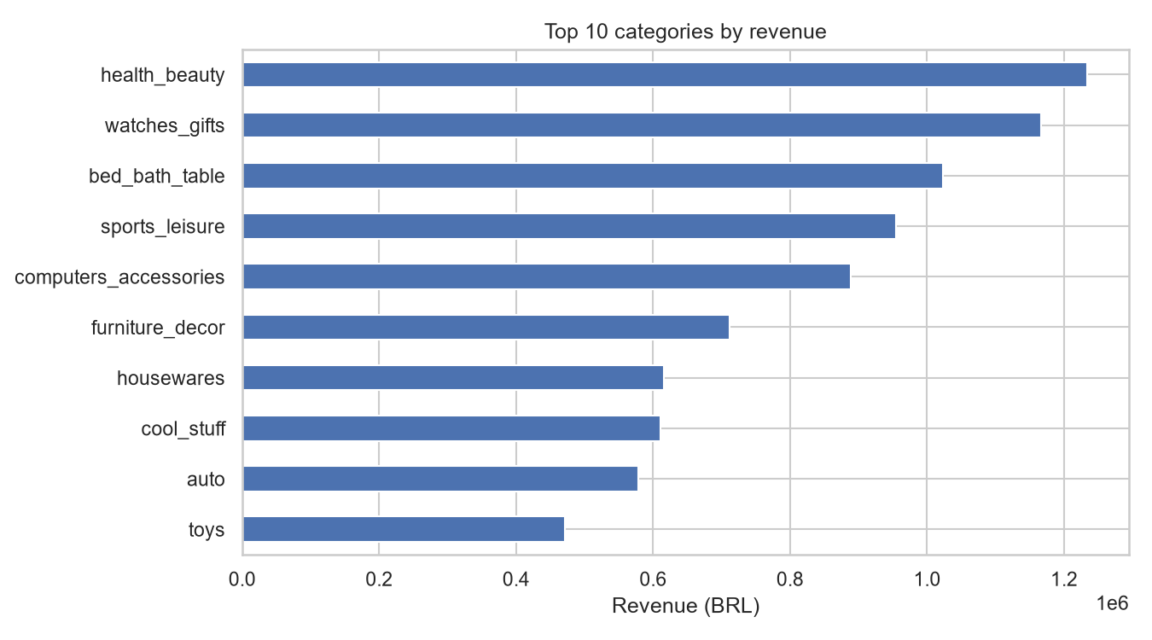
Which categories matter most?
Health & beauty, watches & gifts and bed, bath & table are the top three categories.

Slide 5
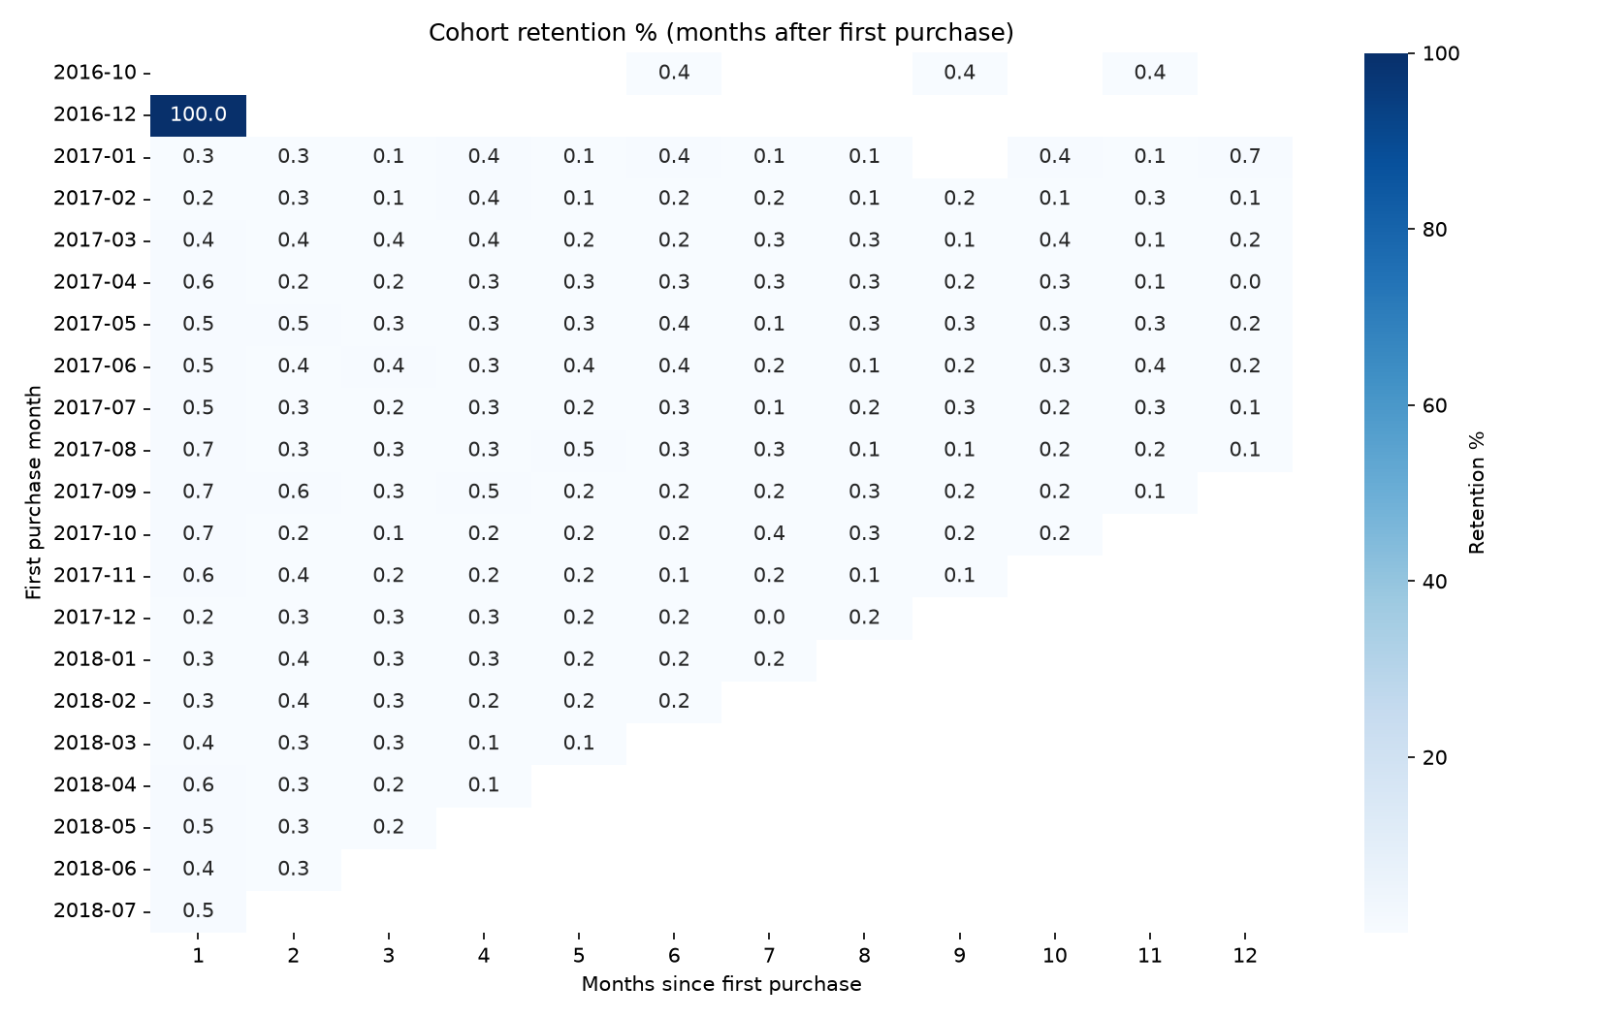
Do customers come back?
Only 3% of customers order again. Retention after the first month is below 1%.

Slide 6
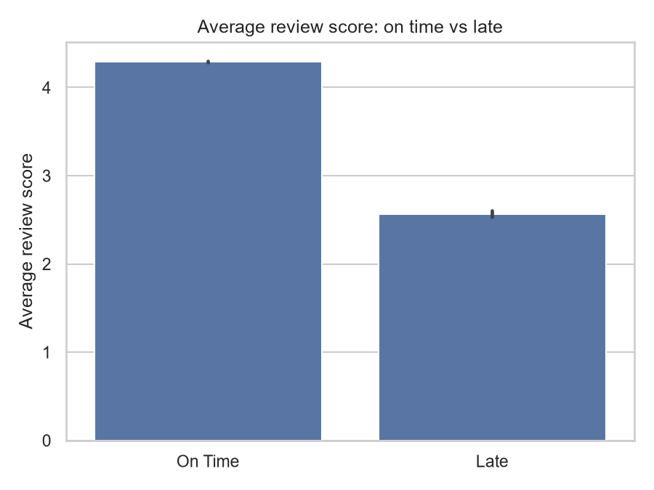
Does late delivery hurt reviews?
Late orders average 2.57 stars versus 4.29 for on-time orders (p < 0.001).

Slide 7
Recommendations
1. Fix late delivery first: set realistic estimates for northern states and review slow sellers.
2. Launch a repeat-purchase offer in the first 30 days for high-value new customers.
3. Win back the high-value 'At Risk' segment, which holds 29% of revenue.

