Slide 1


rishti
Under the Expert Guidance of:
Poonam Saini, Faculty,
Computer Science and Engineering
Team:
18103009 Neetish Kumar
18103018 Ankit Goyal
18103106 Bishwash Pokhrel
18103107 Jaspreet Singh

Slide 2
Table of contents
01
02
03
04
05
Problem Statement
What is Drishti
Technologies Used
Currency Note Recognition
Future Scope

Slide 3

-Team Drishti
Imagine being blindfolded for an entire day… this is just a fraction of what a blind person goes through in their everyday life or that’s the entire life of a blind person

Slide 4

Problem Statement?
Here’s what you’ll find in this project:
Difficulty in distinguishing between currency notes, low availabilty of audio information, few navigation tools.
To aid their daily works with technology.
The scope of this project was defined by meeting the teachers of Institute For The Blind, Sector 26.
Notes:
Change Problem Statement

Slide 5
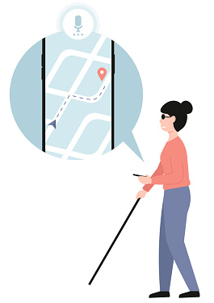

What is Drishti
Drishti is a platform built for helping persons with visual imparities.
It’s highlights based on actual needs are:
a. Currency Note Recognition
b. Text to Speech
c. Local Navigation Aide
rishti

Slide 6




Technologies Used
React Native
Flask
GraphQL
Python

Slide 7

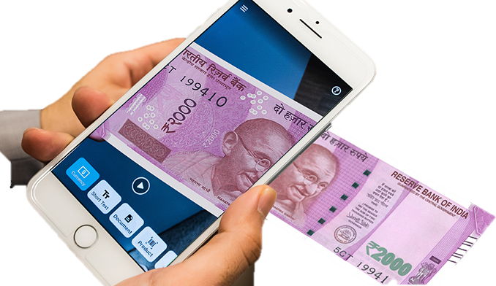
Currency Note Recognition
One of the most prominent challenges faced by visually impaired people
Unable to recognize the paper currencies due to similarity of paper texture and size
Development of real-time currency note recognition

Slide 8

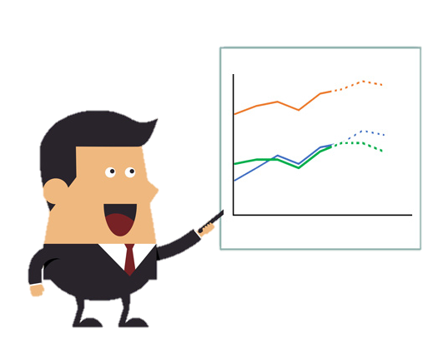
Phase 1
Dataset building and Pre-processing
Model Training
Model Predictions
Stage 1
Stage 2
Stage 3

Slide 9
8,460 total images…
Dataset Building and Pre-Processing
Three Small Datasets
Merging datasets
01
02
03
04
No Single large Dataset available
Dataset Cleaning

Slide 10

Model Training
Convolutional Neural Networks (CNNs)
Transfer Learning – EfficientNet
Requirements - High Accuracy and Lightweight
Notes:
Mention training times, number of other models used while iterating

Slide 11
Benchmarks
Base Model
InceptionV3 | low | 155.9 MB | 90.05% | 87.5%
 | high | 228.1 MB | 69.79% | 69.4%
EfficientNet | low | 15.8 MB | 99.58% | 99.44%
 | high | 46.7 MB | 99.5% | 99.81%
Augmentation
Size
Train-Acc.
Validation-Acc.
EfficientNet
InceptionV3
Notes:
Visible borders for table head and vertical head
Flip rows

Slide 12
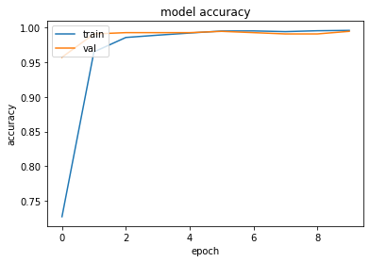
EfficientNet Accuracy
Fig. EfficientNet Accuracy for the first 10 epochs

Slide 13
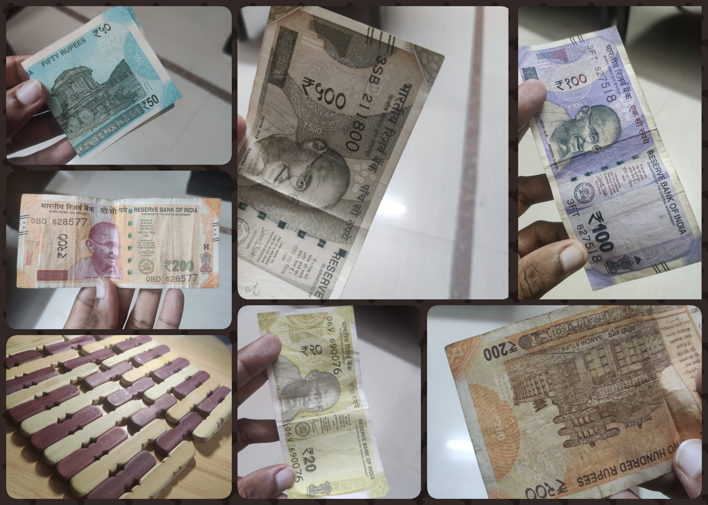
Model Predictions
Low Light
Cropped Image
Cropped + Flipped
No Currency
Folded Note
Rotated Note

Slide 14
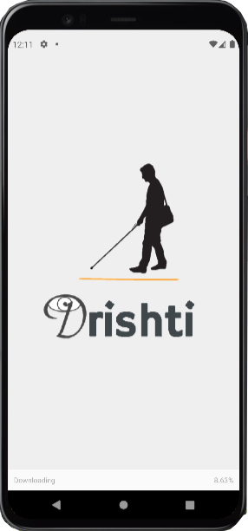
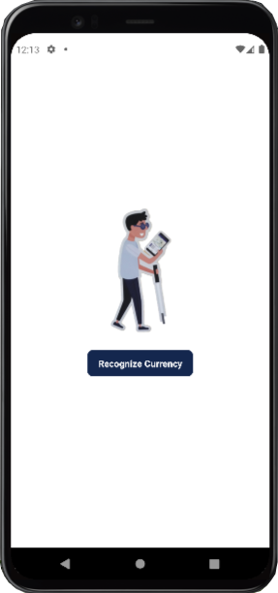
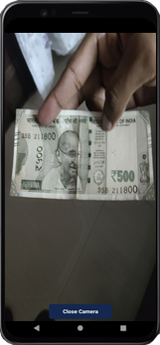
Drishti App

Slide 15
Time for the Demo!!!

Slide 16
Future Scope
Net Amount
Text
To
Speech
Local
Navigation

Slide 17
Challenges
Refining system for Currency Note Recognition
Heavy Training Modules
Ease of Code vs Real Requirement
User Experience

Slide 18
Any Questions?
Thank You

