Slide 1

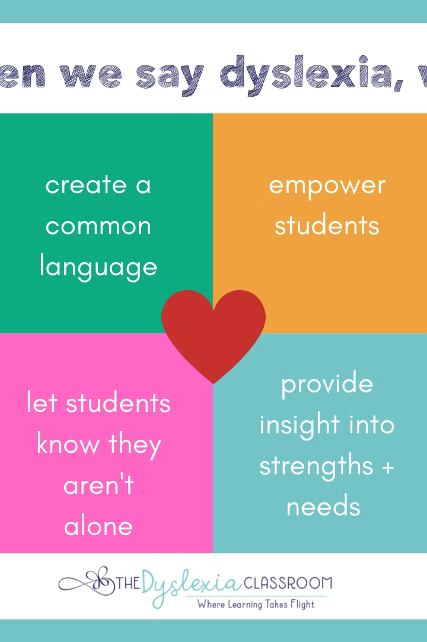
Introduction to
Dyslexify
Web Application
This web application is designed to provide a supportive environment for individuals with dyslexia. It offers various features like image to speech recognition, text to speech recognition, a JavaScript extension, and Lexi Virtual Assistant.
.a

Slide 2

A FRESH APPROACH TO THE CONCEPT
Dyslexia undermines literacy skills, hindering reading, writing, and spelling abilities. It disrupts the brain's language processing, creating significant hurdles in comprehending written material.
Between 5% and 20% of Indians suffer from dyslexia, with urban regions having a higher prevalence of the condition. This indicates that millions of Indian schoolchildren experience reading and comprehension problems as a result of this disorder.
The creation of solutions like our product Dyslexify, a machine learning initiative intended to help people with Dyslexia improve their reading and comprehension skills.
Though there's no cure for dyslexia, early assessment and intervention result in the best outcome. Sometimes dyslexia goes undiagnosed for years and isn't recognized until adulthood, but it's never too late to seek help.

Slide 3
WHAT WE OFFER
Image-to-speech recognition
Text-to-speech recognition
Javascript Extension
Ml-driven suggestion of books, using daal4py
Ai-powered document assistant, using GPU strength
3d model with AR interface
Dyslexify has the potential to significantly improve the lives of students in India and around the world and will have a major impact on the education sector.

Slide 4
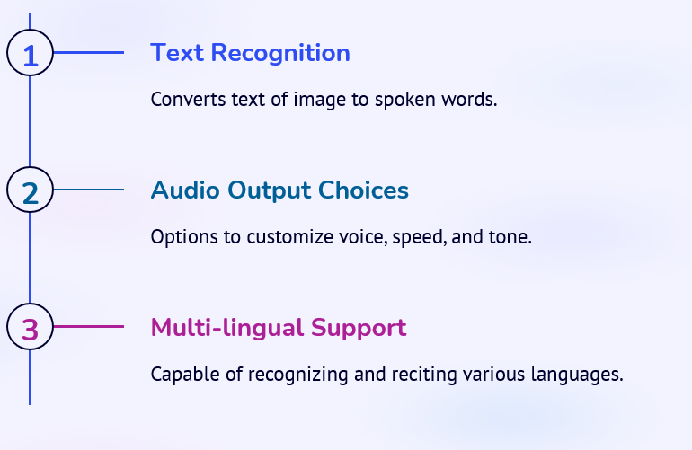
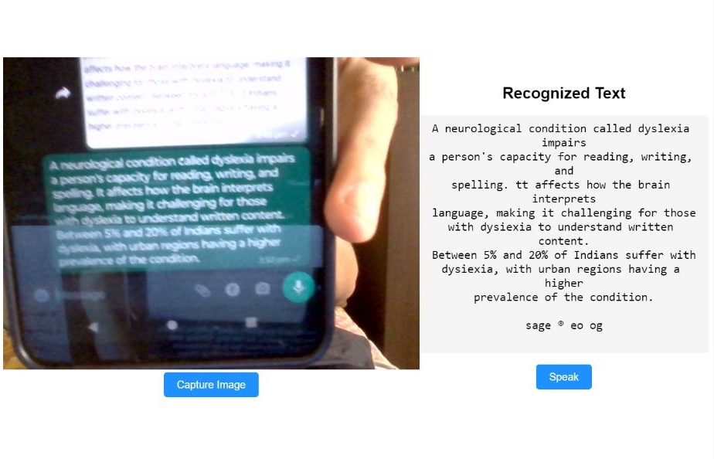
Overview of Image to Speech Recognition Feature

Slide 5



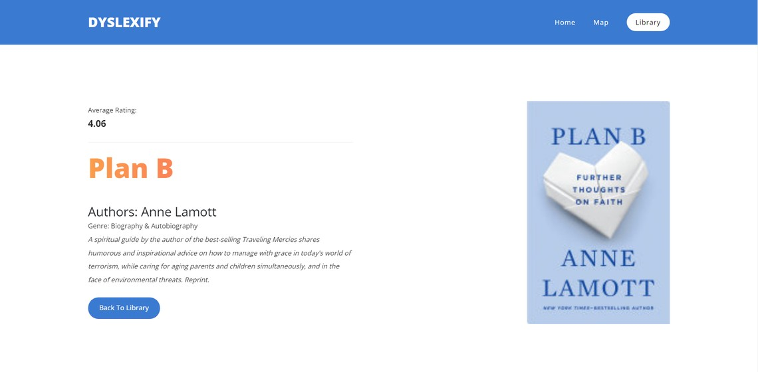
ML DRIVEN SUGGESTION OF BOOKS

Slide 6
Introduction to Javascript Extension for Dyslexia Support
1
Enhanced Functionality
2
Seamless Integration
JavaScript extension offers added interactive elements for a dynamic user experience.
Integrates fluidly with the existing web application infrastructure.
3
Personalized Enhancement
4
Continuous Updates
Allows users to tailor their experience based on individual preferences and requirements.
Regularly updated to incorporate the latest advancements in dyslexia support technology.

Slide 7
Explanation of Text-to-Speech Recognition Feature
Adjustable Preferences
Versatile Usage
Customizable voice, pitch, and speed for optimal user experience.
Converts written text into spoken language to facilitate comprehension.
Interactive Interface
Integrative Capabilities
Intuitive controls allow personalized navigation throughout the application.
Compatible with various document types and web pages for seamless usage.

Slide 8






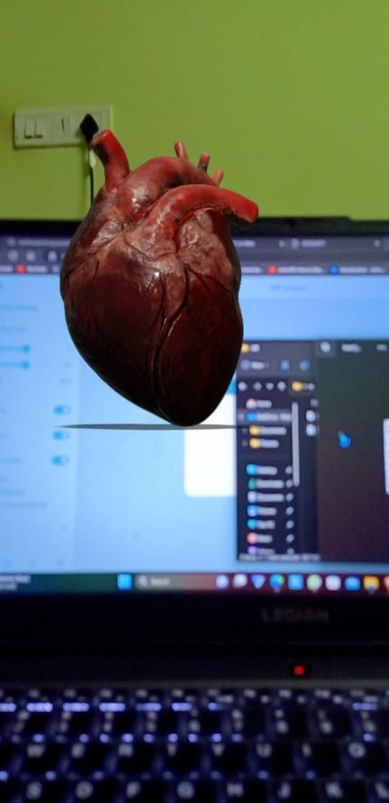

3D MODEL WITH AR INTERFACE

Slide 9
Benefits of Using the Dyslexify
Web Application
Empowerment
Accessibility
Empower individuals with dyslexia to navigate digital content with confidence.
Provides accessible tools for individuals to comprehend and engage with information effortlessly.
Customization
Empathy & Inclusivity
Allows personalized settings for a tailored user experience with the web application.
Promotes empathy and inclusivity within the digital environment, fostering a supportive community.

Slide 10
TECHNOLOGIES USED
Machine Learning and AI: Dyslexify uses machine learning and AI technologies such as to develop its features, such as image-to-speech recognition, text-to-speech recognition, and personalized reading experience.
Framework: Flask, React
Programming Languages: Python, Javascript
APIs and Integrations: OpenAI, GPT 3.5 3D

Slide 11



Conclusion and Next Steps
Evaluate
Assess the effectiveness of the application based on user feedback and performance metrics.
Expand
Explore opportunities to expand the application's features
and accessibility.
Community Engagement
Encourage community involvement and feedback for
continuous improvement.

Slide 12

ESTIMATED COST OF/AFTER IMPLEMENTING THE SOLUTION
Dyslexify's low-scale implementation may cost Rs. 10,000 for development and a few thousand to a few tens of thousands of Indian Rupees per month for operation.
For a large-scale implementation, the development cost can range from Rs. 1 lakhs to 5 lakhs, and the operating cost can be several lakhs of Indian Rupees per month, depending on various factors.

Slide 13



TEAM MEMBERS
VIVEK KUMAR
(CYBER SECURITY)
SARTHAK JOSHI
(ML/AI)
ABHISHEK SINGH MAURYA
(WEB DEVELOPER)

Slide 14
THANK YOU

