Slide 1

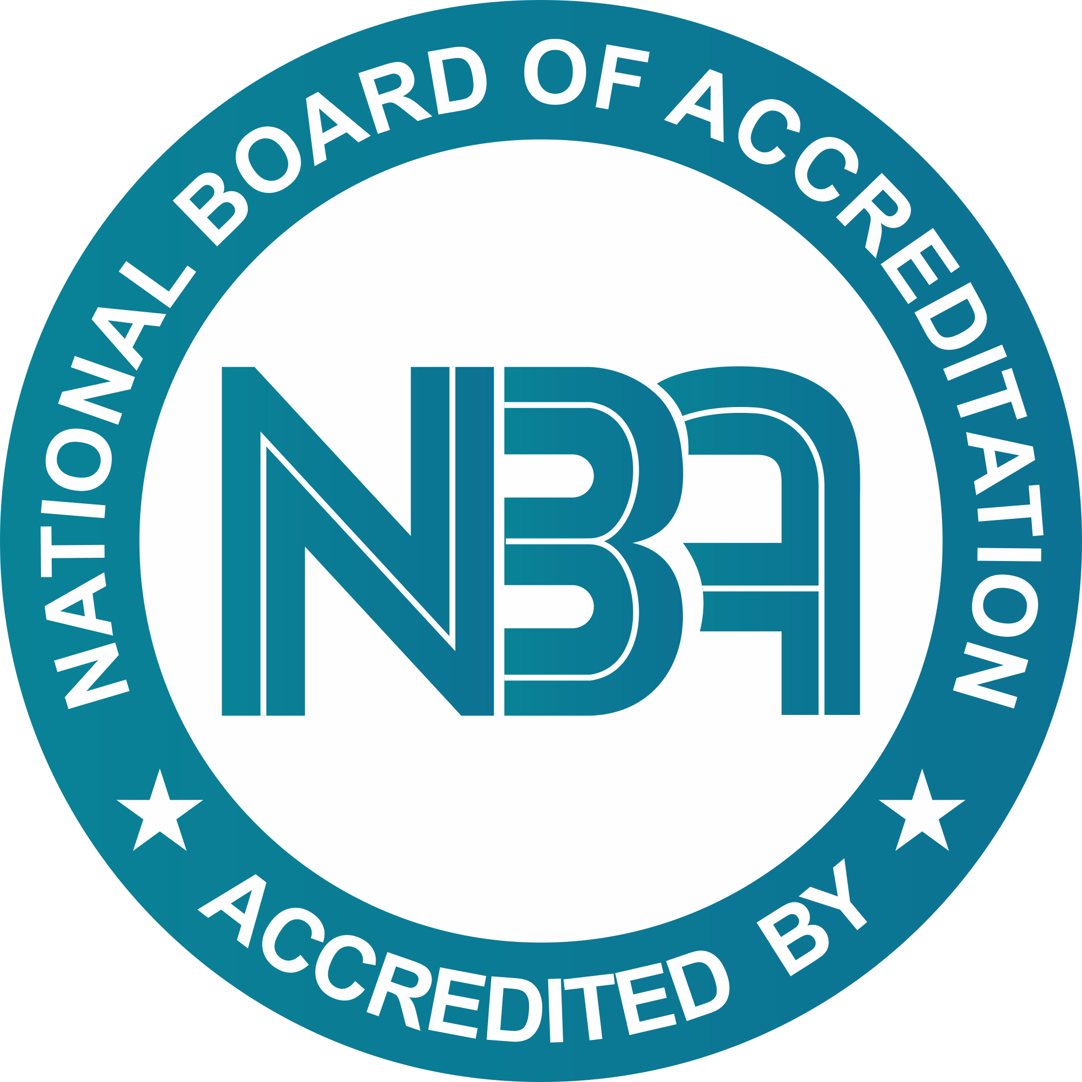
U20CSPR02- MAJOR PROJECT
BATCH No.: L5
DOMAIN : Blockchain Technology
PROJECT TITLE : A Blockchain-Enabled NFT Marketplace for Transparent and Immutable Digital Asset Ownership
S. No. | Register number | Name of the Student
1 | U22CS357 | Kattamoori Sreeraag
2 | U22CS361 | Keesara Vivek Reddy
3 | U22CS334 | Kandela Eswar
4 | U22CS327 | Kalluru Venkata Subba Reddy
GUIDED BY: Ms. E.Benitha Sowmiya

Slide 2
Abstract
Objective
Introduction
Motivation of the project
Literature Survey
Problem Statement
Existing System
Proposed System
Algorithms/Methodology of the proposed work
System Architecture
Modules
Source Code
Result and Discussion
Conclusion and Future Scope
References
CONTENTS

Slide 3

Abstract
Non-Fungible Tokens (NFTs) are unique blockchain-based digital assets that ensure ownership, authenticity, and scarcity. This project develops a decentralized NFT marketplace that allows users to mint, buy, sell, and transfer NFTs without intermediaries. The system utilizes SHA-256 cryptographic hashing to maintain metadata integrity and Elliptic Curve Cryptography (ECC) for secure wallet authentication and transaction signing. Solidity smart contracts deployed on the Ethereum Virtual Machine (EVM) handle NFT minting, ownership management, and transaction validation, while blockchain consensus mechanisms ensure secure verification. Users provide digital asset data through an Ethereum wallet, and the system generates a unique NFT token recorded on the blockchain, enabling transparent and tamper-proof digital asset ownership. The output is a unique NFT token with secure and transparent ownership stored on the blockchain.

Slide 4
Objective
To design and implement a decentralized NFT marketplace using blockchain technology for secure digital asset management.
To develop ERC-721 compliant smart contracts in Solidity for NFT minting, ownership verification, and transfer on the Ethereum blockchain.
To ensure secure authentication and transaction signing using Ethereum wallet integration and Elliptic Curve Cryptography (ECC).
To maintain data integrity and asset authenticity through cryptographic hashing (SHA-256) and immutable blockchain storage.
To build a Web3-enabled user interface that supports NFT creation, listing, buying, and trading through decentralized blockchain transactions.

Slide 5
Problem Statement
Inefficient digital asset marketplace management
Lack of automated NFT lifecycle management
Poor user interaction with centralized applications
Inefficient digital asset metadata management
Limited real-time asset transaction monitoring

Slide 6
Motivation of the project
Rapid growth of digital assets and creator economy
Lack of ownership proof in traditional digital systems
Need for decentralized and trustless marketplaces
Increasing adoption of blockchain and Web3 technologies
Real-world demand for secure digital asset trading platforms

Slide 7
Literature Survey
S. No. | Paper Title, Author Name,Year & Journal name | Techniques Used | Observations
1 | Non-Fungible Tokens: A Survey on Digital Ownership and Blockchain Applications Author :- W. Wang, D. Hoang et al. Year :-2023 Journal name:- IEEE Access | Blockchain architecture, Smart contracts, NFT token standards, cryptographic hashing | Advantage: Ensures secure digital ownership verification and transparent transactions Disadvantage:- Limited scalability in large NFT marketplacesBlockchain-Based NFT Marketplace
2 | Blockchain-Based NFT Marketplace Architecture for Secure Digital Asset Trading Author :- F. Regner, A. Urbach, N. Schweizer Year :-2023 Journal name :- Electronic Markets Journal | Ethereum blockchain, ERC-721 token standard, decentralized marketplace model | Advantage: Improves trust and authenticity of digital assets in decentralized trading Disadvantage: High gas fees and network congestion.
3 | Mapping the NFT Revolution: Market Trends and Transaction Analysis Author :- S. Nadini, L. Alessandretti et al. Year :- 2024 Journal name :-Nature – Scientific Reports | Blockchain data analytics, NFT transaction tracking, distributed ledger analysis | Advantage: Provides transparency and insights into NFT market behaviour Disadvantage: Does not provide complete marketplace system architecture

Slide 8
Literature Survey
4 | Decentralized NFT Storage and Metadata Management Using Smart Contracts Author :- Y. Chen, H. Zhang, L. Xu Year :-2024 Journal name :- Journal of Blockchain Research and Applications | Smart contracts, decentralized storage, NFT metadata management | Advantage: Improves NFT metadata storage efficiency and asset tracking Disadvantage :Security vulnerabilities in decentralized storage systems
5 | Scalable NFT Marketplace Using Hybrid Blockchain Storage Architecture Author :- J. Lee, M. Park, K. Kim Year :- 2025 Journal name :- International Journal of Blockchain Applications and Research | Hybrid blockchain storage, decentralized applications (DApps), smart contract automation | Advantage: Enhances scalability using off-chain storage with on-chain ownership verification Disadvantage: Requires advanced monitoring and additional security mechanisms

Slide 9
Existing System :-
Centralized Platform Governance: Digital asset marketplaces operate under centralized administrative control where a single authority manages asset storage, transactions, and user data.
Non-Verifiable Ownership Records: Ownership details are stored in private databases without cryptographic verification or publicly auditable mechanisms.
High Operational and Transactional Overhead: Centralized systems impose high service fees and commissions due to reliance on intermediary-controlled transaction processing.
Restricted Transactional Transparency: Asset transactions and ownership histories are maintained in closed backend systems, limiting independent verification by users.
Susceptibility to Data Manipulation and Service Failure: Centralized infrastructures are prone to data alteration, security breaches, system failures, and administrative censorship.

Slide 10
Drawbacks of Existing System
Centralized Control: Existing digital marketplaces are controlled by a single authority, leading to lack of decentralization and increased dependency on intermediaries.
Lack of Transparency: Ownership records and transaction details are stored in private databases, making it difficult for users to verify authenticity.
Risk of Fraud and Duplication: Digital assets can be copied or manipulated easily, resulting in fake ownership claims.
High Transaction Fees: Centralized platforms charge high commission and service fees for buying and selling digital assets.
Limited Ownership Rights: Users do not have complete control over their assets, as platforms can restrict access or remove content.
Data Manipulation Risk: Centralized storage systems are vulnerable to hacking, data loss, or unauthorized modification.

Slide 11
Proposed System :-
Immutable Ownership Records: Leverages distributed ledger technology to maintain immutable, tamper-resistant, and cryptographically verifiable NFT ownership states.
Smart Contract-Based Transactions: Utilizes Solidity smart contracts deployed on the Ethereum Virtual Machine (EVM) to autonomously execute NFT minting, ownership validation, and asset transfer operations.
Peer-to-Peer NFT Transfers: Facilitates decentralized peer-to-peer asset exchange through blockchain-validated transactions without intermediary intervention.
Off-Chain Metadata Storage: Implements hybrid storage architecture by maintaining NFT metadata in MongoDB to reduce on-chain storage overhead and optimize gas efficiency.
Secure Wallet-Based Authentication: Employs cryptographic wallet authentication and digital signature verification to ensure secure user identity validation and transaction authorization.

Slide 12
Algorithms/Methodology of the Proposed Work:-
Implements a decentralized NFT marketplace using blockchain technology.
Uses crypto wallets with Elliptic Curve Cryptography (ECC) for secure user authentication and transaction signing.
Applies SHA-256 hashing to ensure integrity and uniqueness of NFT metadata.
Executes Solidity smart contracts on the Ethereum Virtual Machine (EVM) for NFT minting and ownership transfer.
Stores critical ownership data on the blockchain and off-chain metadata in MongoDB to reduce gas costs and improve efficiency.

Slide 13
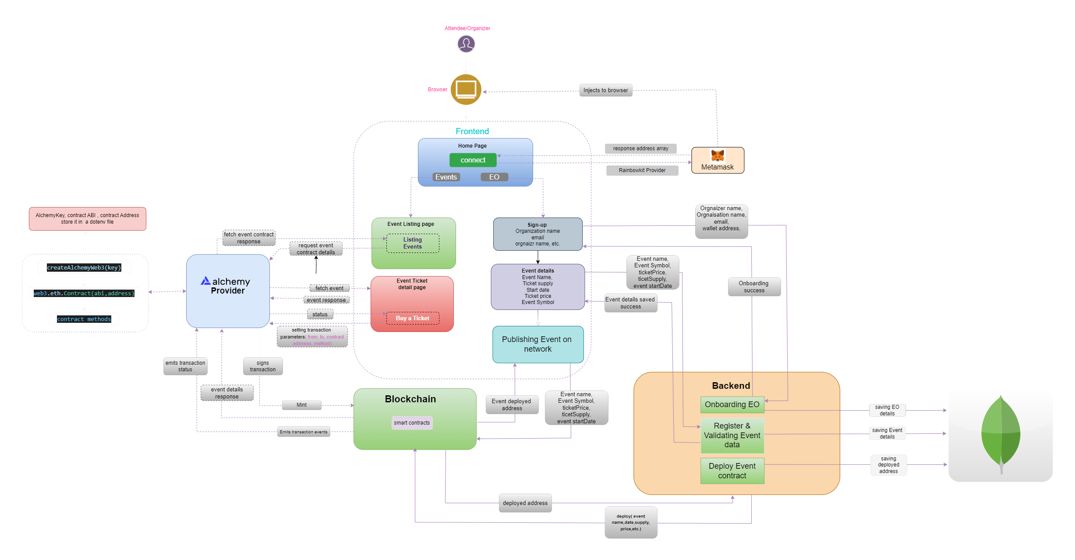
System Architecture:-

Slide 14
Modules :-
User Wallet Module
NFT Minting Module
Marketplace Module
Transaction Module
Database Module

Slide 15
User Wallet Module :-
Connects the user's cryptocurrency wallet (such as MetaMask) to the NFT marketplace platform.
Enables secure user authentication through blockchain wallet addresses.
Uses public key cryptography where the public key acts as the wallet address and the private key is used for secure transaction signing.
Generates digital signatures to verify the authenticity of transactions.
Elliptic Curve Cryptography (ECC) ensures secure wallet authentication and transaction verification.

Slide 16
NFT Minting Module :-
Converts digital assets such as images, videos, or documents into Non-Fungible Tokens (NFTs).
Generates a unique Token ID for each NFT created on the platform.
Stores metadata including asset name, description, creator information, and ownership details.
Uses Solidity-based smart contracts to manage NFT creation and ownership on the blockchain.
Applies the SHA-256 hashing algorithm to ensure uniqueness and maintain data integrity.
Executes smart contracts through the Ethereum Virtual Machine (EVM).

Slide 17
Marketplace Module
Allows users to list NFTs for sale within the decentralized marketplace platform.
Enables peer-to-peer NFT trading between buyers and sellers without intermediaries.
Displays NFT details including price, creator information, and ownership status.
Smart contracts manage NFT listing, purchasing, and ownership transfer operations.
Ensures transparent and immutable asset trading using blockchain technology.

Slide 18
Transaction Module
Manages blockchain transactions related to NFT minting, buying, selling, and transferring.
Each transaction generates a unique transaction hash for identification and tracking.
Uses digital signatures to securely authorize transactions.
Blockchain consensus algorithms validate and confirm transactions across the network.
Proof of Work (PoW) and Proof of Stake (PoS) mechanisms ensure secure and reliable transaction processing.

Slide 19
Database Module
Stores application-related information that does not require blockchain storage.
Maintains user details, NFT metadata references, and marketplace records.
Uses off-chain storage to reduce blockchain load and improve system efficiency.
Database Management Systems (Mongo DB) handle data storage and retrieval.
Enables fast access to application data while blockchain maintains ownership and transaction records.

Slide 20
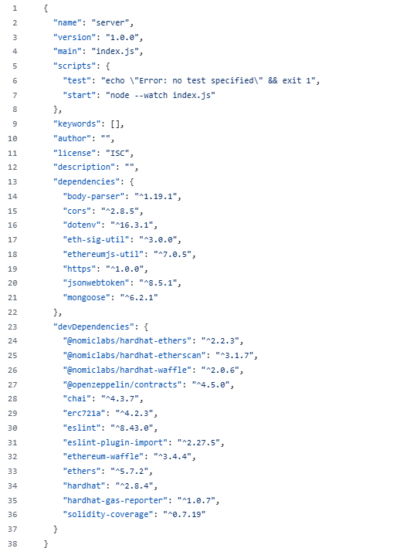
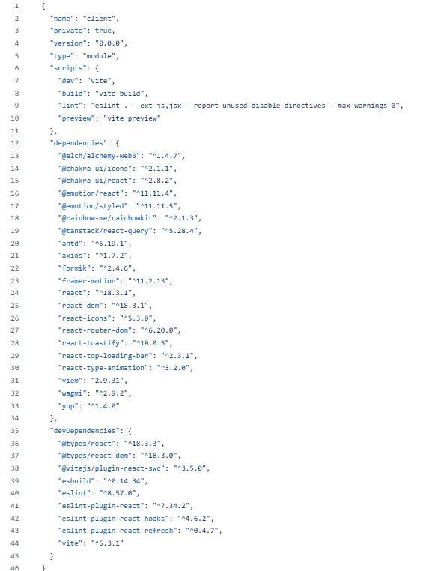
Implementation:

Slide 21
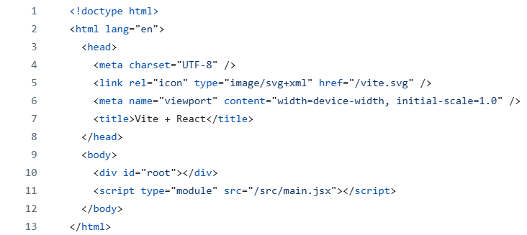

Slide 22
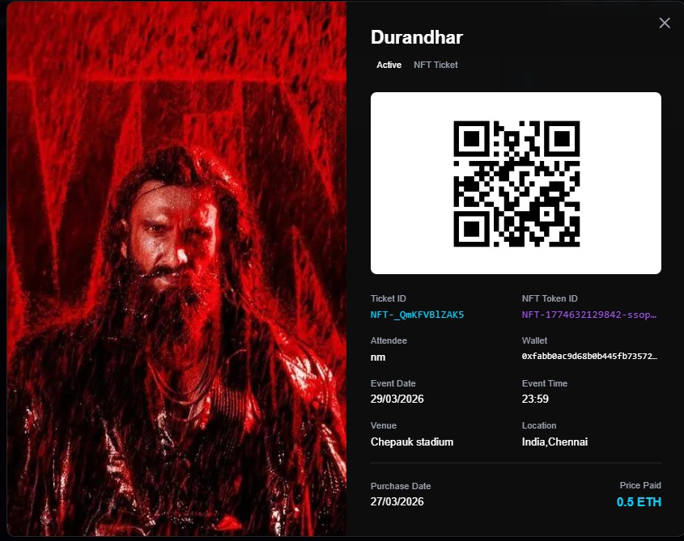
Result :

Slide 23
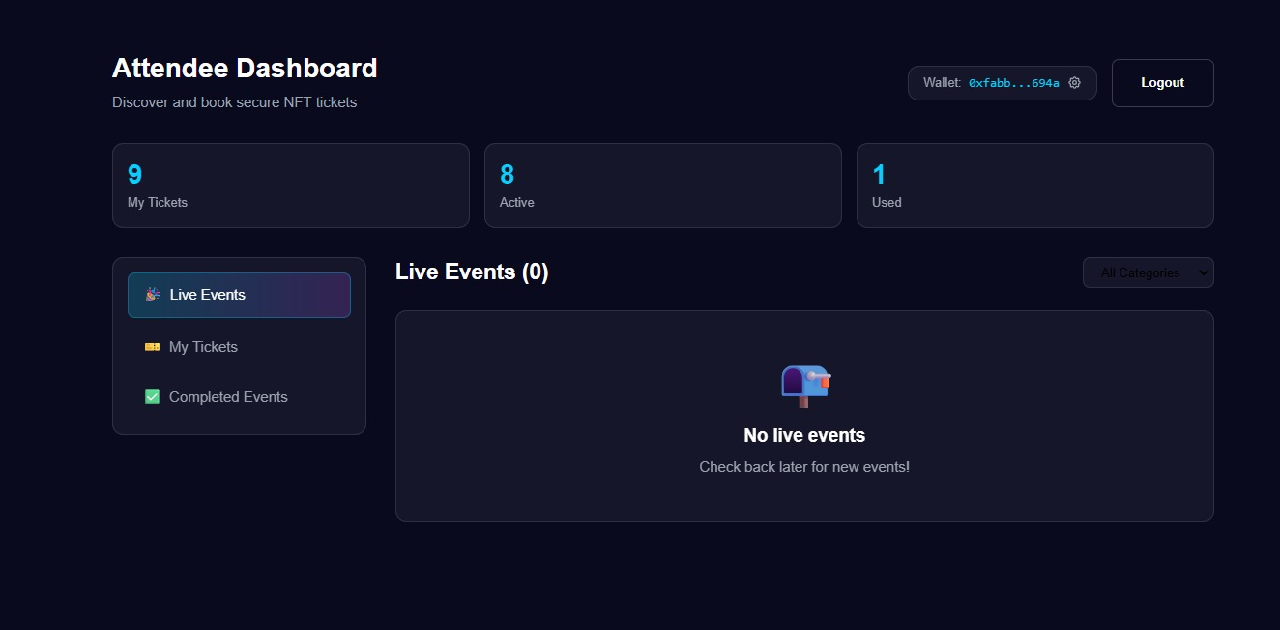
.

Slide 24
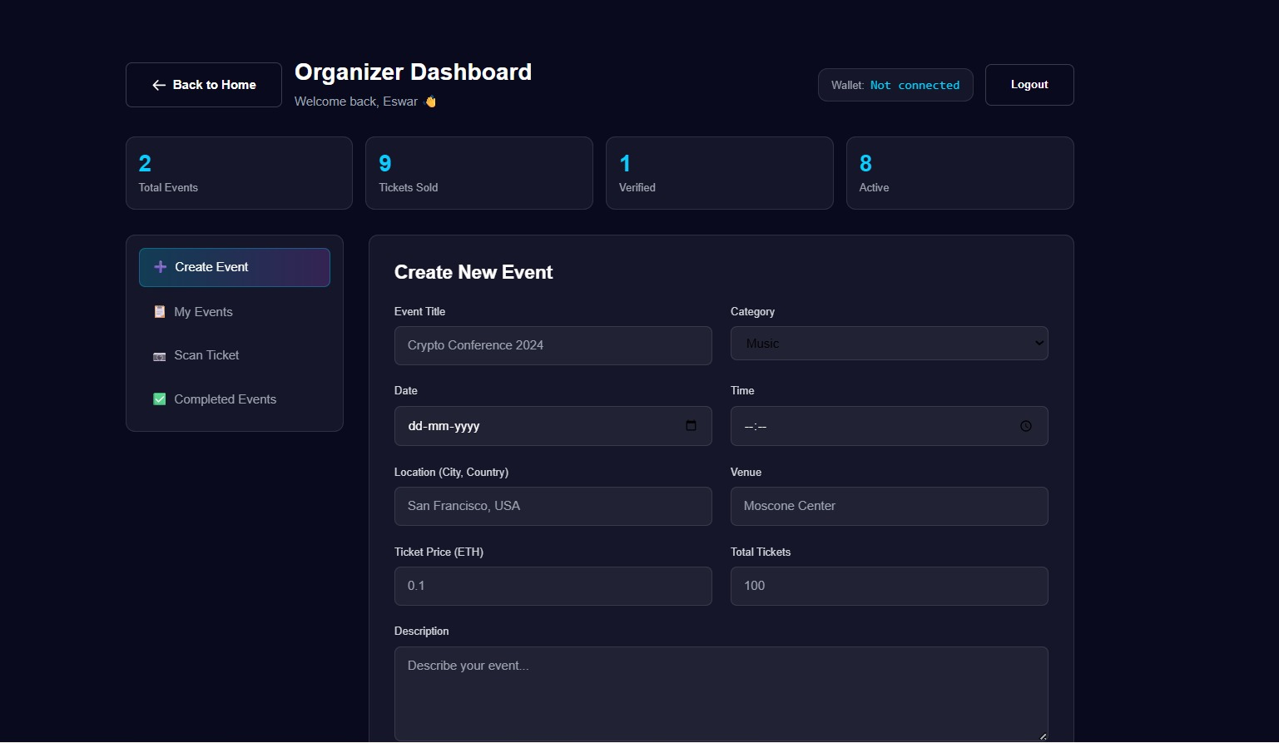

Slide 25
Conclusion and Future Scope:
Developed a decentralized NFT marketplace for secure digital asset and event ticket trading.
Implemented smart contracts for NFT minting, ownership verification, and transactions.
Used MetaMask wallet authentication for secure and decentralized user access.
Applied hybrid storage (Blockchain + MongoDB) for efficient data management.
The system ensures transparency, security, and trustless transactions.
Integrate decentralized storage systems (IPFS) for better asset storage.
Add multi-blockchain support such as Ethereum, Polygon, and Solana.
Develop mobile applications for improved user accessibility.
Implement AI-based recommendation systems for NFT discovery.
Enhance security with smart contract auditing and fraud detection.

Slide 26
References:-
Entriken, W., Shirley, D., Evans, J., & Sachs, N. (2021). ERC-721 Non-Fungible Token Standard. Ethereum Improvement Proposal (EIP-721).
Szabo, N. (2020). Blockchain-Based Smart Contracts for Digital Assets. IEEE Access.
Nadini, M., Alessandretti, L., Di Giacinto, F., Martino, M., Aiello, L. M., & Baronchelli, A. (2022). Mapping the NFT Revolution. Nature Scientific Reports.
Dowling, M. (2022). Is Non-Fungible Token Pricing Driven by Cryptocurrencies?. Finance Research Letters.
Ethereum Foundation. (2023). Ethereum Official Documentation. Ethereum.org.
Solidity Team. (2023). Solidity Programming Language Documentation. Soliditylang.org.
OpenSea. (2023). OpenSea Developer Documentation. OpenSea Docs.
MongoDB Inc. (2023). MongoDB Official Documentation. MongoDB Manual.
Buterin, V. (2024). A Next-Generation Smart Contract and Decentralized Application Platform. Ethereum Whitepaper.
Wood, G. (2025). Ethereum: A Secure Decentralised Generalised Transaction Ledger. Ethereum Yellow Paper.

Slide 27
ThankYou!

