Slide 1






Presented By,
Dharshan S [4AD22CD013]
Puneeth K S [4AD22CD035]
Sanjay G J [4AD22CD042]
Vivek V [4AD22CD057]
“AI Powered Student Assistant Chatbot using RAG with langchain”
Under the guidance of,
Dr . Anitha D B
Associate professor &HoD
CSE-Data Science
ATME College of Engineering,
Mysuru
Department of CSE-DS, ATMECE

Slide 2
CONTENTS
1.Introduction
2.Problem Statement
3.Literature Survey
4.Recap of Phase -1 work done
5.Implementation details
6.System Architecture
7.Expected outcomes
8. References
ATME College of Engineering,
Mysuru
Department of CSE-DS, ATMECE

Slide 3
INTRODUCTION
Retrieval-Augmented Generation (RAG) is a technique that makes AI smarter by letting it search for information in documents before giving an answer. This way, the AI doesn’t just rely on what it was trained on but also uses the latest and most relevant knowledge in the documents we upload.
LangChain is a tool that helps developers easily connect large language models with external data like documents, databases, or APIs. It provides ready-made components to build powerful AI applications quickly.
In this project, we are building a Student Assistant Chatbot using RAG and LangChain. Students can upload their study materials (like PDFs or notes), and the chatbot will answer questions based on those documents. It can also generate quizzes, create personalized study plans, and keep track of chat history and uploaded files. The system is built with FastAPI (backend), MongoDB (database), and React (frontend), and packaged with Docker so it can run smoothly on the cloud.
ATME College of Engineering,
Mysuru
Department of CSE-DS, ATMECE

Slide 4
PROBLEM STATEMENT
AI Powered Student Assistant Chatbot using RAG with langchain
An intelligent chatbot that helps students with academic Q&A using uploaded study materials.
Uses RAG (Retrieval-Augmented Generation) to provide accurate, context-aware answers.
Built with LangChain for modular AI pipelines, enabling quizzes, study plans, and personalized support
Objectives of the project:
The main Objectives of project are:
1.Design a Conversational AI System Using RAG
2.Integrate LangChain Framework for Modular Pipeline
3.Build an Interactive User Interface
ATME College of Engineering,
Mysuru
Department of CSE-DS, ATMECE

Slide 5
LITERATURE SURVEY
Sl.no | Title,Author,Year | Summary | Limitation/Gaps
1. | “Design and Implementation of LangChain-based Chatbot” Author: Huaxiao Zhang, Zhigang Li. Year:2024 | The paper presents a LangChain-based chatbot that uses LLMs and local knowledge bases like PDFs and videos to provide accurate, context-aware responses. | The system relies on cloud-based LLMs, which raises concerns regarding data privacy and information security.
2. | “Development of Interactive Assistance for Academic Preparation Using Large Language Models” Author:Kumar P, Haresh M. Year:2024 | It presents a student chatbot using locally deployed LLMs with LangChain, Ollama, and Meta’s 7B model.It uses RAG with FAISS and Milvus to retrieve academic content via a Flask-based web interface. | The system is limited by the performance of lightweight local LLMs.It also requires high computational resources for real-time responses.
3. | “A Client-Server Based Educational Chatbot for Academic Institutions” Author:Rohan Paul Richard, Joel Mathew. Year:2025 | A client-server educational chatbot is developed using LangChain and FastAPI for accurate, context-aware responses.It integrates academic PDFs and slides and supports multiple users with JWT-based authentication. | It supports only text-based inputs, limiting interactivity.Performance may vary based on server load and hardware constraints.
ATME College of Engineering,
Mysuru
Department of CSE-DS, ATMECE

Slide 6
LITERATURE SURVEY
Sl.no | Title,Author,Year | Summary | Limitation/Gaps
4. | “An Interactive Question-Answering System using Large Language Model and Retrieval-Augmented Generation in an Intelligent Tutoring System on the Programming Domain” Author: Owen Christian Wijaya and Ayu Purwarianti. Year:2023 | A web-based intelligent tutoring system for programming combines LLMs with RAG to provide contextual responses.Built using LangChain, it uses a history-aware retriever, Redis memory, and CO-STAR prompt design for improved interaction. | System performance depends on model selection and may vary across tasks.Lacks integration of code execution or real-time feedback features for hands-on learning.
5. | “Unleashing AI in Education: A Pre-Trained LLMs for Accurate and Efficient Question-Answering Systems” Author: Josie C. Calfoforo Year:2022 | The system integrates RAG, LangChain, and QLoRA for efficient, accurate question answering from policy PDFs.It supports conversational queries with context retention and provides source document references for transparency. | Focus is limited to policy-related documents, restricting wider academic applicability. Expansion to other domains and complex queries is needed for broader use.
6. | “RAG based Chatbot using LLMs” Author: Ananya G and Dr. Vanishree Year:2023 | The chatbot combines RAG and LLMs to answer PDF-based queries with real-time interaction and improved efficiency. | Performance depends on PDF quality and requires careful tuning of reinforcement learning.
ATME College of Engineering,
Mysuru
Department of CSE-DS, ATMECE

Slide 7
LITERATURE SURVEY
Sl.no | Title,Author,Year | Summary | Limitation/Gaps
7. | “ScrapeTalk: Chatbot Conversation with Web Scraped Insights” Author: Sriram G, Adaline Suji R. Year: | ScrapeTalk is a RAG-based chatbot that uses web scraping and GPT-3.5 to deliver real-time, context-aware answers. | Reliance on live web data may affect accuracy and performance due to changing or inaccessible web content.
8. | “Enhancing Question-Answering with Knowledge Graph Retrieval and Generation using LLMs” Author: Supraj Gijre, Priyash Laddha. Year: | The system combines RAG with knowledge graphs and LLMs to improve accuracy and context in document-based QA. | Building and maintaining knowledge graphs adds complexity and may not scale easily across diverse domains.
9. | “Retrieval Augmented Generation Approach for Multipdf Chatbot using LangChain” Author:Anuj Jaiswal, Aakash Jha. Year: | The chatbot uses RAG with LangChain and Gemini Pro to enable interactive querying across multiple PDFs. | Its effectiveness depends on PDF quality and may be affected by inherent biases in the generative model.
ATME College of Engineering,
Mysuru
Department of CSE-DS, ATMECE

Slide 8

LITERATURE SURVEY
Sl.no | Title,Author,Year | Summary | Limitation/Gaps
10. | "Retrieval-Augmented Generation (RAG) Chatbots for Education: A Survey of Applications“ Author:Jakub Swacha and Michał Gracel Year:2025 | Highlighting their effectiveness in reducing hallucinations by integrating external knowledge. Most chatbots support students across diverse fields like computer science and healthcare. OpenAI’s GPT is commonly used, with limited use of RAGAS for evaluation. | The study notes a lack of evaluations linked to learning outcomes, limited adoption of standardized metrics like RAG, ethical concerns around privacy, and high deployment costs.
11. | “Optimizing RAG techniques for Automotive industry PDF Chatbots: A case Study with Locally Deployed Models” Author: Kaiyi Zhang. Year:2025 | The study evaluates LLMs in the context of RAG-based automotive chatbots, focusing on their ability to understand and reason through prompts. | Findings reveal that LLMs may produce correct answers without truly grasping prompt logic, especially in multi-step reasoning tasks.
12. | “From Questions to Insightful Answers: Building an Informed Chatbot for University Resources” Author: subhash Neupane. Year:2024 | A university chatbot is developed to provide context-aware and user-friendly responses to student queries using NLP and domain-specific knowledge bases. | Limited multilingual support and lack of integration with mobile apps reduce its accessibility and scalability.
ATME College of Engineering,
Mysuru
Department of CSE-DS, ATMECE

Slide 9
LITERATURE SURVEY
Sl.no | Title,Author,Year | Summary | Limitation/Gaps
13. | “Unimib Assistant: Designing a student-friendly RAG-Based chatbot for all their needs “ Author: Chiara Antico. Year:2022 | Unimib Assistant is a student-focused chatbot designed to offer accurate, context-aware answers related to university services, using RAG and NLP techniques tailored for educational settings. | Currently limited in personalization and multilingual capabilities, with future improvements needed for broader user adaptation and proactive engagement.
14. | “FACTS About Building Retrieval Augmented Generation-based Chatbots” Author: Sebastian Gehrmann. Year:2020 | This paper provides a detailed analysis of best practices and pitfalls in building RAG-based chatbots, emphasizing the importance of retrieval quality, grounding, and system-wide optimization. | Challenges include retrieval errors, prompt sensitivity, and feedback loops that can degrade factual accuracy, requiring careful tuning of all components.
ATME College of Engineering,
Mysuru
Department of CSE-DS, ATMECE

Slide 10
Recap of Phase -1 work done
1. Problem Identification & Motivation
Students face difficulty accessing accurate, context-specific academic information quickly.
Existing resources are scattered, unstructured, or not personalized.
Need for an intelligent system providing instant answers, quizzes, and study plans.
2. Project Purpose & Objectives
Build a RAG-based Student Assistant Chatbot using LangChain for accurate Q&A.
Enable document upload, processing, and personalized learning features (quizzes & study plans).
Maintain user profiles, chat/document history, and deploy a cloud-ready system.
ATME College of Engineering,
Mysuru
Department of CSE-DS, ATMECE

Slide 11
Recap of Phase -1 work done
3. Literature Survey Completed
Reviewed RAG-based educational chatbots and LangChain pipelines.
Studied vector databases for semantic search (FAISS, Milvus).
Identified gaps: lack of personalization, study plan generation, and full document support.
4. Methodology Outlined (Design Stage)
Frontend: React/HTML/CSS for chat, document upload, and interface.
Backend: Python + FastAPI to process requests, manage database, and handle LLM queries.
RAG Pipeline: Extract & embed document text → store in vector DB → retrieve → generate answers, quizzes, study plans.
ATME College of Engineering,
Mysuru
Department of CSE-DS, ATMECE

Slide 12
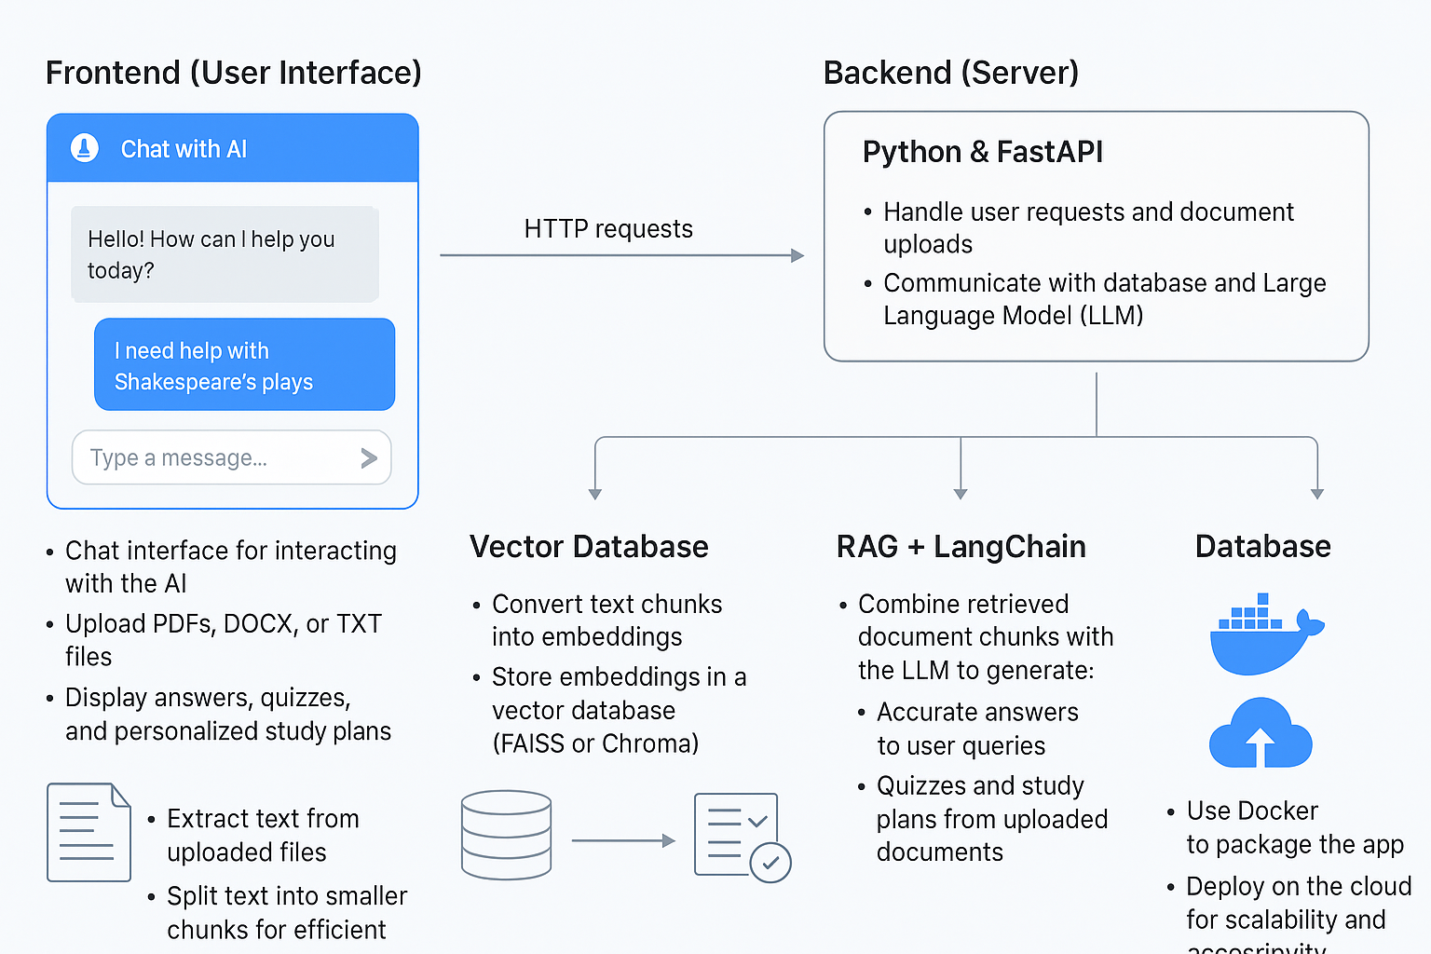
IMPLEMENTATION
Frontend: Built with React/HTML/CSS,Users can chat, upload documents, and see answers, quizzes, and study plans.
Backend: Built with Python & FastAPI,Handles user requests, document uploads, and communicates with the database and LLM.
Document Processing: Extract text from PDFs, DOCX, and TXT files.Split text into small chunks for easy search.
Vector Database:Convert text chunks into embeddings and store in a vector database(ChromaDB),Retrieve relevant text based on user queries.
RAG+LangChain: Combine retrieved document chunks with the LLM to generate accurate answers,Also generate quizzes and study plans from uploaded documents.
Database: MongoDB stores user profiles, chat history, and uploaded documents.
Deployment: We are using Docker package to deploy our project on the cloud. Deploy on the cloud for scalability and accessibility.
ATME College of Engineering,
Mysuru
Department of CSE-DS, ATMECE

Slide 13
SYSTEM ARCHITECTURE
SOFTWARE:
Python:The core programming language for our project,Used to implement backend logic, RAG pipeline, document processing, embeddings, and API integration.
FastAPI: A lightweight, high-performance web framework for building APIs,Provides endpoints like /upload, /chat, /quiz, /study plan so the frontend (React) can interact with the backend.
LangChain:A framework for building LLM-powered applications,Handles the RAG pipeline (retrieving chunks from FAISS, combining them with LLM prompts) for Q&A, quiz generation, and study plans.
MongoDB:A NoSQL database used for persistence.Stores user profiles, chat history, and document history, enabling personalized and continuous student interaction.
React: A frontend framework for building a modern web interface.Provides an interactive chat UI where students can upload documents, ask questions, view quizzes, and access study plans.
Docker:Used for containerization of the whole application (backend + frontend + database).Ensures smooth deployment on cloud platforms with scalability and no dependency issues.
ATME College of Engineering,
Mysuru
Department of CSE-DS, ATMECE

Slide 14
EXPECTED OUTCOMES
Intelligent student assistant chatbot with:
Accurate academic Q&A grounded in documents
Quiz generation from uploaded study materials
Personalized study plan creation
Persistence: User profiles, chat history, and document history
Deployment-ready: Dockerized, scalable cloud solution
ATME College of Engineering,
Mysuru
Department of CSE-DS, ATMECE

Slide 15
ATME College of Engineering,
Mysuru
Department of CSE-DS, ATMECE

Slide 16
THANK YOU
ATME College of Engineering,
Mysuru
Department of CSE-DS, ATMECE

Slide 17
Research Publication
📖 Title: A Review on RAG-Based Student Assistant Chatbot using LangChain
👨‍💻 Authors: Dharshan S, Puneeth K S, Sanjay G J, Vivek V, Dr. Anitha D B
📰 Journal: EPRA International Journal of Research and Development (IJRD)
📅 Volume 10 | Issue 8 | August 2025
🔗 DOI: https://doi.org/10.36713/epra23698
⭐ SJIF Impact Factor (2025): 8.688

Slide 18
Achievements
✅ Successfully published our review paper in a peer-reviewed, indexed international journal.

