Slide 1
01
Business Problem
Customer Shopping
Management Question
Which products, customer segments, and purchase drivers create the highest revenue?
Business Goal
Increase Sales
Improve Engagement
Optimize Marketing
Support Product Planning
Customer Shopping Behavior Analysis

Slide 2
02
Dataset Information
Customer Shopping
Source: Kaggle | Customer Shopping Behavior Dataset
3,900
18
$233K
$59.76
Rows / Purchases
Columns
Total Revenue
Avg Purchase
Key Fields
37 Missing Ratings
Customer ID
Age
Gender
Category
Handled in Python EDA
Item
Amount
Season
Subscription
Discount
Shipping
Payment
Review Rating
Customer Shopping Behavior Analysis

Slide 3
03
Python EDA
Customer Shopping
01
Load CSV
02
Inspect Data
03
Clean Missing Ratings
04
Create Age Groups
05
Analyze Trends
06
Export Clean Data
EDA Outputs
Category Revenue | Age Groups | Subscription Split | Discounts | Shipping | Season
Customer Shopping Behavior Analysis

Slide 4
04
SQL Queries
Customer Shopping
Business Question
SQL Output
Total revenue & average purchase
$233K revenue | $59.76 avg purchase
Revenue and sales by category
Clothing leads category performance
Subscription status split
27% subscribed | 73% non-subscribed
Discount impact on spend
No-discount avg spend is higher
Shipping and season performance
2-Day / Express strong | Fall strongest
Dashboard KPI validation
SQL totals matched Power BI cards
Customer Shopping Behavior Analysis

Slide 5
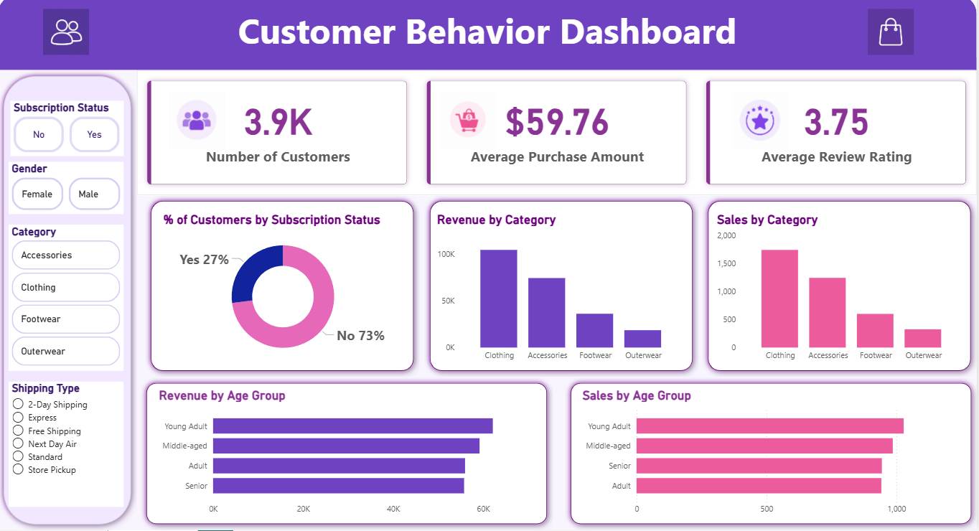
05
Power BI Dashboard
Customer Shopping
KPI Cards
Slicers
Category Charts
Age Segment Charts
Customer Shopping Behavior Analysis

Slide 6
06
Key Insights & Recommendations
Customer Shopping
Key Insights
Recommendations
• Clothing: $104K | 1,737 orders
• Accessories: $74K | 1,240 orders
• Subscription: 27% customers
• Fall: $60K highest revenue
• No-discount avg spend: $60.13
• Bundle Clothing + Accessories
• Improve subscription benefits
• Use targeted discounts only
• Promote fast shipping options
• Plan inventory before Fall
Customer Shopping Behavior Analysis

