Slide 1
Mini Project
QUICK FOODIE
ABUBAKAR – 084
L SRIRAM – 114
VIVEK RAJ -122

Slide 2
ABSTRACT:
Quick foodie is an online food ordering system is proposed here which simplifies the food ordering process. It is a fully responsive website.
This website contains different categories of food. For each category we’ll have different variety of food.
User can browse all categories and food items and
can also order the food.
Admin can add update or delete food and its categories, they can also manage and track food order and delivery.

Slide 3
Hardware/Software
Software Requirements:
INTERPRETER:
Visual Studio Code
Text Editor
Hardware Requirements:
1 GB RAM
1GB CORE
Front End:
1)HTML
2)CSS
3)JAVA SCRIPT
BACK END:
PHP
MY SQL for connectivity

Slide 4
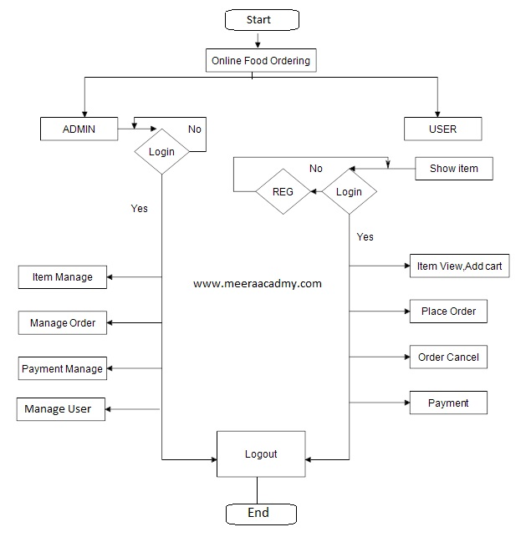

ARCHITECHTURE DESIGN:

Slide 5
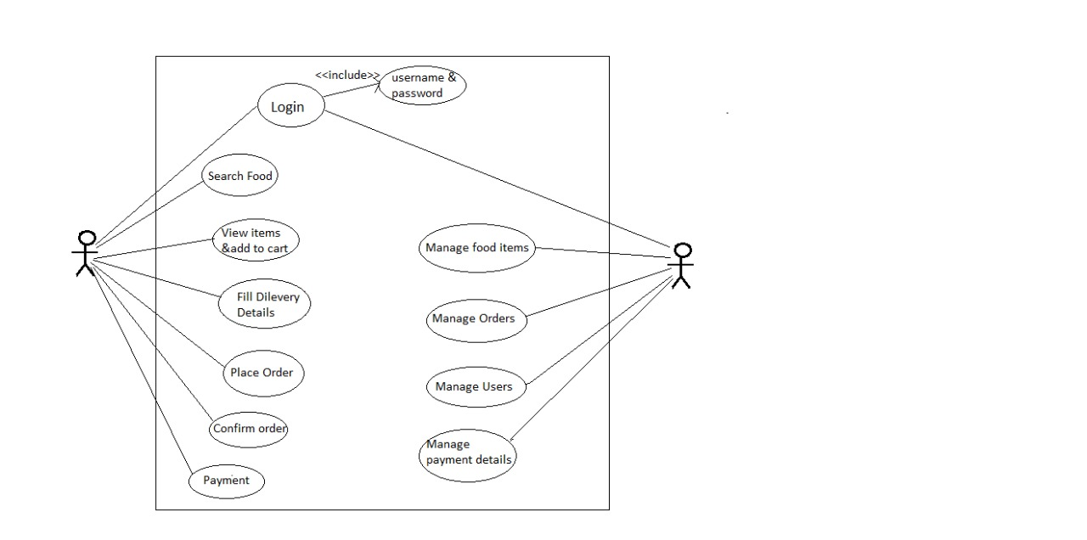

Slide 6

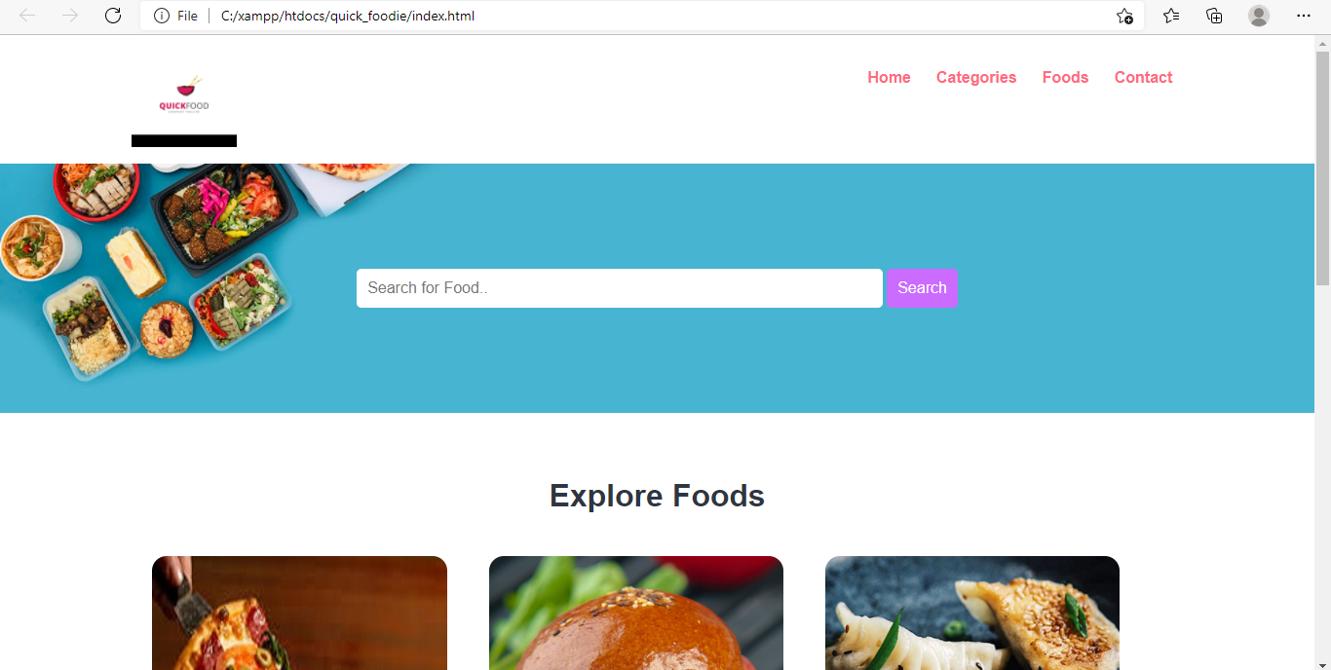

Slide 7
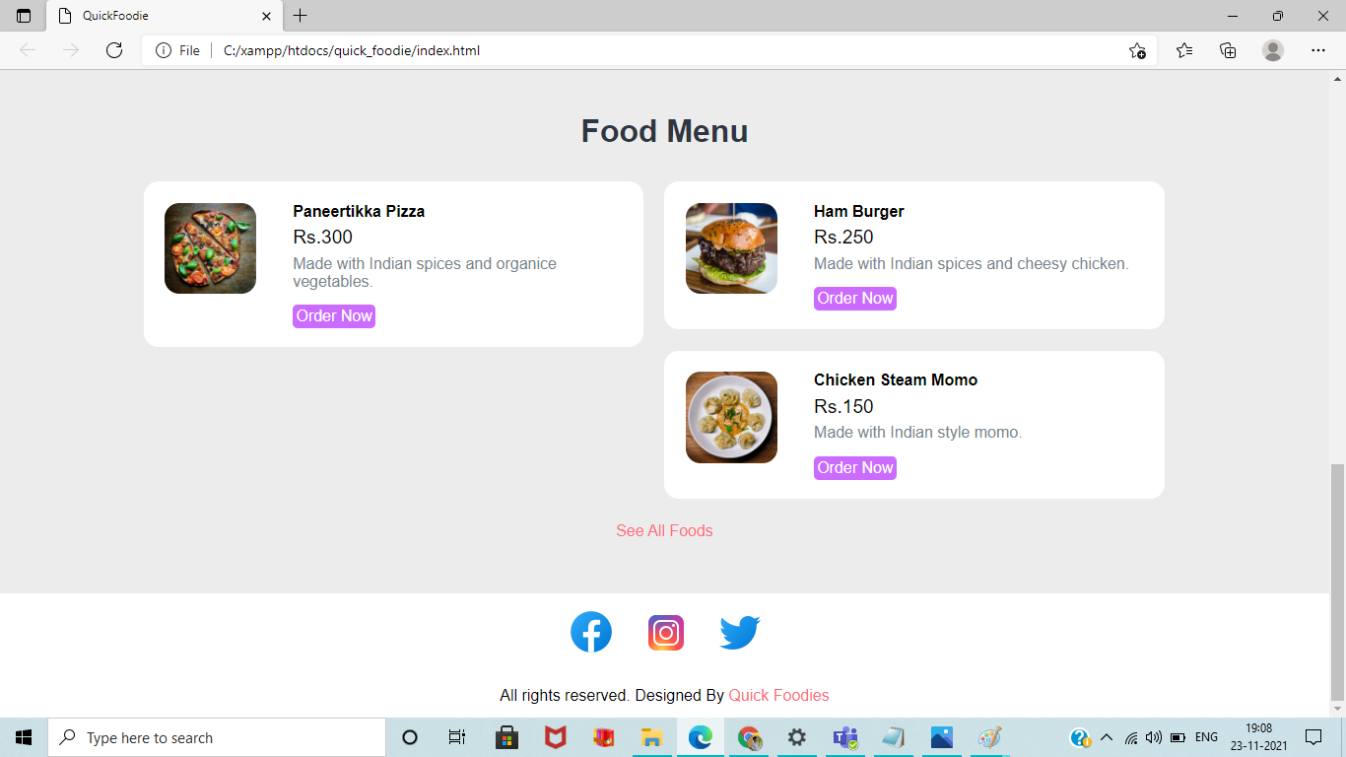

Slide 8
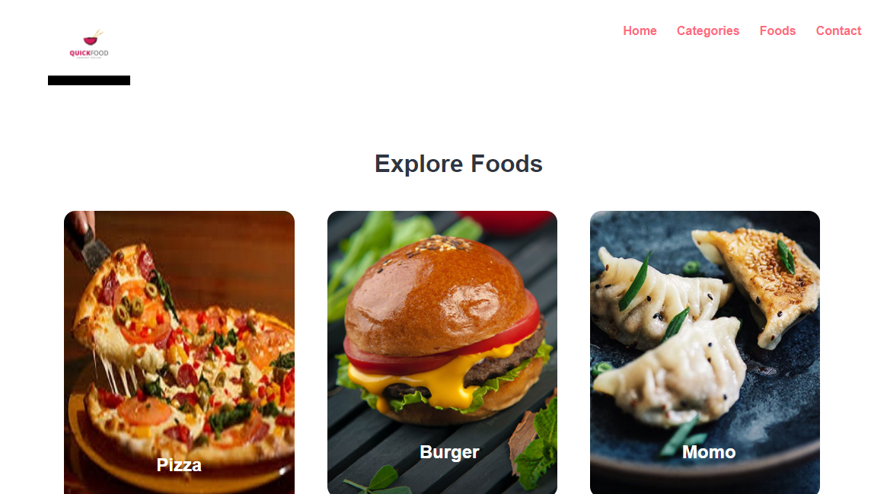

Slide 9
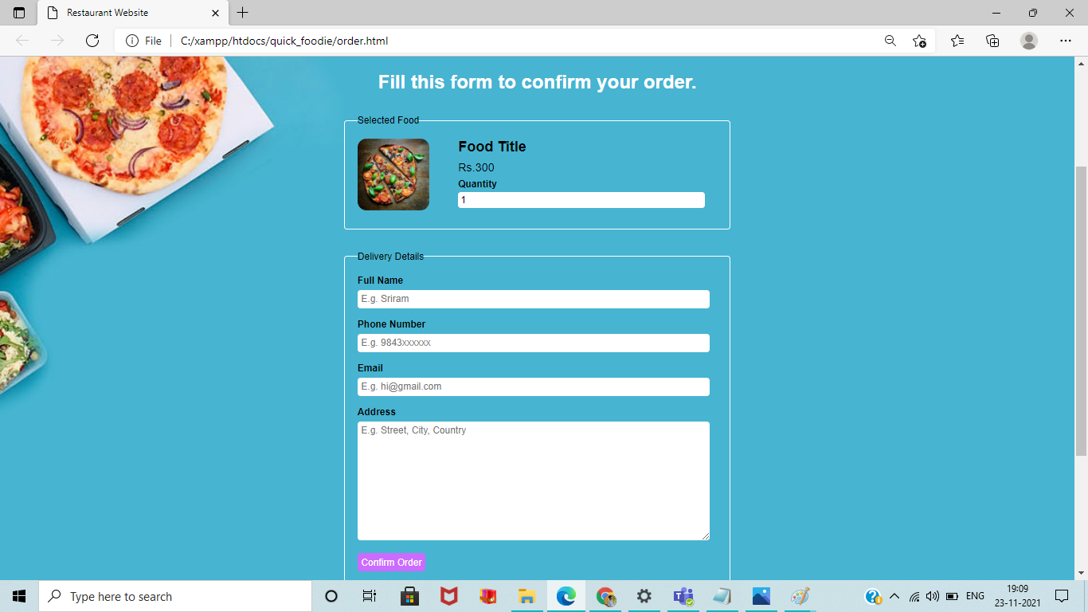

Slide 10
REFERENCES
http://ictactjournals.in/paper/IJMS_Vol_5_Iss_4_Paper_3_1089_1094.pdf
https://www.php.net/manual/en/langref.php
https://dev.mysql.com/doc/refman/8.0/en/

Slide 11
THANK YOU

