Slide 1
PREDICTING MARKET VOLATILITY AND BUILDING SHORT-TERM TRADING STRATEGIES USING DATA FROM REDDIT’S WALLSTREETBETS
Vivek kumar

Slide 2
INTRODUCTION
In the recent years, with the rise of social media, there is now a quicker, more efficient way of dissemination of data & information to influence traders judgements.
Top investor/leaders tweets is enough to fluctuate the stock prices of any companies by billion.
Contemplating these recent changes in stock marketing, our project aims to analyze data scraped from groups like reddit’s WSB as a means to predict market volatility and build a robust short-term trading strategy.

Slide 3
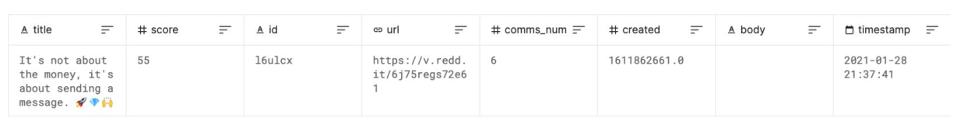
DATA SET AND PROCESSING
In this project, we are using stock price dataset hosted on Kaggle.com that consisted of scrapped post from WSB subreddit.
several steps of preprocessing needed to make the data usable for our purposes.
Dropped NAN values and converted all strings to lowercase, among other things.
For the sentiment analysis stage, we removed handlers, URLs, special characters, single characters, and substituted multiple spaces with a single space.

Slide 4
FEATURES AND DATA PROCESSING
Used both pandas and numpy, to process the Kaggle dataset of Reddit - rfWallStreetBets. Which enable to filter these posts.
Further, mapped these posts on date keys to group posts from the same day and calculate values such as: total comments and average score for that day.
However, based on short-term market volatility and the limits this set on data availability. later, concluded with creating a seven element feature vector for every post that mentions the stock and created a sub-matrix for each stock category.
The seven features include:
post score
total comms num
len of post
positive_sentiment
neutral sentiment
negative sentiment
bias (column of 1’s)

Slide 5
METHODS
Various machine learning techniques for stock prediction such as simple linear regression model and a support vector machine model.
Used binary classifier as the baseline. Input features were created from the data-set, and passed into the logistic regression classifier.
Feature scaling was applied on the input features to ensure a reasonable range of each weight.
Classifier tries to minimize a loss function to maximize the probability of each label being correct.
The result is the impact of each variable on the odds ratio of the observed event of interest, which is represented through a weight vector.
Newton's method was used to solve for the optimal weights. This is a numerical algorithm that helps us solve an equation of the form ∂F/∂Θ =0.

Slide 6
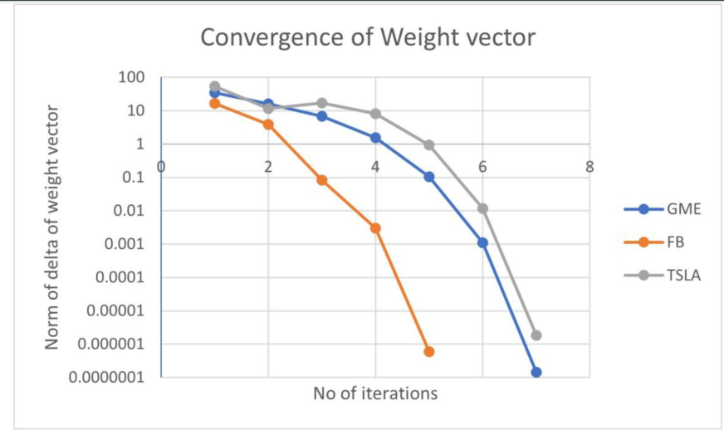
METHODS
As an alternative to the logistic regression employed above, and to fit a nonlinear function to this prediction task, we also constructed a 3-layer neural network to do binary classification on individual posts.
The network consisted of 3 256-dimensional linear layers with ReLU nonlinearities, and a sigmoid at the head. The resultant weights answer the question of whether the stock price went up at market open the next day - in other words, whether Pk < Pk+1 where P, represents the price of a security at market open on day i.

Slide 7
EXPERIMENTS AND RESULTS
An attempt was made to improve on the baseline logistic regression. A few key changes were incorporated: The labels were changed to indicate whether there was a significant shift in stock value. The idea behind this change was that mention of the stock in the sub-reddit could be correlated to a rise or fall in the stock but not necessarily either. Each feature vector was remodelled to represent a single post, rather than an aggregate of posts made on the day. This allowed us to extract the fine details present in the data-set, while providing more examples for training and testing.
The baseline model with 80 training examples and 20 elements in the test set, with an accuracy of about 73%. This results:
Price of the security at the opening of the market on the following day was higher than it was on the day of the post/comment.
on the other hand, indicates that the opening price of the selected security was higher on the day of the post/comment in question, and went down the next day at market open. This was also highly contextualized to GME.
The convergence of the algorithm for 3 different stocks(GameStop, Facebook, Tesla) is presented above. This is a semi-log plot showing the decreasing norm of the difference in weight vector between subsequent iterations.

Slide 8
CONCLUSION AND FUTURE WORK
The real challenge lies in bringing out this correlation, and we made an attempt at overcoming it by building a neural network.
While these results may not hold much value by themselves, they declare the start of a new spectrum of ideas and possibilities for prediction of stock prices.
The neural network was more reliable than a simple logistic regression, but only by a slight amount. Possible extensions include scraping more data, including those from conventional mainstream media sources, and instead of relying on a black-box sentiment analyzer, make the sentiments trainable weights that tailored to the task of stock price prediction.
To explore variable timings in periods when looking at the stock volatility, perhaps time periods such as 6 hours, 1 week etc. as opposed to 24 hours, Reddit - r/WallStreetBets can be further expanded.
To incorporate more features than the ones that exist right now, by considering additional sources such as: other finance focused Reddit groups, finance related podcast transcripts and news articles.
With this more robust feature vector, to explore some pre-trained models for sentiment analysis and general language modeling such as BERT, this could be interesting addition as this will enhance the language used.

