Slide 1
EARLY EPILEPSY SEIZURE DETECTION
An Explainable Deep Learning Pipeline for Scalp EEG
CHB-MIT Scalp EEG Database | 1D CNN | SHAP | LIME
Wasnik Aishwary Manoj (23115111) • Vivek Anand (23115109)
Guided by Dr. Bunil Kumar Balbantaray
Final Year Project — Computer Science & Engineering
National Institute of Technology, Raipur
Early Epilepsy Seizure Detection
NIT Raipur

Slide 2
Why this problem matters
2
Motivation for automatic seizure detection and explainability
Seizures are unpredictable, and continuous EEG monitoring produces a large amount of signal data.
Epilepsy
Continuous monitoring
Need for explanation
More than 50 million people worldwide live with epilepsy.
EEG recordings may need to be monitored continuously to identify seizure activity.
A black-box alert is difficult to inspect. The project therefore adds an explainability layer.
Goal
Build a complete pipeline from raw EEG recordings to a seizure prediction, and show which channels and time regions influenced individual predictions.
Early Epilepsy Seizure Detection
NIT Raipur

Slide 3
Dataset
3
CHB-MIT Scalp EEG Database
PhysioNet • pediatric epilepsy patients • continuous scalp EEG recordings
23
256 Hz
5
315,686
EEG channels per recording
original sampling rate
subjects processed so far
4-second windows
Seizure windows
Class imbalance
Main challenge
843 windows contain true seizure activity.
Only about 0.27% of all windows are seizure windows.
The severe imbalance strongly affects model training and evaluation.
Early Epilepsy Seizure Detection
NIT Raipur

Slide 4
Processing pipeline
4
From raw EDF recordings to an explainable prediction
1. Raw EDF
2. Filtering
3. Normalization
4. Windowing
5. CNN
6. SHAP / LIME
23-channel EEG
Loaded with MNE
60 Hz notch
0.5–40 Hz band-pass
Per-channel z-score
within each recording
4 s windows
50% overlap
1D CNN in PyTorch
Weighted sampling
Per-window attribution
channels + time regions
Input to the model: 23 channels × 512 samples (4 seconds at 128 Hz).
The data is processed file-by-file and stored in a memory-safe form so the complete dataset does not have to remain in RAM.
Early Epilepsy Seizure Detection
NIT Raipur

Slide 5
CNN architecture
5
A 1D convolutional network built stage by stage
Input
Conv Block 1
Conv Block 2
Conv Block 3
Global Pool
Classifier
23 × 512
Conv1D 23→32, k=7
BatchNorm → ReLU → MaxPool(4)
Conv1D 32→64, k=5
BatchNorm → ReLU → MaxPool(4)
Conv1D 64→128, k=3
BatchNorm → ReLU
AdaptiveAvgPool1d(1)
128→64 → Dropout(0.3) → 64→1
Output: one raw seizure logit. Sigmoid converts the logit to a seizure probability.
Early Epilepsy Seizure Detection
NIT Raipur

Slide 6
Engineering challenges
6
Problems encountered during implementation and the fixes
1. Out-of-memory crashes
2. Data leakage
Problem
Loading all EDF files at once required more than 15 GB RAM and crashed the machine.
Fix
Process one file at a time, write processed arrays to disk, and use memory-mapped arrays so only the active batch is held in RAM.
Problem
A random window-level split allowed overlapping windows from the same recording to appear in both train and test, giving an inflated F1 of about 0.98.
Fix
Split by complete EDF file/recording so all windows from one recording stay in the same split.
Early Epilepsy Seizure Detection
NIT Raipur

Slide 7
Results
7
Performance on the held-out file-level test set
The final experiment uses a file-level train/test split. This avoids leakage between overlapping windows from the same recording.
Confusion matrix
0.85
0.89
0.87
Precision
Recall
F1-score
89,257
32
TN
FP
22
178
FN
TP
Interpretation
The model detects most seizure windows while keeping false alarms relatively low in this five-subject experiment. The result is a baseline rather than a final clinical model.
89,489 total test windows
Early Epilepsy Seizure Detection
NIT Raipur

Slide 8
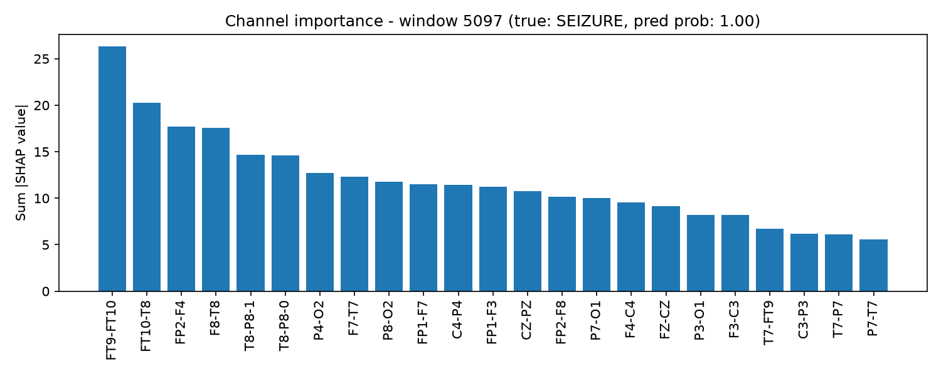
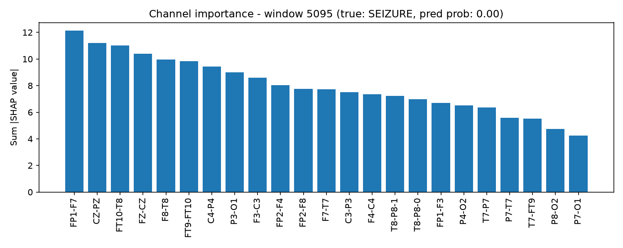
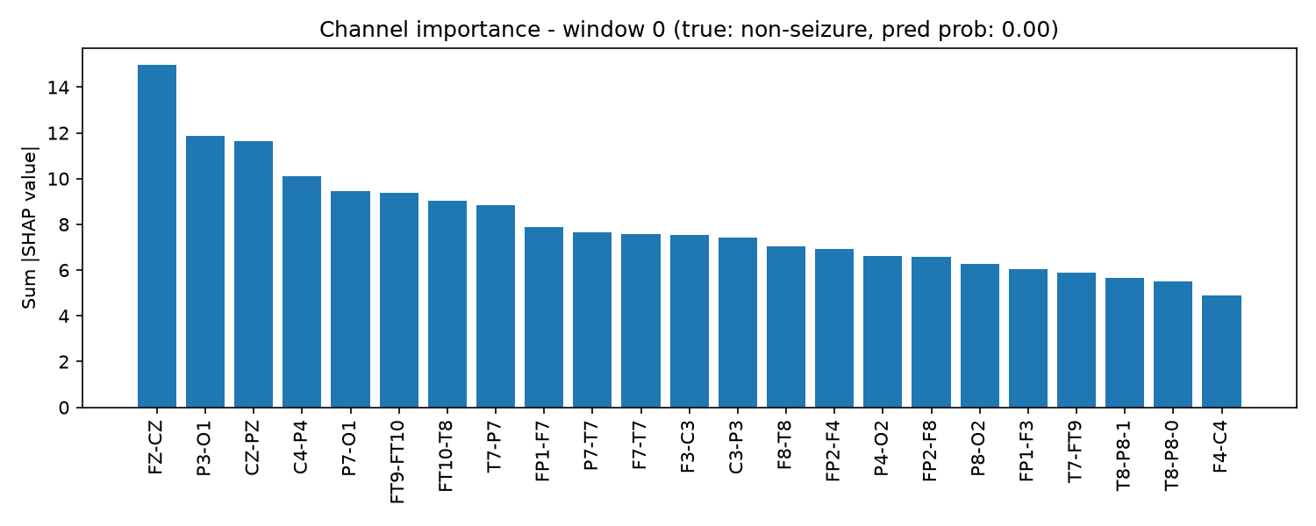
Explainability with SHAP
8
Channel importance for individual predictions
SHAP GradientExplainer estimates how much each EEG channel contributed to a specific prediction.
The three examples show a correctly detected seizure, a missed seizure, and a correct non-seizure window.
The plotted value is the sum of absolute SHAP values across time, so the bars show importance magnitude rather than positive/negative direction.
Early Epilepsy Seizure Detection
NIT Raipur

Slide 9
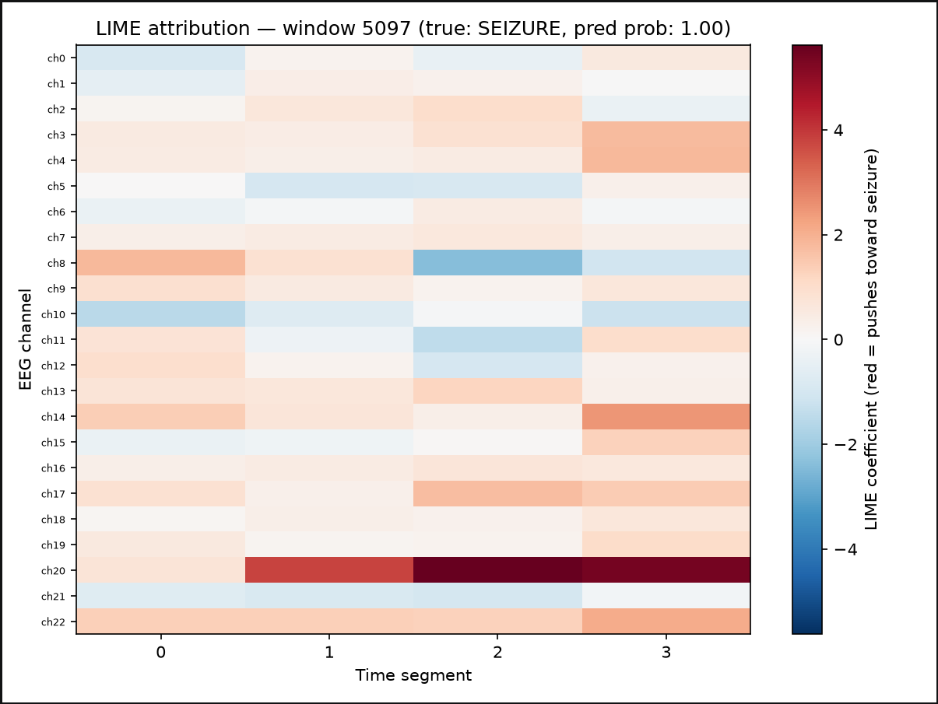
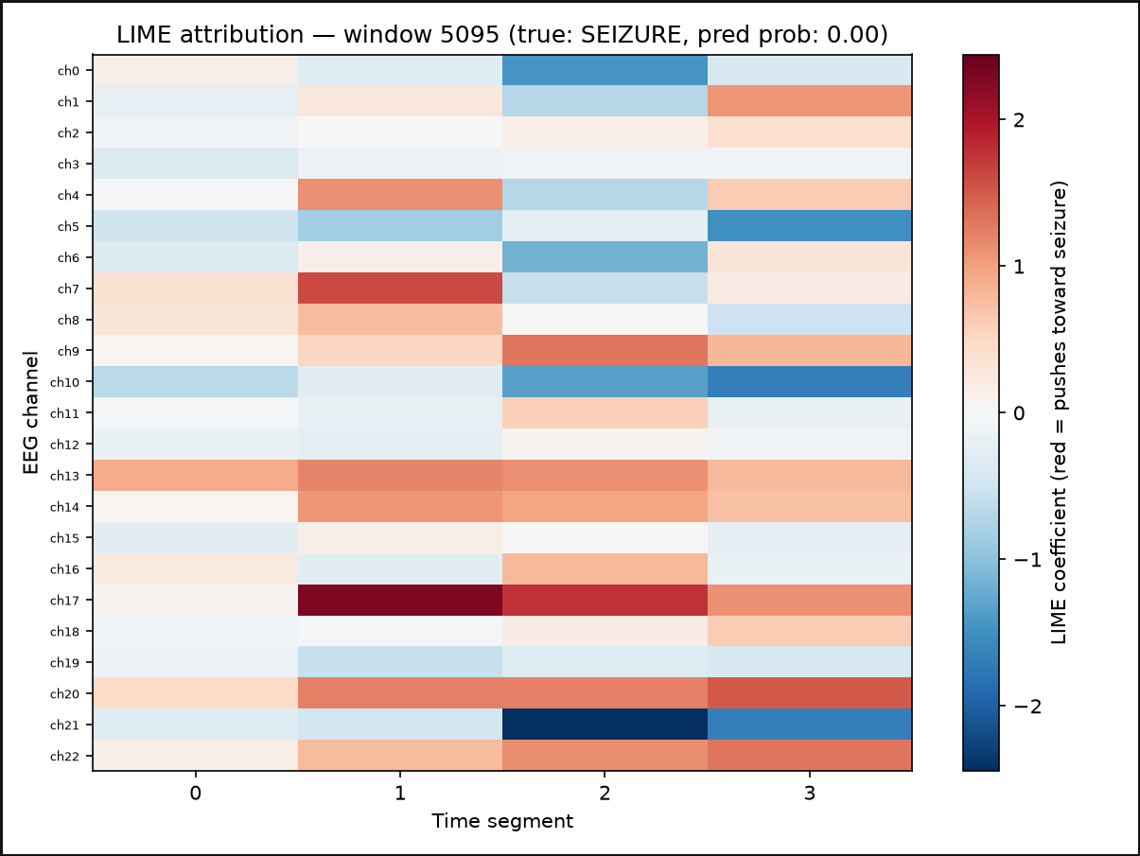
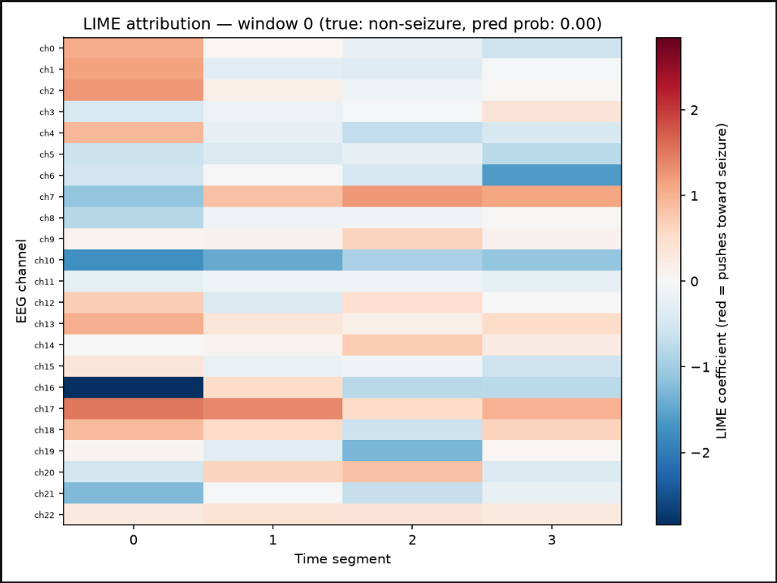
Explainability with LIME
9
A second method for checking local model behaviour
LIME was implemented specifically for this project. Each window is divided into channel × time regions, perturbed, and used to fit a local surrogate model.
Representation
Perturbations
Surrogate
23 channels × 4 time segments = 92 regions
500 masked samples; zero is the normalized baseline
Weighted Ridge regression on the CNN logit
Early Epilepsy Seizure Detection
NIT Raipur

Slide 10
Summary
10
What was built and what remains
What was built
Current limitations / next steps
• EEG preprocessing and 4-second windowing
• 1D CNN seizure classifier
• File-level train/test split to reduce leakage
• Memory-safe processing for EDF recordings
• SHAP channel-level explanations
• Custom LIME channel × time explanations
• Current experiment covers five subjects
• File-level split is not the same as a patient-independent split
• More subjects are needed for stronger generalisation claims
• Further tuning and validation can improve reliability
• Explanations are model attribution, not clinical causality
Thank you
Questions are welcome.
github.com/VivekA28/epilepsy-seizure-detection
Early Epilepsy Seizure Detection
NIT Raipur

