Slide 1

Customer Shopping Behavior Analysis
3,900 purchases — 18 features — goal: actionable customer insights

Slide 2
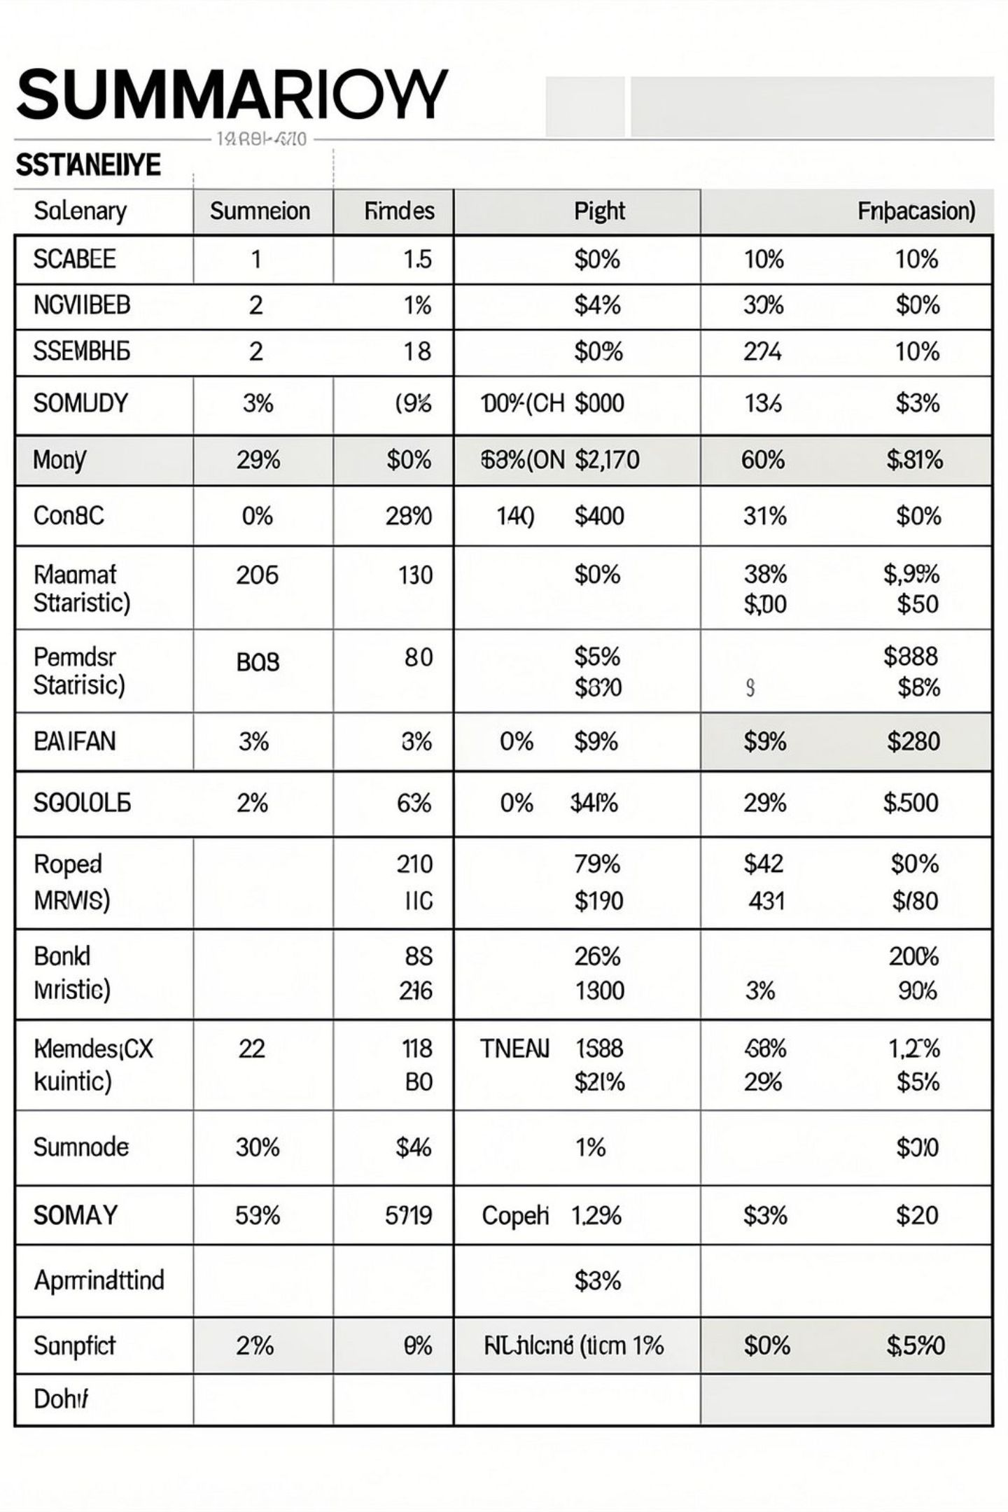
Dataset Snapshot
Rows & Columns
Key Features
Rows: 3,900 · Columns: 18
Demographics, Purchase details, Behavior metrics
Missing Data
37 missing values in Review Rating

Slide 3

Data Preparation (Python)
Loading & Explore
pandas, df.info(), .describe()
Missing Values
Imputed Review Rating by category median
Standardize
Renamed to snake_case
Feature Eng.
age_group, purchase_frequency_days
Redundancy
Dropped promo_code_used (redundant with discount_applied)

Slide 4
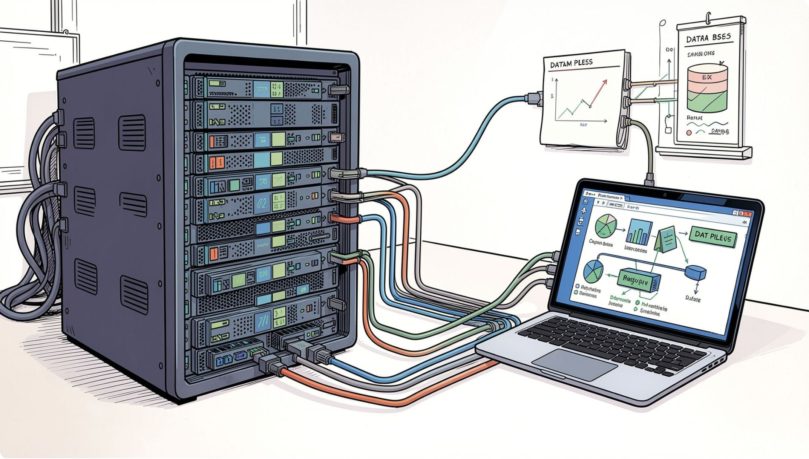
Database Integration
Cleaned DataFrame loaded into PostgreSQL for SQL analysis
Enables performant business queries
Supports dashboard data sources

Slide 5
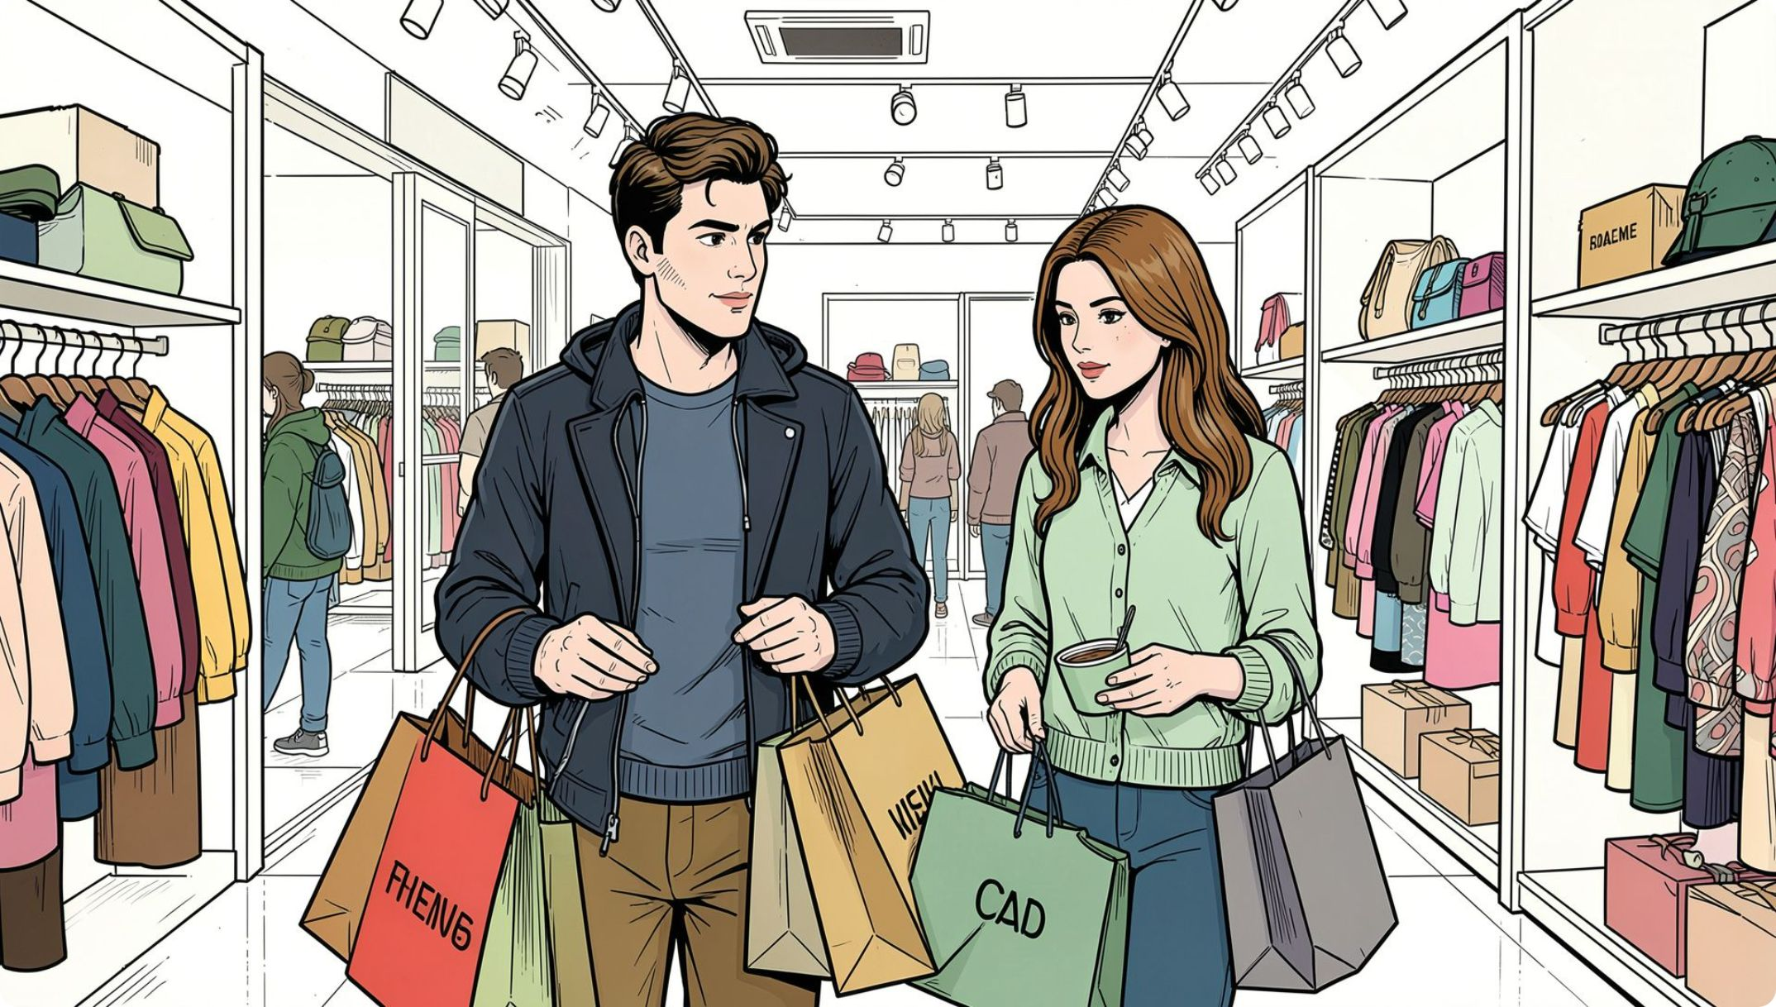
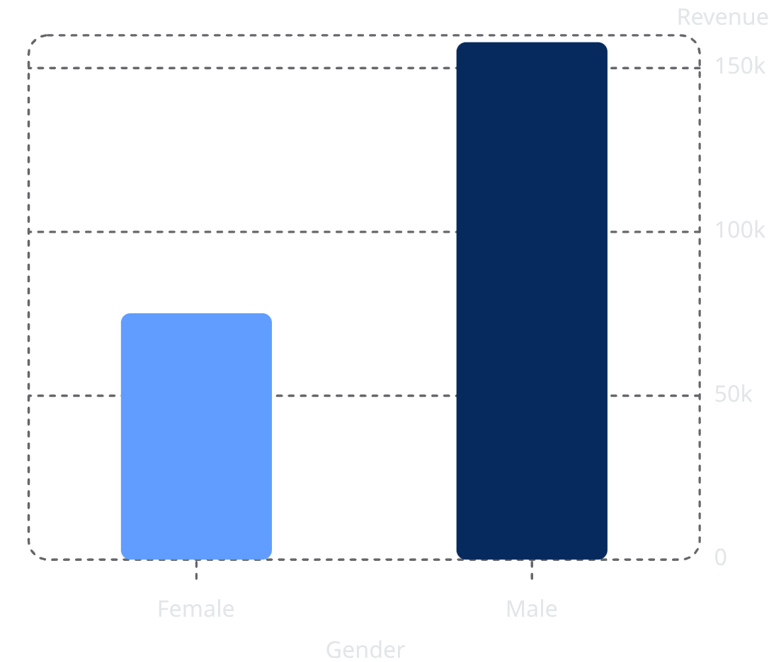
Revenue by Gender
Male revenue notably higher. Investigate demographic drivers.

Slide 6
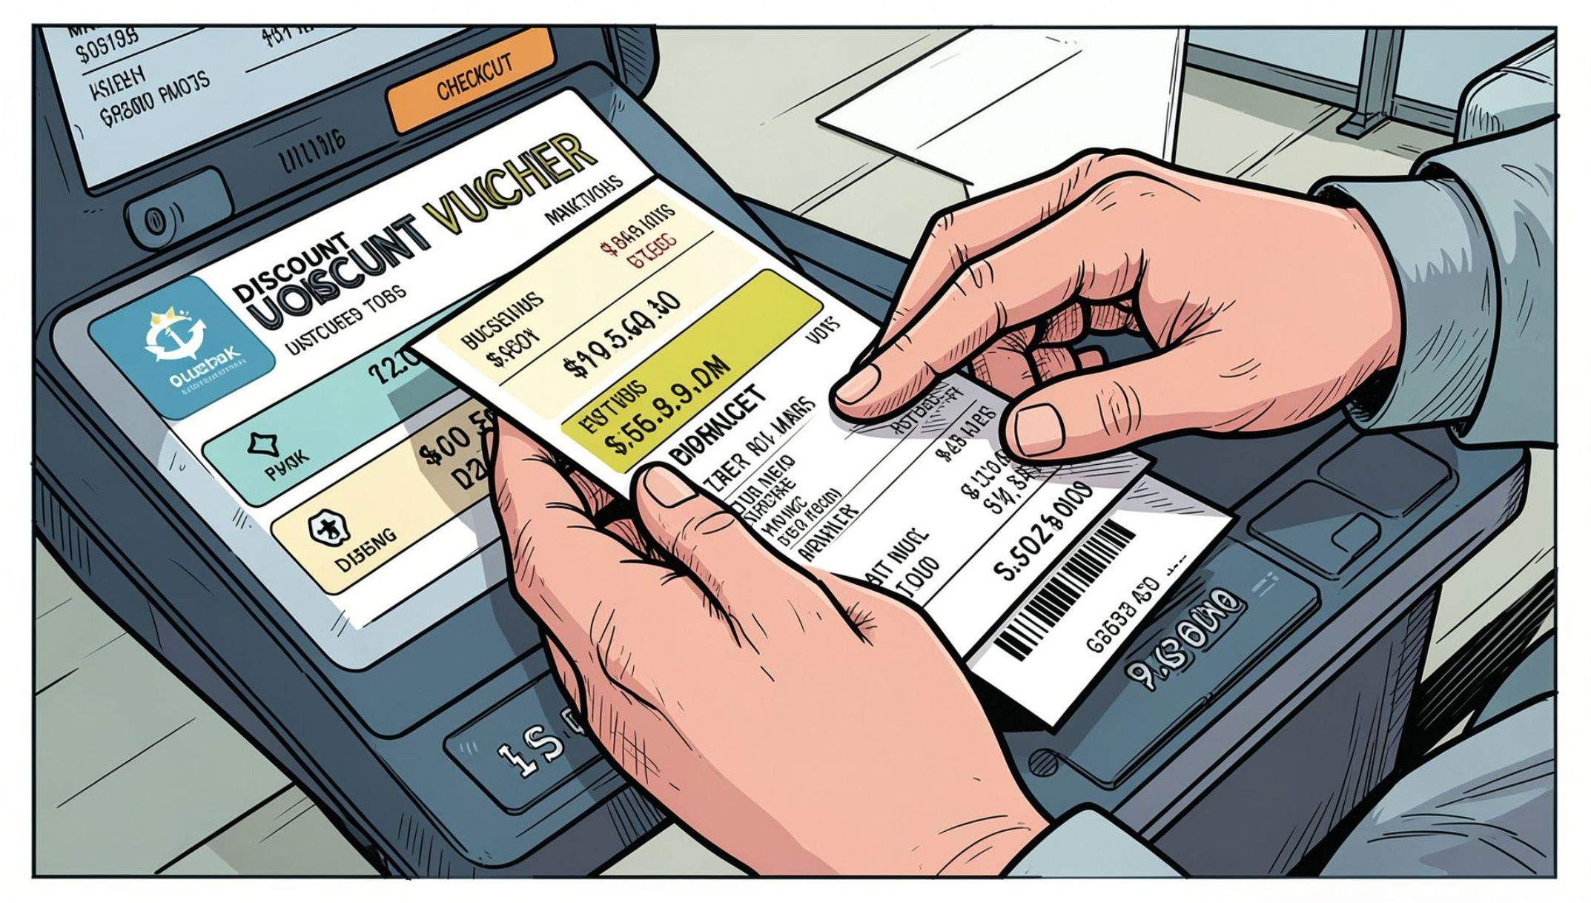
High‑Spending Discount Users
839 rows: customers who used discounts but spent above average
Example Records
IDs and purchase amounts (sample): 2→64, 3→73, 4→90 …
Action
Review discount ROI by segment

Slide 7
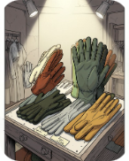
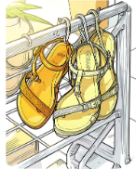
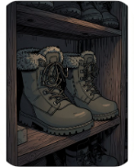
Top Products & Discount Dependence
Top discount‑dependent items (% discounted):
Gloves
Sandals
Boots
Hat — 50.00%
Sneakers — 49.66%
Coat — 49.07%
Sweater — 48.17%
Pants — 47.37%
Avg Rating: 3.86
Avg Rating: 3.84
Avg Rating: 3.82

Slide 8
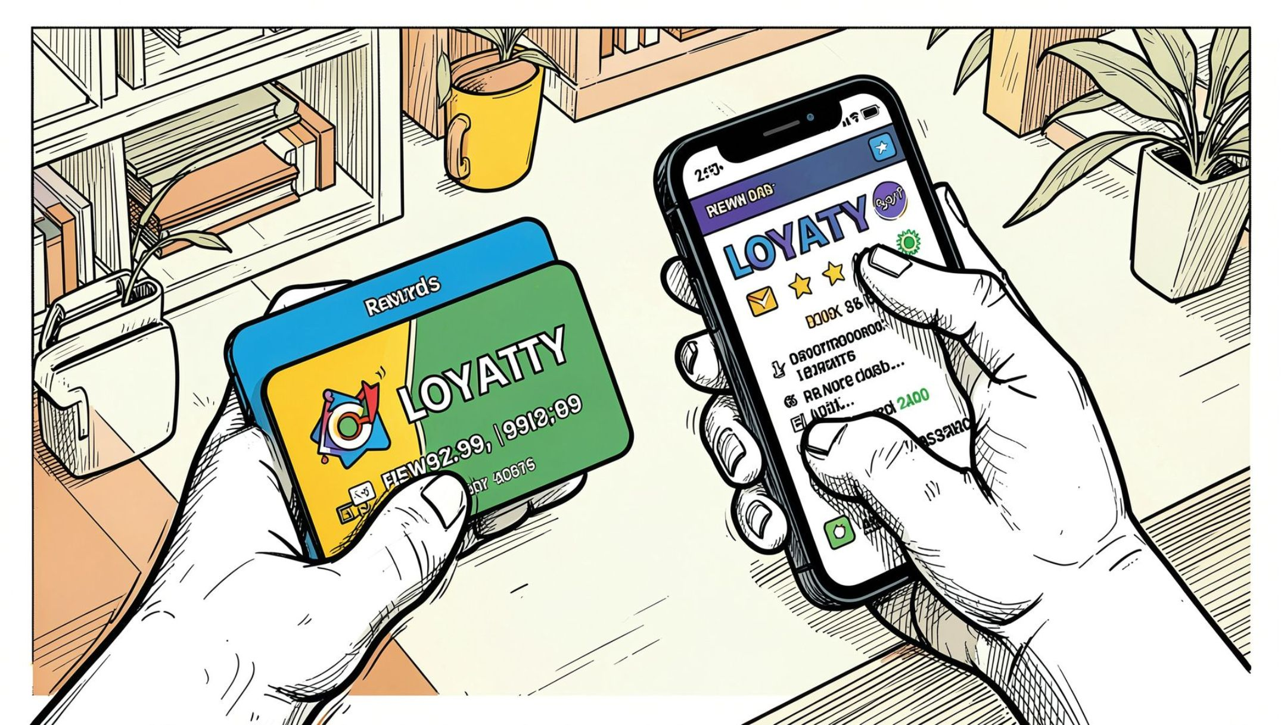
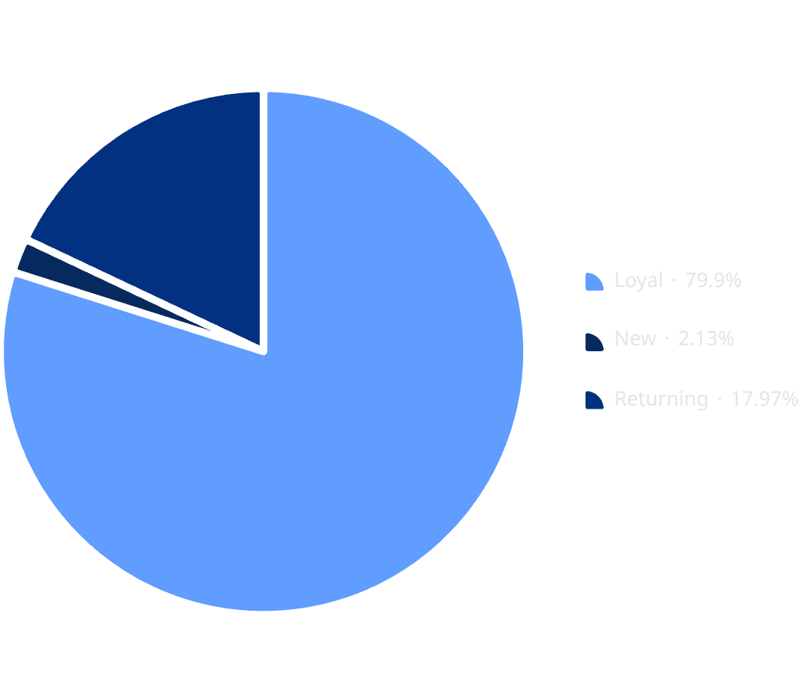
Customer Segments & Loyalty
Focus: convert Returning → Loyal. Loyalty programs & targeted rewards.

Slide 9
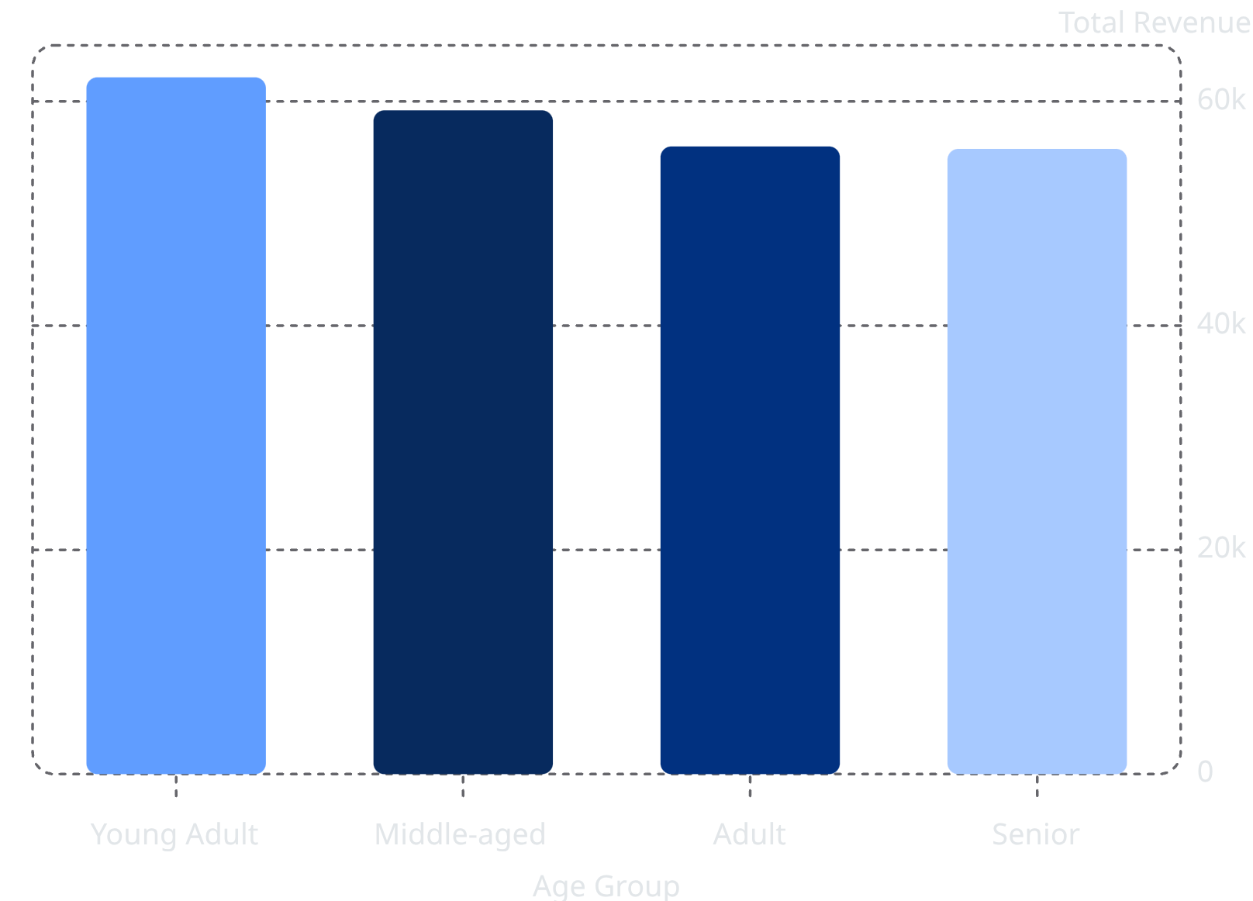
Age & Subscription Insights
Subscribers vs Non‑Subscribers:
Subscribers
Non‑Subscribers
1,053 customers · Avg spend $59.49 · Revenue $62,645
2,847 customers · Avg spend $59.87 · Revenue $170,436

Slide 10
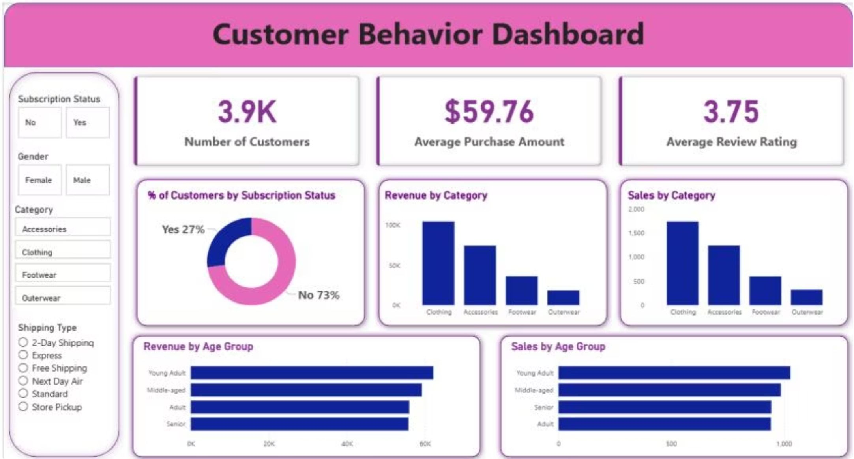
Dashboard & Recommendations
Boost Subscriptions
Promote exclusive benefits
Loyalty Programs
Reward repeat buyers
Review Discounts
Balance sales vs margins
Product Positioning
Highlight top-rated / best-selling items
Targeted Marketing
Focus on high-revenue age groups & express-shipping users

