Slide 1

UI Development Workshop
Learn to code in Angular and JavaScript
Presented by:
Joshua Weil
Sr Software Engineer

Slide 2

UI Development Workshop
Agenda
Tech Talk
Development Activity
Question and Answers
Today’s UI Technology Landscape
The Importance of UI and UX in Software Engineering
The Software Development Life Cycle (SDLC)
Building a List Management App in Angular
Step By Step Instructions and Source Code available on Plunkr and GitHub
Not your basic Hello World
Feel Free to ask questions as we go.
I will be sure to follow up with questions I am unable to answer
No Stupid Questions

Slide 3

UI Technology Landscape
New UI Technology and Frameworks are released Everyday
What you need to know – the short list
Html
Semantic HTML – (HTML5)
Templating – (Mustache, Handlebars)
Web Components
Shadow Dom
JavaScript
MVC – Model View Controller (Angular, Ember)
MVVM – Model View, View Model (Angular, Backbone, Knockout)
DOM Heavy – View Frameworks (React)
The Basics – (jQuery)
ECMAScript & TypeScript – (ES5, ES6, TS)
CSS
Selectors – (#, ., >, [], *)
Preprocessors – (Sass, Less, Stylus)
Frameworks – (Bootstrap, Foundation)
Responsive – (Progressive Enhancement, Graceful Degradation)
https://hackernoon.com/how-it-feels-to-learn-javascript-in-2016-d3a717dd577f#.1vtwd7ly6

Slide 4


Music App
Fullscreen Photo
Project Description
Sugar Plum Gummi Bears Candy Canes Danish Cake Bear Claw Cake. Dessert Bear Claw Powder Chocolate Cake Wafer Fruitcake Macaroon Tart Croissant. Pastry Gummies Marshmallow Jelly Beans Gummi Bears Tart

Slide 5
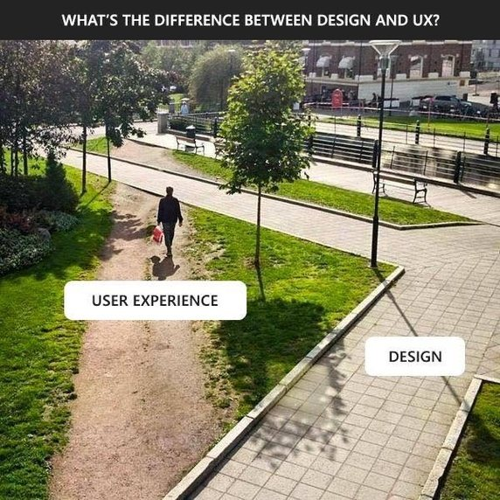

Slide 6


Software Development Life Cycle
Planning
Research & Analysis
Design
Implementation
Maintenance
The days of Waterfall are gone
Todays leading SDLC styles include Agile, Lean, and Kanban

Slide 7

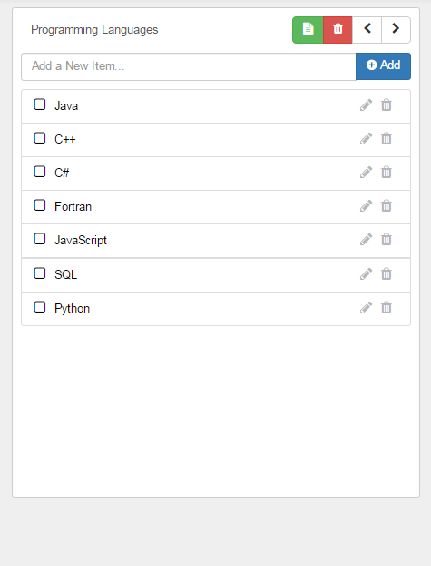
List Management App
Let’s Write some Code
Requirements
Add Items to the List
Edit Items on the List
Remove Items from the List
Mark an Item off the List
Create New Lists
Cycle through Lists
Open Last used List by Default
Remove List

Slide 8
Thank You
Questions?
Plunkr
https://plnkr.co/edit/UZ6AYHDTZLrpY4y6JpHZ?p=preview
GitHub
https://github.com/weiljx/listManager
LinkedIn
https://www.linkedin.com/in/joshua-weil-92aa5b26?trk=nav_responsive_tab_profile
Email
Joshua.weil@lexisnexis.com

