Slide 1
Introduction to Intel x86 Assembly, Architecture, Applications, & Alliteration
Xeno Kovah – 2009/2010
xkovah at gmail
Approved for Public Release: 10-3348. Distribution Unlimited

Slide 2
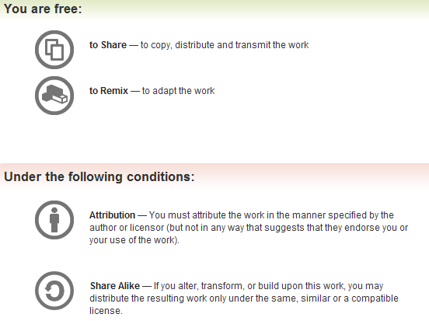
All materials is licensed under a Creative Commons “Share Alike” license.
http://creativecommons.org/licenses/by-sa/3.0/

Slide 3
Additional Content/Ideas/Info Provided By:
Jon A. Erickson, Christian Arllen, Dave Keppler
Who suggested what, is inline with the material

Slide 4
About Me
Security nerd - generalist, not specialist
Realmz ~1996, Mac OS 8, BEQ->BNE FTW!
x86 ~2002
Know or have known ~5 assembly languages(x86, SPARC, ARM, PPC, 68HC12). x86 is by far the most complex.
Routinely read assembly when debugging my own code, reading exploit code, and reverse engineering things
Notes:
5 min

Slide 5
About You?
Name & Department
Why did you want to take the class?
If you know you will be applying this knowledge, to which OS and/or development environment?
Notes:
10 min

Slide 6
About the Class
The intent of this class is to expose you to the most commonly generated assembly instructions, and the most frequently dealt with architecture hardware.
  32 bit instructions/hardware
  Implementation of a Stack
  Common tools
Many things will therefore be left out or deferred to later classes.
  Floating point instructions/hardware
  16/64 bit instructions/hardware
  Complicated or rare 32 bit instructions
  Instruction pipeline, caching hierarchy, alternate modes of operation, hw virtualization, etc
Notes:
2 min

Slide 7
About the Class 2
The hope is that the material covered will be provide the required background to delve deeper into areas which may have seemed daunting previously.
Because I can't anticipate the needs of all job classes, if there are specific areas which you think would be useful to certain job types, let me know. The focus areas are currently primarily influenced by my security background, but I would like to make the class as widely applicable as possible.

Slide 8
Agenda
Day 1 - Part 1 - Architecture Introduction, Windows tools
Day 1 - Part 2 - Windows Tools & Analysis, Learning New Instructions
Day 2 - Part 1 - Linux Tools & Analysis
Day 2 - Part 2 - Inline Assembly, Read The Fun Manual, Choose Your Own Adventure
Notes:
2 min

Slide 9
Miss Alaineous
Questions: Ask 'em if you got 'em
  If you fall behind and get lost and try to tough it out until you understand, it's more likely that you will stay lost, so ask questions ASAP.
Browsing the web and/or checking email during class is a good way to get lost ;)
Vote on class schedule.
Benevolent dictator clause.
It's called x86 because of the progression of Intel chips from 8086, 80186, 80286, etc. I just had to get that out of the way. :)

Slide 10
What you're going to learn
#include <stdio.h>
int main(){
  printf(“Hello World!\n”);
  return 0x1234;
}

Slide 11
Is the same as…
.text:00401730 main
.text:00401730 push ebp
.text:00401731 mov ebp, esp
.text:00401733 push offset aHelloWorld ; "Hello world\n"
.text:00401738 call ds:__imp__printf
.text:0040173E add esp, 4
.text:00401741 mov eax, 1234h
.text:00401746 pop ebp
.text:00401747 retn
Windows Visual C++ 2005, /GS (buffer overflow protection) option turned off
Disassembled with IDA Pro 4.9 Free Version

Slide 12
Is the same as…
08048374 <main>:
8048374: 8d 4c 24 04 lea 0x4(%esp),%ecx
8048378: 83 e4 f0 and $0xfffffff0,%esp
804837b: ff 71 fc pushl -0x4(%ecx)
804837e: 55 push %ebp
804837f: 89 e5 mov %esp,%ebp
8048381: 51 push %ecx
8048382: 83 ec 04 sub $0x4,%esp
8048385: c7 04 24 60 84 04 08 movl $0x8048460,(%esp)
804838c: e8 43 ff ff ff call 80482d4 <puts@plt>
8048391: b8 2a 00 00 00 mov $0x1234,%eax
8048396: 83 c4 04 add $0x4,%esp
8048399: 59 pop %ecx
804839a: 5d pop %ebp
804839b: 8d 61 fc lea -0x4(%ecx),%esp
804839e: c3 ret
804839f: 90 nop
Ubuntu 8.04, GCC 4.2.4
Disassembled with “objdump -d”

Slide 13
Is the same as…
_main:
00001fca pushl %ebp
00001fcb movl %esp,%ebp
00001fcd pushl %ebx
00001fce subl $0x14,%esp
00001fd1 calll 0x00001fd6
00001fd6 popl %ebx
00001fd7 leal 0x0000001a(%ebx),%eax
00001fdd movl %eax,(%esp)
00001fe0 calll 0x00003005 ; symbol stub for: _puts
00001fe5 movl $0x00001234,%eax
00001fea addl $0x14,%esp
00001fed popl %ebx
00001fee leave
00001fef ret
Mac OS 10.5.6, GCC 4.0.1
Disassembled from command line with “otool -tV”

Slide 14
But it all boils down to…
.text:00401000 main
.text:00401000 push offset aHelloWorld ; "Hello world\n"
.text:00401005 call ds:__imp__printf
.text:0040100B pop ecx
.text:0040100C mov eax, 1234h
.text:00401011 retn
Windows Visual C++ 2005, /GS (buffer overflow protection) option turned off
Optimize for minimum size (/O1) turned on
Disassembled with IDA Pro 4.9 Free Version

Slide 15
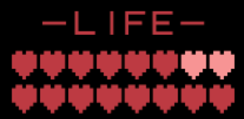
Take Heart!
By one measure, only 14 assembly instructions account for 90% of code!
  http://www.blackhat.com/presentations/bh-usa-06/BH-US-06-Bilar.pdf
I think that knowing about 20-30 (not counting variations) is good enough that you will have the check the manual very infrequently
You've already seen 11 instructions, just in the hello world variations!

Slide 16
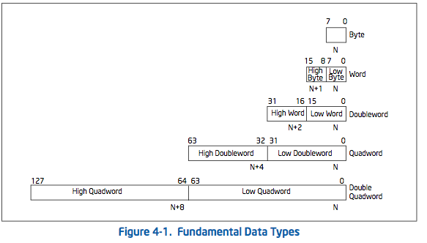
Refresher - Data Types
In C: char
short
int/long
double/long long
?->
long double?

Slide 17
Refresher - Alt. Radices Decimal, Binary, Hexidecimal
If you don't know this, you must memorize tonight
Decimal (base 10) | Binary (base 2) | Hex (base 16)
00 | 0000b | 0x00
01 | 0001b | 0x01
02 | 0010b | 0x02
03 | 0011b | 0x03
04 | 0100b | 0x04
05 | 0101b | 0x05
06 | 0110b | 0x06
07 | 0111b | 0x07
08 | 1000b | 0x08
09 | 1001b | 0x09
10 | 1010b | 0x0A
11 | 1011b | 0x0B
12 | 1100b | 0x0C
13 | 1101b | 0x0D
14 | 1110b | 0x0E
15 | 1111b | 0x0F

Slide 18
Refresher - Negative Numbers
“one's complement” = flip all bits. 0->1, 1->0
“two's complement” = one's complement + 1
Negative numbers are defined as the “two's complement” of the positive number
0x01 to 0x7F positive byte, 0x80 to 0xFF negative byte
0x00000001 to 0x7FFFFFFF positive dword
0x80000000 to 0xFFFFFFFF negative dword
Number | One's Comp. | Two's Comp. (negative)
00000001b : 0x01 | 11111110b : 0xFE | 11111111b : 0xFF : -1
00000100b : 0x04 | 11111011b : 0xFB | 11111100b : 0xFC : -4
00011010b : 0x1A | 11100101b : 0xE5 | 11100110b : 0xE6 : -26
? | ? | 10110000b : 0xB0 : -?

Slide 19
Architecture - CISC vs. RISC
Intel is CISC - Complex Instruction Set Computer
  Many very special purpose instructions that you will never see, and a given compiler may never use - just need to know how to use the manual
  Variable-length instructions, between 1 and 16(?) bytes long.
    16 is max len in theory, I don't know if it can happen in practice
Other major architectures are typically RISC - Reduced Instruction Set Computer
  Typically more registers, less and fixed-size instructions
  Examples: PowerPC, ARM, SPARC, MIPS

Slide 20
Architecture - Endian
Endianness comes from Jonathan Swift's Gulliver's Travels. It doesn't matter which way you eat your eggs :)
Little Endian - 0x12345678 stored in RAM “little end” first. The least significant byte of a word or larger is stored in the lowest address. E.g. 0x78563412
  Intel is Little Endian
Big Endian - 0x12345678 stored as is.
  Network traffic is Big Endian
  Most everyone else you've heard of (PowerPC, ARM, SPARC, MIPS) is either Big Endian by default or can be configured as either (Bi-Endian)
Book p. 163
Book for this class is “Professional Assembly Language” by Blum

Slide 21
Endianess pictures
Big Endian
(Others)
Little Endian
(Intel)
High Memory
Addresses
Register
Register
00
00
0x5
00
00
FE
ED
FA
CE
FE
ED
FA
CE
0x4
CE
FA
ED
FE
0x3
FE
ED
FA
CE
0x2
0x1
0x0
Low Memory
Addresses

Slide 22
Architecture - Registers
Registers are small memory storage areas built into the processor (still volatile memory)
8 “general purpose” registers + the instruction pointer which points at the next instruction to execute
  But two of the 8 are not that general
On x86-32, registers are 32 bits long
On x86-64, they're 64 bits
Book p. 25

Slide 23
Architecture - Register Conventions 1
These are Intel's suggestions to compiler developers (and assembly handcoders). Registers don't have to be used these ways, but if you see them being used like this, you'll know why. But I simplified some descriptions. I also color coded as GREEN for the ones which we will actually see in this class (as opposed to future ones), and RED for not.
EAX - Stores function return values
EBX - Base pointer to the data section
ECX - Counter for string and loop operations
EDX - I/O pointer
Intel Arch v1 Section 3.4.1 - General-Purpose Registers

Slide 24
Architecture - Registers Conventions 2
ESI - Source pointer for string operations
EDI - Destination pointer for string operations
ESP - Stack pointer
EBP - Stack frame base pointer
EIP - Pointer to next instruction to execute (“instruction pointer”)

Slide 25
Architecture - Registers Conventions 3
Caller-save registers - eax, edx, ecx
  If the caller has anything in the registers that it cares about, the caller is in charge of saving the value before a call to a subroutine, and restoring the value after the call returns
  Put another way - the callee can (and is highly likely to) modify values in caller-save registers
Callee-save registers - ebp, ebx, esi, edi
  If the callee needs to use more registers than are saved by the caller, the callee is responsible for making sure the values are stored/restored
  Put another way - the callee must be a good citizen and not modify registers which the caller didn't save, unless the callee itself saves and restores the existing values

Slide 26
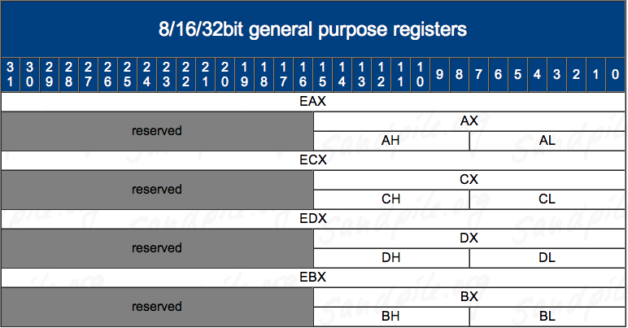
Architecture - Registers - 8/16/32 bit addressing 1
http://www.sandpile.org/ia32/reg.htm

Slide 27
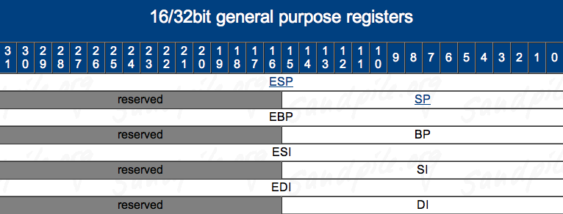
Architecture - Registers - 8/16/32 bit addressing 2
http://www.sandpile.org/ia32/reg.htm

Slide 28
Architecture - EFLAGS
EFLAGS register holds many single bit flags. Will only ask you to remember the following for now.
  Zero Flag (ZF) - Set if the result of some instruction is zero; cleared otherwise.
  Sign Flag (SF) - Set equal to the most-significant bit of the result, which is the sign bit of a signed integer. (0 indicates a positive value and 1 indicates a negative value.)
Intel Vol 1 Sec 3.4.3 - page 3-20

Slide 29
Your first x86 instruction:
NOP
1
NOP - No Operation! No registers, no values, no nothin'!
Just there to pad/align bytes, or to delay time
Bad guys use it to make simple exploits more reliable. But that's another class ;)

Slide 30
Extra! Extra!
Late-breaking NOP news!
Amaze those who know x86 by citing this interesting bit of trivia:
“The one-byte NOP instruction is an alias mnemonic for the XCHG (E)AX, (E)AX instruction.”
  I had never looked in the manual for NOP apparently :)
Every other person I had told this to had never heard it either.
Thanks to Jon Erickson for cluing me in to this.
XCHG instruction is not officially in this class. But if I hadn't just told you what it does, I bet you would have guessed right anyway.
XCHG in book p. 112

Slide 31
The Stack
The stack is a conceptual area of main memory (RAM) which is designated by the OS when a program is started.
  Different OS start it at different addresses by convention
A stack is a Last-In-First-Out (LIFO/FILO) data structure where data is "pushed" on to the top of the stack and "popped" off the top.
By convention the stack grows toward lower memory addresses. Adding something to the stack means the top of the stack is now at a lower memory address.

Slide 32
The Stack 2
As already mentioned, esp points to the top of the stack, the lowest address which is being used
  While data will exist at addresses beyond the top of the stack, it is considered undefined
The stack keeps track of which functions were called before the current one, it holds local variables and is frequently used to pass arguments to the next function to be called.
A firm understanding of what is happening on the stack is *essential* to understanding a program's operation.

Slide 33
PUSH - Push Word, Doubleword or Quadword onto the Stack
2
For our purposes, it will always be a DWORD (4 bytes).
  Can either be an immediate (a numeric constant), or the value in a register
The push instruction automatically decrements the stack pointer, esp, by 4.
Book p. 120
Notes:
Will always be a DWORD because we will be running the processor in 32bit mode, and the instruction for a 16 bit push is the same as the one for a 32bit push. The processor just interprets the size based on the mode it is currently running in.

Slide 34
push eax
Registers Before
Registers After
eax | 0x00000003
esp | 0x0012FF8C
eax | 0x00000003
esp | 0x0012FF88
Stack Before
Stack After
0x0012FF90
0x00000001
0x00000002
undef
undef
undef
0x00000001
0x00000002
0x00000003
undef
undef
esp
0x0012FF8C
0x0012FF88
esp
0x0012FF84
0x0012FF80

Slide 35
POP- Pop a Value from the Stack
3
Take a DWORD off the stack, put it in a register, and increment esp by 4
Book p. 120

Slide 36
pop eax
Registers Before
Registers After
eax | 0xFFFFFFFF
esp | 0x0012FF88
eax | 0x00000003
esp | 0x0012FF8C
Stack Before
Stack After
0x0012FF90
0x00000001
0x00000002
0x00000003
undef
undef
0x00000001
0x00000002
undef(0x00000003)
undef
undef
0x0012FF8C
esp
esp
0x0012FF88
0x0012FF84
0x0012FF80

Slide 37
Calling Conventions
How code calls a subroutine is compiler-dependent and configurable. But there are a few conventions.
We will only deal with the “cdecl” and “stdcall” conventions.
More info at
  http://en.wikipedia.org/wiki/X86_calling_conventions
  http://www.programmersheaven.com/2/Calling-conventions

Slide 38
Calling Conventions - cdecl
“C declaration” - most common calling convention
Function parameters pushed onto stack right to left
Saves the old stack frame pointer and sets up a new stack frame
eax or edx:eax returns the result for primitive data types
Caller is responsible for cleaning up the stack
Notes:
Colon notation means the full value is represented by the concatenation of the two values.
If edx = 0x11112222 and eax = 0x33334444, then edx:eax is the quadword 0x1111222233334444

Slide 39
Calling Conventions - stdcall
I typically only see this convention used by Microsoft C++ code - e.g. Win32 API
Function parameters pushed onto stack right to left
Saves the old stack frame pointer and sets up a new stack frame
eax or edx:eax returns the result for primitive data types
Callee responsible for cleaning up any stack parameters it takes
Aside: typical MS, “If I call my new way of doing stuff 'standard' it must be true!”
Notes:
Colon notation means the full value is represented by the concatenation of the two values.
If edx = 0x11112222 and eax = 0x33334444, then edx:eax is the quadword 0x1111222233334444

Slide 40
CALL - Call Procedure
4
CALL's job is to transfer control to a different function, in a way that control can later be resumed where it left off
First it pushes the address of the next instruction onto the stack
  For use by RET for when the procedure is done
Then it changes eip to the address given in the instruction
Destination address can be specified in multiple ways
  Absolute address
  Relative address (relative to the end of the instruction)
Book p. 132

Slide 41
RET - Return from Procedure
5
Two forms
  Pop the top of the stack into eip (remember pop increments stack pointer)
    In this form, the instruction is just written as “ret”
    Typically used by cdecl functions
  Pop the top of the stack into eip and add a constant number of bytes to esp
    In this form, the instruction is written as “ret 0x8”, or “ret 0x20”, etc
    Typically used by stdcall functions_x0013_
Kinda book p. 133

Slide 42
MOV - Move
6
Can move:
  register to register
  memory to register, register to memory
  immediate to register, immediate to memory
Never memory to memory!
Memory addresses are given in r/m32 form talked about later
Book p. 97

Slide 43
General Stack Frame Operation
We are going to pretend that main() is the very first function
being executed in a program. This is what its stack looks like
to start with (assuming it has any local variables).
stack bottom
Local Variables
main() frame
undef
undef
…
stack top
Book p. 306

Slide 44
General Stack Frame Operation 2
When main() decides to call a subroutine, main() becomes “the caller”. We will assume main() has some registers it would like to remain the same, so it will save them. We will also assume that the callee function takes some input arguments.
stack bottom
Local Variables
Caller-Save Registers
Arguments to Pass to Callee
main() frame
undef
undef
…
stack top

Slide 45
General Stack Frame Operation 3
When main() actually issues the CALL instruction, the return address gets saved onto the stack, and because the next instruction after the call will be the beginning of the called function, we consider the frame to have changed to the callee.
stack bottom
Local Variables
Caller-Save Registers
Arguments to Pass to Callee
Caller's saved return address
main() frame
undef
undef
…
stack top

Slide 46
General Stack Frame Operation 4
When foo() starts, the frame pointer (ebp) still points to main()'s frame. So the first thing it does is to save the old frame pointer on the stack and set the new value to point to its own frame.
stack bottom
Local Variables
Caller-Save Registers
Arguments to Pass to Callee
Caller's saved return address
Saved Frame Pointer
main() frame
foo()'s frame
undef
…
stack top

Slide 47
General Stack Frame Operation 5
Next, we'll assume the the callee foo() would like to use all the registers, and must therefore save the callee-save registers. Then it will allocate space for its local variables.
stack bottom
Local Variables
Caller-Save Registers
Arguments to Pass to Callee
Caller's saved return address
Saved Frame Pointer
Callee-Save Registers
Local Variables
main() frame
foo()'s frame
undef
…
stack top

Slide 48
General Stack Frame Operation 6
At this point, foo() decides it wants to call bar(). It is still the callee-of-main(), but it will now be the caller-of-bar. So it saves any caller-save registers that it needs to. It then puts the function arguments on the stack as well.
stack bottom
Saved Frame Pointer
Callee-Save Registers
Local Variables
Caller-Save Registers
Arguments to Pass to Callee
main() frame
foo()'s frame
undef
…
stack top

Slide 49
General Stack Frame Layout
Every part of the stack frame is technically optional (that is,
you can hand code asm without following the conventions.)
But compilers generate code which uses portions if they are needed. Which pieces are used can sometimes be manipulated with compiler options. (E.g. omit frame pointers, changing calling convention to pass arguments in registers, etc.)
stack bottom
Saved Frame Pointer
Callee-Save Registers
Local Variables
Caller-Save Registers
Arguments to Pass to Callee
main() frame
foo()'s frame
undef
…
stack top

Slide 50
Stack Frames are a Linked List!
The ebp in the current frame points at the saved ebp of the previous frame.
stack bottom
main() frame
foo()'s frame
bar()'s frame
…
stack top

Slide 51
Example1.c
The stack frames in this example will be very simple.
Only saved frame pointer (ebp) and saved return addresses (eip).
//Example1 - using the stack
//to call subroutines
//New instructions:
//push, pop, call, ret, mov
int sub(){
return 0xbeef;
}
int main(){
sub();
return 0xf00d;
}
sub:
00401000 push ebp
00401001 mov ebp,esp
00401003 mov eax,0BEEFh
00401008 pop ebp
00401009 ret
main:
00401010 push ebp
00401011 mov ebp,esp
00401013 call sub (401000h)
00401018 mov eax,0F00Dh
0040101D pop ebp
0040101E ret

Slide 52
Example1.c 1:
EIP = 00401010, but no instruction yet executed
Key:
 executed instruction,
 modified value
 start value
eax | 0x003435C0 
ebp | 0x0012FFB8 
esp | 0x0012FF6C 
0x0012FF6C
0x004012E8 
sub:
00401000 push ebp
00401001 mov ebp,esp
00401003 mov eax,0BEEFh
00401008 pop ebp
00401009 ret
main:
00401010 push ebp
00401011 mov ebp,esp
00401013 call sub (401000h)
00401018 mov eax,0F00Dh
0040101D pop ebp
0040101E ret
0x0012FF68
undef
undef
undef
undef
undef
0x0012FF64
Belongs to the frame *before* main() is called
0x0012FF60
0x0012FF5C
0x0012FF58

Slide 53
Example1.c 2
Key:
 executed instruction,
 modified value
 start value
eax | 0x003435C0 
ebp | 0x0012FFB8 
esp | 0x0012FF68 
0x0012FF6C
0x004012E8 
sub:
00401000 push ebp
00401001 mov ebp,esp
00401003 mov eax,0BEEFh
00401008 pop ebp
00401009 ret
main:
00401010 push ebp 
00401011 mov ebp,esp
00401013 call sub (401000h)
00401018 mov eax,0F00Dh
0040101D pop ebp
0040101E ret
0x0012FF68
0x0012FFB8 
undef
undef
undef
undef
0x0012FF64
0x0012FF60
0x0012FF5C
0x0012FF58

Slide 54
Example1.c 3
Key:
 executed instruction,
 modified value
 start value
eax | 0x003435C0 
ebp | 0x0012FF68 
esp | 0x0012FF68
0x0012FF6C
0x004012E8 
sub:
00401000 push ebp
00401001 mov ebp,esp
00401003 mov eax,0BEEFh
00401008 pop ebp
00401009 ret
main:
00401010 push ebp
00401011 mov ebp,esp 
00401013 call sub (401000h)
00401018 mov eax,0F00Dh
0040101D pop ebp
0040101E ret
0x0012FF68
0x0012FFB8
undef
undef
undef
undef
0x0012FF64
0x0012FF60
0x0012FF5C
0x0012FF58

Slide 55
Example1.c 4
Key:
 executed instruction,
 modified value
 start value
eax | 0x003435C0 
ebp | 0x0012FF68
esp | 0x0012FF64 
0x0012FF6C
0x004012E8 
sub:
00401000 push ebp
00401001 mov ebp,esp
00401003 mov eax,0BEEFh
00401008 pop ebp
00401009 ret
main:
00401010 push ebp
00401011 mov ebp,esp
00401013 call sub (401000h) 
00401018 mov eax,0F00Dh
0040101D pop ebp
0040101E ret
0x0012FF68
0x0012FFB8
0x00401018 
undef
undef
undef
0x0012FF64
0x0012FF60
0x0012FF5C
0x0012FF58

Slide 56
Example1.c 5
Key:
 executed instruction,
 modified value
 start value
eax | 0x003435C0 
ebp | 0x0012FF68
esp | 0x0012FF60 
0x0012FF6C
0x004012E8 
sub:
00401000 push ebp 
00401001 mov ebp,esp
00401003 mov eax,0BEEFh
00401008 pop ebp
00401009 ret
main:
00401010 push ebp
00401011 mov ebp,esp
00401013 call sub (401000h)
00401018 mov eax,0F00Dh
0040101D pop ebp
0040101E ret
0x0012FF68
0x0012FFB8
0x00401018
0x0012FF68 
undef
undef
0x0012FF64
0x0012FF60
0x0012FF5C
0x0012FF58

Slide 57
Example1.c 6
Key:
 executed instruction,
 modified value
 start value
eax | 0x003435C0 
ebp | 0x0012FF60 
esp | 0x0012FF60
0x0012FF6C
0x004012E8 
sub:
00401000 push ebp
00401001 mov ebp,esp 
00401003 mov eax,0BEEFh
00401008 pop ebp
00401009 ret
main:
00401010 push ebp
00401011 mov ebp,esp
00401013 call sub (401000h)
00401018 mov eax,0F00Dh
0040101D pop ebp
0040101E ret
0x0012FF68
0x0012FFB8
0x00401018
0x0012FF68
undef
undef
0x0012FF64
0x0012FF60
0x0012FF5C
0x0012FF58

Slide 58
Example1.c 6
STACK FRAME TIME OUT
“Function-before-
main”'s frame
sub
push ebp
mov ebp, esp
mov eax, 0BEEFh
pop ebp
retn
main
push ebp
mov ebp, esp
call _sub
mov eax, 0F00Dh
pop ebp
retn
0x004012E8 
0x0012FF6C
main's frame
(saved frame pointer
and saved return address)
0x0012FF68
0x0012FFB8
0x00401018
0x0012FF68
undef
undef
0x0012FF64
sub's frame
(only saved frame pointer,
because it doesn't call
anything else, and doesn't
have local variables)
0x0012FF60
0x0012FF5C
0x0012FF58

Slide 59
Example1.c 7
Key:
 executed instruction,
 modified value
 start value
eax | 0x0000BEEF
ebp | 0x0012FF60
esp | 0x0012FF60
0x0012FF6C
0x004012E8 
sub:
00401000 push ebp
00401001 mov ebp,esp
00401003 mov eax,0BEEFh 
00401008 pop ebp
00401009 ret
main:
00401010 push ebp
00401011 mov ebp,esp
00401013 call sub (401000h)
00401018 mov eax,0F00Dh
0040101D pop ebp
0040101E ret
0x0012FF68
0x0012FFB8
0x00401018
0x0012FF68
undef
undef
0x0012FF64
0x0012FF60
0x0012FF5C
0x0012FF58

Slide 60
Example1.c 8
Key:
 executed instruction,
 modified value
 start value
eax | 0x0000BEEF
ebp | 0x0012FF68 
esp | 0x0012FF64 
0x0012FF6C
0x004012E8 
sub:
00401000 push ebp
00401001 mov ebp,esp
00401003 mov eax,0BEEFh
00401008 pop ebp 
00401009 ret
main:
00401010 push ebp
00401011 mov ebp,esp
00401013 call sub (401000h)
00401018 mov eax,0F00Dh
0040101D pop ebp
0040101E ret
0x0012FF68
0x0012FFB8
0x00401018
undef 
undef
undef
0x0012FF64
0x0012FF60
0x0012FF5C
0x0012FF58

Slide 61
Example1.c 9
Key:
 executed instruction,
 modified value
 start value
eax | 0x0000BEEF
ebp | 0x0012FF68
esp | 0x0012FF68 
0x0012FF6C
0x004012E8 
sub:
00401000 push ebp
00401001 mov ebp,esp
00401003 mov eax,0BEEFh
00401008 pop ebp
00401009 ret 
main:
00401010 push ebp
00401011 mov ebp,esp
00401013 call sub (401000h)
00401018 mov eax,0F00Dh
0040101D pop ebp
0040101E ret
0x0012FF68
0x0012FFB8
undef 
undef
undef
undef
0x0012FF64
0x0012FF60
0x0012FF5C
0x0012FF58

Slide 62
Example1.c 9
Key:
 executed instruction,
 modified value
 start value
eax | 0x0000F00D 
ebp | 0x0012FF68
esp | 0x0012FF68
0x0012FF6C
0x004012E8 
sub:
00401000 push ebp
00401001 mov ebp,esp
00401003 mov eax,0BEEFh
00401008 pop ebp
00401009 ret
main:
00401010 push ebp
00401011 mov ebp,esp
00401013 call sub (401000h)
00401018 mov eax,0F00Dh 
0040101D pop ebp
0040101E ret
0x0012FF68
0x0012FFB8
undef
undef
undef
undef
0x0012FF64
0x0012FF60
0x0012FF5C
0x0012FF58

Slide 63
Example1.c 10
Key:
 executed instruction,
 modified value
 start value
eax | 0x0000F00D
ebp | 0x0012FFB8 
esp | 0x0012FF6C 
0x0012FF6C
0x004012E8 
sub:
00401000 push ebp
00401001 mov ebp,esp
00401003 mov eax,0BEEFh
00401008 pop ebp
00401009 ret
main:
00401010 push ebp
00401011 mov ebp,esp
00401013 call sub (401000h)
00401018 mov eax,0F00Dh
0040101D pop ebp 
0040101E ret
0x0012FF68
undef 
undef
undef
undef
undef
0x0012FF64
0x0012FF60
0x0012FF5C
0x0012FF58

Slide 64
Example1.c 11
Key:
 executed instruction,
 modified value
 start value
eax | 0x0000F00D
ebp | 0x0012FFB8
esp | 0x0012FF70 
0x0012FF6C
undef 
sub:
00401000 push ebp
00401001 mov ebp,esp
00401003 mov eax,0BEEFh
00401008 pop ebp
00401009 ret
main:
00401010 push ebp
00401011 mov ebp,esp
00401013 call sub (401000h)
00401018 mov eax,0F00Dh
0040101D pop ebp
0040101E ret 
0x0012FF68
undef
undef
undef
undef
undef
0x0012FF64
0x0012FF60
0x0012FF5C
0x0012FF58
Execution would continue at the value ret
removed from the stack: 0x004012E8

Slide 65
Example1 Notes
sub() is deadcode - its return value is not used for anything, and main always returns 0xF00D. If optimizations are turned on in the compiler, it would remove sub()
Because there are no input parameters to sub(), there is no difference whether we compile as cdecl vs stdcall calling conventions

Slide 66
Let's do that in a tool
Visual C++ 2008 Express Edition (which I will shorthand as “VisualStudio” or VS)
Standard Windows development environment
Available for free, but missing some features that pro developers might want
Can't move applications to other systems without installing the “redistributable libraries”

Slide 67
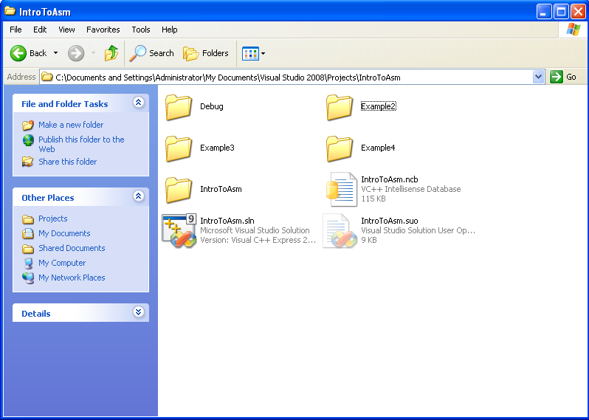
Finding the VisualStudio solution file

Slide 68
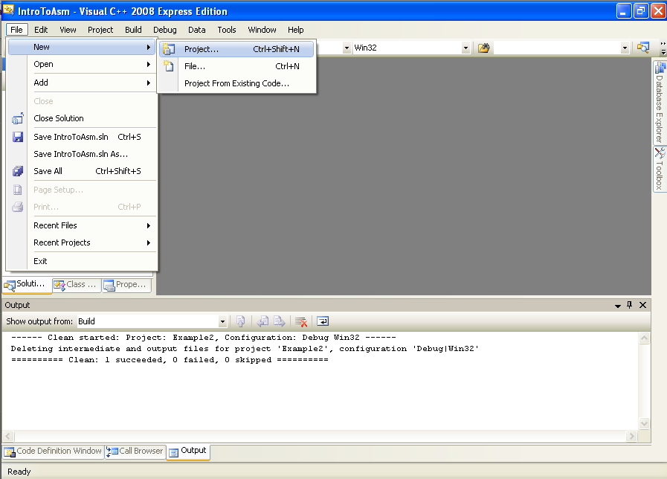
Creating a new project 1
Creating a new project - 1

Slide 69
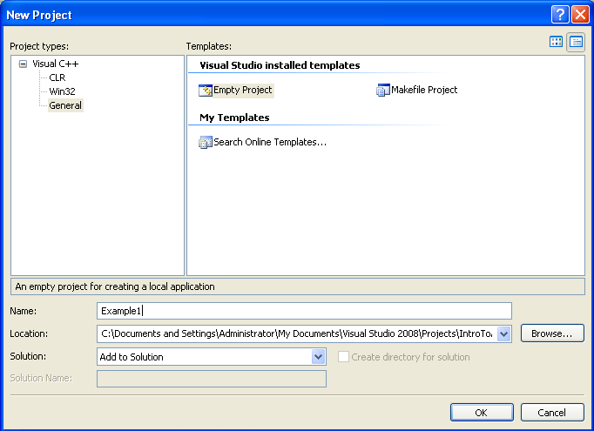
Creating a new project 2
Creating a new project - 2

Slide 70
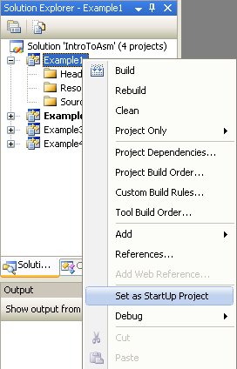
Creating a new project 3
Creating a new project - 3

Slide 71
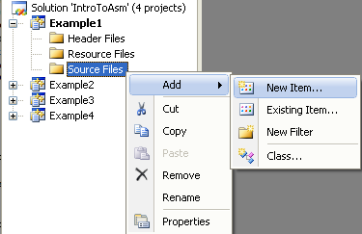
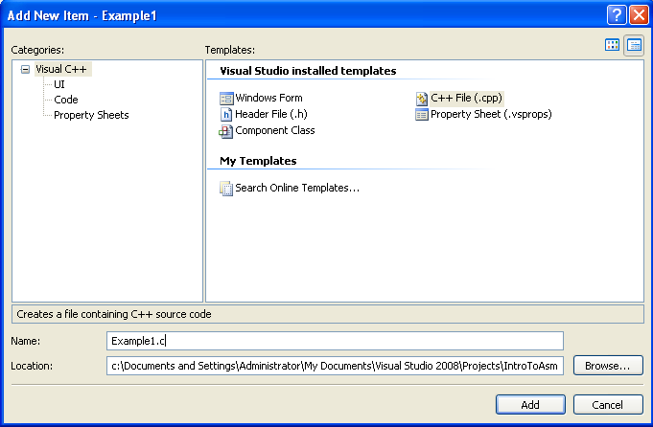
Adding files to the project

Slide 72
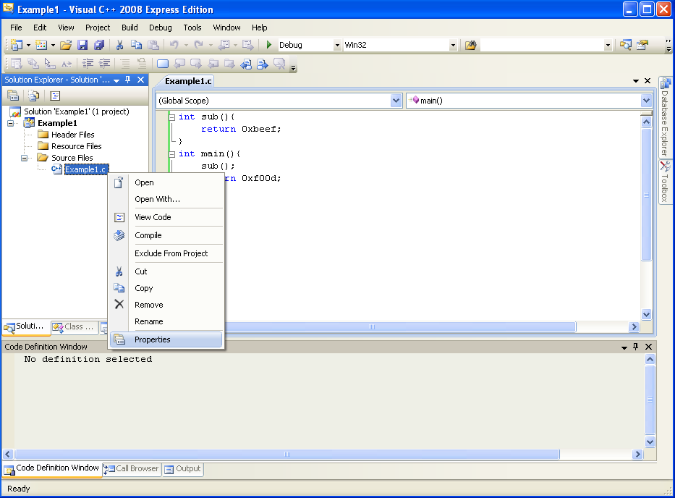
Setting project properties
Setting project properties - 1

Slide 73
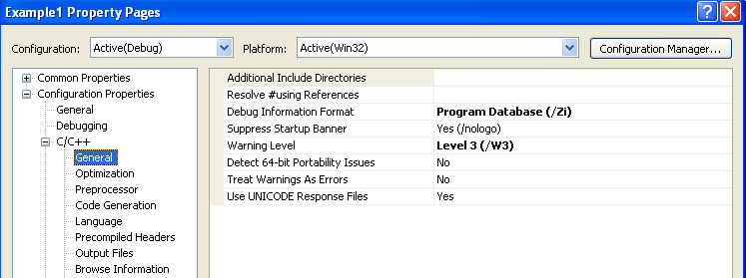
Setting project properties 2
Setting project properties - 2
Unfortunately the debug information format alters the code which gets generated too much, making it not as simple as I would like for this class.

Slide 74
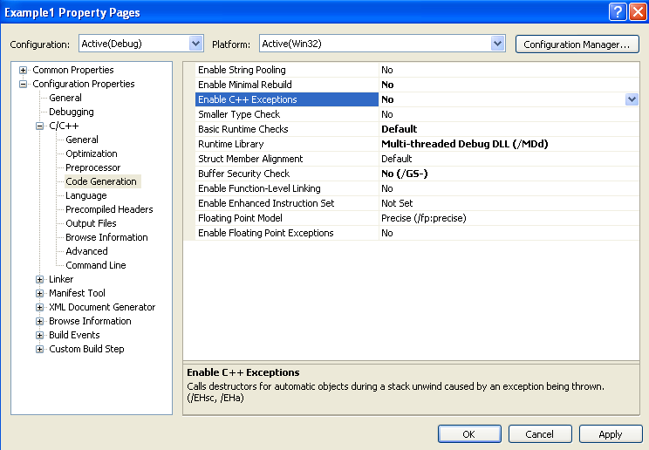
Setting project properties 3
Setting project properties - 3
This would just add extra complexity to the asm which we don't want for now

Slide 75
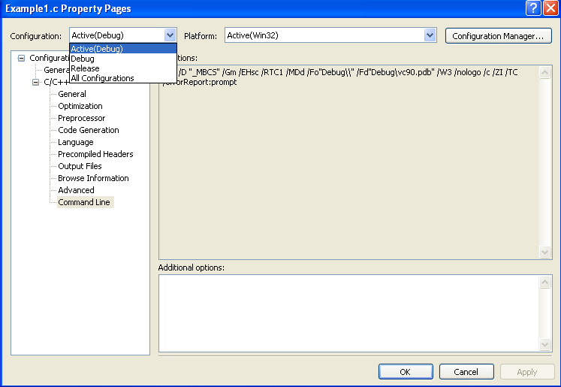
Setting project properties 4
Setting project properties - 4
Click this to change which config set is active
It's all just a wrapper to set command line options
Different options can be set for release vs debug builds

Slide 76
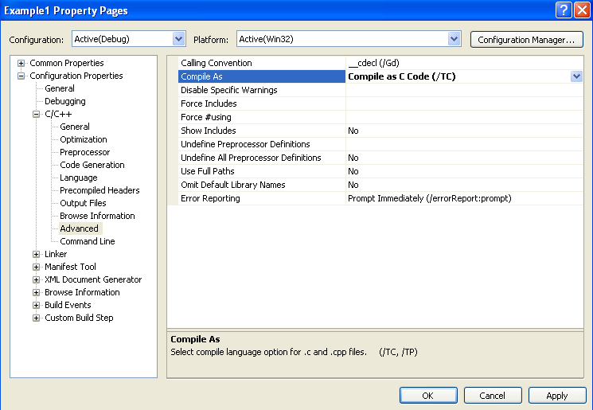
Setting project properties 5
Setting project properties - 5
C++ has more complicated compiler-generated code, and while our stuff is simple enough that the compiler probably wouldn't do anything different, it's good to do this just to be safe

Slide 77
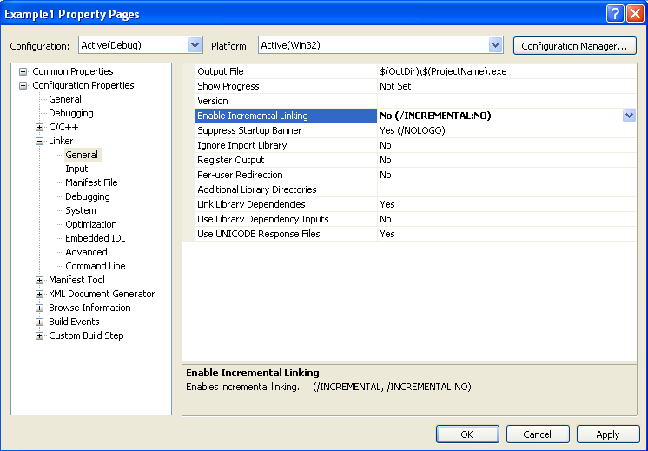
Setting project properties 6
Setting project properties - 6
Another thing where I found out the hard way that it will increase the asm complexity

Slide 78
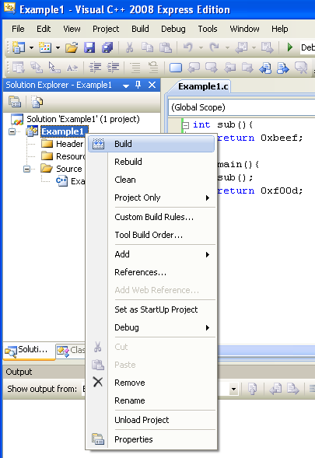
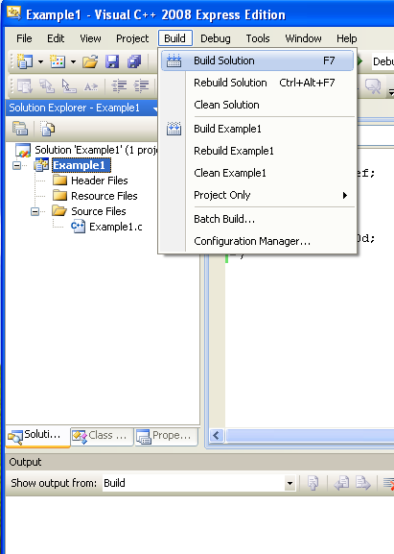
Building project
Building the project - 1

Slide 79
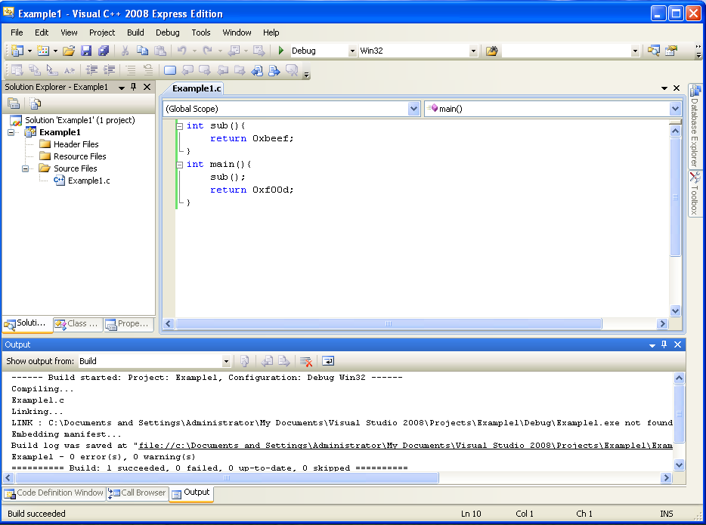
Building project 2
Building the project - 2
Information about whether the build succeeded will be here. If it fails, a separate error tab will open up

Slide 80
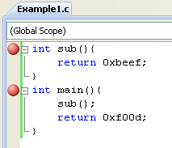
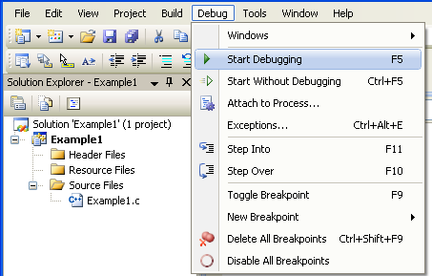
Setting breakpoints & start debugger
Click to the left of the line to break at.

Slide 81
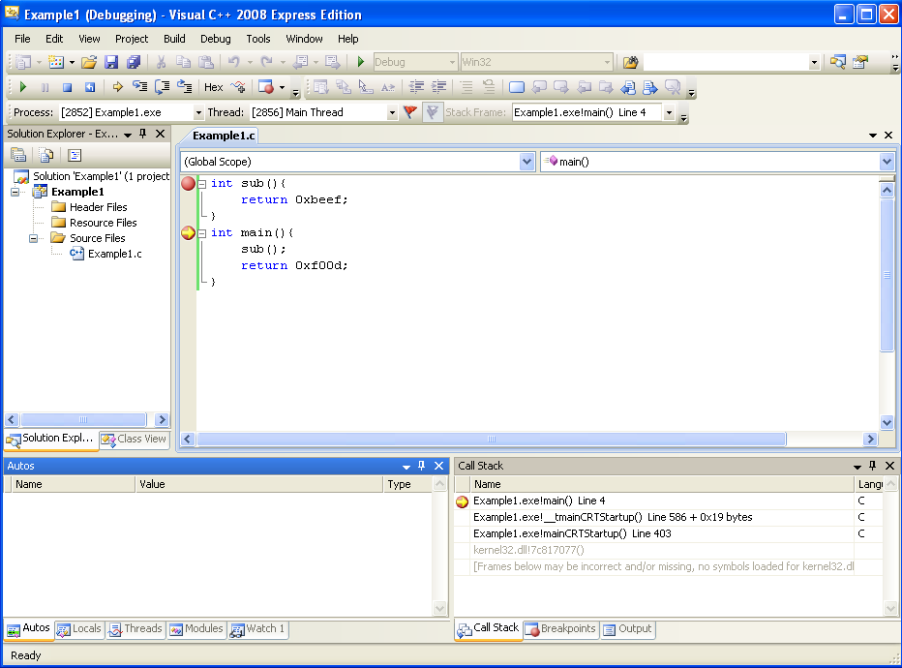
Debugging the program 2
Step into
Step over
Step out
Continue
Stop debugging
Restart debugging
Current stopped location

Slide 82
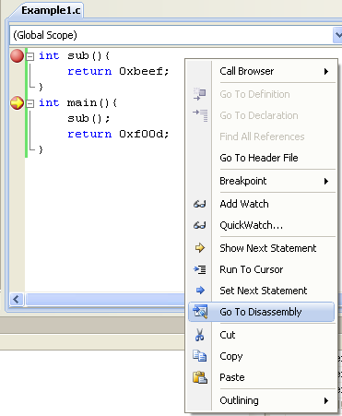
Showing assembly
Right click: Only available while debugging

Slide 83
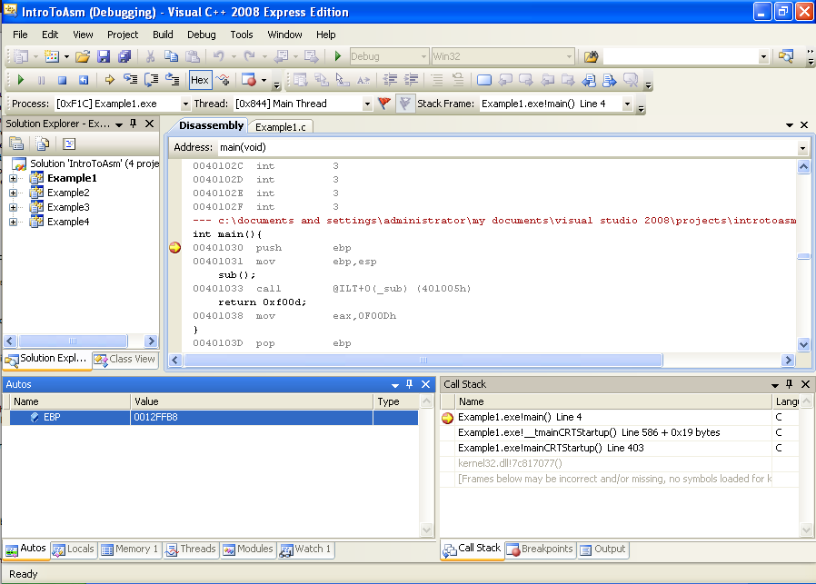
Watching registers
Note that it knows the ebp register is going to be used in this instruction

Slide 84
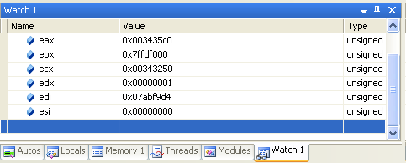
Showing registers
Here you can enter register names or variable names

Slide 85
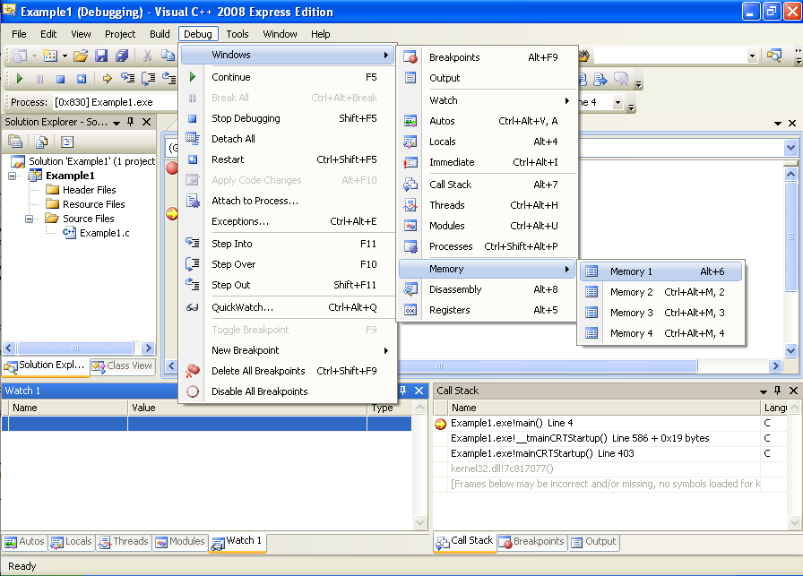
Watching the stack change 1
Watching the stack change - 1

Slide 86
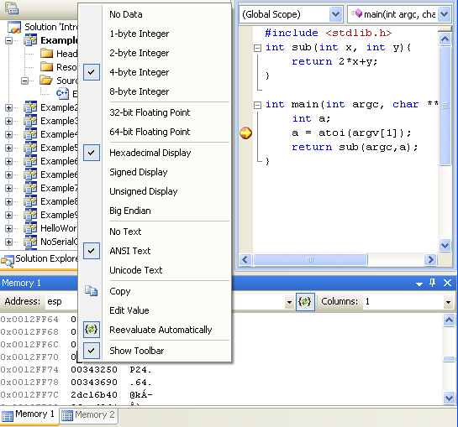
Watching the stack change 2
Watching the stack change - 2
Right click on the body of the data in the window and make sure everything's set like this
Set address to esp (will always be the top of the stack)
Set to 1
Click “Reevaluate Automatically” so that it will change the display as esp changes

Slide 87
Going through Example1.c in Visual Studio
sub:
push ebp
mov ebp,esp
mov eax,0BEEFh
pop ebp
ret
main:
push ebp
mov ebp,esp
call sub
mov eax,0F00Dh
pop ebp
ret

Slide 88
Example2.c with Input parameters and Local Variables
.text:00000000 _sub: push ebp
.text:00000001 mov ebp, esp
.text:00000003 mov eax, [ebp+8]
.text:00000006 mov ecx, [ebp+0Ch]
.text:00000009 lea eax, [ecx+eax*2]
.text:0000000C pop ebp
.text:0000000D retn
.text:00000010 _main: push ebp
.text:00000011 mov ebp, esp
.text:00000013 push ecx
.text:00000014 mov eax, [ebp+0Ch]
.text:00000017 mov ecx, [eax+4]
.text:0000001A push ecx
.text:0000001B call dword ptr ds:__imp__atoi
.text:00000021 add esp, 4
.text:00000024 mov [ebp-4], eax
.text:00000027 mov edx, [ebp-4]
.text:0000002A push edx
.text:0000002B mov eax, [ebp+8]
.text:0000002E push eax
.text:0000002F call _sub
.text:00000034 add esp, 8
.text:00000037 mov esp, ebp
.text:00000039 pop ebp
.text:0000003A retn
#include <stdlib.h>
int sub(int x, int y){
return 2*x+y;
}
int main(int argc, char ** argv){
int a;
a = atoi(argv[1]);
return sub(argc,a);
}

Slide 89
"r/m32" Addressing Forms
Anywhere you see an r/m32 it means it could be taking a value either from a register, or a memory address.
I'm just calling these “r/m32 forms” because anywhere you see “r/m32” in the manual, the instruction can be a variation of the below forms.
In Intel syntax, most of the time square brackets [] means to treat the value within as a memory address, and fetch the value at that address (like dereferencing a pointer)
  mov eax, ebx
  mov eax, [ebx]
  mov eax, [ebx+ecx*X] (X=1, 2, 4, 8)
  mov eax, [ebx+ecx*X+Y] (Y= one byte, 0-255 or 4 bytes, 0-2^32-1)
Most complicated form is: [base + index*scale + disp]
More info: Intel v2a, Section 2.1.5 page 2-4
in particular Tables 2-2 and 2-3

Slide 90
LEA - Load Effective Address
7
Frequently used with pointer arithmetic, sometimes for just arithmetic in general
Uses the r/m32 form but is the exception to the rule that the square brackets [ ] syntax means dereference (“value at”)
Example: ebx = 0x2, edx = 0x1000
  lea eax, [edx+ebx*2]
  eax = 0x1004, not the value at 0x1004
Not covered in book

Slide 91
ADD and SUB
8
9
Adds or Subtracts, just as expected
Destination operand can be r/m32 or register
Source operand can be r/m32 or register or immediate
No source and destination as r/m32s, because that could allow for memory to memory transfer, which isn't allowed on x86
Evaluates the operation as if it were on signed AND unsigned data, and sets flags as appropriate. Instructions modify OF, SF, ZF, AF, PF, and CF flags
add esp, 8
sub eax, [ebx*2]
Add p. 202, Sub p. 210

Slide 92
Example2.c - 1
eax | 0xcafe 
ecx | 0xbabe 
edx | 0xfeed 
ebp | 0x0012FF50 
esp | 0x0012FF24 
.text:00000000 _sub: push ebp
.text:00000001 mov ebp, esp
.text:00000003 mov eax, [ebp+8]
.text:00000006 mov ecx, [ebp+0Ch]
.text:00000009 lea eax, [ecx+eax*2]
.text:0000000C pop ebp
.text:0000000D retn
.text:00000010 _main: push ebp 
.text:00000011 mov ebp, esp
.text:00000013 push ecx
.text:00000014 mov eax, [ebp+0Ch]
.text:00000017 mov ecx, [eax+4]
.text:0000001A push ecx
.text:0000001B call dword ptr ds:__imp__atoi
.text:00000021 add esp, 4
.text:00000024 mov [ebp-4], eax
.text:00000027 mov edx, [ebp-4]
.text:0000002A push edx
.text:0000002B mov eax, [ebp+8]
.text:0000002E push eax
.text:0000002F call _sub
.text:00000034 add esp, 8
.text:00000037 mov esp, ebp
.text:00000039 pop ebp
.text:0000003A retn
0x0012FF30
0x12FFB0 (char ** argv)
0x2 (int argc) 
Addr after “call _main” 
0x0012FF50(saved ebp)
undef
undef
undef
undef
undef
undef
0x0012FF2C
0x0012FF28
0x0012FF24
0x0012FF20
0x0012FF1C
0x0012FF18
0x0012FF14
0x0012FF10
0x0012FF0C
Key: executed instruction , modified value , arbitrary example start value 
Notes:
Talk about how this is like speaking a new language, and right now we're at the stage where we're literally just sounding out characters. As you get more experienced, eventually your eyes are able to pull out strings of words without needing to thing about the characters. But for now, we do this example and sound it all out together.

Slide 93
Example2.c - 2
eax | 0xcafe
ecx | 0xbabe
edx | 0xfeed
ebp | 0x0012FF24 
esp | 0x0012FF24
.text:00000000 _sub: push ebp
.text:00000001 mov ebp, esp
.text:00000003 mov eax, [ebp+8]
.text:00000006 mov ecx, [ebp+0Ch]
.text:0000000C pop ebp
.text:0000000D retn
.text:00000010 _main: push ebp
.text:00000011 mov ebp, esp 
.text:00000013 push ecx
.text:00000014 mov eax, [ebp+0Ch]
.text:00000017 mov ecx, [eax+4]
.text:0000001A push ecx
.text:0000001B call dword ptr ds:__imp__atoi
.text:00000021 add esp, 4
.text:00000024 mov [ebp-4], eax
.text:00000027 mov edx, [ebp-4]
.text:0000002A push edx
.text:0000002B mov eax, [ebp+8]
.text:0000002E push eax
.text:0000002F call _sub
.text:00000034 add esp, 8
.text:00000037 mov esp, ebp
.text:00000039 pop ebp
.text:0000003A retn
.text:00000009 lea eax, [ecx+eax*2]
0x0012FF30
0x12FFB0 (char ** argv)
0x2 (int argc)
Addr after “call _main”
0x0012FF50 (saved ebp)
undef
undef
undef
undef
undef
undef
0x0012FF2C
0x0012FF28
0x0012FF24
0x0012FF20
0x0012FF1C
0x0012FF18
0x0012FF14
0x0012FF10
0x0012FF0C

Slide 94
Example2.c - 3
eax | 0xcafe
ecx | 0xbabe
edx | 0xfeed
ebp | 0x0012FF24
esp | 0x0012FF20 
.text:00000000 _sub: push ebp
.text:00000001 mov ebp, esp
.text:00000003 mov eax, [ebp+8]
.text:00000006 mov ecx, [ebp+0Ch]
.text:00000009 lea eax, [ecx+eax*2]
.text:0000000C pop ebp
.text:0000000D retn
.text:00000010 _main: push ebp
.text:00000011 mov ebp, esp
.text:00000013 push ecx 
.text:00000014 mov eax, [ebp+0Ch]
.text:00000017 mov ecx, [eax+4]
.text:0000001A push ecx
.text:0000001B call dword ptr ds:__imp__atoi
.text:00000021 add esp, 4
.text:00000024 mov [ebp-4], eax
.text:00000027 mov edx, [ebp-4]
.text:0000002A push edx
.text:0000002B mov eax, [ebp+8]
.text:0000002E push eax
.text:0000002F call _sub
.text:00000034 add esp, 8
.text:00000037 mov esp, ebp
.text:00000039 pop ebp
.text:0000003A retn
0x0012FF30
0x12FFB0 (char ** argv)
0x2 (int argc)
Addr after “call _main”
0x0012FF50 (saved ebp)
0xbabe (int a) 
undef
undef
undef
undef
undef
0x0012FF2C
0x0012FF28
Caller-save, or space for local var? This time it turns out to be space for local var since there is no corresponding pop, and the address is used later to refer to the value we know is stored in a.
0x0012FF24
0x0012FF20
0x0012FF1C
0x0012FF18
0x0012FF14
0x0012FF10
0x0012FF0C

Slide 95
Example2.c - 4
eax | 0x12FFB0 
ecx | 0xbabe
edx | 0xfeed
ebp | 0x0012FF24
esp | 0x0012FF20
.text:00000000 _sub: push ebp
.text:00000001 mov ebp, esp
.text:00000003 mov eax, [ebp+8]
.text:00000006 mov ecx, [ebp+0Ch]
.text:00000009 lea eax, [ecx+eax*2]
.text:0000000C pop ebp
.text:0000000D retn
.text:00000010 _main: push ebp
.text:00000011 mov ebp, esp
.text:00000013 push ecx
.text:00000014 mov eax, [ebp+0Ch] 
.text:00000017 mov ecx, [eax+4]
.text:0000001A push ecx
.text:0000001B call dword ptr ds:__imp__atoi
.text:00000021 add esp, 4
.text:00000024 mov [ebp-4], eax
.text:00000027 mov edx, [ebp-4]
.text:0000002A push edx
.text:0000002B mov eax, [ebp+8]
.text:0000002E push eax
.text:0000002F call _sub
.text:00000034 add esp, 8
.text:00000037 mov esp, ebp
.text:00000039 pop ebp
.text:0000003A retn
0x0012FF30
0x12FFB0 (char ** argv)
0x2 (int argc)
Addr after “call _main”
0x0012FF50 (saved ebp)
0xbabe (int a)
undef
undef
undef
undef
undef
0x0012FF2C
0x0012FF28
0x0012FF24
Getting the base of the argv char * array (aka argv[0])
0x0012FF20
0x0012FF1C
0x0012FF18
0x0012FF14
0x0012FF10
0x0012FF0C

Slide 96
Example2 - 5
eax | 0x12FFB0
ecx | 0x12FFD4(arbitrary)
edx | 0xfeed
ebp | 0x0012FF24
esp | 0x0012FF20
.text:00000000 _sub: push ebp
.text:00000001 mov ebp, esp
.text:00000003 mov eax, [ebp+8]
.text:00000006 mov ecx, [ebp+0Ch]
.text:00000009 lea eax, [ecx+eax*2]
.text:0000000C pop ebp
.text:0000000D retn
.text:00000010 _main: push ebp
.text:00000011 mov ebp, esp
.text:00000013 push ecx
.text:00000014 mov eax, [ebp+0Ch]
.text:00000017 mov ecx, [eax+4] 
.text:0000001A push ecx
.text:0000001B call dword ptr ds:__imp__atoi
.text:00000021 add esp, 4
.text:00000024 mov [ebp-4], eax
.text:00000027 mov edx, [ebp-4]
.text:0000002A push edx
.text:0000002B mov eax, [ebp+8]
.text:0000002E push eax
.text:0000002F call _sub
.text:00000034 add esp, 8
.text:00000037 mov esp, ebp
.text:00000039 pop ebp
.text:0000003A retn
0x0012FF30
0x12FFB0 (char ** argv)
0x2 (int argc)
Addr after “call _main”
0x0012FF50 (saved ebp)
0xbabe (int a)
undef
undef
undef
undef
undef
0x0012FF2C
0x0012FF28
0x0012FF24
Getting the char * at argv[1]
(I chose 0x12FFD4 arbitrarily since it's out of the stack scope we're currently looking at)
0x0012FF20
0x0012FF1C
0x0012FF18
0x0012FF14
0x0012FF10
0x0012FF0C

Slide 97
Example2 - 6
eax | 0x100 (arbitrary)
ecx | 0x12FFD4
edx | 0xfeed
ebp | 0x0012FF24
esp | 0x0012FF20
.text:00000000 _sub: push ebp
.text:00000001 mov ebp, esp
.text:00000003 mov eax, [ebp+8]
.text:00000006 mov ecx, [ebp+0Ch]
.text:00000009 lea eax, [ecx+eax*2]
.text:0000000C pop ebp
.text:0000000D retn
.text:00000010 _main: push ebp
.text:00000011 mov ebp, esp
.text:00000013 push ecx
.text:00000014 mov eax, [ebp+0Ch]
.text:00000017 mov ecx, [eax+4]
.text:0000001A push ecx 
.text:0000001B call dword ptr ds:__imp__atoi 
.text:00000021 add esp, 4 
.text:00000024 mov [ebp-4], eax
.text:00000027 mov edx, [ebp-4]
.text:0000002A push edx
.text:0000002B mov eax, [ebp+8]
.text:0000002E push eax
.text:0000002F call _sub
.text:00000034 add esp, 8
.text:00000037 mov esp, ebp
.text:00000039 pop ebp
.text:0000003A retn
Saving some slides…
This will push the address of the string at argv[1] (0x12FFD4). atoi() will read the string and turn in into an int, put that int in eax, and return. Then the adding 4 to esp will negate the having pushed the input parameter and make 0x12FF1C undefined again (this is indicative of cdecl)
0x0012FF30
0x12FFB0 (char ** argv)
0x2 (int argc)
Addr after “call _main”
0x0012FF50 (saved ebp)
0xbabe (int a)
undef 
undef 
undef
undef
undef
0x0012FF2C
0x0012FF28
0x0012FF24
0x0012FF20
0x0012FF1C
0x0012FF18
0x0012FF14
0x0012FF10
0x0012FF0C

Slide 98
Example2 - 7
eax | 0x100
ecx | 0x12FFD4
edx | 0x100 
ebp | 0x0012FF24
esp | 0x0012FF1C 
.text:00000000 _sub: push ebp
.text:00000001 mov ebp, esp
.text:00000003 mov eax, [ebp+8]
.text:00000006 mov ecx, [ebp+0Ch]
.text:00000009 lea eax, [ecx+eax*2]
.text:0000000C pop ebp
.text:0000000D retn
.text:00000010 _main: push ebp
.text:00000011 mov ebp, esp
.text:00000013 push ecx
.text:00000014 mov eax, [ebp+0Ch]
.text:00000017 mov ecx, [eax+4]
.text:0000001A push ecx
.text:0000001B call dword ptr ds:__imp__atoi
.text:00000021 add esp, 4
.text:00000024 mov [ebp-4], eax 
.text:00000027 mov edx, [ebp-4] 
.text:0000002A push edx 
.text:0000002B mov eax, [ebp+8]
.text:0000002E push eax
.text:0000002F call _sub
.text:00000034 add esp, 8
.text:00000037 mov esp, ebp
.text:00000039 pop ebp
.text:0000003A retn
0x0012FF30
0x12FFB0 (char ** argv)
0x2 (int argc)
Addr after “call _main”
0x0012FF50 (saved ebp)
0x100 (int a) 
0x100 (int y) 
undef
undef
undef
undef
0x0012FF2C
0x0012FF28
First setting “a” equal to the return value. Then pushing “a” as the second parameter in sub(). We can see an obvious optimization would have been to replace the last two instructions with “push eax”.
0x0012FF24
0x0012FF20
0x0012FF1C
0x0012FF18
0x0012FF14
0x0012FF10
0x0012FF0C

Slide 99
Example2 - 8
eax | 0x2 
ecx | 0x12FFD4
edx | 0x100
ebp | 0x0012FF24
esp | 0x0012FF18 
.text:00000000 _sub: push ebp
.text:00000001 mov ebp, esp
.text:00000003 mov eax, [ebp+8]
.text:00000006 mov ecx, [ebp+0Ch]
.text:00000009 lea eax, [ecx+eax*2]
.text:0000000C pop ebp
.text:0000000D retn
.text:00000010 _main: push ebp
.text:00000011 mov ebp, esp
.text:00000013 push ecx
.text:00000014 mov eax, [ebp+0Ch]
.text:00000017 mov ecx, [eax+4]
.text:0000001A push ecx
.text:0000001B call dword ptr ds:__imp__atoi
.text:00000021 add esp, 4
.text:00000024 mov [ebp-4], eax
.text:00000027 mov edx, [ebp-4]
.text:0000002A push edx
.text:0000002B mov eax, [ebp+8] 
.text:0000002E push eax 
.text:0000002F call _sub
.text:00000034 add esp, 8
.text:00000037 mov esp, ebp
.text:00000039 pop ebp
.text:0000003A retn
0x0012FF30
0x12FFB0 (char ** argv)
0x2 (int argc)
Addr after “call _main”
0x0012FF50 (saved ebp)
0x100 (int a)
0x100 (int y)
0x2 (int x) 
undef
undef
undef
0x0012FF2C
0x0012FF28
0x0012FF24
0x0012FF20
0x0012FF1C
0x0012FF18
Pushing argc as the first parameter (int x) to sub()
0x0012FF14
0x0012FF10
0x0012FF0C

Slide 100
Example2 - 9
eax | 0x2
ecx | 0x12FFD4
edx | 0x100
ebp | 0x0012FF24
esp | 0x0012FF14 
.text:00000000 _sub: push ebp
.text:00000001 mov ebp, esp
.text:00000003 mov eax, [ebp+8]
.text:00000006 mov ecx, [ebp+0Ch]
.text:00000009 lea eax, [ecx+eax*2]
.text:0000000C pop ebp
.text:0000000D retn
.text:00000010 _main: push ebp
.text:00000011 mov ebp, esp
.text:00000013 push ecx
.text:00000014 mov eax, [ebp+0Ch]
.text:00000017 mov ecx, [eax+4]
.text:0000001A push ecx
.text:0000001B call dword ptr ds:__imp__atoi
.text:00000021 add esp, 4
.text:00000024 mov [ebp-4], eax
.text:00000027 mov edx, [ebp-4]
.text:0000002A push edx
.text:0000002B mov eax, [ebp+8]
.text:0000002E push eax
.text:0000002F call _sub 
.text:00000034 add esp, 8
.text:00000037 mov esp, ebp
.text:00000039 pop ebp
.text:0000003A retn
0x0012FF30
0x12FFB0 (char ** argv)
0x2 (int argc)
Addr after “call _main”
0x0012FF50 (saved ebp)
0x100 (int a)
0x100 (int y)
0x2 (int x)
0x00000034 
undef
undef
0x0012FF2C
0x0012FF28
0x0012FF24
0x0012FF20
0x0012FF1C
0x0012FF18
0x0012FF14
0x0012FF10
0x0012FF0C

Slide 101
Example2 - 10
eax | 0x2
ecx | 0x12FFD4
edx | 0x100
ebp | 0x0012FF10 
esp | 0x0012FF10 
.text:00000000 _sub: push ebp 
.text:00000001 mov ebp, esp 
.text:00000003 mov eax, [ebp+8]
.text:00000006 mov ecx, [ebp+0Ch]
.text:00000009 lea eax, [ecx+eax*2]
.text:0000000C pop ebp
.text:0000000D retn
.text:00000010 _main: push ebp
.text:00000011 mov ebp, esp
.text:00000013 push ecx
.text:00000014 mov eax, [ebp+0Ch]
.text:00000017 mov ecx, [eax+4]
.text:0000001A push ecx
.text:0000001B call dword ptr ds:__imp__atoi
.text:00000021 add esp, 4
.text:00000024 mov [ebp-4], eax
.text:00000027 mov edx, [ebp-4]
.text:0000002A push edx
.text:0000002B mov eax, [ebp+8]
.text:0000002E push eax
.text:0000002F call _sub
.text:00000034 add esp, 8
.text:00000037 mov esp, ebp
.text:00000039 pop ebp
.text:0000003A retn
0x0012FF30
0x12FFB0 (char ** argv)
0x2 (int argc)
Addr after “call _main”
0x0012FF50 (saved ebp)
0x100 (int a)
0x100 (int y)
0x2 (int x)
0x00000034
0x0012FF24(saved ebp)
undef
0x0012FF2C
0x0012FF28
0x0012FF24
0x0012FF20
0x0012FF1C
0x0012FF18
0x0012FF14
0x0012FF10
0x0012FF0C

Slide 102
Example2 - 11
eax | 0x2  (no value change)
ecx | 0x100 
edx | 0x100
ebp | 0x0012FF10
esp | 0x0012FF10
.text:00000000 _sub: push ebp
.text:00000001 mov ebp, esp
.text:00000003 mov eax, [ebp+8] 
.text:00000006 mov ecx, [ebp+0Ch] 
.text:00000009 lea eax, [ecx+eax*2]
.text:0000000C pop ebp
.text:0000000D retn
.text:00000010 _main: push ebp
.text:00000011 mov ebp, esp
.text:00000013 push ecx
.text:00000014 mov eax, [ebp+0Ch]
.text:00000017 mov ecx, [eax+4]
.text:0000001A push ecx
.text:0000001B call dword ptr ds:__imp__atoi
.text:00000021 add esp, 4
.text:00000024 mov [ebp-4], eax
.text:00000027 mov edx, [ebp-4]
.text:0000002A push edx
.text:0000002B mov eax, [ebp+8]
.text:0000002E push eax
.text:0000002F call _sub
.text:00000034 add esp, 8
.text:00000037 mov esp, ebp
.text:00000039 pop ebp
.text:0000003A retn
Move “x” into eax, and “y” into ecx.
0x0012FF30
0x12FFB0 (char ** argv)
0x2 (int argc)
Addr after “call _main”
0x0012FF50 (saved ebp)
0x100 (int a)
0x100 (int y)
0x2 (int x)
0x00000034
0x0012FF24 (saved ebp)
undef
0x0012FF2C
0x0012FF28
0x0012FF24
0x0012FF20
0x0012FF1C
0x0012FF18
0x0012FF14
0x0012FF10
0x0012FF0C

Slide 103
Example2 - 12
eax | 0x104 
ecx | 0x100
edx | 0x100
ebp | 0x0012FF10
esp | 0x0012FF10
.text:00000000 _sub: push ebp
.text:00000001 mov ebp, esp
.text:00000003 mov eax, [ebp+8]
.text:00000006 mov ecx, [ebp+0Ch]
.text:00000009 lea eax, [ecx+eax*2] 
.text:0000000C pop ebp
.text:0000000D retn
.text:00000010 _main: push ebp
.text:00000011 mov ebp, esp
.text:00000013 push ecx
.text:00000014 mov eax, [ebp+0Ch]
.text:00000017 mov ecx, [eax+4]
.text:0000001A push ecx
.text:0000001B call dword ptr ds:__imp__atoi
.text:00000021 add esp, 4
.text:00000024 mov [ebp-4], eax
.text:00000027 mov edx, [ebp-4]
.text:0000002A push edx
.text:0000002B mov eax, [ebp+8]
.text:0000002E push eax
.text:0000002F call _sub
.text:00000034 add esp, 8
.text:00000037 mov esp, ebp
.text:00000039 pop ebp
.text:0000003A retn
Set the return value (eax) to 2*x + y.
Note: neither pointer arith, nor an “address” which was loaded. Just an afficient way to do a calculation.
0x0012FF30
0x12FFB0 (char ** argv)
0x2 (int argc)
Addr after “call _main”
0x0012FF50 (saved ebp)
0x100 (int a)
0x100 (int y)
0x2 (int x)
0x00000034
0x0012FF24 (saved ebp)
undef
0x0012FF2C
0x0012FF28
0x0012FF24
0x0012FF20
0x0012FF1C
0x0012FF18
0x0012FF14
0x0012FF10
0x0012FF0C

Slide 104
Example2 - 13
eax | 0x104
ecx | 0x100
edx | 0x100
ebp | 0x0012FF24 
esp | 0x0012FF14 
.text:00000000 _sub: push ebp
.text:00000001 mov ebp, esp
.text:00000003 mov eax, [ebp+8]
.text:00000006 mov ecx, [ebp+0Ch]
.text:00000009 lea eax, [ecx+eax*2]
.text:0000000C pop ebp 
.text:0000000D retn
.text:00000010 _main: push ebp
.text:00000011 mov ebp, esp
.text:00000013 push ecx
.text:00000014 mov eax, [ebp+0Ch]
.text:00000017 mov ecx, [eax+4]
.text:0000001A push ecx
.text:0000001B call dword ptr ds:__imp__atoi
.text:00000021 add esp, 4
.text:00000024 mov [ebp-4], eax
.text:00000027 mov edx, [ebp-4]
.text:0000002A push edx
.text:0000002B mov eax, [ebp+8]
.text:0000002E push eax
.text:0000002F call _sub
.text:00000034 add esp, 8
.text:00000037 mov esp, ebp
.text:00000039 pop ebp
.text:0000003A retn
0x0012FF30
0x12FFB0 (char ** argv)
0x2 (int argc)
Addr after “call _main”
0x0012FF50 (saved ebp)
0x100 (int a)
0x100 (int y)
0x2 (int x)
0x00000034
undef 
undef
0x0012FF2C
0x0012FF28
0x0012FF24
0x0012FF20
0x0012FF1C
0x0012FF18
0x0012FF14
0x0012FF10
0x0012FF0C

Slide 105
Example2 - 14
eax | 0x104
ecx | 0x100
edx | 0x100
ebp | 0x0012FF24
esp | 0x0012FF18 
.text:00000000 _sub: push ebp
.text:00000001 mov ebp, esp
.text:00000003 mov eax, [ebp+8]
.text:00000006 mov ecx, [ebp+0Ch]
.text:00000009 lea eax, [ecx+eax*2]
.text:0000000C pop ebp
.text:0000000D retn 
.text:00000010 _main: push ebp
.text:00000011 mov ebp, esp
.text:00000013 push ecx
.text:00000014 mov eax, [ebp+0Ch]
.text:00000017 mov ecx, [eax+4]
.text:0000001A push ecx
.text:0000001B call dword ptr ds:__imp__atoi
.text:00000021 add esp, 4
.text:00000024 mov [ebp-4], eax
.text:00000027 mov edx, [ebp-4]
.text:0000002A push edx
.text:0000002B mov eax, [ebp+8]
.text:0000002E push eax
.text:0000002F call _sub
.text:00000034 add esp, 8
.text:00000037 mov esp, ebp
.text:00000039 pop ebp
.text:0000003A retn
0x0012FF30
0x12FFB0 (char ** argv)
0x2 (int argc)
Addr after “call _main”
0x0012FF50 (saved ebp)
0x100 (int a)
0x100 (int y)
0x2 (int x)
undef 
undef
undef
0x0012FF2C
0x0012FF28
0x0012FF24
0x0012FF20
0x0012FF1C
0x0012FF18
0x0012FF14
0x0012FF10
0x0012FF0C

Slide 106
Example2 - 15
eax | 0x104
ecx | 0x100
edx | 0x100
ebp | 0x0012FF24
esp | 0x0012FF20 
.text:00000000 _sub: push ebp
.text:00000001 mov ebp, esp
.text:00000003 mov eax, [ebp+8]
.text:00000006 mov ecx, [ebp+0Ch]
.text:00000009 lea eax, [ecx+eax*2]
.text:0000000C pop ebp
.text:0000000D retn
.text:00000010 _main: push ebp
.text:00000011 mov ebp, esp
.text:00000013 push ecx
.text:00000014 mov eax, [ebp+0Ch]
.text:00000017 mov ecx, [eax+4]
.text:0000001A push ecx
.text:0000001B call dword ptr ds:__imp__atoi
.text:00000021 add esp, 4
.text:00000024 mov [ebp-4], eax
.text:00000027 mov edx, [ebp-4]
.text:0000002A push edx
.text:0000002B mov eax, [ebp+8]
.text:0000002E push eax
.text:0000002F call _sub
.text:00000034 add esp, 8 
.text:00000037 mov esp, ebp
.text:00000039 pop ebp
.text:0000003A retn
0x0012FF30
0x12FFB0 (char ** argv)
0x2 (int argc)
Addr after “call _main”
0x0012FF50 (saved ebp)
0x100 (int a)
undef 
undef 
undef
undef
undef
0x0012FF2C
0x0012FF28
0x0012FF24
0x0012FF20
0x0012FF1C
0x0012FF18
0x0012FF14
0x0012FF10
0x0012FF0C

Slide 107
Example2 - 16
eax | 0x104
ecx | 0x100
edx | 0x100
ebp | 0x0012FF24
esp | 0x0012FF24 
.text:00000000 _sub: push ebp
.text:00000001 mov ebp, esp
.text:00000003 mov eax, [ebp+8]
.text:00000006 mov ecx, [ebp+0Ch]
.text:00000009 lea eax, [ecx+eax*2]
.text:0000000C pop ebp
.text:0000000D retn
.text:00000010 _main: push ebp
.text:00000011 mov ebp, esp
.text:00000013 push ecx
.text:00000014 mov eax, [ebp+0Ch]
.text:00000017 mov ecx, [eax+4]
.text:0000001A push ecx
.text:0000001B call dword ptr ds:__imp__atoi
.text:00000021 add esp, 4
.text:00000024 mov [ebp-4], eax
.text:00000027 mov edx, [ebp-4]
.text:0000002A push edx
.text:0000002B mov eax, [ebp+8]
.text:0000002E push eax
.text:0000002F call _sub
.text:00000034 add esp, 8
.text:00000037 mov esp, ebp 
.text:00000039 pop ebp
.text:0000003A retn
0x0012FF30
0x12FFB0 (char ** argv)
0x2 (int argc)
Addr after “call _main”
0x0012FF50 (saved ebp)
undef 
undef
undef
undef
undef
undef
0x0012FF2C
0x0012FF28
0x0012FF24
0x0012FF20
0x0012FF1C
0x0012FF18
0x0012FF14
0x0012FF10
0x0012FF0C

Slide 108
Example2 - 17
eax | 0x104
ecx | 0x100
edx | 0x100
ebp | 0x0012FF50 
esp | 0x0012FF28 
.text:00000000 _sub: push ebp
.text:00000001 mov ebp, esp
.text:00000003 mov eax, [ebp+8]
.text:00000006 mov ecx, [ebp+0Ch]
.text:00000009 lea eax, [ecx+eax*2]
.text:0000000C pop ebp
.text:0000000D retn
.text:00000010 _main: push ebp
.text:00000011 mov ebp, esp
.text:00000013 push ecx
.text:00000014 mov eax, [ebp+0Ch]
.text:00000017 mov ecx, [eax+4]
.text:0000001A push ecx
.text:0000001B call dword ptr ds:__imp__atoi
.text:00000021 add esp, 4
.text:00000024 mov [ebp-4], eax
.text:00000027 mov edx, [ebp-4]
.text:0000002A push edx
.text:0000002B mov eax, [ebp+8]
.text:0000002E push eax
.text:0000002F call _sub
.text:00000034 add esp, 8
.text:00000037 mov esp, ebp
.text:00000039 pop ebp 
.text:0000003A retn
0x0012FF30
0x12FFB0 (char ** argv)
0x2 (int argc)
Addr after “call _main”
undef 
undef
undef
undef
undef
undef
undef
0x0012FF2C
0x0012FF28
0x0012FF24
0x0012FF20
0x0012FF1C
0x0012FF18
0x0012FF14
0x0012FF10
0x0012FF0C

Slide 109
Going through Example2.c in Visual Studio
sub:
push ebp
mov ebp,esp
mov eax,0BEEFh
pop ebp
ret
main:
push ebp
mov ebp,esp
call sub
mov eax,0F00Dh
pop ebp
ret

Slide 110
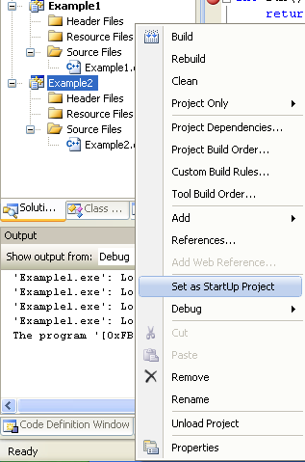
Changing active project

Slide 111
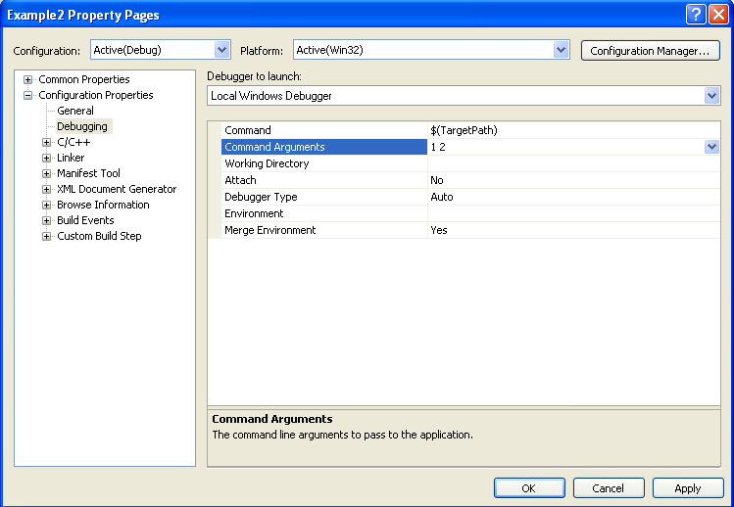
Setting command line arguments
Setting command line arguments

Slide 112
Instructions we now know (9)
NOP
PUSH/POP
CALL/RET
MOV
LEA
ADD/SUB

Slide 113
Back to Hello World
.text:00401730 main
.text:00401730 push ebp
.text:00401731 mov ebp, esp
.text:00401733 push offset aHelloWorld ; "Hello world\n“
.text:00401738 call ds:__imp__printf
.text:0040173E add esp, 4
.text:00401741 mov eax, 1234h
.text:00401746 pop ebp
.text:00401747 retn
Are we all comfortable with this now?
Windows Visual C++ 2005, /GS (buffer overflow protection) option turned off
Disassembled with IDA Pro 4.9 Free Version
Notes:
1 min

