Slide 1

Project Based Learning : IS633L
Intelligent Traffic Management
System Using IoT Analytics
Under the guidance of Dr. Siddesh G.M.
By:
Sanjana.D - 1MS15IS101
Vighnesh Balaji - 1MS15IS143

Slide 2
ABSTRACT
Due to population increase in large urban areas there is an increase in vehicular density, leading to increasing in commuting time.
As opposed to the existing conventional traffic management mechanism which is based on fixed time concept, here traffic monitoring is based on density of vehicles on each road.
Using IOT analytics the data which is collected is analysed and the most efficient way to control traffic is implemented using multivariate linear regression. [1]

Slide 3
Sl. No | NAME | BY | Key Idea | DRAWBACK
1 | Intelligent Traffic Information system Based on Integration of Internet of Things and Agent Technology[2] | Hasan Omar Al-Sakran | 1. Traffic Objects are tagged and they can be tracked, monitored, managed and processed automatically to predict future traffic flow. 2. Using object ad-hoc networking, RFID this paper presents a low cost, highly scalable traffic management. | 1.This approach involves a large number of RFID’s and sensors which calls for improved security for the data transmitted and the IoT devices. 2.Another research direction is analytics of large volumes of data generated.
2 | The Research of Data Mining in Traffic Flow Data[3] | XuLuhang (Shandong University) | Time-series data mining algorithms and clustering algorithms applied to the problem of handling traffic flow. | 1. A number of complex factors not fully taken into account.
3 | Traffic-Congestion Forecasting Algorithm Based on Pheromone Communication Model[4] | Satoshi Kurihara Osaka University, Japan | Method of forecasting congestion based on pheromone-communications model | 1.Requires computers at intersections and sensors to count the number of vehicles. 2. current system cannot respond to dynamic changes in road conditions in real time even though some automatic control occurs according to the traffic flow.
4 | Data mining for predicting traffic congestion and its application to Spanish data | 1.E. Florido 2.O.Casta ̃no 3.A. Troncoso 4.F. MartinAlvarez | C4.5 algorithm, Artificial neural networks (ANN) and Neural Networks | 1. Results with an error ranging from 85% to 95%.

Slide 4
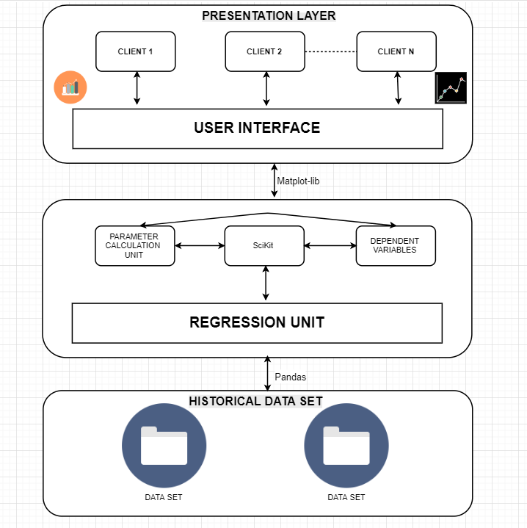
Architecture

Slide 5
Dataset
The Datasets include the traffic in Great Britain and in specific to London over the years 2000 to 2016 in CSV and Excel Format from their official government website: https://data.gov.uk/dataset/gb-road-traffic-counts.
Traffic collected is classified based on a number of factors:
Road traffic by Vehicle Type
Road traffic by Road Class
Cars and Goods Vehicle Traffic by Road Class
The data available is present in both kilometres and miles. The total size of the data being well over 30GB.
Among the many attributes present in our various datasets the attributes which are of paramount importance to our project and algorithms are:
Year
Length of the road in kilometres.
Vehicle type (i.e. cars, light goods, heavy goods vehicles, others)
Road Class (i.e. motorway, rural road, urban road, minor road)
Total count on each road.

Slide 6
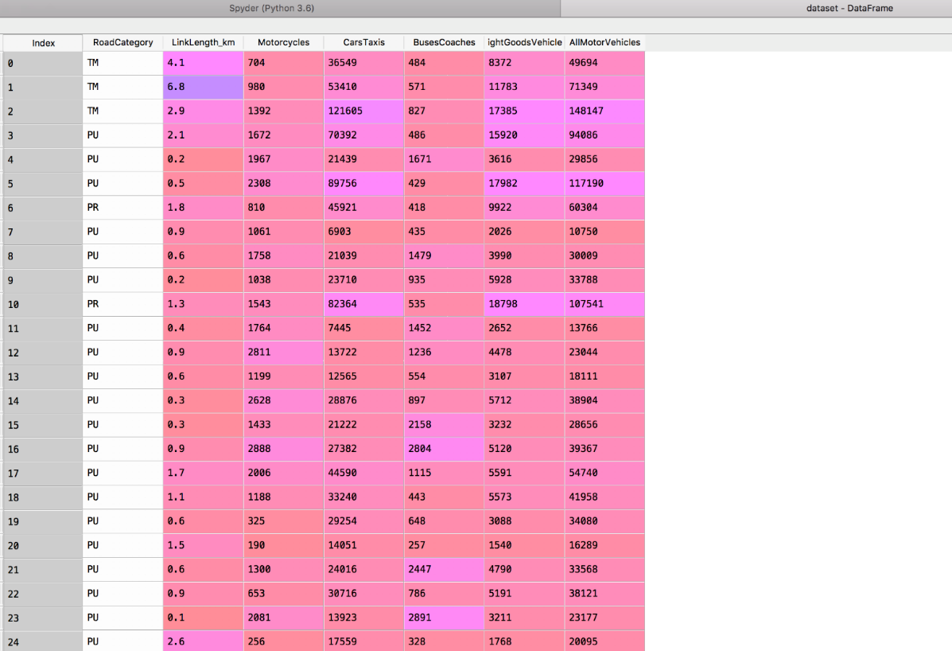

Slide 7
Implementation

Slide 8
Results

Slide 9
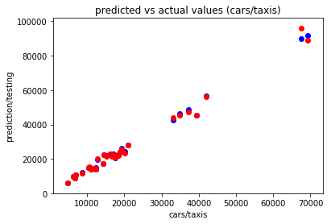
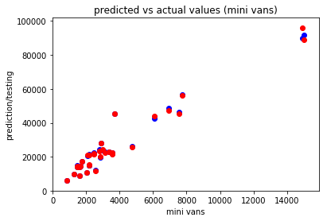
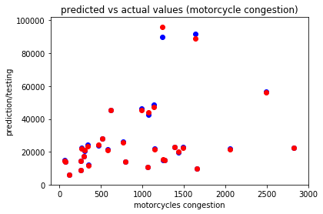
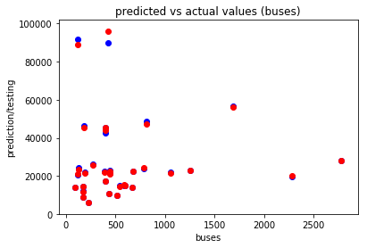

Slide 10
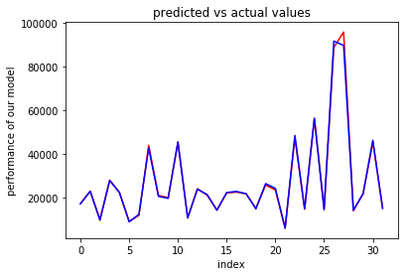

Slide 11
Conclusion and Future Works

Slide 12
REFERENCES
^{[1]} Nellore, K., & Hancke, G. P. (2016). A survey on urban traffic management system using wireless sensor networks. Sensors, 16(2), 157.
^{[2]} Al-Sakran, H. O. (2015). Intelligent traffic information system based on integration of Internet of Things and Agent technology. International Journal of Advanced Computer Science and Applications (IJACSA), 6(2), 37-43.
[3] XuLuhang (2015) The Research of Data Mining in Traffic Flow Data International Journal of Database Theory and ApplicationVol.8, No.4, pp.19-30
^{[4]} Kurihara, S. (2013). Traffic-congestion forecasting algorithm based on pheromone communication model. In Ant Colony Optimization-Techniques and Applications. InTech.

