Slide 1
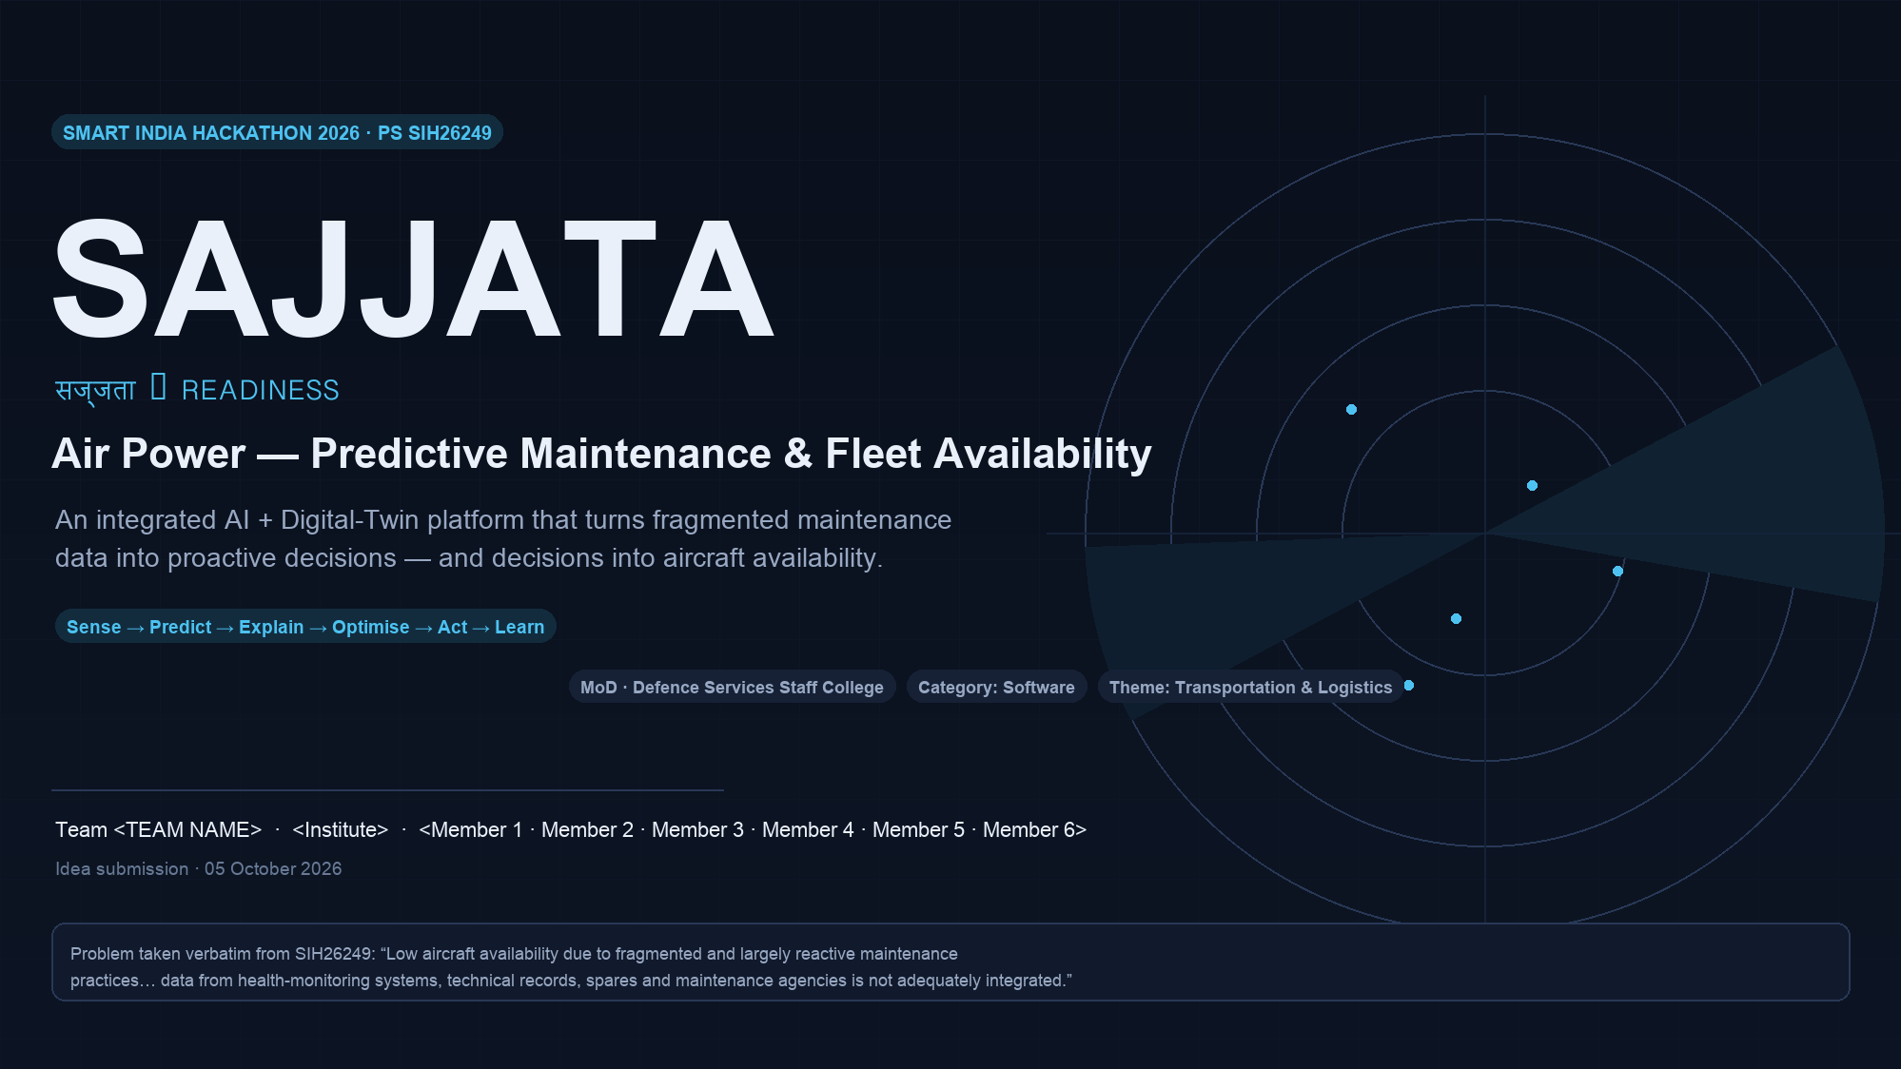
Notes:
SAJJATA (sajjata = readiness). One line: turn fragmented maintenance data into proactive decisions, and decisions into aircraft availability.
Open with the PS verbatim - availability is lost to fragmentation and reactive practice. We will show the full chain: data to prediction to approved work order to fleet readiness.
The problem statement publishes NO dataset; every number shown later that is not a target is measured by us on clearly-labelled synthetic data. Say this up front - credibility is a weapon in this room.

Slide 2
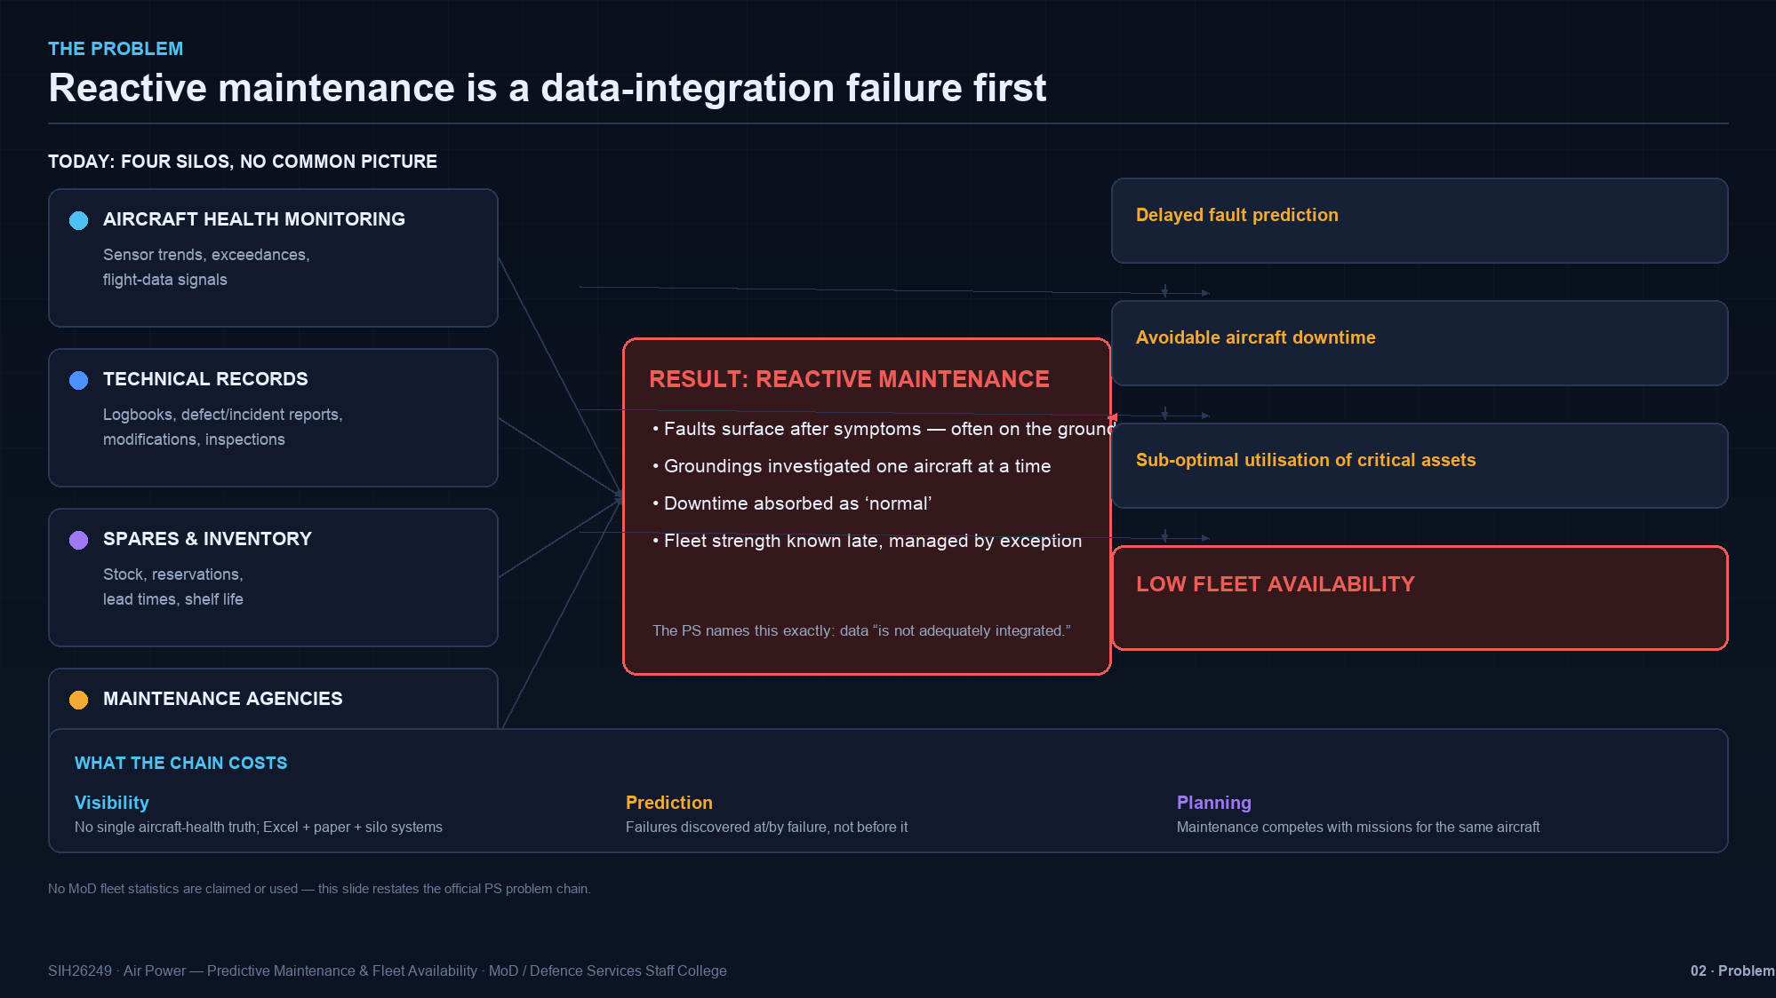
Notes:
Four real data silos from the PS: health monitoring, technical records, spares, maintenance agencies. The right panel is the causal chain the PS itself states: delayed fault prediction, avoidable downtime, sub-optimal utilisation.
Positioning line: this is a data-integration failure first and an AI problem second. No fleet statistics are claimed - the panel restates the official problem chain only.

Slide 3
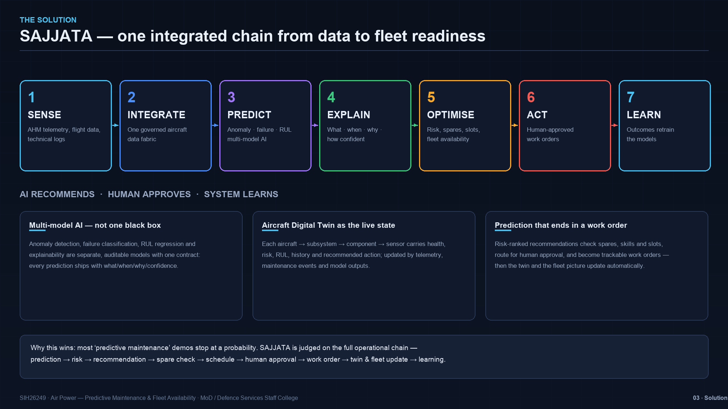
Notes:
Seven verbs - Sense, Integrate, Predict, Explain, Optimise, Act, Learn. Emphasise three pillars: (1) multi-model AI, not one black box; (2) the digital twin as the live, auditable aircraft state; (3) every prediction ends in a human-approved work order - we do not stop at a probability.

Slide 4
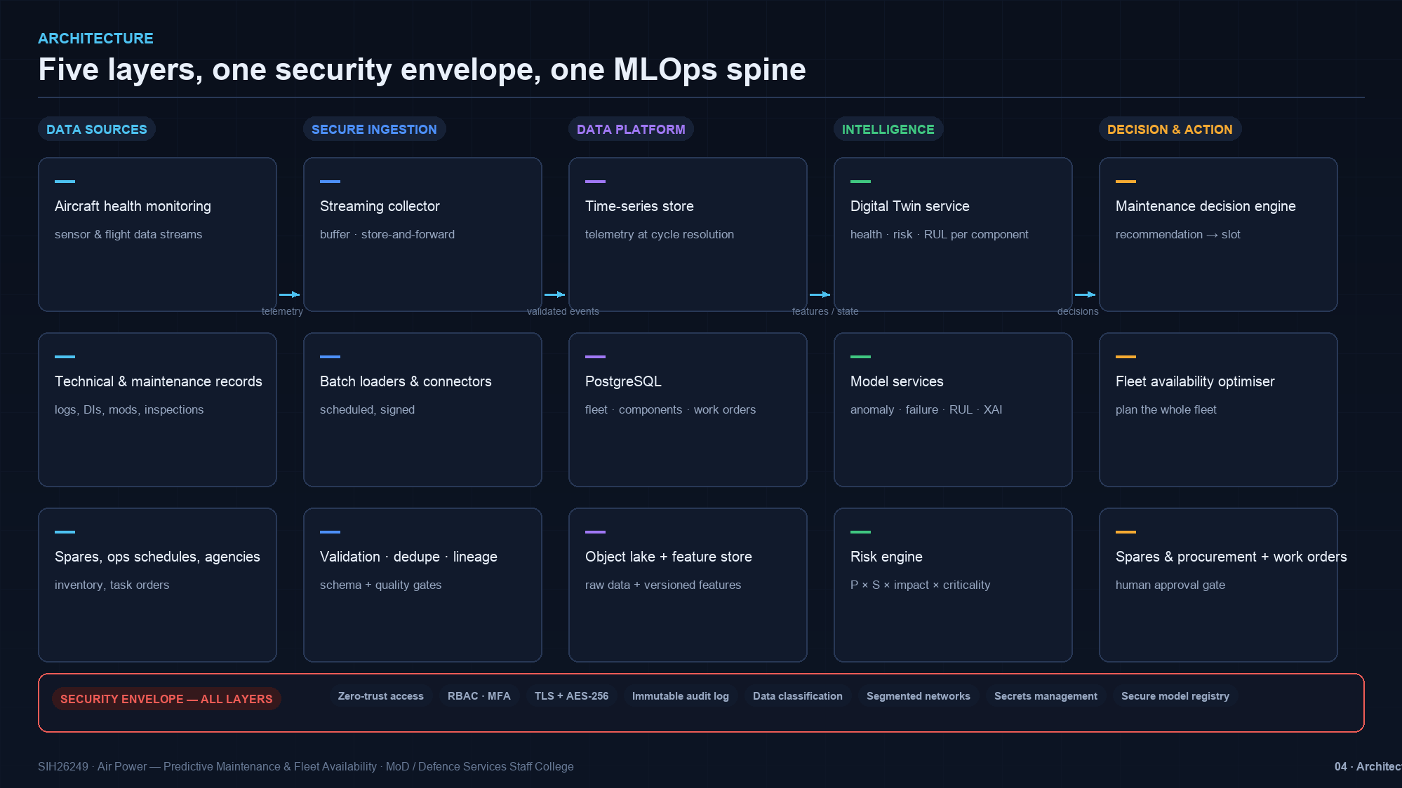
Notes:
Walk left to right: sources -> validated ingestion (streaming with store-and-forward, batch loaders, quality gates) -> data platform (time-series + PostgreSQL + object lake + feature store) -> intelligence (twin, model services, risk engine) -> decision & action (maintenance decision engine, fleet optimiser, spares, work orders).
Red band: security envelope wraps all layers - zero-trust, RBAC+MFA, TLS + AES-256, immutable audit, classification, segmentation, secrets, secure model registry.

Slide 5
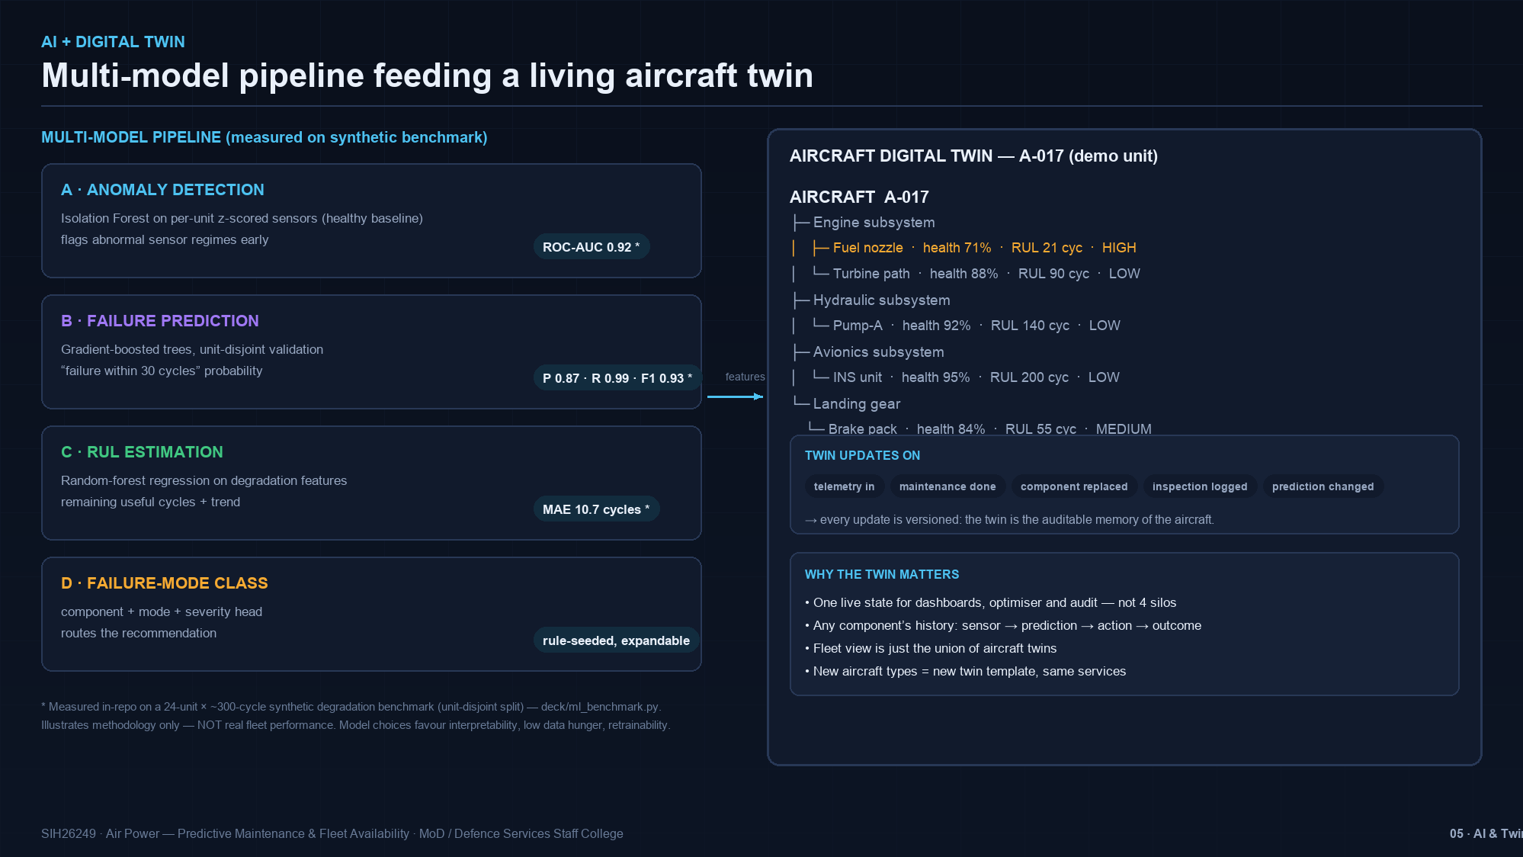
Notes:
Model A anomaly: isolation forest on per-unit z-scored sensors (each aircraft baselined against its own healthy period). Model B: boosted trees, unit-disjoint split. Model C: RUL regression. Model D routes severity.
Star means MEASURED on our synthetic benchmark (repo: deck/ml_benchmark.py) - methodology demonstration, not fleet performance. Right: A-017 twin showing the fuel-nozzle story; twin updates on telemetry, maintenance, replacement, inspection, prediction changes - versioned.

Slide 6
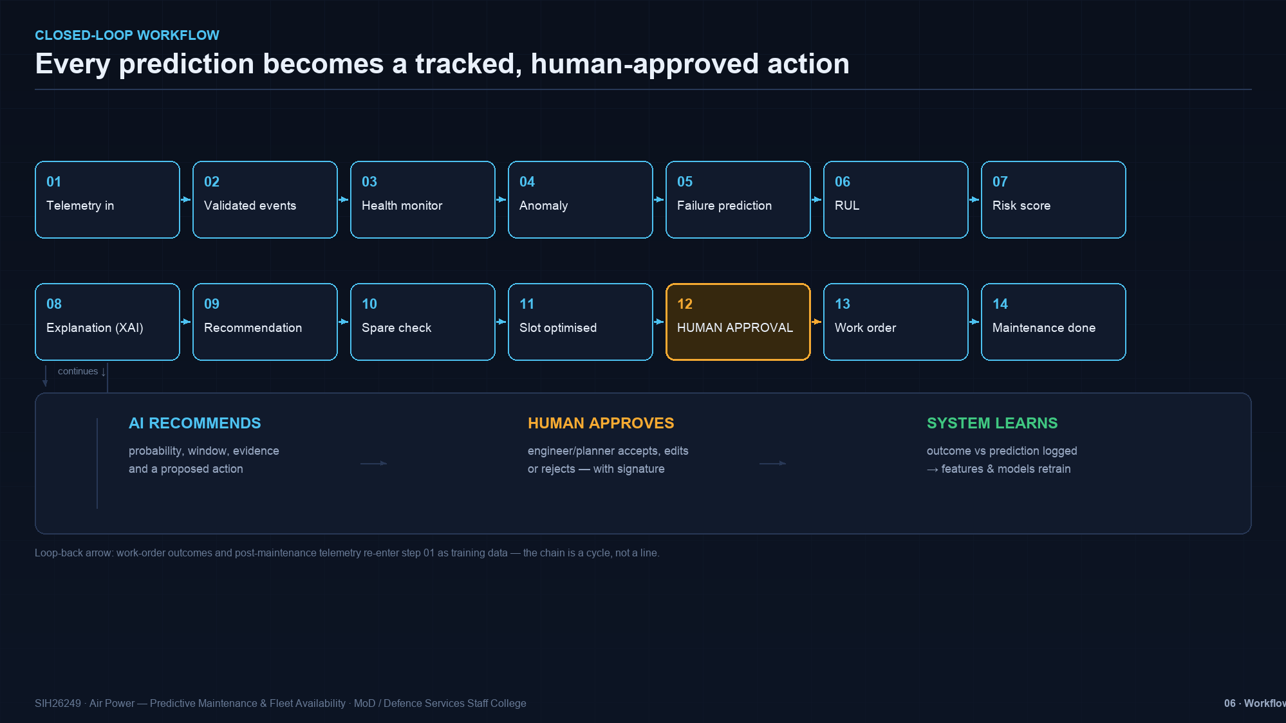
Notes:
The 16-step closed loop. Pause on step 12: HUMAN APPROVAL - AI recommends, human decides, system learns. Outcomes loop back as training data. This is the slide that answers 'so what' - nothing in the chain dead-ends.

Slide 7
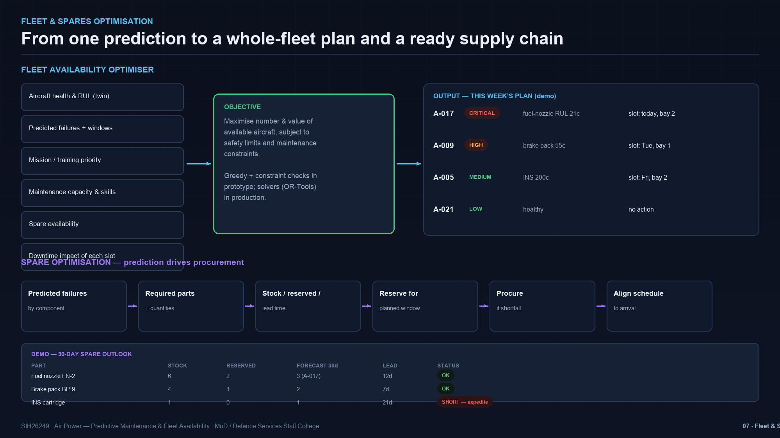
Notes:
Fleet optimiser: inputs left, objective centre (maximise available aircraft subject to safety + maintenance constraints; greedy + constraint checks in prototype, OR-Tools solvers in production), this-week plan right.
Spares: prediction -> parts -> reservation -> procurement -> schedule alignment. Demo table shows a real shortage case (INS cartridge, 21-day lead) - the system flags it BEFORE the failure window.

Slide 8
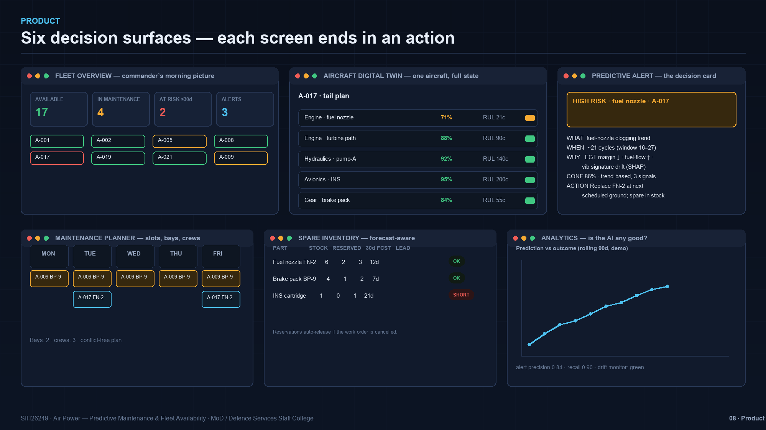
Notes:
Six screens, each ending in an action: commander's fleet picture, one-aircraft twin, the alert decision card (WHAT/WHEN/WHY/CONF/ACTION), planner with bays and crews, forecast-aware inventory, and analytics that grade the AI itself (precision/recall + drift monitor).

Slide 9
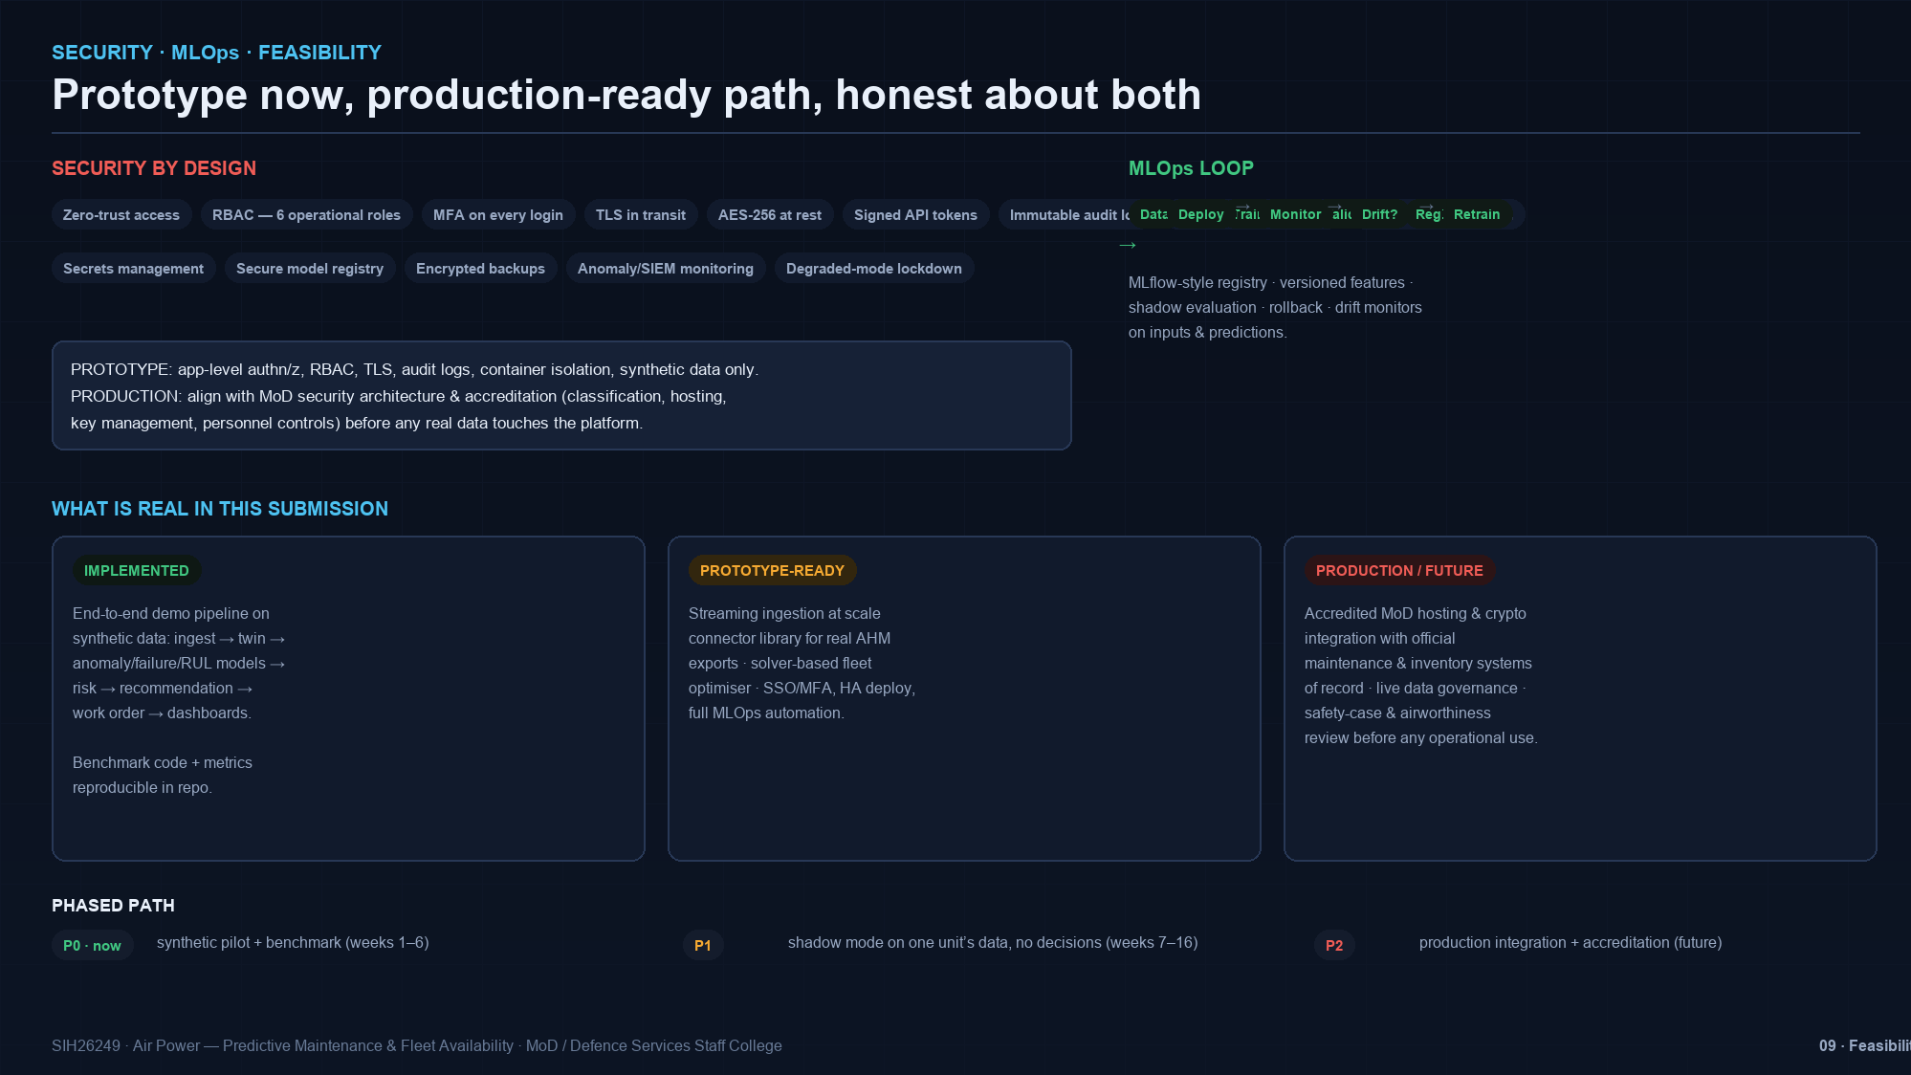
Notes:
Three honest bands: IMPLEMENTED (end-to-end demo pipeline on synthetic data, reproducible benchmark), PROTOTYPE-READY (scale-out ingestion, connectors, solvers, SSO/MFA, HA), PRODUCTION/FUTURE (accredited MoD hosting, official system-of-record integration, safety case).
MLOps loop top-right: registry, versioned features, shadow evaluation, rollback, drift monitors. Phased path: P0 synthetic pilot (weeks 1-6), P1 shadow mode on one unit's data (weeks 7-16), P2 production integration + accreditation.

Slide 10
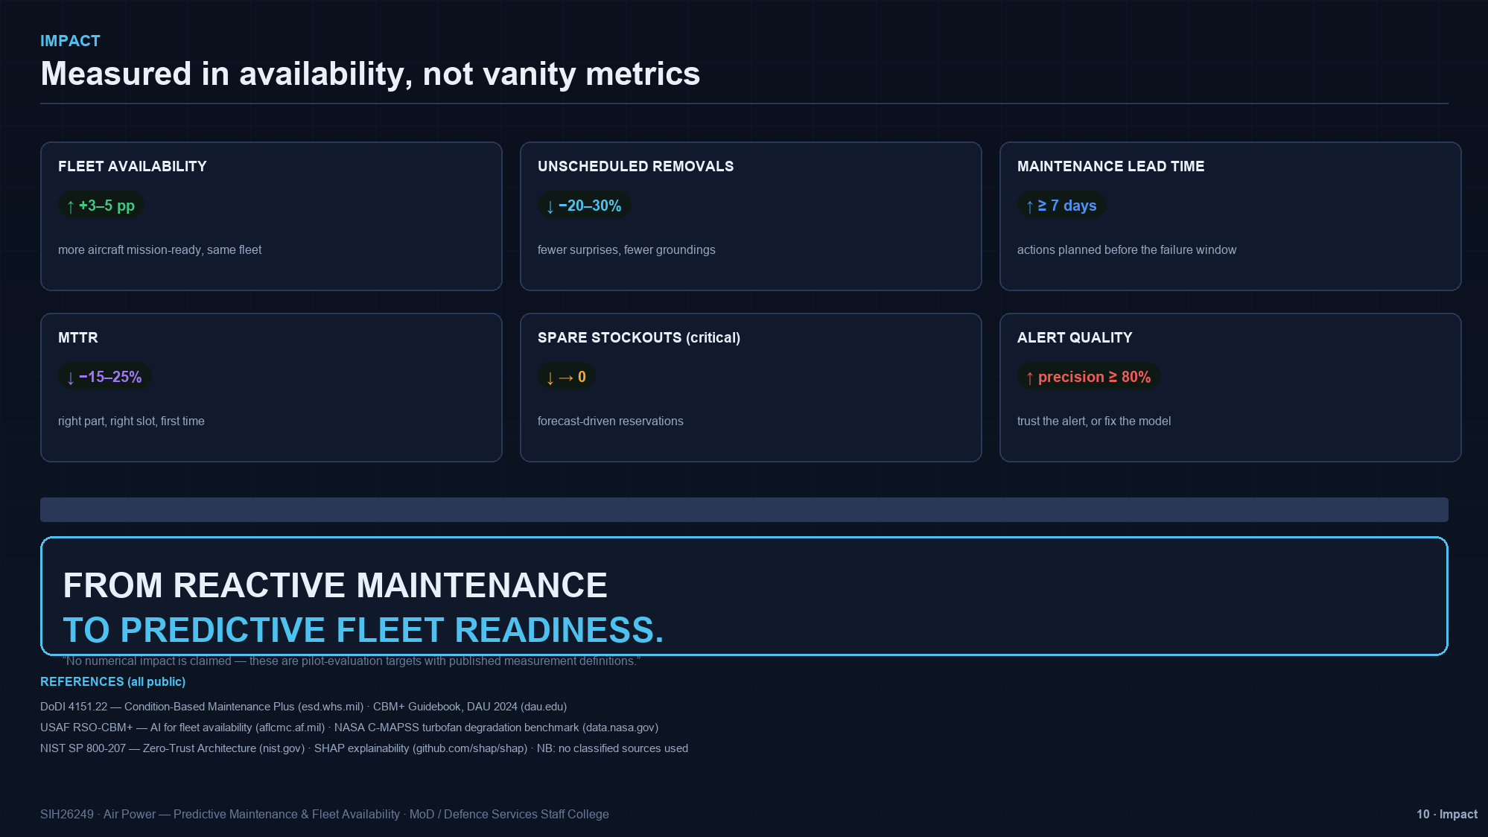
Notes:
Targets, not claims: availability +3-5pp, unscheduled removals -20-30%, lead time >=7 days, MTTR -15-25%, critical stockouts ->0, alert precision >=80%. Each has a published measurement definition; nothing is presented as achieved.
Close on the line: FROM REACTIVE MAINTENANCE TO PREDICTIVE FLEET READINESS. References are public policy and benchmark sources (DoDI 4151.22, CBM+ Guidebook, USAF RSO-CBM+, NASA C-MAPSS, NIST SP 800-207, SHAP).

