Slide 1
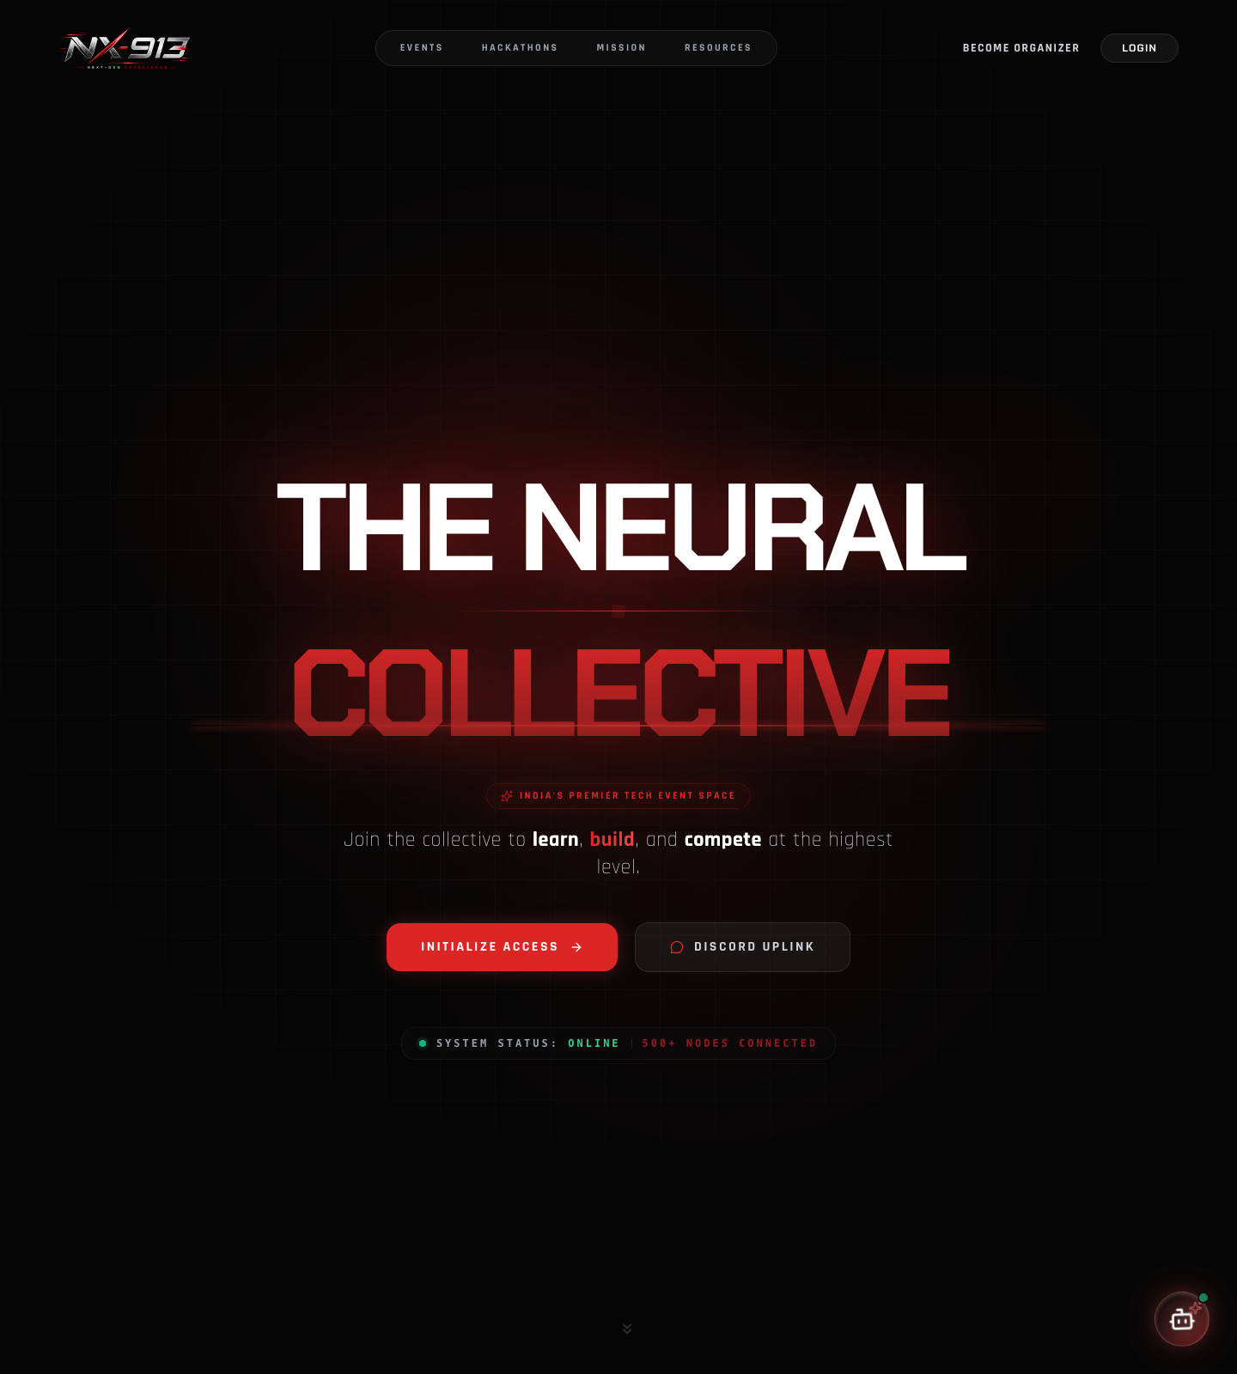
N
NX-913 CAMPUS OS
PITCH DECK
https://nx-913.com
N X - 9 1 3
NX-913
The Next-Generation Campus Event & Hackathon Operating System
From Registration to NAAC Reports — In One Click
Unified Student Engagement · Hackathon Lifecycle · Academic Compliance
🎓 Student Portal
🎪 Organizer Suite
⚖️ Judging Console
🏛️ Admin Oversight
NX-913 · CAMPUS EVENT & HACKATHON OS
01 / 16
Notes:
Respected Principal, Dean of Student Affairs, HODs, and fellow student leads: Today, we introduce NX-913 — an enterprise-grade platform built specifically for our institution to centralize, streamline, and elevate how our college organizes, manages, and documents every single event, workshop, and hackathon.

Slide 2
N
NX-913 CAMPUS OS
PITCH DECK
02 THE PAIN POINTS
The Current Campus Dilemma
Manual, disconnected workflows cost us hours, money, and student trust — every single event.
🧩 Scattered Information
💸 Manual Payment Chaos
20+ clubs use separate Google Forms, WhatsApp groups, Notion pages & Unstop links — students miss out on events.
UPI screenshots & manual bank verification → reconciliation delays, cash leakage & accounting disputes.
🚪 Gate Congestion & Fake Passes
⚔️ Hackathon Nightmares
Manual paper registers at auditorium doors cause long queues & ticket duplication.
Team formation friction, lost submissions & manual judging sheets → delayed results & disputes.
📜 Certificate & Reporting Burden
Organizers spend weeks emailing Canva certificates; faculty spend weeks compiling NAAC/IQAC reports.
Notes:
Every time our college hosts a festival or workshop, our faculty and student coordinators spend dozens of hours on repetitive manual work. Payments are tracked on personal UPI accounts, gate entry is bottlenecked by paper registers, and generating NAAC reports takes weeks of manual collation. NX-913 was engineered to solve every single one of these bottlenecks.

Slide 3
N
NX-913 CAMPUS OS
PITCH DECK
03 THE SOLUTION
System Overview & Role-Based Architecture
One platform. Four secure portals. Zero fragmented tools.
🎓 Student / Attendee Portal
🎪 Organizer & Faculty Coordinator Portal
⚖️ Hackathon Judging & Mentor Console
One-click event discovery, team builder, digital ticket pass & verifiable certificate vault.
Event builder, ticketing tiers, coupon engine, broadcast center & live attendance scanner.
Multi-criteria weighted scoring rubrics, submission inspection & live dynamic leaderboards.
🏛️ College Admin & Dean Oversight Panel
Event approval workflows, cross-department analytics, asset libraries & system audit logs.
Notes:
NX-913 operates on a secure, role-based architecture. A student sees a personalized hub; a club organizer gets an operations command center; judges get an evaluation portal; and college leadership gets complete administrative oversight and audit logs.

Slide 4
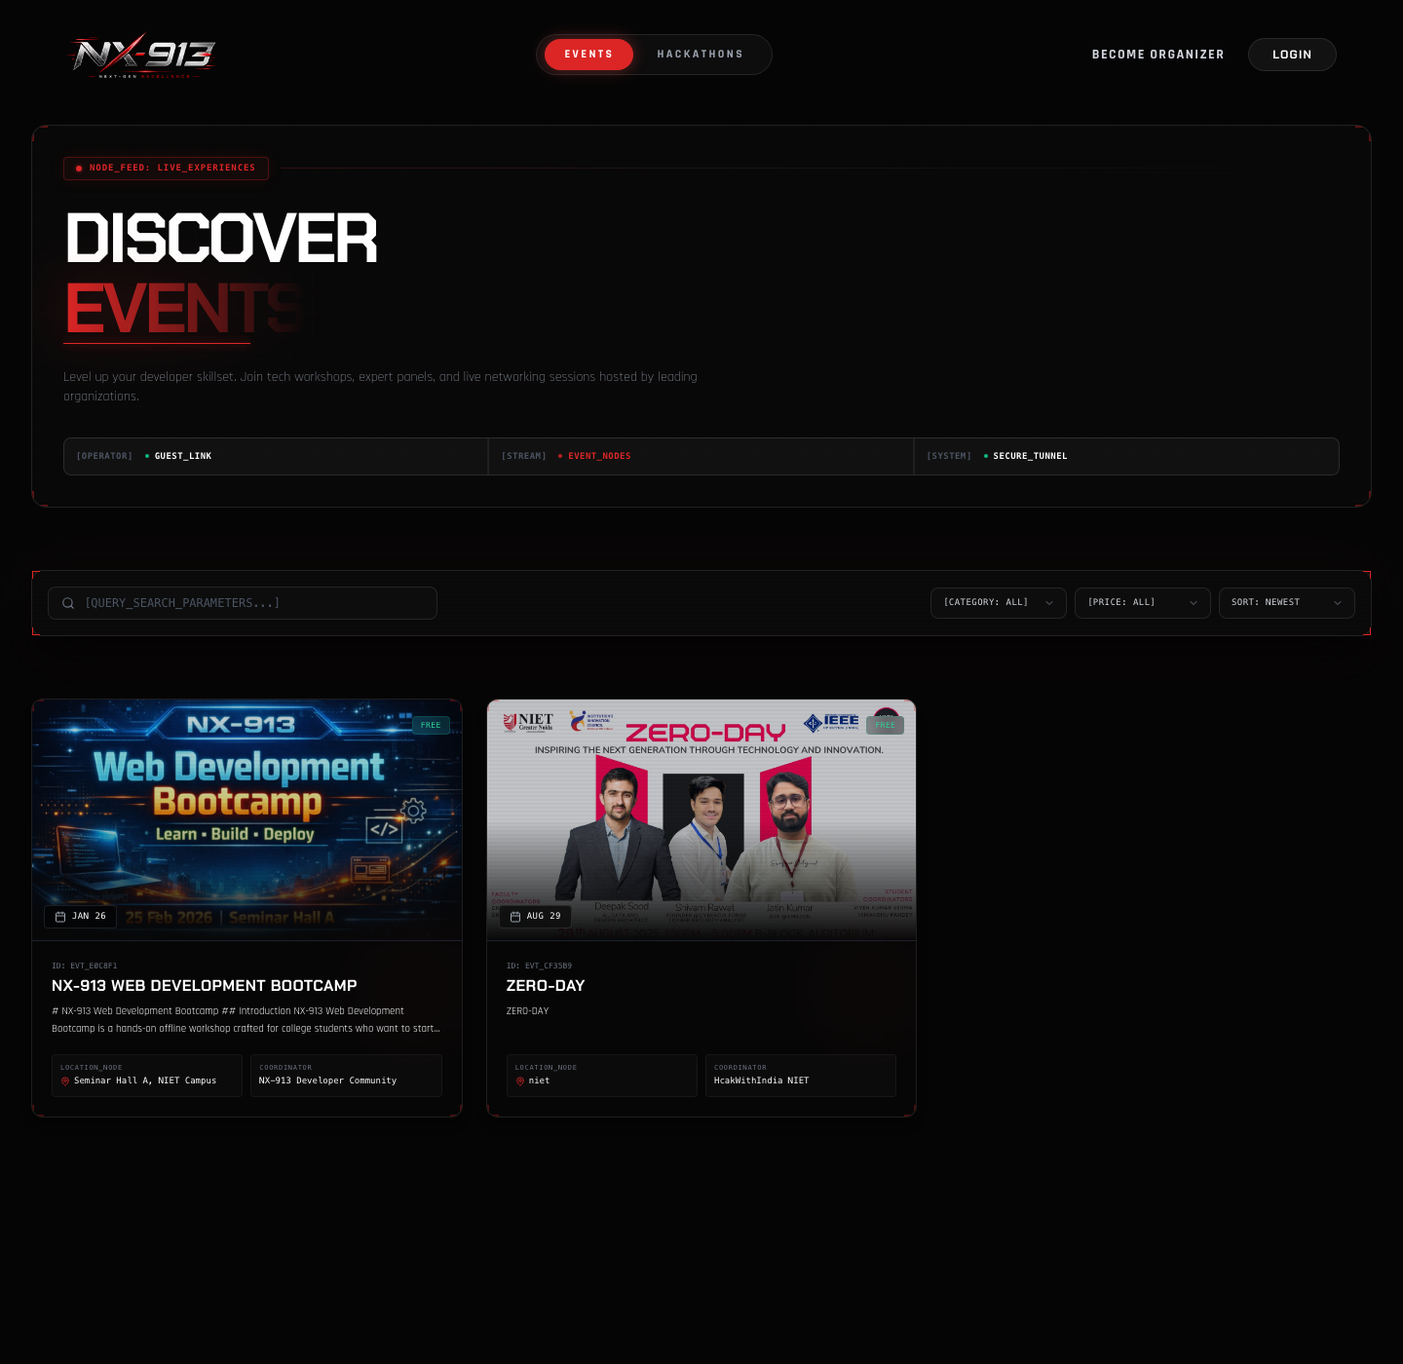
N
NX-913 CAMPUS OS
PITCH DECK
04 THE ECOSYSTEM
The Student Experience
Engagement, gamification & community — everything a student needs in one hub.
https://nx-913.com/events
🔐 Secure & Effortless Auth
🎫 Ticket & Pass Wallet
Google OAuth, GitHub OAuth, OTP login & 2FA with session management.
Instant PDF tickets with QR codes, add-to-calendar (.ics) & live pass status.
🤝 Solo Hacker & Team Matchmaking
🏆 Gamification & Ranks
Find teammates by skill tag — Frontend, AI/ML, Backend, UI/UX.
Experience badges, departmental ranks & verified activity logs.
🌐 Social & Community
👤 Public Profile · /u/username
Follow clubs, bookmark events, verified testimonials & upvote showcase projects.
On-platform portfolio of badges, ranks & verified achievements.
Notes:
For students, NX-913 turns campus involvement into a seamless experience. They log in with their college or GitHub account, find hackathon teammates instantly through the Solo Hacker directory, get instant digital QR passes on their phones, and build an on-platform portfolio of badges and verified achievements.

Slide 5
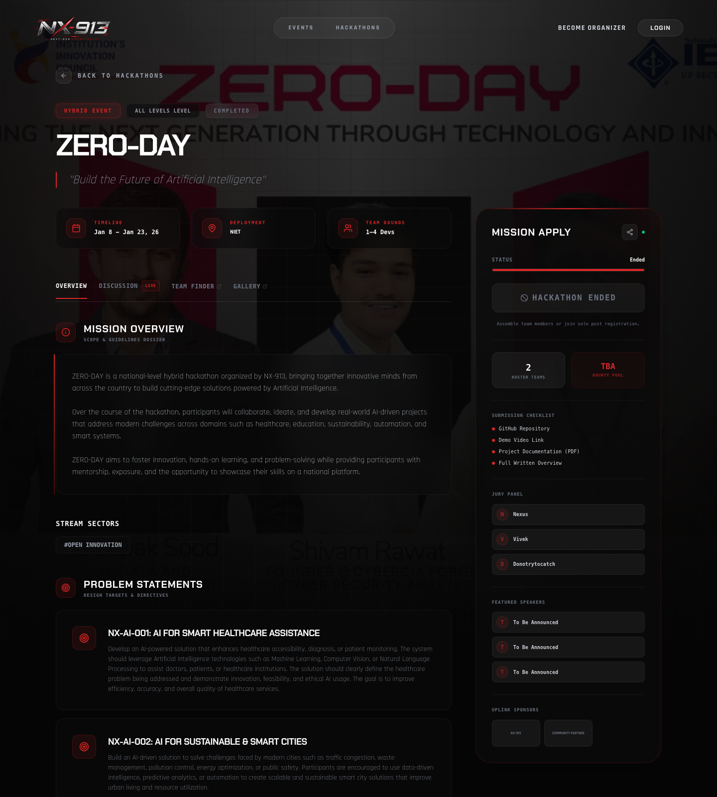
N
NX-913 CAMPUS OS
PITCH DECK
05 THE ECOSYSTEM
The Hackathon & Competition Engine
From team formation to live podium — a complete competition lifecycle.
https://nx-913.com/hackathons
👥 Dynamic Team Workspace
📦 Submission Engine
Create teams, share auto-generated secure invite codes & assign project roles.
Submit GitHub repos, live demo URLs, pitch videos, tech-stack tags & docs.
⚖️ Digital Judging Portal
🥇 Real-Time Dynamic Leaderboard
Multi-track judge assignment & weighted rubrics — Innovation 30% · Feasibility 30% · Code Quality 20% · Presentation 20%.
Auto-computed rankings, tie-breaker handling & instant podium reveals — zero grading disputes.
Notes:
Hosting a national-level or inter-department hackathon on NX-913 is seamless. Teams manage their work in private workspaces, submit their GitHub repos and live links directly, and judges evaluate submissions digitally on weighted rubrics that instantly feed into a live, transparent leaderboard.

Slide 6
N
NX-913 CAMPUS OS
PITCH DECK
06 THE ECOSYSTEM
Smart Gate Check-in & Offline PWA Protocol
Festival-scale entry that never stops — even when the Wi-Fi dies.
📷 In-Browser QR Scanner
⏱️ Multi-Session Attendance
📶 PWA & Offline Fallback Protocol
Works on any smartphone camera or webcam with sub-second verification — no special hardware.
Track checkpoints across Day 1 Inauguration, Lunch, Day 2 Hackathon & Valedictory.
Campus Wi-Fi fails? Scanner caches the guest list in encrypted local storage (IndexedDB), validates offline, auto-syncs on reconnect.
⚡ Zero Gate Delays
Sub-second verification, zero duplicate check-ins — gates never stop moving.
Notes:
One of our flagship engineering innovations is the Offline PWA Protocol. During large college fests, auditorium network connectivity often collapses. NX-913's scanner works completely offline, validating tickets locally and syncing with the central database the moment Wi-Fi reconnects. The gates never stop moving.

Slide 7
N
NX-913 CAMPUS OS
PITCH DECK
07 THE ECOSYSTEM
Certificate Studio & Public Verification
Design once. Generate hundreds. Verify anywhere — zero forgery.
🎨 Visual Certificate Studio
⚡ Bulk Queue Dispatch
🔍 Tamper-Proof QR Verification
Custom templates for Participants, Winners, Runners-Up, Mentors & Volunteers with {{name}}, {{event}}, {{date}}, {{rank}} placeholders.
BullMQ + Puppeteer workers generate hundreds of high-res PDF/PNG certificates in the background.
Every certificate carries a unique cryptographic QR linking to the official /verify page — zero forgery.
💼 Placement & LinkedIn Ready
One-click sharing to LinkedIn to boost student employability & showcase college achievements.
Notes:
Say goodbye to weeks of manual Canva certificate creation. Organizers design a template once, and the platform auto-generates hundreds of personalized certificates in seconds. Crucially, every certificate features a tamper-proof QR code that recruiters can verify online, eliminating certificate forgery under our college's name.

Slide 8
N
NX-913 CAMPUS OS
PITCH DECK
08 THE ECOSYSTEM
AI-Powered Official NAAC / IQAC Report Builder
From 2 weeks of paperwork to a ready-to-sign report in 2 minutes.
📄 One-Click Official Export
📊 Pre-Populated Sections
🤖 AI-Assisted Drafting
Standardized institutional report templates in DOCX & PDF.
Executive summary, participant lists with timestamps, speaker profiles, photo collage, feedback & financial balance sheet.
Groq LPU + Gemini compile executive summaries & outcome analysis from raw event data.
🏛️ Accreditation Compliant
Direct adherence to NAAC Criterion V, IQAC & AICTE/NIRF documentation guidelines.
Notes:
For our faculty coordinators and HODs, this is a game-changer. NX-913 automatically aggregates attendance, photos, speaker details, and feedback into a standardized, ready-to-sign official Event Report formatted specifically for NAAC and IQAC compliance, reducing post-event paperwork from 2 weeks to 2 minutes.

Slide 9
N
NX-913 CAMPUS OS
PITCH DECK
09 HARDWARE & SECURITY
Financial Transparency, Invoicing & Payments
Every rupee through official channels — audited, invoiced, zero leakage.
💳 Integrated Razorpay Gateway
🎟️ Flexible Ticketing & Coupons
🧾 Automated GST & Invoicing
UPI (GPay, PhonePe, Paytm), Credit/Debit Cards & Net Banking.
Free tickets, multi-tier pricing (Early Bird · Standard · VIP) & discount coupon management.
Instant digital invoices & payment receipts issued to attendees.
🛡️ Zero Cash Leakage & Audit Logs
Tamper-proof transaction logs for faculty & accounts, with automated bulk refunds.
Notes:
For paid events and workshops, NX-913 eliminates unverified UPI screenshots and personal bank transfers. All transactions flow through an official Razorpay gateway with instant invoicing, real-time revenue analytics, and an audit trail for college accounts.

Slide 10
N
NX-913 CAMPUS OS
PITCH DECK
10 HARDWARE & SECURITY
Organizer Suite — Broadcasts, Assets & Analytics
An operations command center for every club and coordinator.
📢 Email Broadcast Engine
📁 Platform Asset Library
📈 Live Analytics & Intelligence
Segmented 1-click updates to registered attendees, shortlisted teams or everyone.
Central repository for college banners, department logos, sponsor decks & guidelines.
Registration velocity, drop-off rates, revenue & venue capacity in real time.
🤖 24/7 AI Attendee Assistant
Low-latency Groq + Gemini chatbot answering schedule, venue, rules & contact FAQs.
Notes:
Club organizers gain an all-in-one management suite: they can send bulk email broadcasts, monitor real-time registration velocity, manage logos in a shared asset library, and let our built-in AI assistant answer repetitive attendee questions 24/7.

Slide 11
N
NX-913 CAMPUS OS
PITCH DECK
11 HARDWARE & SECURITY
Enterprise Architecture, Performance & Security
Built to survive the 2,000-student same-second registration rush.
⚡ Frontend
🛠️ Backend
🔄 Async Processing
Next.js 16 (App Router, SSR/SSG) · React 19 · Tailwind CSS · Zustand · Framer Motion · PWA offline.
Node.js 22 · Express.js · TypeScript · Mongoose ODM · REST API.
Redis & BullMQ workers — Puppeteer PDF rendering, certificate generation, Nodemailer/Resend bulk mailers.
🔒 Enterprise Security
JWT + refresh rotation, HTTP-only cookies, RBAC & CSRF, rate limiting, Helmet, Zod validation, audit logs & Sentry.
Notes:
We didn't just build a simple website; NX-913 is built on modern enterprise architecture. Using asynchronous background queues with Redis and BullMQ, the system handles heavy traffic spikes during ticket releases and certificate generation without slowing down or crashing.

Slide 12
N
NX-913 CAMPUS OS
PITCH DECK
12 HARDWARE & SECURITY
Administrative Governance & Department Oversight
Full control for leadership — nothing goes live without authorization.
🛡️ Event Approval Workflow
🏢 Club & Organizer Verification
📊 Cross-Department Insights
Club events require faculty/Dean review before publishing — no unauthorized listings.
Verify clubs, assign organizer permissions & audit coordinator actions.
Compare participation across CSE, IT, ECE, Mech & MBA; annual activity summaries.
🎛️ Platform Feature Flags
Enable/disable payments, hackathons & public signups dynamically via backend toggles.
Notes:
College leadership retains 100% control. The admin dashboard ensures that no event goes live without proper faculty authorization, provides cross-department participation analytics, and maintains a permanent institutional history of all extracurricular activities.

Slide 13
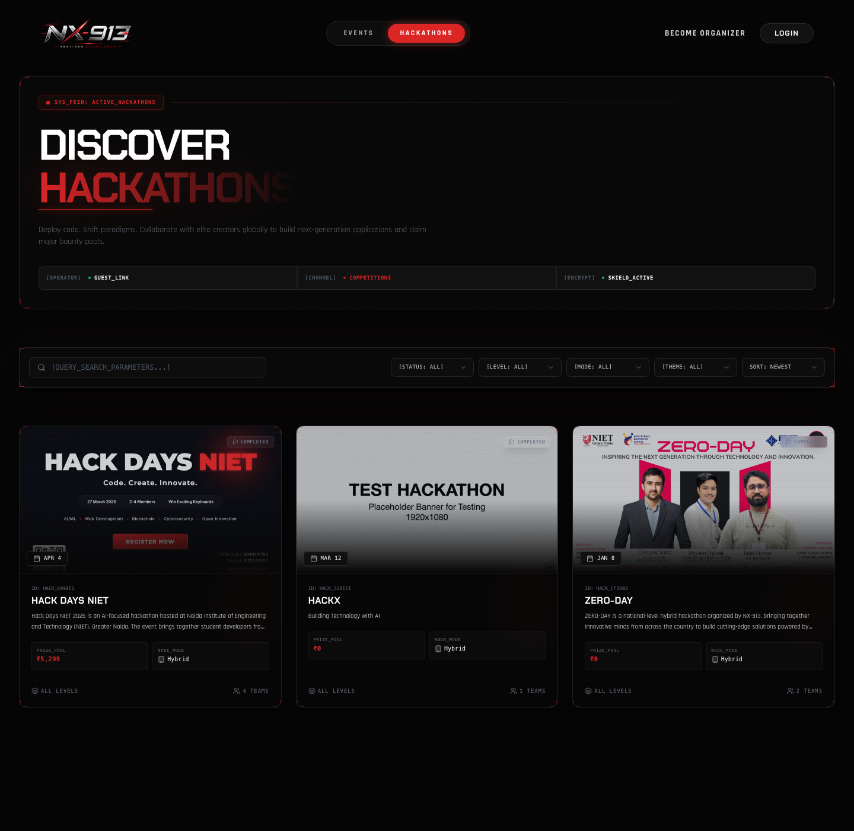
N
NX-913 CAMPUS OS
PITCH DECK
13 THE ROADMAP
Live Demonstration Workflow
A 3-minute walkthrough of the complete journey — end to end.
https://nx-913.com/hackathons
1️⃣ Student Flow
2️⃣ Hackathon Flow
Browse events → Register in 1 click → QR Pass appears in wallet.
Form team with invite code → Submit demo URL & GitHub repo.
3️⃣ Gate Scanner
4️⃣ Admin / Faculty Flow
Organizer mobile camera scans student QR → sub-second attendance confirmation.
One-click certificate release with QR verification → one-click NAAC/IQAC report download.
Notes:
Let us show you this in action right now with a live 3-minute walkthrough.

Slide 14
N
NX-913 CAMPUS OS
PITCH DECK
14 THE ROADMAP
Phased Rollout Plan & Institutional Call-to-Action
From pilot to official college portal — in three phases.
📅 Phase 1 — Pilot Deployment
📅 Phase 2 — Club & Faculty Onboarding
📅 Phase 3 — Campus-Wide Launch
Weeks 1–2 · Deploy for 2 departmental workshops; validate gate scanning & certificate dispatch.
Weeks 3–4 · 30-min training for club leads, societies (IEEE, GDSC, ACM, Cultural) & coordinators.
Month 2 · Official event portal linked on the college website & student app.
🎯 Our Request Today
Seeking official approval from College Administration to launch the Phase 1 Pilot.
Notes:
We have built, tested, and optimized NX-913. We propose starting with a pilot for the next department event, followed by onboarding all student clubs. We seek your official approval today to launch NX-913 as our college's official event platform.

Slide 15
N
NX-913 CAMPUS OS
PITCH DECK
15 Q&A PREP
Tough Questions, Confident Answers
What the Dean, Principal & faculty may ask — and the evidence-backed response.
"What if the internet fails during a 1,000-person fest?"
"Can a student create a fake or inappropriate event?"
Offline PWA Protocol — encrypted local cache, sub-0.5s validation, auto-sync on reconnect.
Strict RBAC — only verified club organizers can create, and events need faculty/admin approval.
"How does this help NAAC / NBA accreditation?"
"Is student data secure and private?"
AI report generator exports structured DOCX/PDF formatted for NAAC Criterion V.
JWT with refresh rotation, 2FA, encrypted hashing, role-based queries & rate-limiting.
"Will the server crash if 2,000 students register at once?"
Async BullMQ/Redis workers handle PDFs, certificates & mail — API stays light.
Notes:
Anticipated questions from the Dean, Principal, and faculty — answered with confidence. (1) Internet failure: Offline PWA Protocol — encrypted local cache, sub-0.5s validation, auto-sync on reconnect. (2) Fake events: strict RBAC — only verified club organizers can create events, and every event needs faculty/admin approval before going public. (3) NAAC/NBA value: AI report generator exports structured DOCX/PDF with participant lists, time-stamped attendance, feedback, and financials — formatted for NAAC Criterion V. (4) Data security: JWT with refresh-token rotation, 2FA, encrypted password hashing, role-based queries, and rate-limiting. (5) Server crash: PDF rendering, certificates, and bulk email run on async BullMQ/Redis workers, keeping the API server light.

Slide 16
N
NX-913 CAMPUS OS
PITCH DECK
Thank You
NX-913 — the unified operating system for every campus event, hackathon & accreditation report.
“From Registration to NAAC Reports — In One Click.”
🎟️ Events & Passes
🏆 Hackathons
📜 Certificates
📄 NAAC Reports
QUESTIONS & DISCUSSION — OPEN FLOOR
NX-913 · CAMPUS EVENT & HACKATHON OS
16 / 16
Notes:
Thank you for your time. We look forward to your approval, guidance, and partnership in making NX-913 the college's official event platform.

