Slide 1
Information Extraction Lecture 3 – Rule-based Named Entity Recognition
CIS, LMU München
Winter Semester 2013-2014
Dr. Alexander Fraser, CIS

Slide 2
Reading and Seminar
For next time, skim the chapter in Sarawagi on statistical NER
This chapter is too technical
You are *not* responsible for learning the mathematical details
Some will be covered later, but most not at all in this course
Just try to get a basic idea of how the NER problem is formulated as a statistical classification problem
Seminar (Ubung), tomorrow in "Gobi"
Starts at 11:00 c.t. (not 10:00!)
Using perl/python and Unix tools for IE
Please bring a Linux laptop if you have one!

Slide 3
Outline
Basic evaluation: Precision/Recall
Rule-based Named Entity Recognition
Learning Rules
Issues in Evaluation
Annotation for NER

Slide 4
Information Extraction
and beyond
Information Extraction (IE) is the process
of extracting structured information
from unstructured machine-readable documents
Ontological
Information
Extraction
Fact
Extraction
Instance
Extraction
Named Entity
Recognition
✓
Elvis Presley | singer
Angela Merkel | politician
✓
Tokenization&
Normalization
...married Elvis
on 1967-05-01
Source
Selection
05/01/67
→
1967-05-01
?
Slide from Suchanek

Slide 5
Relation Extraction: Disease Outbreaks
May 19 1995, Atlanta -- The Centers for Disease Control and Prevention, which is in the front line of the world's response to the deadly Ebola epidemic in Zaire , is finding itself hard pressed to cope with the crisis…
Date | Disease Name | Location
Jan. 1995 | Malaria | Ethiopia
July 1995 | Mad Cow Disease | U.K.
Feb. 1995 | Pneumonia | U.S.
May 1995 | Ebola | Zaire
Information Extraction System
Slide from Manning

Slide 6
Named Entity Recognition
Named Entity Recognition (NER) is the process of finding entities (people, cities, organizations, dates, ...) in a text.
Elvis Presley was born in 1935 in East Tupelo, Mississippi.
Slide from Suchanek

Slide 7
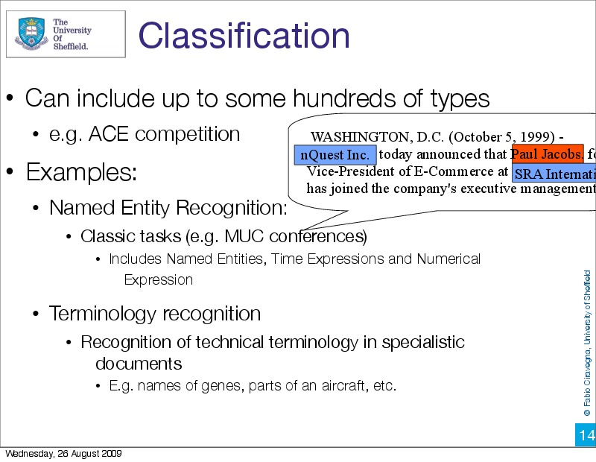

Slide 8
Evaluation
How can the performance of a system be evaluated?
Standard Methodology from Information Retrieval:
Precision
Recall
F-measure (combination of Precision/Recall)
Slide from Butt/Jurafsky/Martin

Slide 9
Recall
Measure of how much relevant information the system has extracted (coverage of system).
Basic idea:
Recall = # of correct answers given by system
total # of possible correct answers in text
Slide from Butt/Jurafsky/Martin

Slide 10
Recall
Measure of how much relevant information the system has extracted (coverage of system).
Exact definition:
Recall = 1 if no possible correct answers
else:
# of correct answers given by system
total # of possible correct answers in text
Slide modified from Butt/Jurafsky/Martin

Slide 11
Precision
Measure of how much of the information the system returned is correct (accuracy).
Basic idea:
Precision = # of correct answers given by system
# of answers given by system
Slide from Butt/Jurafsky/Martin

Slide 12
Precision
Measure of how much of the information the system returned is correct (accuracy).
Exact definition:
Precision = 1 if no answers given by system
else:
# of correct answers given by system
# of answers given by system
Slide modified from Butt/Jurafsky/Martin

Slide 13
Evaluation
Every system, algorithm or theory should be evaluated, i.e. its output should be compared to the gold standard (i.e. the ideal output). Suppose we try to find scientists…
Algorithm output:
O = {Einstein, Bohr, Planck, Clinton, Obama}
✓
✓
✓
✗
✗
Gold standard:
G = {Einstein, Bohr, Planck, Heisenberg}
✓
✓
✓
✗
Precision:
What proportion of the
output is correct?
| O ∧ G |
|O|
Recall:
What proportion of the
gold standard did we get?
| O ∧ G |
|G|
Slide modified from Suchanek

Slide 14
Explorative Algorithms
Explorative algorithms extract everything they find.
(very low threshold)
Algorithm output:
O = {Einstein, Bohr, Planck, Clinton, Obama, Elvis,…}
Gold standard:
G = {Einstein, Bohr, Planck, Heisenberg}
Precision:
What proportion of the
output is correct?
BAD
Recall:
What proportion of the
gold standard did we get?
GREAT
Slide from Suchanek

Slide 15
Conservative Algorithms
Conservative algorithms extract only things about which they are very certain
(very high threshold)
Algorithm output:
O = {Einstein}
Gold standard:
G = {Einstein, Bohr, Planck, Heisenberg}
Precision:
What proportion of the
output is correct?
GREAT
Recall:
What proportion of the
gold standard did we get?
BAD
Slide from Suchanek

Slide 16
Precision & Recall Exercise
What is the algorithm output, the gold standard ,the precision and the recall in the following cases?
Nostradamus predicts a trip to the moon
for every century from the 15th to the 20th incl.
The weather forecast predicts that the next 3 days will be sunny. It does not say anything about the 2 days that follow. In reality, it is sunny during all 5 days.
On Elvis Radio ™ , 90% of the songs are by Elvis.
An algorithm learns to detect Elvis songs.
Out of 100 songs on Elvis Radio, the algorithm says that 20 are by Elvis (and says nothing about the other 80). Out of these 20 songs, 15 were by Elvis and 5 were not.
output={e1,…,e15, x1,…,x5}
gold={e1,…,e90}
prec=15/20=75 %, rec=15/90=16%
Slide from Suchanek

Slide 17
F1- Measure
You can’t get it all...
Precision 1
0
1 Recall
The F1-measure combines precision and recall
as the harmonic mean:
F1 = 2 * precision * recall / (precision + recall)
Slide from Suchanek

Slide 18
F-measure
Precision and Recall stand in opposition to one another. As precision goes up, recall usually goes down (and vice versa).
The F-measure combines the two values.
F-measure = (ß²+1)PR
ß² P+R
When ß = 1, precision and recall are weighted
equally (same as F1).
When ß is > 1, precision is favored.
When ß is < 1, recall is favored.
Slide modified from Butt/Jurafsky/Martin

Slide 19
Summary: Precision/Recall
Precision and recall are very key concepts
Definitely know these formulas, they are applicable everywhere (even real life)!
F-Measure is a nice way to combine them to get a single number
People sometimes don't specify Beta when they say F-Measure
In this case Beta=1, i.e., they mean F1
We will return to evaluation in more detail later in this lecture
Now let's look at rules for (open-class) NER

Slide 20
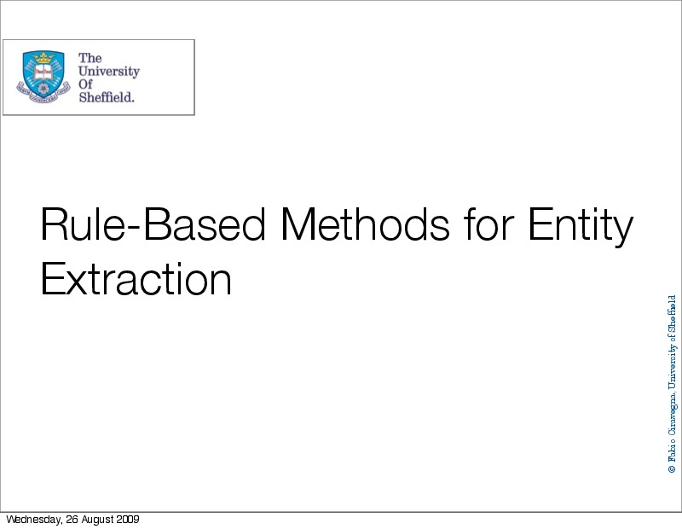

Slide 21
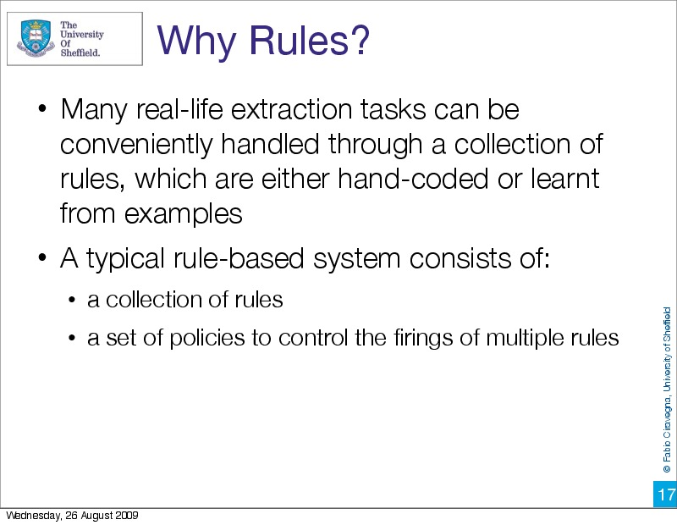

Slide 22
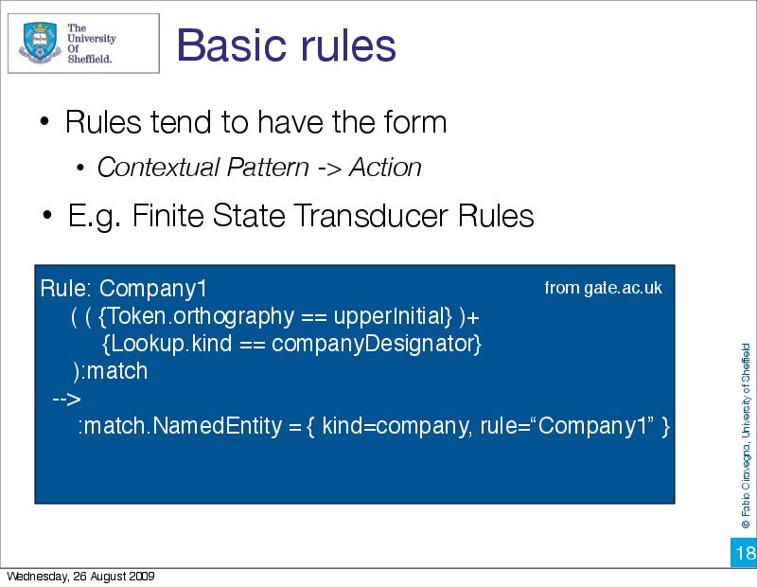

Slide 23
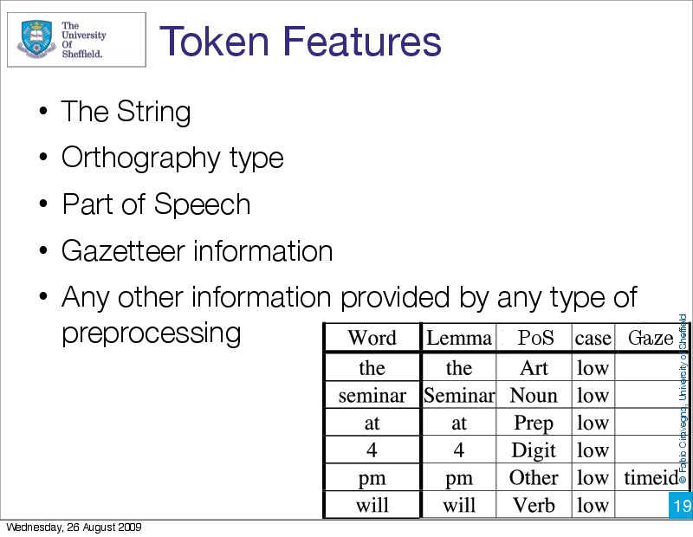

Slide 24
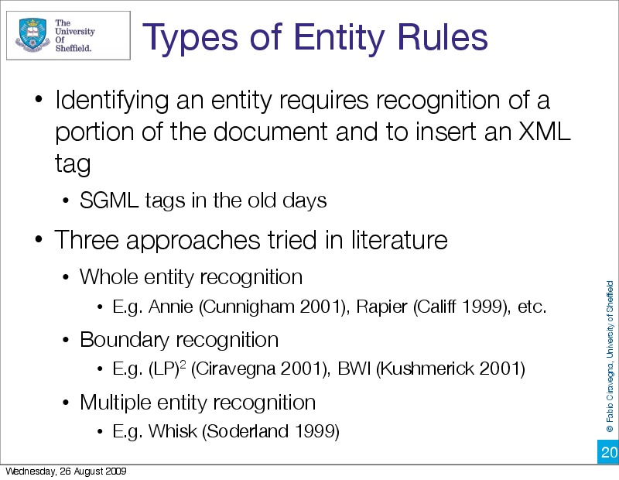

Slide 25
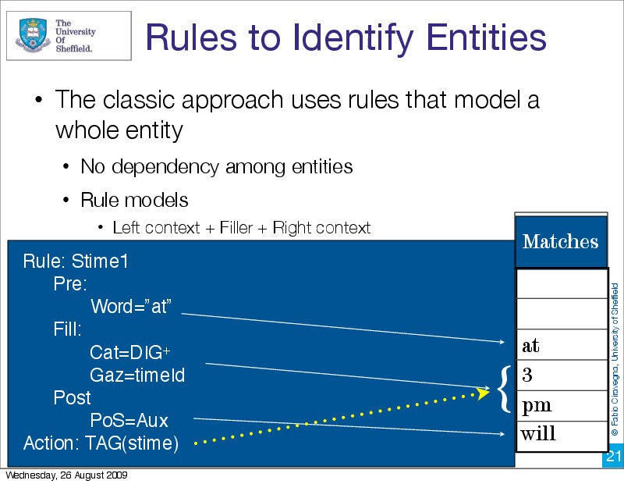

Slide 26
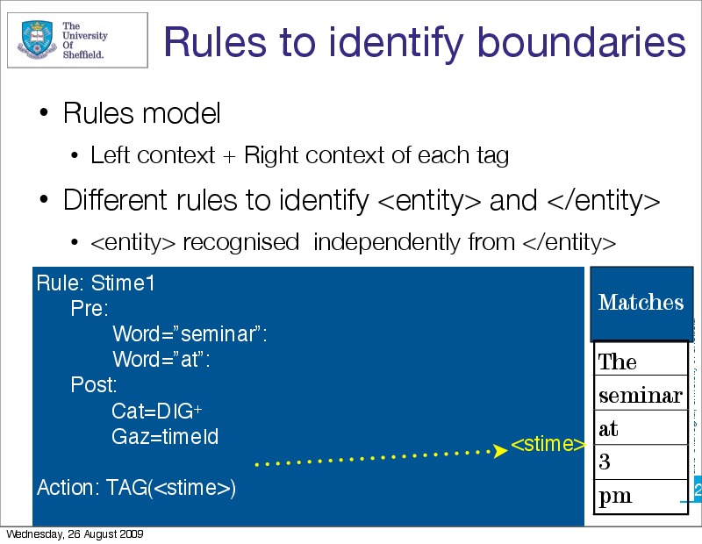

Slide 27
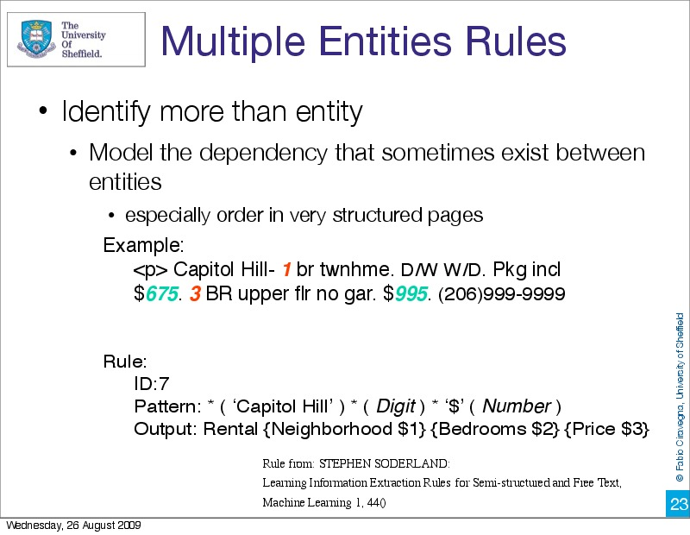

Slide 28
Discussion
Multi-entity rules are typically used when there is a lot of structure
Single-entity rules are often used when manually writing rules
Humans are good at creating general rules from a limited number of examples
Boundary rules are often used in learning approaches
They generalize well from few examples
For instance, they can use rules for stime and etime that are learned from different training examples
But they may overgeneralize!
Slide modified from Ciravegna

Slide 29
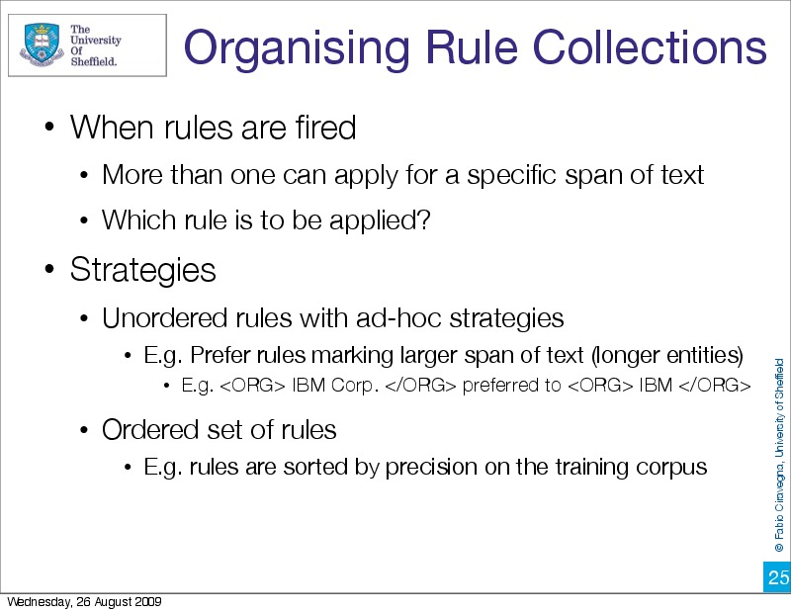

Slide 30
Rule-based NER
Through about 2000, handcrafted rule-based NER was better than statistical NER
For instance in the Message Understanding Conferences, which featured shared tasks
Since 2000, statistical approaches have started to dominate the academic literature
In industry, there is still diversity
High precision -> rule-based
High recall -> statistical
Between, many different solutions (including combining both approaches)
But it is easier to tune statistical systems to improve precision than to tune rule-based systems to increase recall...

Slide 31
Learning Rules
We will now talk about learning rules
Still closely following Sarawagi Chapter 2
The key resource required is a gold standard annotated corpus
This is referred to as the "training" corpus
The system "learns" through training
The goal is to learn rules which may generalize well to new examples which were not seen during training
We will discuss bottom-up and top-down creation of rules

Slide 32
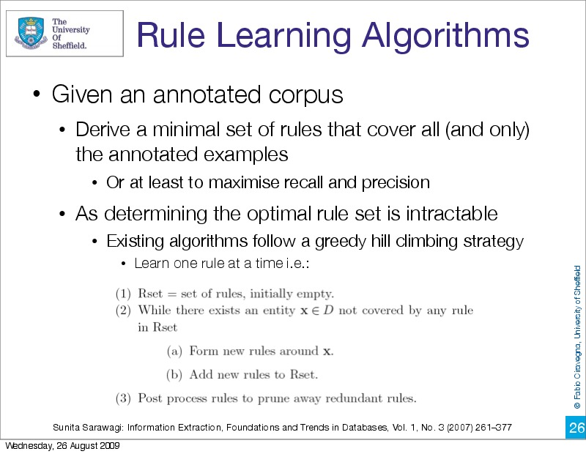

Slide 33
Overfitting and Overgeneralization
One key concept here is "overfitting" examples
What is meant here is that we memorize too much from one example
For instance, if we have:
and we memorize that in this exact context Elvis Presley is a person, we are failing to generalize to other contexts
We can also "overgeneralize"
An example would be to learn that the first word of a sentence is a first name
This is true in this sentence
But this rule will apply to every sentence, and often be wrong
Elvis Presley was born in 1935 in East Tupelo, Mississippi.

Slide 34
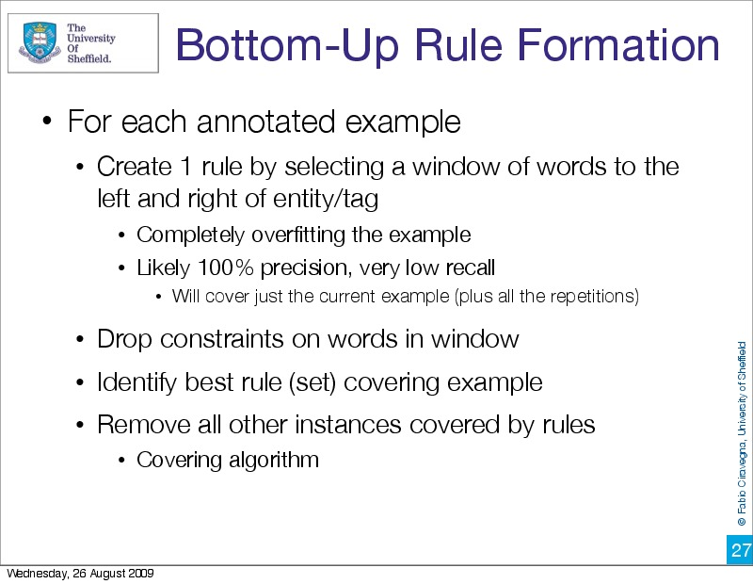

Slide 35
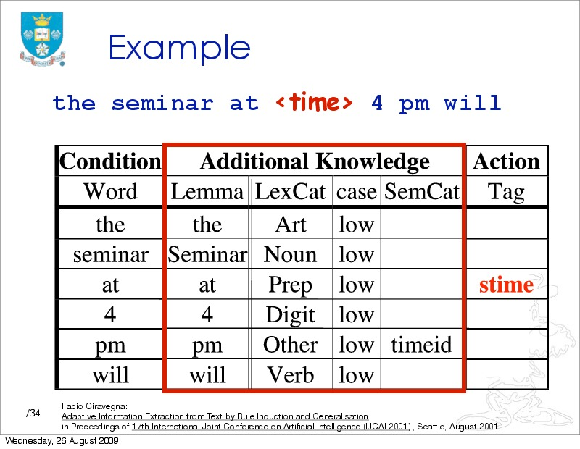

Slide 36
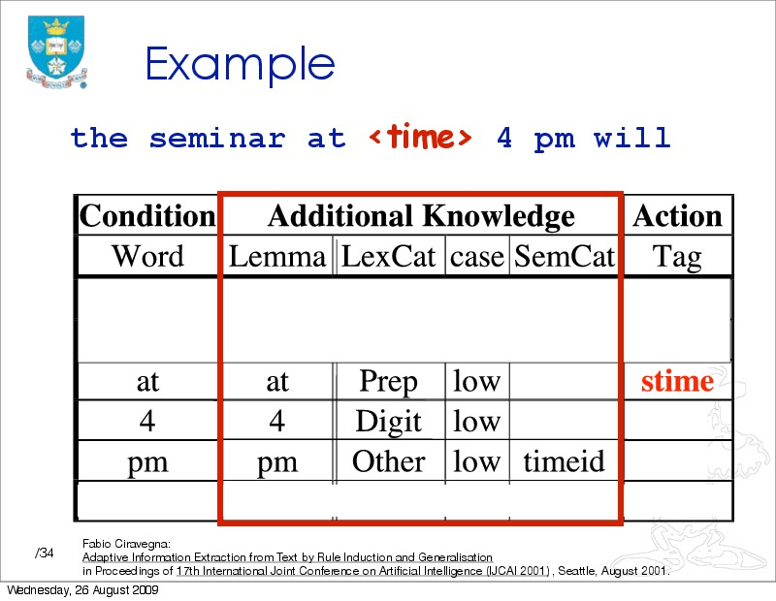

Slide 37
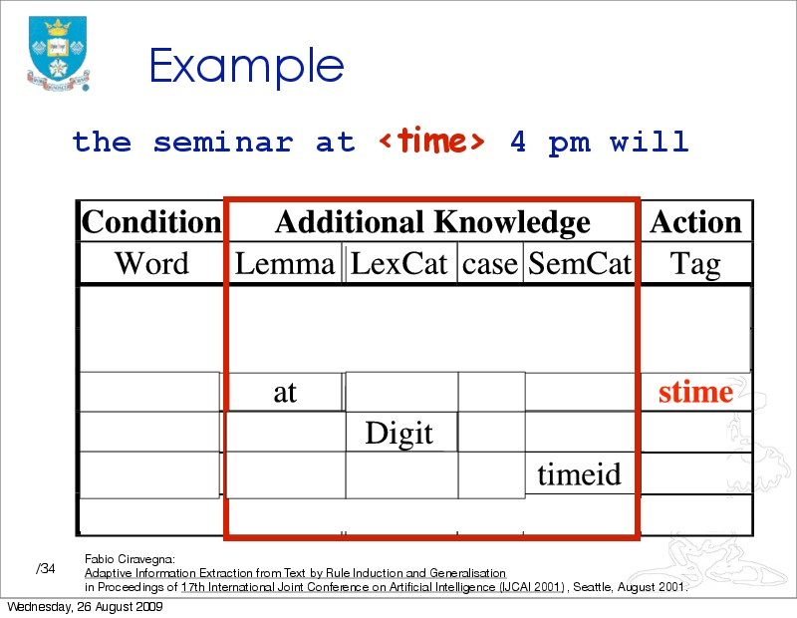

Slide 38
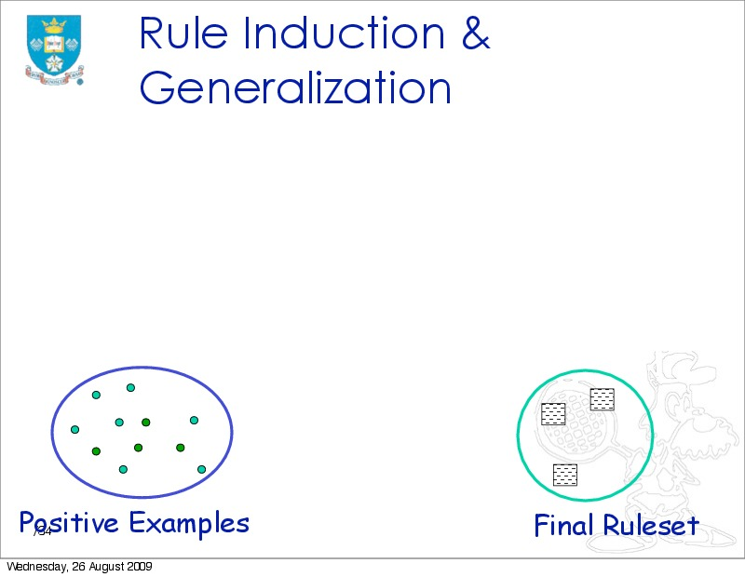
Slide from Ciravegna

Slide 39
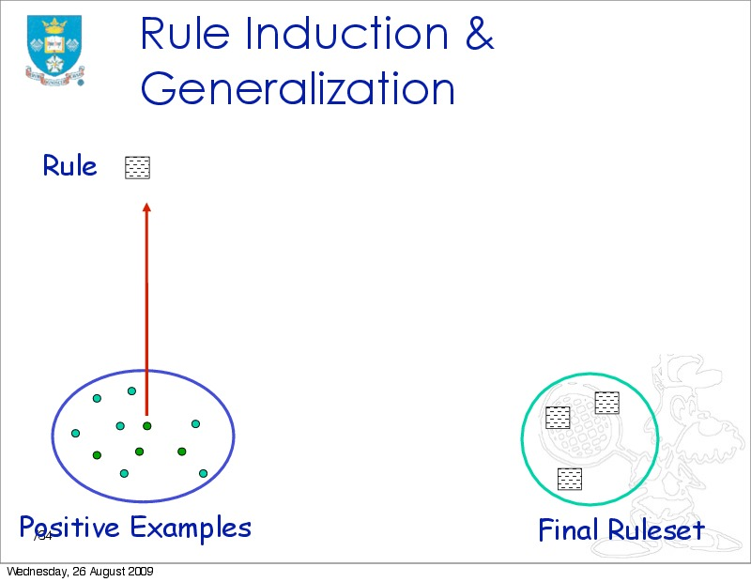
Slide from Ciravegna

Slide 40
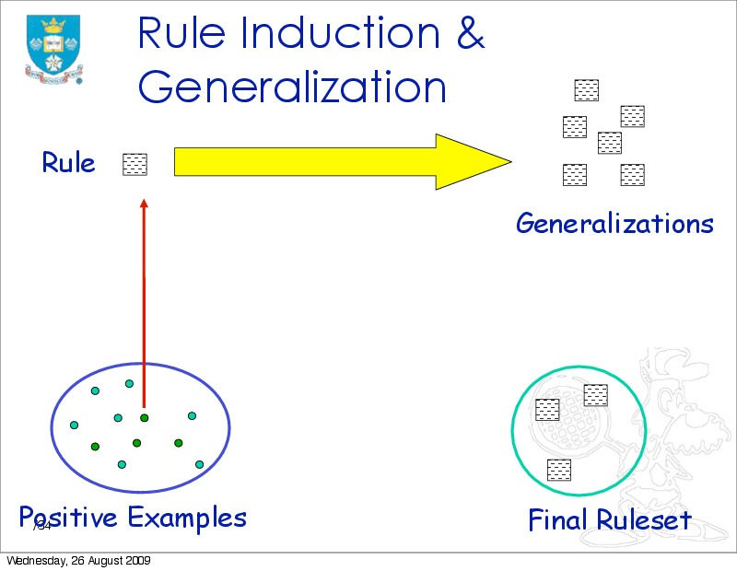
Slide from Ciravegna

Slide 41

Slide from Ciravegna

Slide 42
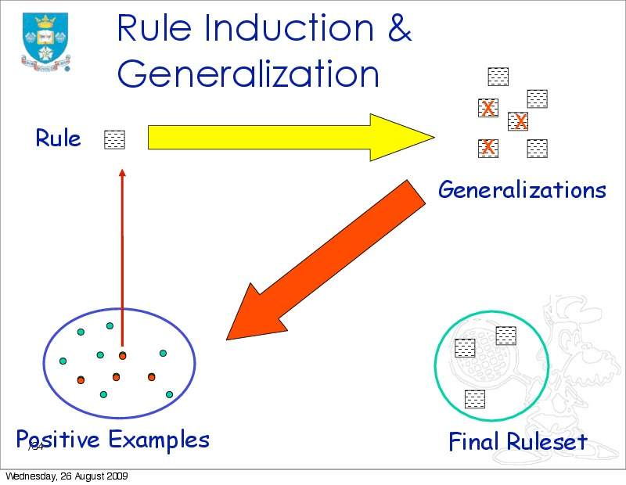
Slide from Ciravegna

Slide 43
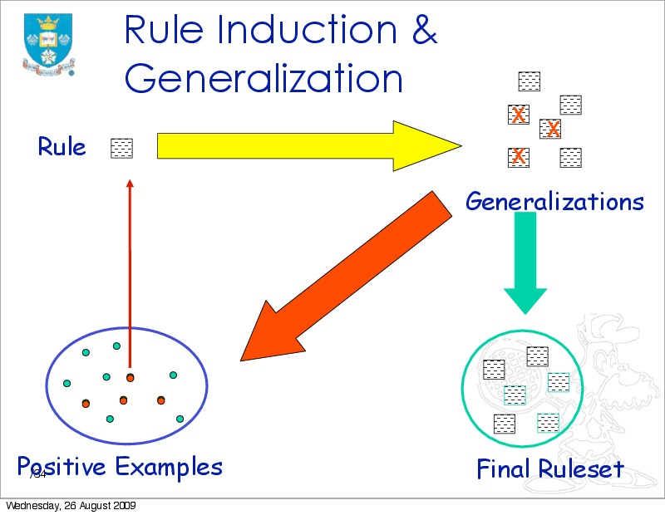
Slide from Ciravegna

Slide 44
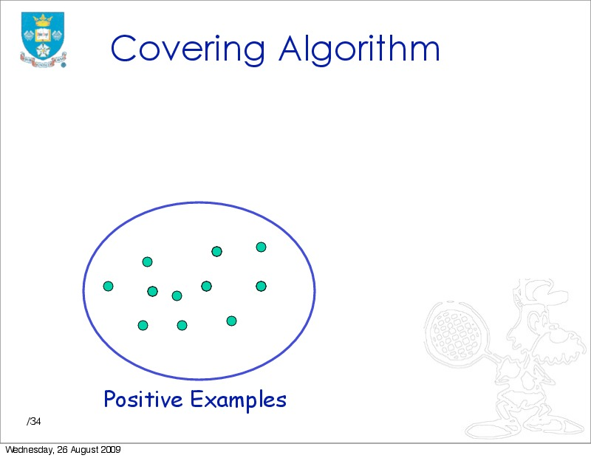
Slide from Ciravegna

Slide 45
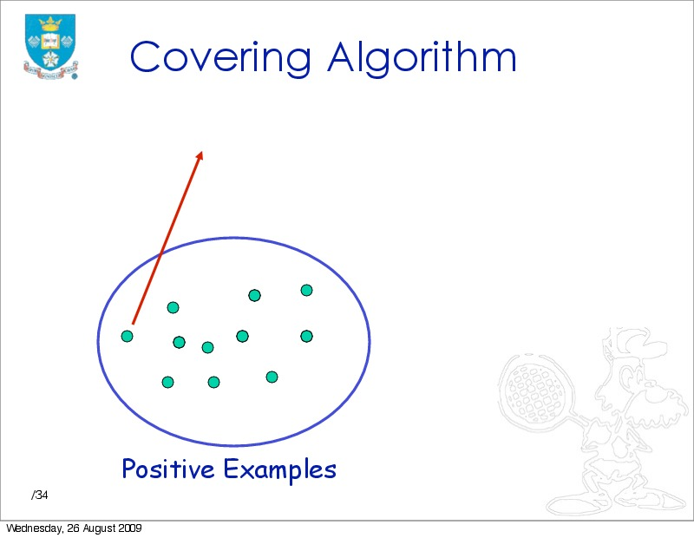
Slide from Ciravegna

Slide 46
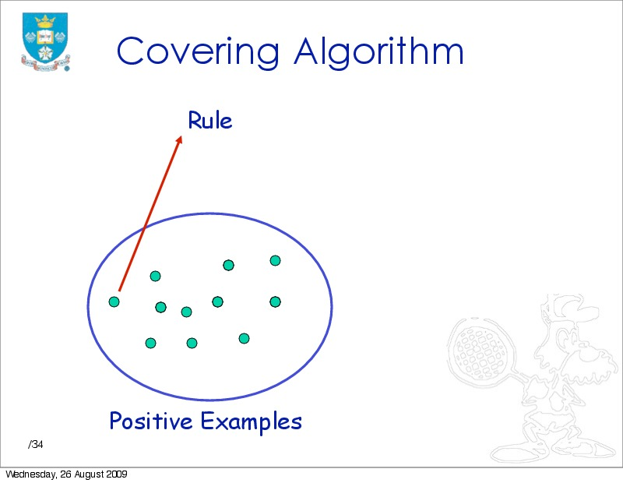
Slide from Ciravegna

Slide 47
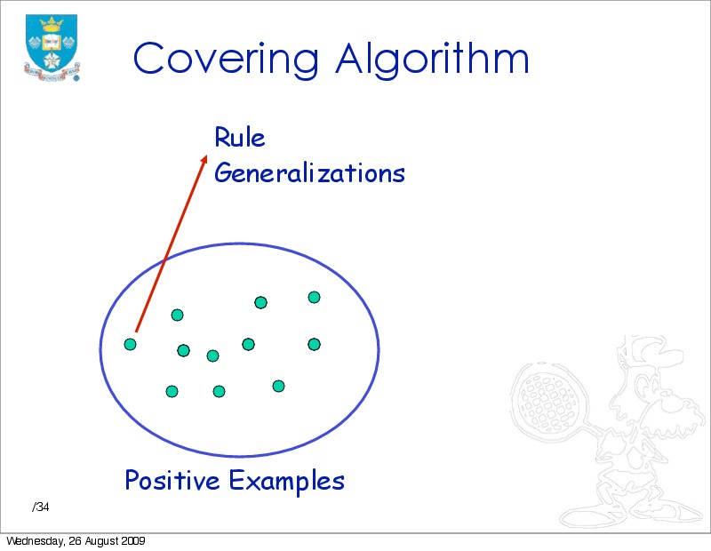
Slide from Ciravegna

Slide 48
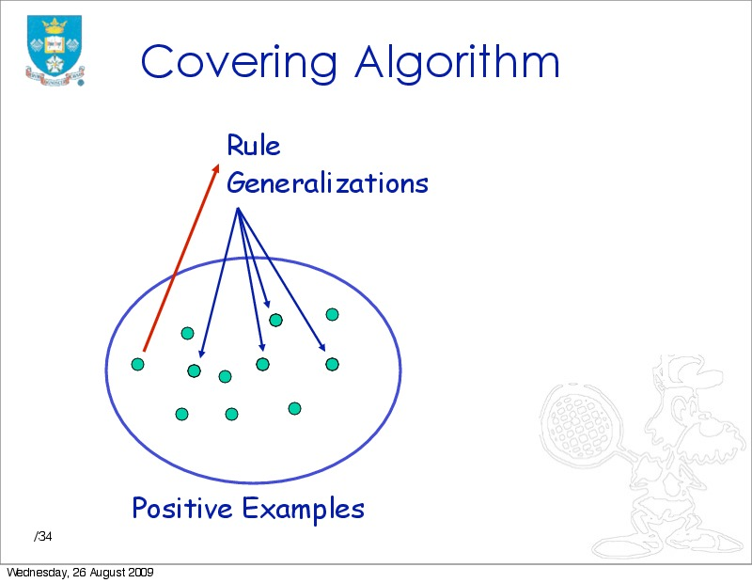
Slide from Ciravegna

Slide 49
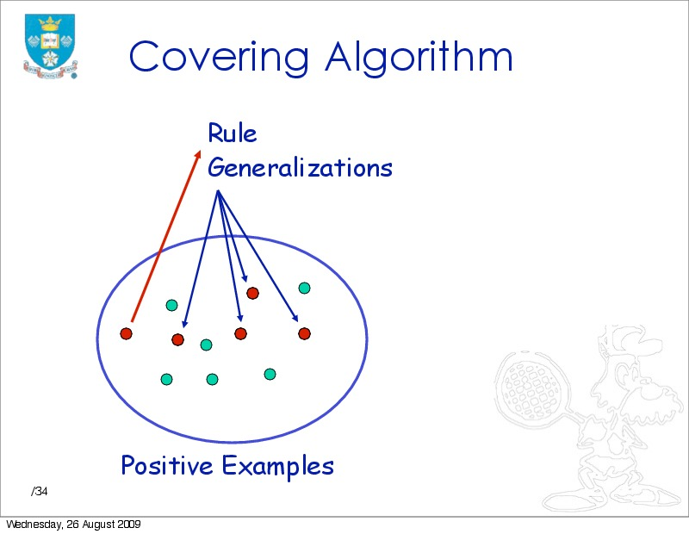
Slide from Ciravegna

Slide 50
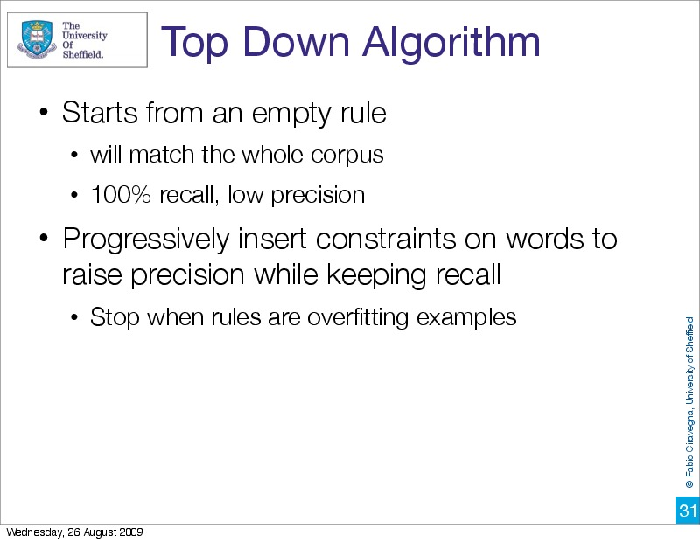

Slide 51
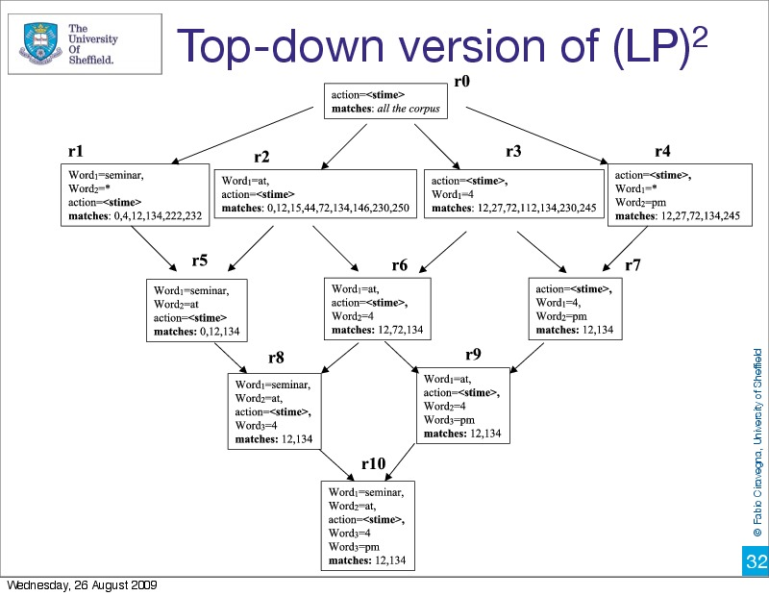

Slide 52
We will have a Referat in the Seminar on rule learning which goes into further detail
Wikipedia also has a useful survey
Now we will return to evaluation
First a simple discussion of precision/recall as actually used
Then further issues
Finally, we will discuss annotation of training sets

Slide 53
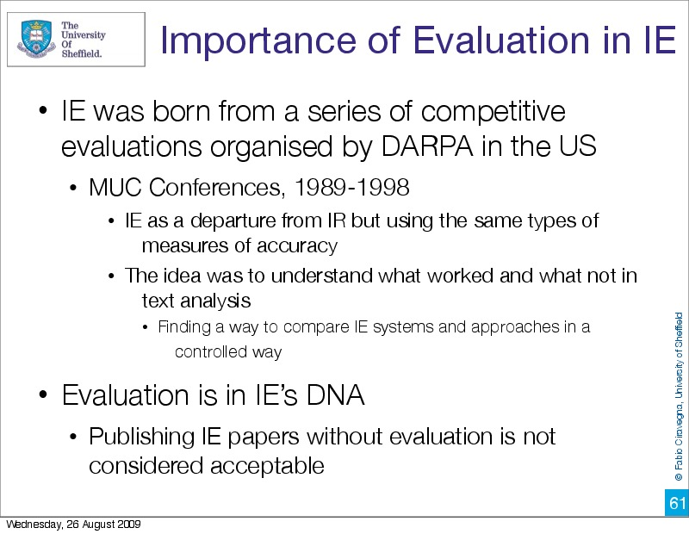

Slide 54
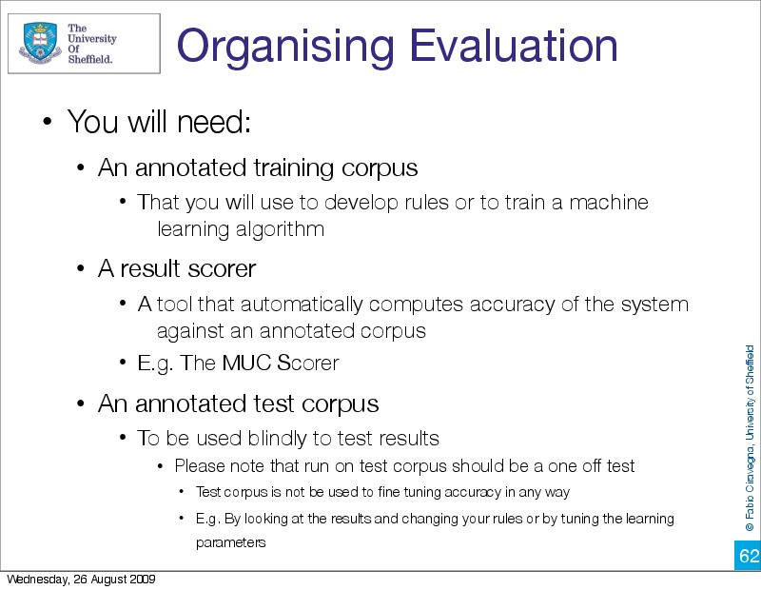

Slide 55
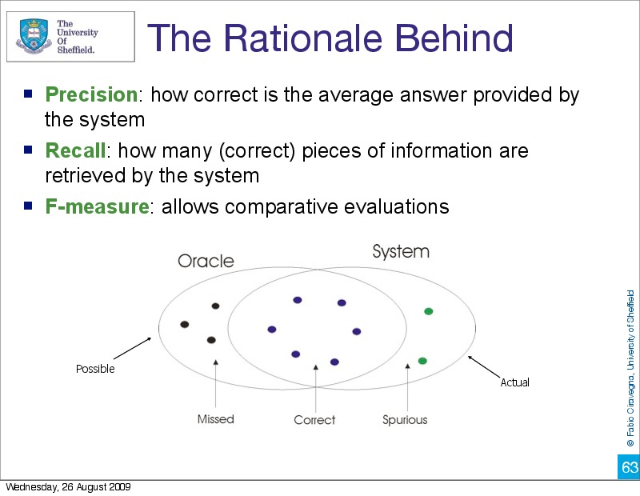

Slide 56
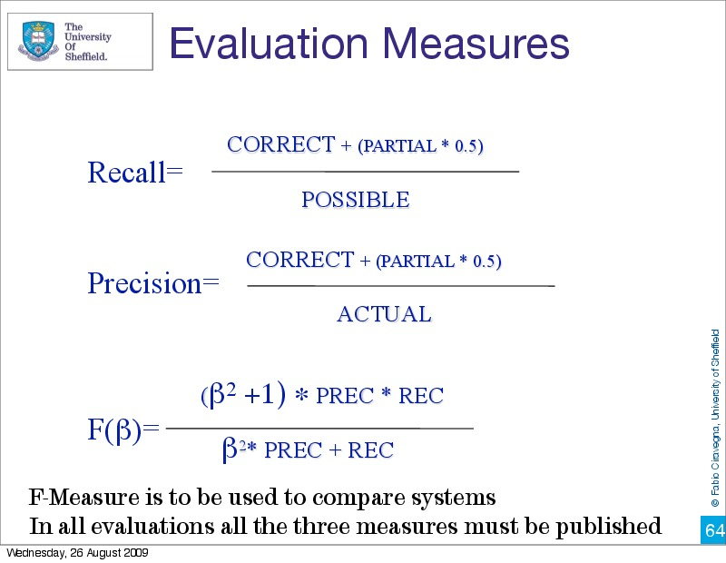

Slide 57
Slide sources
Many of the slides today were from Fabio Ciravegna, University of Sheffield

Slide 58
Thank you for your attention!

