Slide 1

Team: “KLUG KHETI” (Smart farming) Abhin P Jose
Shalini Sarode
Vippin Kumar Jeetmal Vivek Agarwal
USE CASE: CO2 Optimiertes Getreide

Slide 2


PROBLEM STATEMENT
Data Overload. Lack of Insights CO₂ Emissions Uncertainty Compliance Complexities Need for Integration

Slide 3

Our Solution:

Slide 4

Data Analysis:

Slide 5
CO2 Calculation:

Slide 6
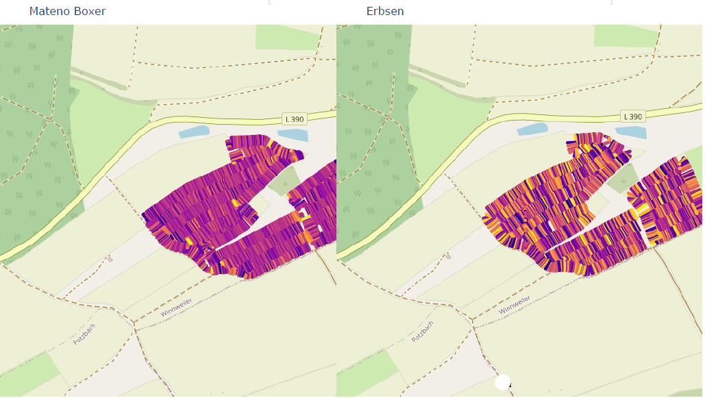
Visualization:

Slide 7
Digital Twin Solution:

Slide 8
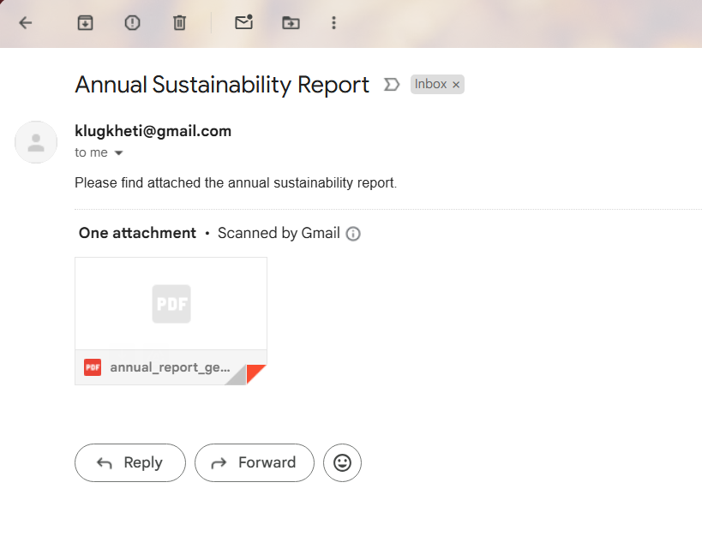
Delivering Insights with Automated Reporting

Slide 9

Looking Ahead: Smarter Solutions with AI:

Slide 10
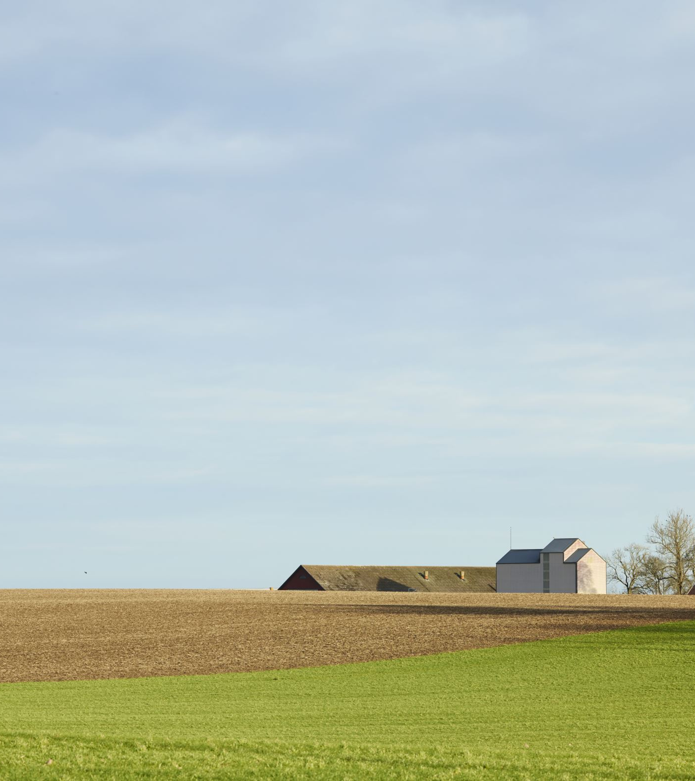
A Greener Tomorrow, One Farm at a Time

Slide 11
Questions?

