Slide 1

Presentation 5
PhD Project
Vivek K

Slide 2
Goals accomplished
Transforming component data from indexing format (1, 2, 3) to subscripted format (_x, _y, _z)
Ex1a: activity(activity_idx). VICON(subject_idx, trial_idx). movement_data. markername_clustername_component
Ex1b: activity(1). VICON(2,1). sternum_cluster1_x
Ex2a: activity(activity_idx). IMU(subject_idx, trial_idx). movement_data. markername. physicalquantity_component
Ex2b: activity(1). IMU(2,1). sternum. q_real
Frames vector added to the IMU sub struct
VICON file name issue handled
Show activity struct example to illustrate the above
Got started with the web version of Mendeley

Slide 3
Data type standardization and Populated struct
Activity (n=31)
VICON (j=25, k=2)
IMU (j=25, k=2)
File path
Movement data
File path
Extension
Meta data
Extension
Markers
Names
Present
Table Vis
Frame rate
Units
…..
Frames
Time
Marker_1_x
…..
Table Vis
Name
Movement Data
Meta Data
Markers
Button
Time
Frames
Marker_1
…
Acc_x
Acc_y
Acc_z
Push_Time
Sensor
Label
Push Index
Gyr_x
…
Updated
Reasons for this practice:
As good practice in order to safeguard against possible data type errors
To have as much consistency as possible in our data structures
Refer to last slide for difference between referencing IMU and VICON data
Red = Struct
Black = String
Green = Logical
Blue = Table
Yellow = Double
Purple = Int32
Orange = Char

Slide 4
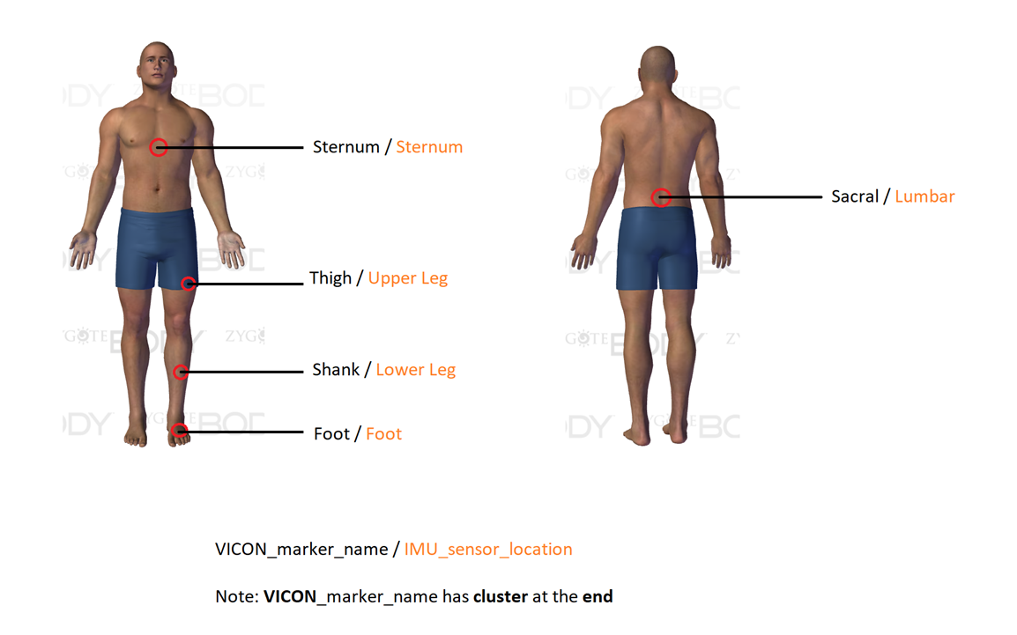
IMU sensor locations to match VICON names
Time consuming due to a lot of errors!
Mapping takes into account case sensitive strings
Verified that code is working after change
Show activity struct in MATLAB for this change

Slide 5
Next steps
Checking that the activity struct saves and reopens without any crashes!
Git and version control of the code
We are all good to start with the IMUsim part ☺

