Slide 1
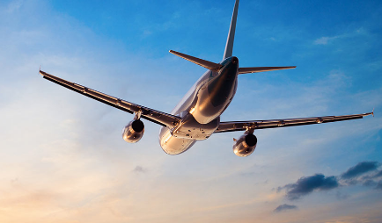
Government Flight Analysis
Team 3:
Vyshak Srishylappa
Vivek kumar
Sankalp jadon

Slide 2
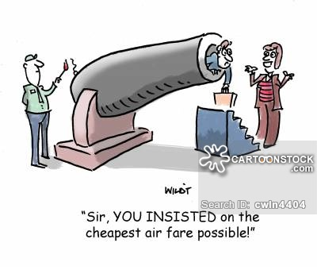
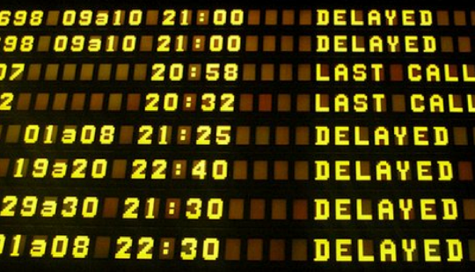

Slide 3
Business cases/problem statement:
Crowded airspace becoming unpredictable.
Rescheduling of critical government air space operations because of delays
Problems in liaisoning between US military and the civilian Air Traffic Control because of sudden delays.
Bad customer satisfaction for US residents.
Sudden surge/decrease in the airfare.
Solution :
Delay Prediction
Average Price Prediction
Flight cancellation Prediction
Flight Recommendation

Slide 4
Data
We have gathered the data from Statistical Computing Statistical Graphics.
Data had around 5 million rows and 25 columns.
We processes our prediction on .5 million rows.
Recommendation: we ran the matchbox recommendation algorithm against 35,000 users who had reviewed the airline carriers.

Slide 5
Arrival Delay Prediction
Based on feature selection, used month, day of the month, visibility, departure delay to train various regression models.
Used Linear regression, boosted decision tree, Neural Network, and Decision Forest.
Concluded that the accuracy was average because various key factors like mechanical issues, airport congestion, etc. were not present in the dataset.
Found that Boosted decision tree was the best algorithm amongst all.

Slide 6
Flight Delay Models Matrix
 | Linear Regression | Neural Networks | Decision Forest Regression | Boosted Decision Tree
MAE | 11.86 | 148.81 | 9.52 | 9.19
RMSE | 25.38 | 160.93 | 24.70 | 23.98
Relative Absolute Error | 0.58 | 0.98 | 0.47 | 0.45
Relative Squared Error | 0.39 | 1.04 | 0.37 | 0.35
Coefficient | 0.60 | -0.04 | 0.62 | 0.64

Slide 7
Flight Cancellation classification
Model | Accuracy | Precision
Two Class Logistic Regression | 0.978 | 0.565
Two Class Neural Network | 0.980 | 0.756
Two Class Boosted DecisionTree | 0.982 | 0.758
Two Class Decision Forest | 0.980 | 0.591
Two Class Decision Jungle | 0.981 | 0.872
Classification done on the Cancelled Column of the dataset. 0 stands for not cancelled and 1 for cancelled.
Two Class Boosted Decision Tree gives better accuracy.
Weather data was scraped from wunderground website.
On Feature Selection, we selected flightnum, hour, temperature, visibility and sea level pressure as the variables that help in better prediction.

Slide 8
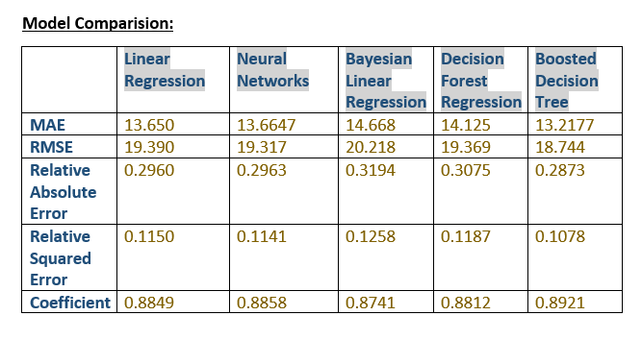
Average Price Prediction
Predict the average price of flights, depending on destination address.
Predict average ticket price according to Flight Carrier.
We found Boosted Decision Tree to be the best model among all others.

Slide 9
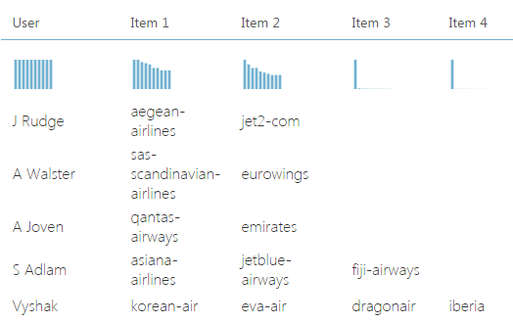
Air Carrier Recommendation
We are using the Microsoft Azure recommendation System to get the related Airlines carriers.
The dataset is trained on UserName, Airlines carrier and their ratings.

Slide 10
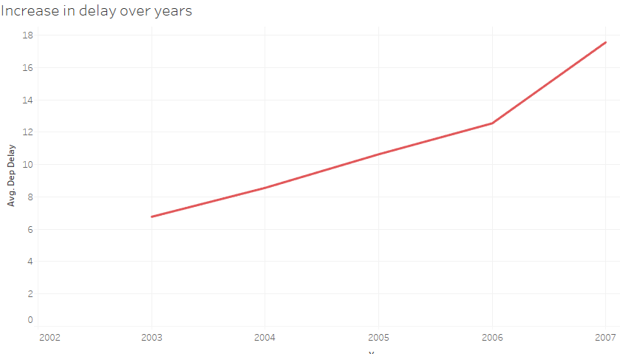
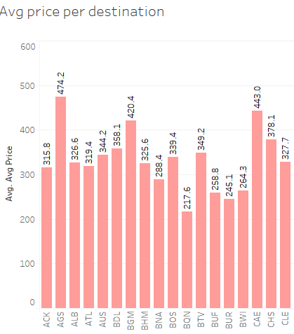
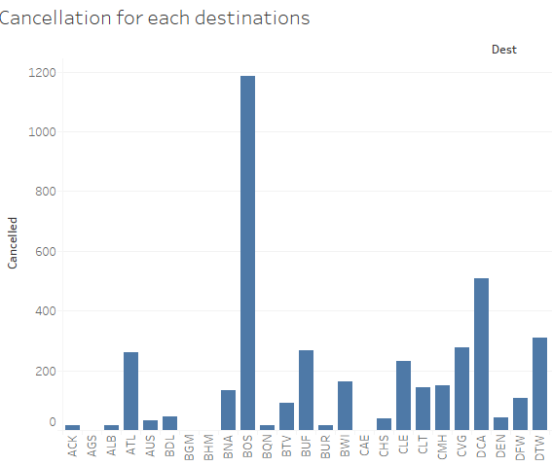
Visualization

Slide 11
Thank You !!

