Slide 1
MiiTime
Take back your time
Notes:
Srinesh Hello, our product is MiiTime, and our app helps users automate scheduling of their daily tasks.

Slide 2
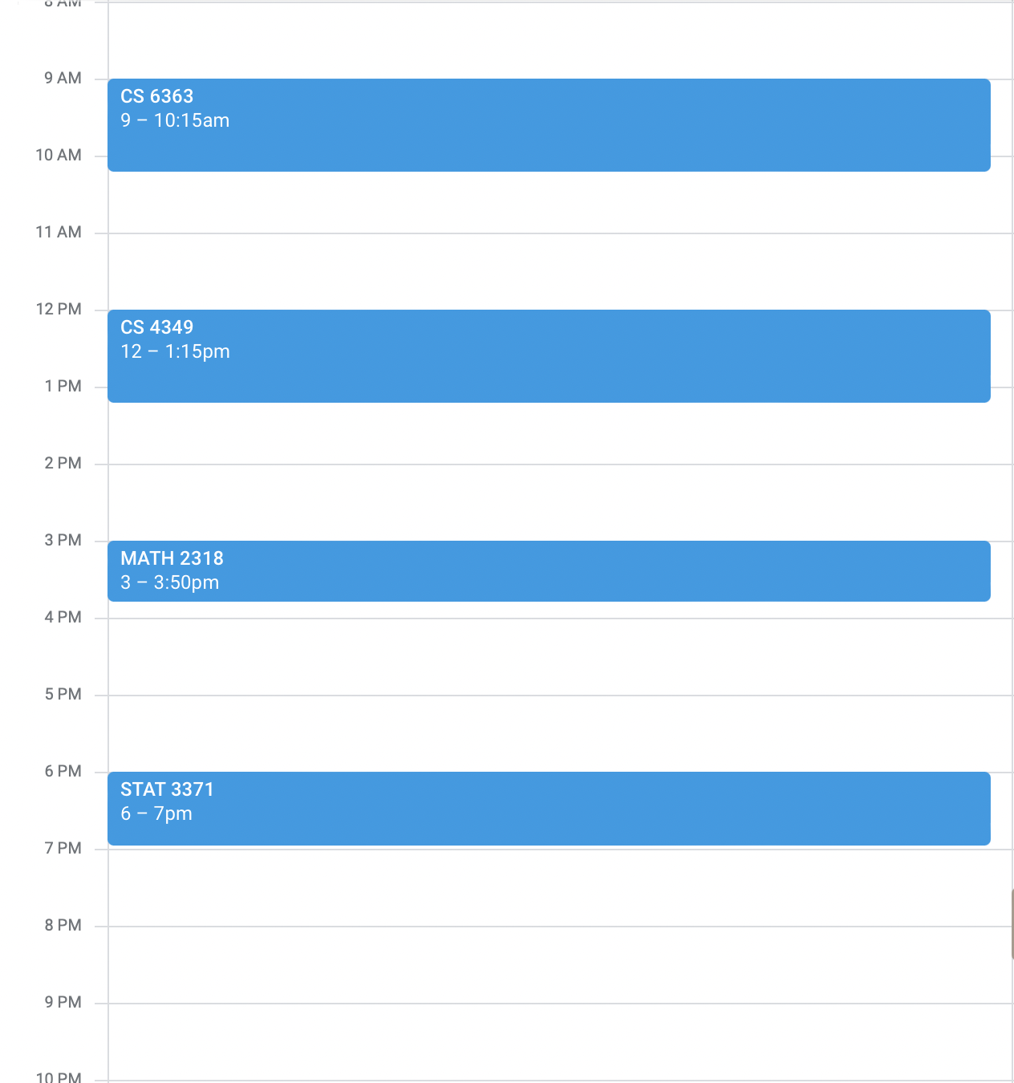
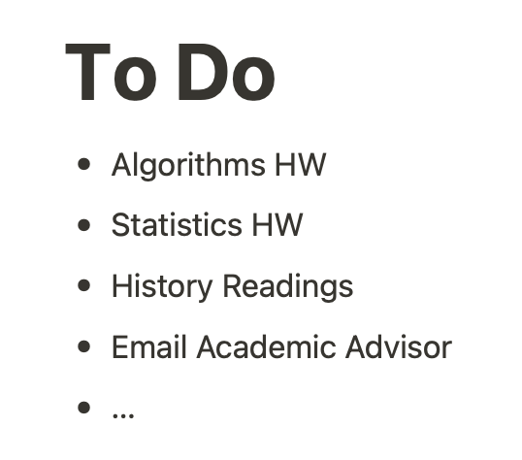
Imagine your schedule
Your schedule looks full of commitments, and you don’t know how to fit in everything you need to make the most of your day.
Notes:
Srinesh Think about the system that you use to remember all the things that you do. Do you use multiple services that you have to keep track of, like adding to-do items to a calendar?

Slide 3
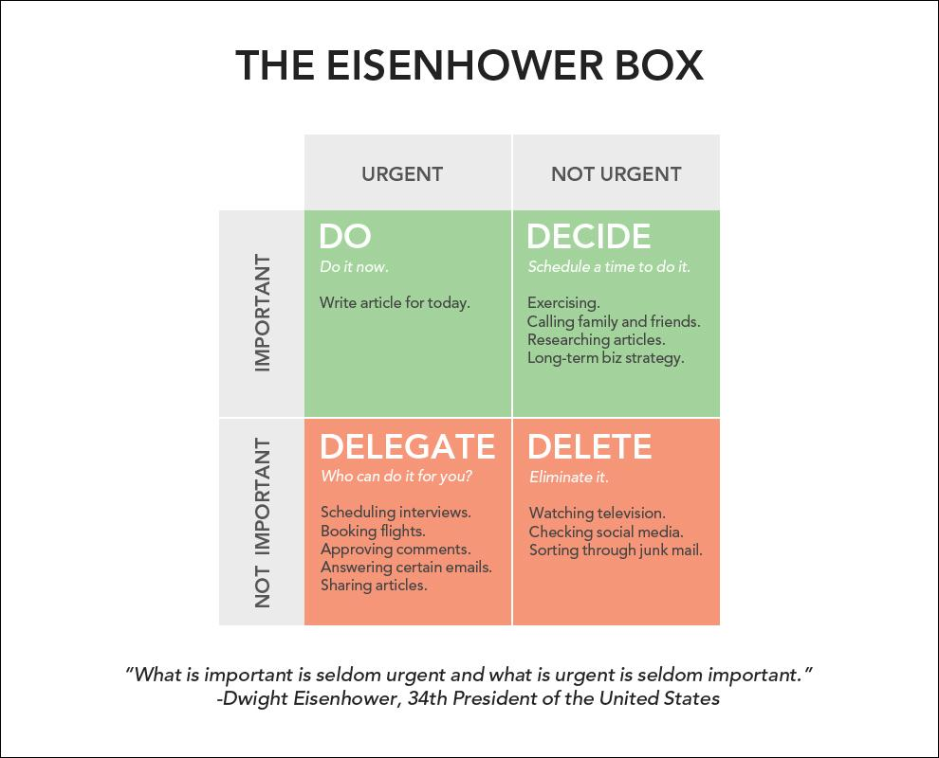
Notes:
Bryant MiiTime focuses on helping you organizing the Important, non-urgent tasks that require intentional planning and focused time allocation to finish.

Slide 4
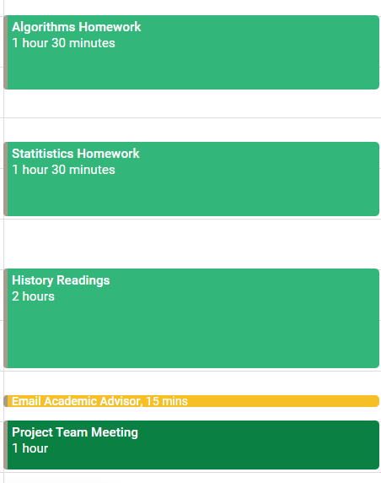
You need to fit in all these activities
But you don’t know how to add them into your schedule.
Notes:
Bryant The big challenge with these tasks is finding time in your schedule to actually do them. A good approach is to schedule time on your google calendar to work on these tasks, but it might be tedious to do that for every task. Any changes in your schedule would make you have to move tasks around too. Thats where MiiTime comes in.

Slide 5
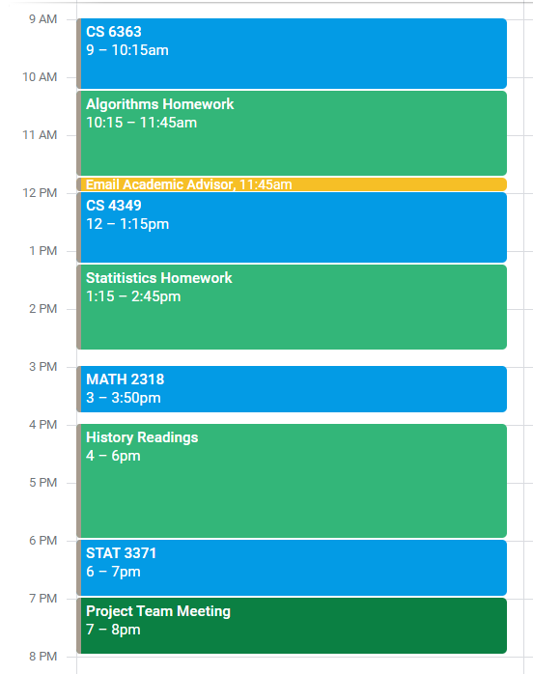
MiiTime will automatically schedule your activities
Notes:
Srinesh MiiTime will sort your activities by priority and various other user selected criteria and automatically assign them to any available time slots in your schedule.

Slide 6
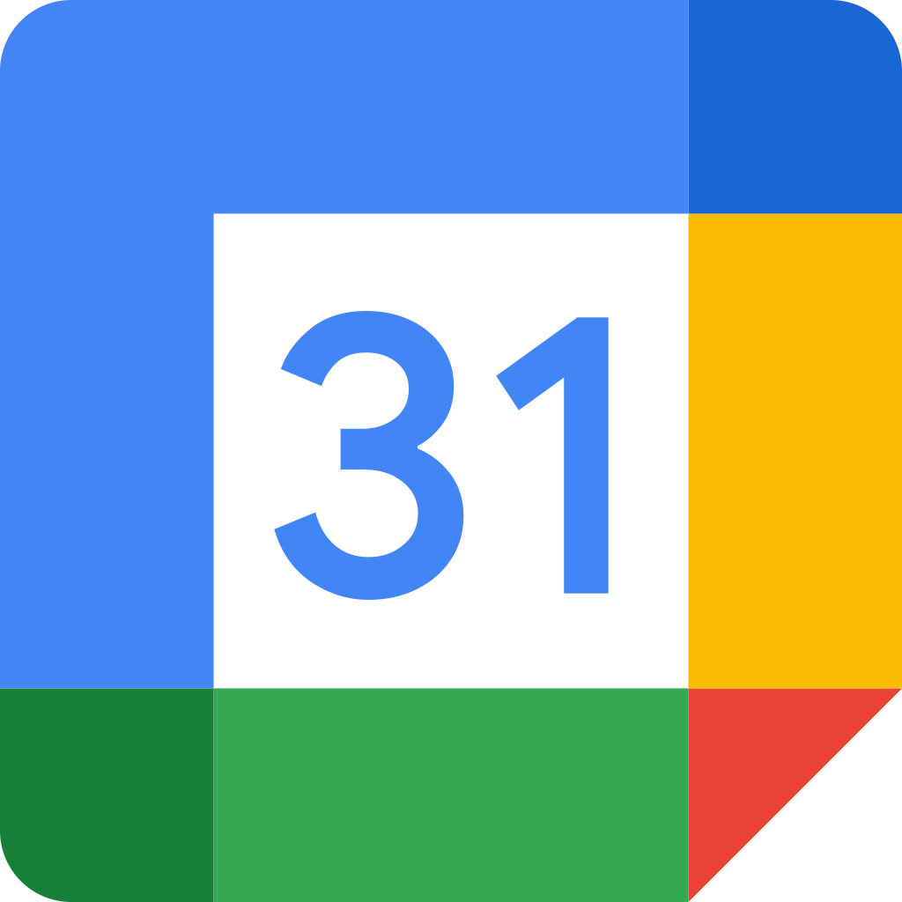
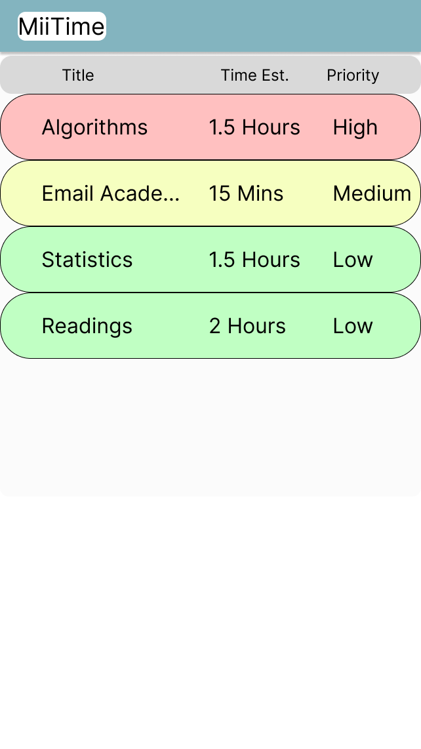

Notes:
MiiTime is able to manage all your scheduling needs by hooking into your calendar service of choice and automatically updating events as you make changes to your activity plan.

Slide 7
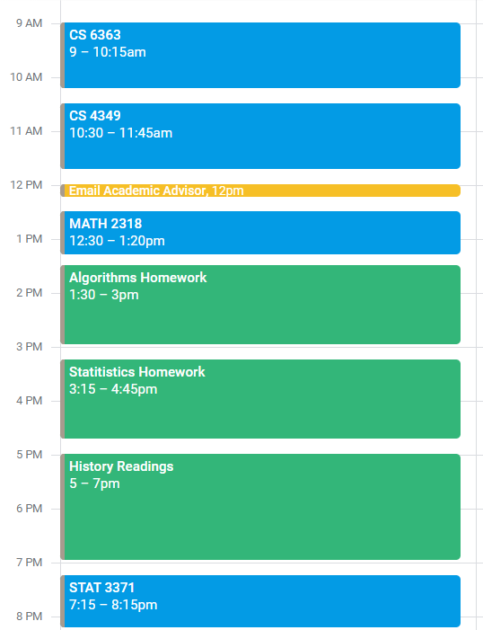
Reschedule as needed
Notes:
It will automatically recalculate your schedule when you make any manual changes. For example, If your class schedule changes, you can adjust the times and MiiTime will automatically recalculate the rest of your activities.

Slide 8
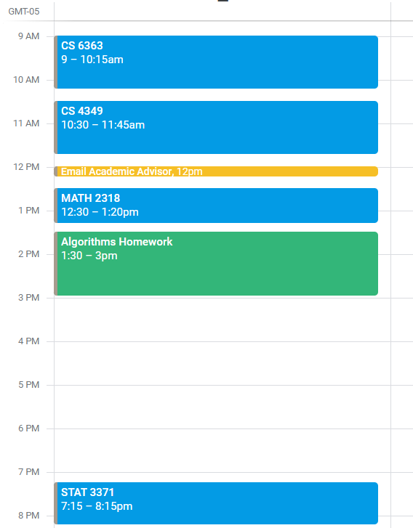
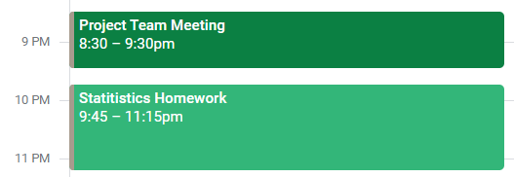
Add break times
Notes:
If you have any times you would like to designate as breaks, or leave certain intervals between activities, MiiView will work around these criteria as well.

Slide 9
On mobile

Slide 10
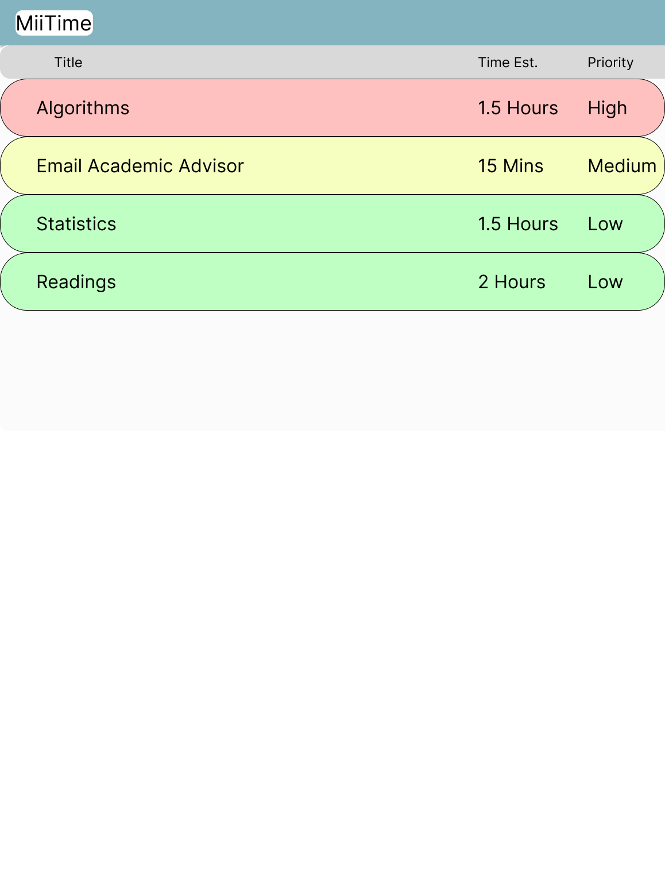
And large form factor devices

Slide 11
Demo
https://www.figma.com/proto/4dOqGPwcEBNDiMGQwgZVBU/MiiTime?node-id=31%3A52&scaling=scale-down&page-id=0%3A1&starting-point-node-id=31%3A52
Notes:
Time management and making time for the things I need to do has always been an issue of myself, and it might also be an issue for you as well.

Slide 12
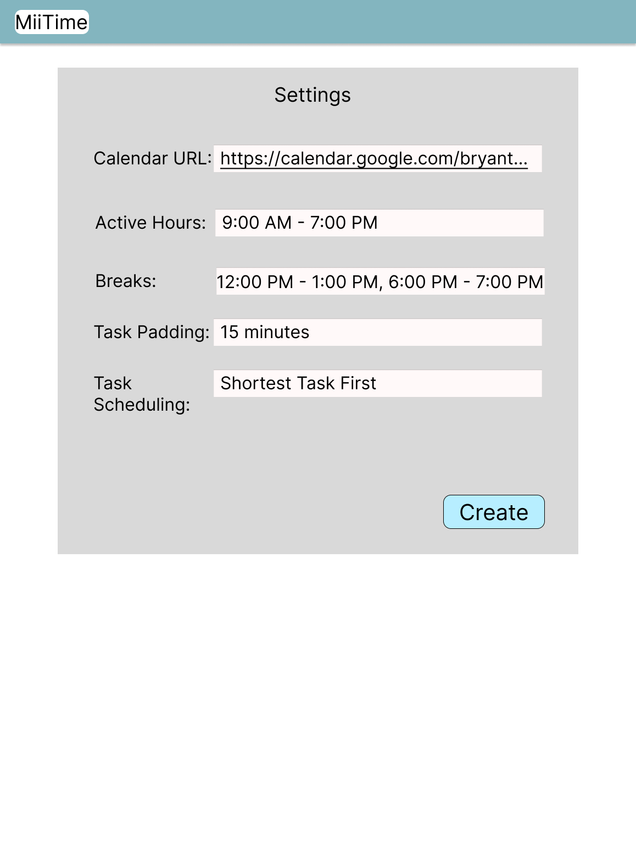
Flexibility in Settings
Notes:
Bryant MiiTime will sort your activities by priority and various other user selected criteria and automatically assign them to any available time slots in your schedule.

Slide 13
Thank you!
Any Questions?
Notes:
Time management and making time for the things I need to do has always been an issue of myself, and it might also be an issue for you as well.

