Slide 1

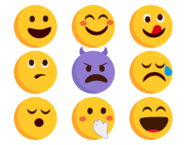
Detection of Emotions by Sequence Classification Using Machine Learning

Slide 2
Contents 1. Meet the team 2. Problem Description 3. Existing Work 4. Deep dive into the project 4.1 Preprocessing Dataset 4.2 Training Naive Bayes Model 4.3 Training LSTM Neural Network Model 4.4 Fine Tuning LLM 4.5 Comparing the results 5. How our proposed work is different 6. Usecases 7. Thankyou

Slide 3
Meet the Team G-36 Vivekanand Reddy Malipatel (A20524971) Divyansh Prakhar Soni (A20517331) Chethan Harinath (A20526469)

Slide 4
- Traditional sentiment analysis models face challenges with contextual nuances, cultural variations, and subtleties of human emotions, limiting their effectiveness across diverse datasets and languages. - This project utilizes pre-trained Large Language Models (LLMs) through transfer learning to enhance emotion detection. - The project aims to improve the model's understanding of context, idiomatic expressions, and cultural nuances. - It also seeks to extend emotion detection capabilities to multiple languages, enabling more comprehensive analysis across different cultural contexts.
Problem Description

Slide 5
- Recent NLP advancements have produced sophisticated models for understanding complex linguistic features and sentiments. - Traditional emotion detection methods relied on manual feature crafting and simpler ML algorithms like SVM and Naive Bayes. - Deep learning models such as CNNs and RNNs have improved performance by capturing semantic relationships in text. - Transformer-based models like BERT and GPT, along with their multilingual variants, have significantly advanced NLP capabilities, being pretrained on diverse corpora to grasp a wide range of linguistic nuances.
Existing Work

Slide 6
1. Remove all the extra columns in the dataset, other than Text and Label. The label field here refers to different emotions like sadness, joy, love, anger, fear, and surprise 2. Spelling correction 3. Expanding shortcut words( eg. I’ve-> I have) 4. Converting entire text to lowercase 5. Removing links/tags/punctuations from text 6. Lemmetizing the text 7. Splitting the data into test set (83362 rows) and train set (333448 rows) totalling to 416810.
Deep Dive into the project
Preprocessing Dataset

Slide 7
1. Trained Naive Bayes model using Scikit learn library 2. Vectorized the words using TF-IDF vectorizer 3. Saved the model for future inferences
Deep Dive into the project
Training Naive Bayes Model

Slide 8
1. Used PyTorch LSTM module to train the LSTM network 2. To calculate loss, we have used cross entropy 3. Used ADAM to optimise the model efficiency 4. Saved model for future inference
Deep Dive into the project
Training LSTM Neural Network Model

Slide 9
1. Chose DeBERTa multi lingual pre trained model as the base model for fine tuning 2. Trained using transfer learning method 3. We fine tuned model and saved it
Deep Dive into the project
Fine Tuning Large Language Model

Slide 10
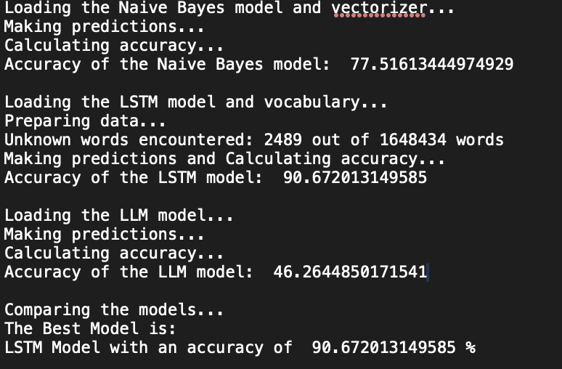
Inferring results from the trained Naive Bayes and LSTM, and the untrained base LLM model with English data.
Deep Dive into the project
Comparing the results

Slide 11
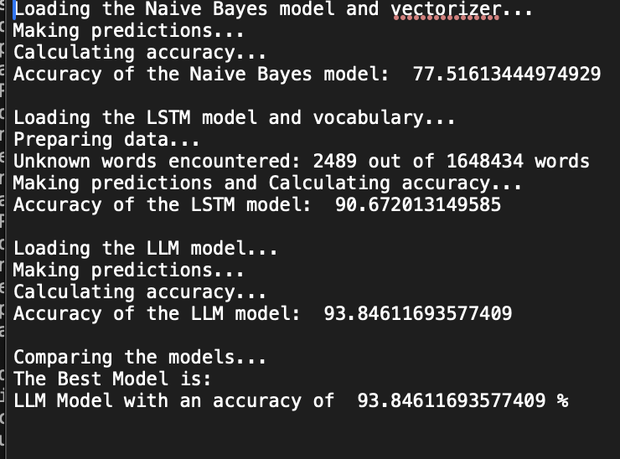
Inferring results from the trained Naive Bayes and LSTM, and the fine-tuned base LLM model with English data.
Deep Dive into the project
Comparing the results

Slide 12
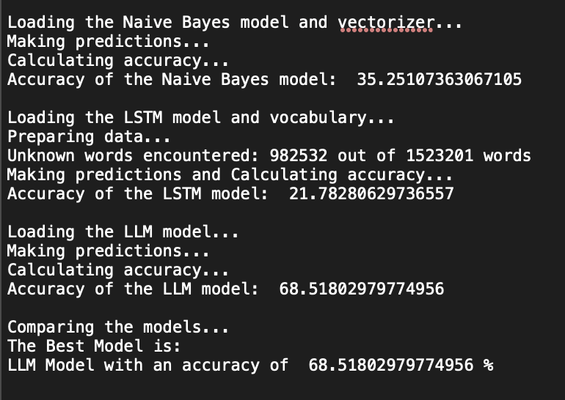
Inferring results from the trained Naive Bayes and LSTM, and the fine-tuned base LLM model with Spanish data
Deep Dive into the project
Comparing the results

Slide 13
- Our work focuses on harnessing the contextual awareness and linguistic diversity of Large Language Models (LLMs) for emotion detection. - Unlike existing research that uses pre-trained models for sentiment analysis, our approach aims to fine-tune LLMs for a deeper contextual understanding of emotional expression in text. - We go beyond surface-level sentiment analysis to grasp the contextual subtleties and complexities of emotions. - Additionally, our project emphasizes multilingual emotion detection by utilizing multilingual models. - This approach allows us to develop a unified framework effective across multiple languages, addressing the lack of resources and research for non-English languages in emotion detection.
How our proposed work is different

Slide 14
1. Customer Sentiment Analysis: Analyzing customer reviews, feedback, and comments to understand their emotions towards products or services. 2. Social Media Monitoring: Monitoring social media platforms to detect and analyze emotions expressed in posts, comments, and messages. 3. Market Research: Analyzing survey responses and interviews to gauge emotional responses to products, brands, or marketing campaigns. 4. Healthcare: Analyzing patient feedback or social media posts to understand emotional states related to healthcare experiences or conditions. 5. Education: Analyzing student responses to coursework or online learning platforms to gauge engagement and emotional responses.
Usecases

Slide 15
1. Dataset taken from https://www.kaggle.com/datasets/nelgiriyewithana/emotions/data 2. Base LLM https://huggingface.co/MoritzLaurer/mDeBERTa-v3-base-xnli-multilingual-nli-2mil7
References

Slide 16
Thankyou!

