Slide 1

Predicting Economic Indicators with Recurrent Neural Networks
Vivek Mevada – C062
Soham Patel – C073
Dhyey Sanghavi – C089

Slide 2
Introduction
The aim of this project is to demonstrate the effectiveness of RNN models in analyzing and predicting time series data, and to compare the performance of different RNN architectures.
By leveraging the power of these models, we can potentially improve our ability to forecast economic and financial trends, which can have important implications for decision-making in various domains.
Why the standard ML approach doesn’t work for time series models: -
Features and target variables are the same
Data correlated over time
Often non-stationary (hard to model)
Need a lot of data to capture the patterns and trends and model those changes appropriately

Slide 3
Problem Definition
Federal Reserve Economic Data (FRED) is a database maintained by the Research division of the Federal Reserve Bank of St. Louis that has more than 816,000 economic time series from various sources.
They cover banking, business/fiscal, consumer price indexes, employment and population, exchange rates, gross domestic product, interest rates, etc.
This economic data can be combined with statistics and Deep Learning models using RNN to analyze and forecast time series data.
The ultimate goal would be to develop an RNN model that can accurately forecast future values based on historical data, which can have applications in a wide range of fields, such as finance, economics, and climate science.

Slide 4
Proposed System/Algorithms/Architecture
Recurrent neural networks (RNNs) are a class of neural networks that are particularly useful for processing sequential data, such as time series data.
RNNs have the ability to maintain a memory of past inputs, which allows them to capture the temporal dependencies in the data.
There are several types of RNNs, including
Vanilla RNNs
Long Short-Term Memory (LSTM) networks
Gated Recurrent Unit (GRU) networks
Each of these RNNs has its own strengths and weaknesses and can be used for time series analysis.

Slide 5
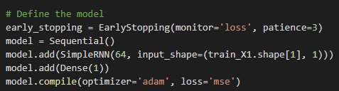
Proposed System/Algorithms/Architecture
Vanilla RNNs
Vanilla RNN (Recurrent Neural Network) is a basic and traditional type of recurrent neural network, which is used for sequence modeling tasks.
Architecture: -
It has a simple architecture consisting of a single layer of recurrent neurons where the output of each neuron is fed back to the input of the same neuron at the next time step.
At each time step, the input vector is combined with the output of the previous time step to generate a hidden state vector that is passed through an activation function (typically a hyperbolic tangent or sigmoid function).
This hidden state vector is then used to produce the output at that time step.

Slide 6
Proposed System/Algorithms/Architecture
Vanilla RNNs
Advantages: -
Simple architecture
Easy to implement
Low computational cost
Disadvantages: -
Suffers from the vanishing gradient problem
Not suitable for learning long-term dependencies

Slide 7
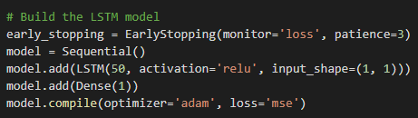
Proposed System/Algorithms/Architecture
LSTM (Long Short-Term Memory)
An LSTM is a type of recurrent neural network that uses memory cells and gates to selectively add, delete, and modify information. This allows it to learn long-term dependencies better than Vanilla RNNs
Architecture: -
The LSTM architecture consists of three types of gates: the input gate, the forget gate, and the output gate. Each gate is responsible for controlling the flow of information into and out of the LSTM cell.
The input gate regulates the input to the memory cell.
The forget gate decides what information to remove from the memory cell
The output gate determines the output value based on the input and the state of the memory cell.

Slide 8
Proposed System/Algorithms/Architecture
LSTM (Long Short-Term Memory)
Advantages: -
Better at learning long-term dependencies than Vanilla RNNs
Can handle vanishing gradients
Can selectively remember or forget information
Disadvantages: -
More complex architecture than Vanilla RNNs
Higher computational cost

Slide 9
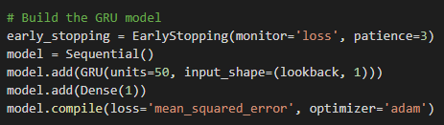
Proposed System/Algorithms/Architecture
GRU (Gated Recurrent Unit)
A GRU is similar to an LSTM, but it has fewer parameters, making it faster to train and less prone to overfitting. It is designed to be simpler than LSTM while still being effective at handling long-term dependencies in sequence-based tasks.
It also uses gates to control the flow of information, but it combines the input and forget gates into a single update gate.
Architecture: -
The GRU architecture consists of two types of gates: the reset gate and the update gate.
The reset gate determines which information from the previous time step should be discarded, while the update gate determines which information from the current time step should be added to the hidden state.
The update gate also controls how much information from the previous time step should be carried forward.

Slide 10
Proposed System/Algorithms/Architecture
GRU (Gated Recurrent Unit)
Advantages: -
Faster to train than LSTMs
Less prone to overfitting
Can handle vanishing gradients
Fewer parameters than LSTMs
Disadvantages: -
May not perform as well as LSTMs on tasks that require long-term memory
Not suitable for learning highly complex sequences

Slide 11
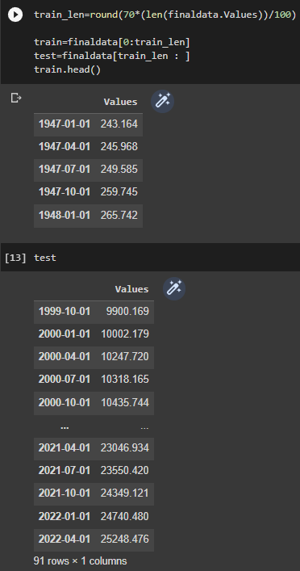
Implementation and Discussion (Work done)
Instead of random-based splitting, we have used another approach called time-based splitting. When we have a timestamp given in our dataset, we can split the data according to time.

Slide 12
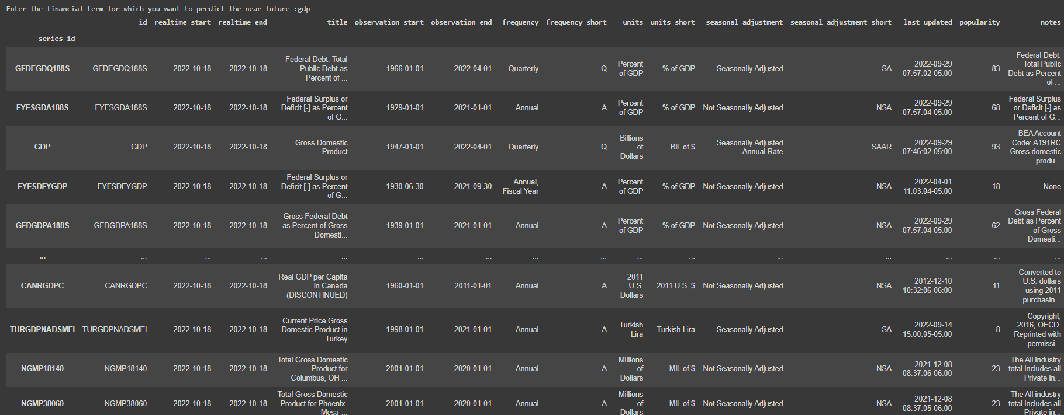
Implementation and Discussion (Work done)
We look for all the GDP available on the FRED API.

Slide 13
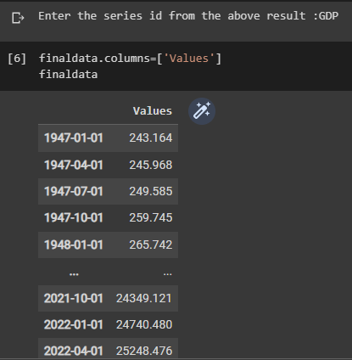
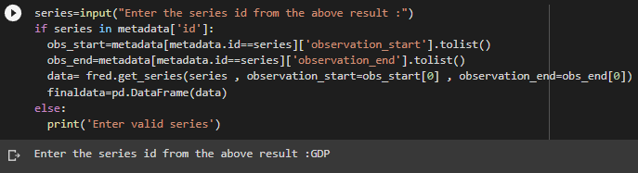
Implementation and Discussion (Work done)
After entering a valid series ID you get the available series data.

Slide 14
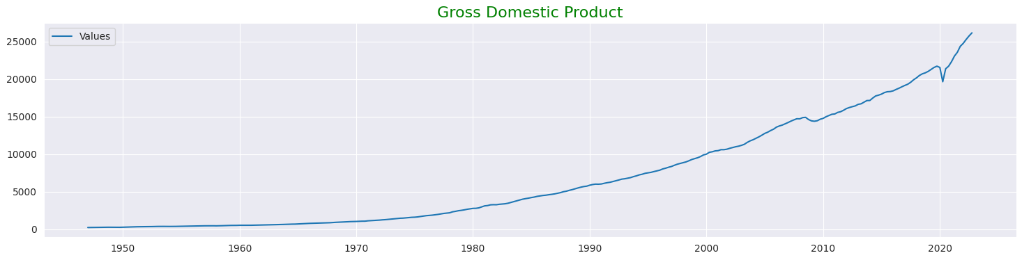
Implementation and Discussion (Work done)
Our time series data looks as follows

Slide 15
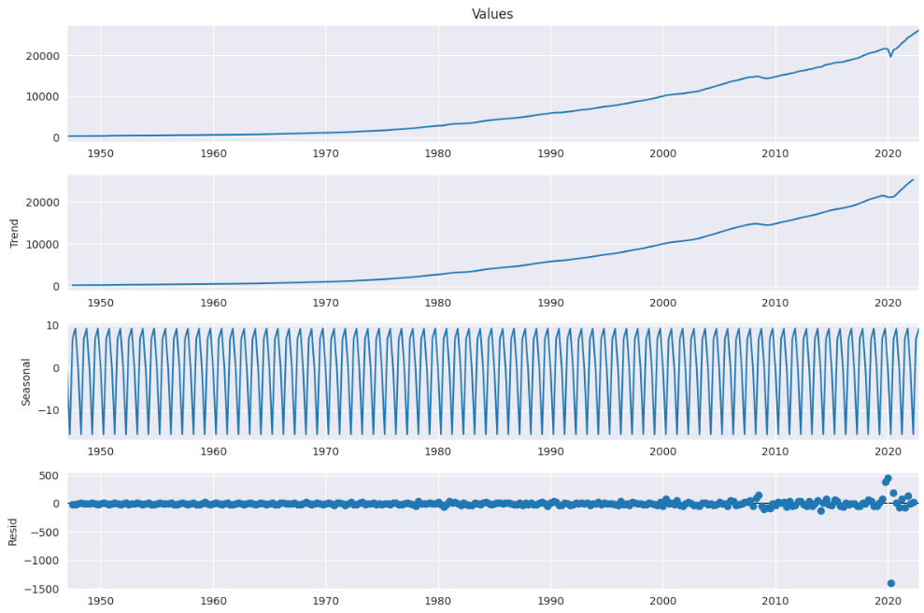
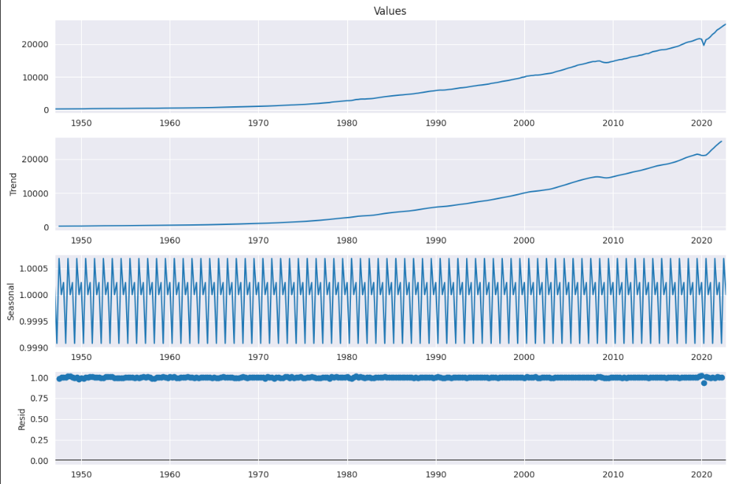
Implementation and Discussion (Work done)
We decompose the available series data into additive and multiplicative seasonal index.

Slide 16
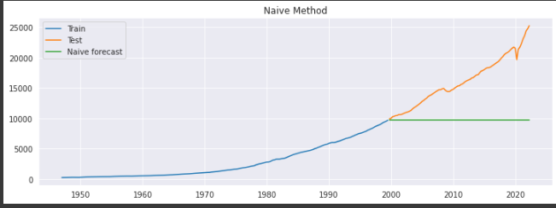
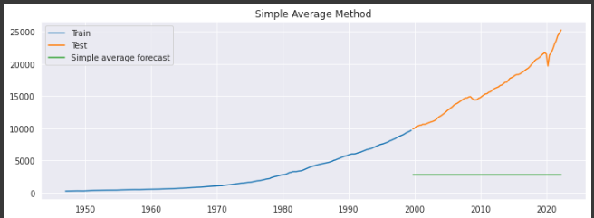
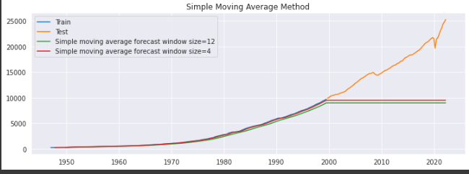
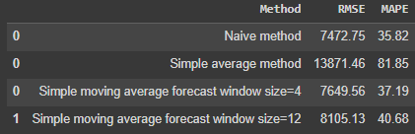
Implementation and Discussion (Work done)
Using Simple Time Series Forecasting we get the following results: -

Slide 17
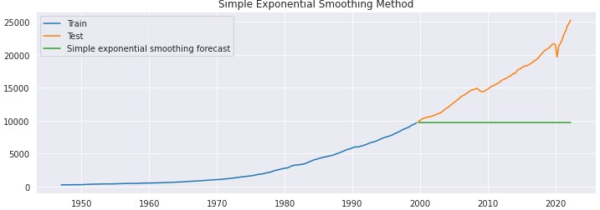
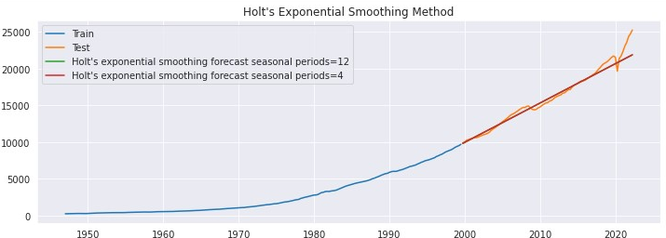
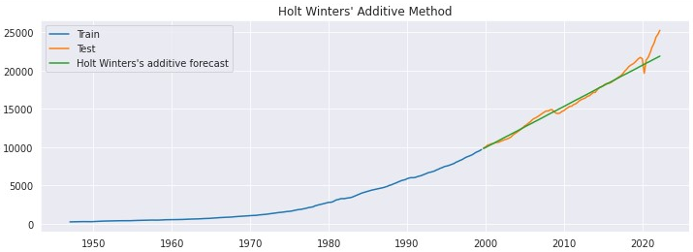
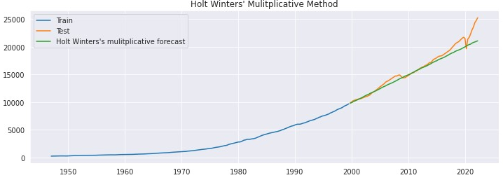
Implementation and Discussion (Work done)
Using Exponential Smoothing Techniques we get the following results: -

Slide 18
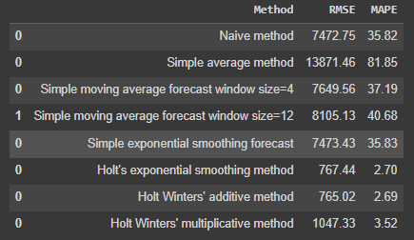
Implementation and Discussion (Work done)
Using Exponential Smoothing Techniques we get the following results: -

Slide 19
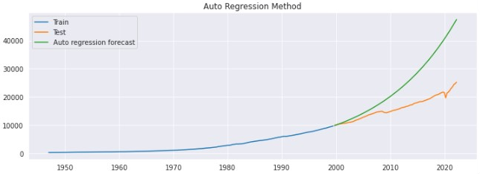
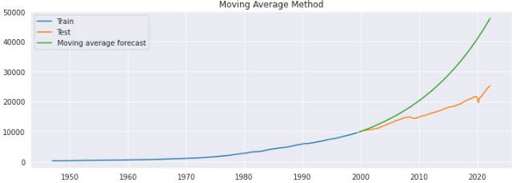
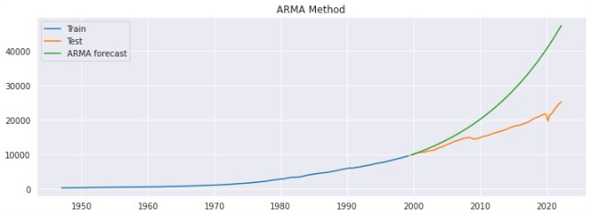
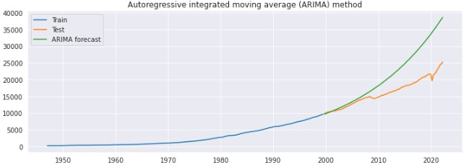
Implementation and Discussion (Work done)
Using Auto Regressive Methods we get the following results: -

Slide 20
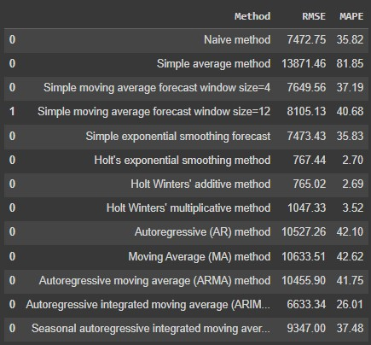
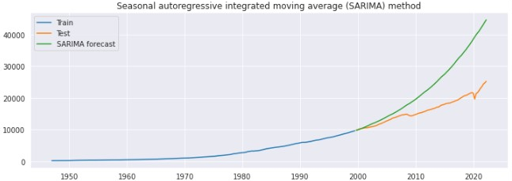
Implementation and Discussion (Work done)
Using Auto Regressive Methods we get the following results: -

Slide 21
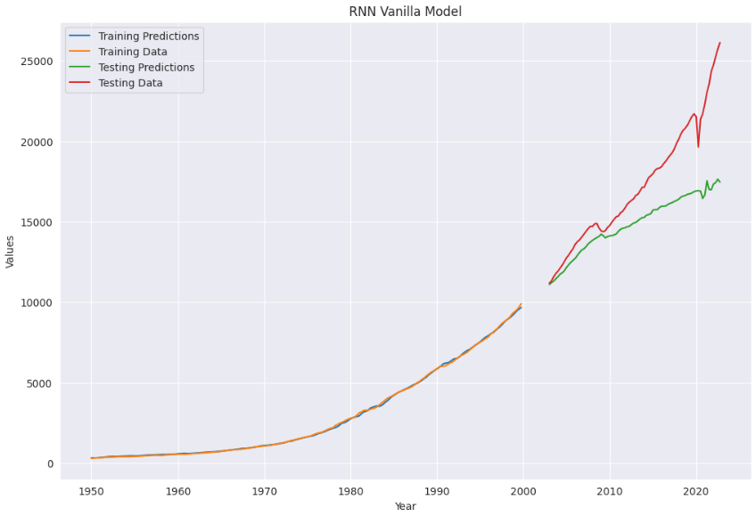
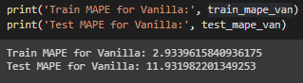
Implementation and Discussion (Work done)
Using Vanilla RNN we get the following results: -

Slide 22
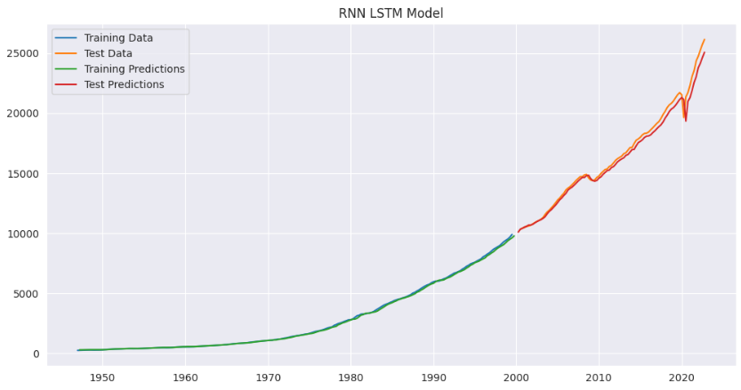

Implementation and Discussion (Work done)
Using LSTM (Long Short-Term Memory) RNN we get the following results: -

Slide 23
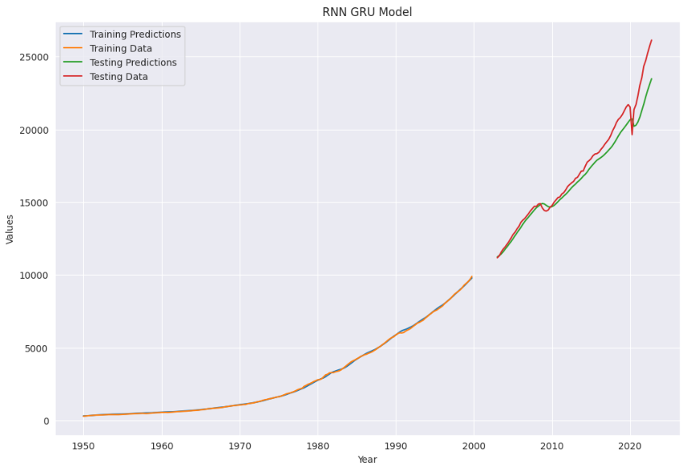
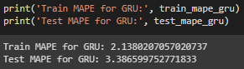
Implementation and Discussion (Work done)
Using GRU RNN we get the following results: -

Slide 24
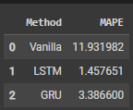
Implementation and Discussion (Work done)
Comparing Simple time series forecasting and Exponential Smoothing methods with our RNN methods: -

Slide 25
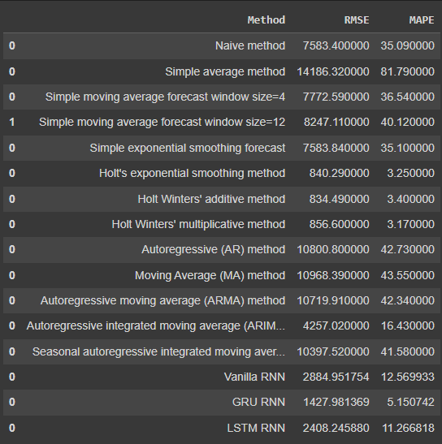
CONCLUSION

Slide 26
26
Code Link
https://colab.research.google.com/drive/1_IJutIaaTOaeipp0qXCaMOxCWXkajxPy?usp=sharing

