Slide 1
Audio Recording and Playback on Zybo Z7 Using SD CaRD
Vivek Mishra (026605200)
CECS 561
05/07/2021

Slide 2
Agenda
Introduction to the DMA project
Implementation.
Challenges : Old and New
Solutions : Old and New
Current Status
Future Plan

Slide 3
Introduction
Load or save audio file in the SD card.
Enable push button 3 to record audio using Line In or J7.
Enable push button 1 to record audio using a Mic or J6.
Enable push button 2 to play audio using a speaker headphone via J5.
Audio is loaded in the 32 GB SD card.

Slide 4
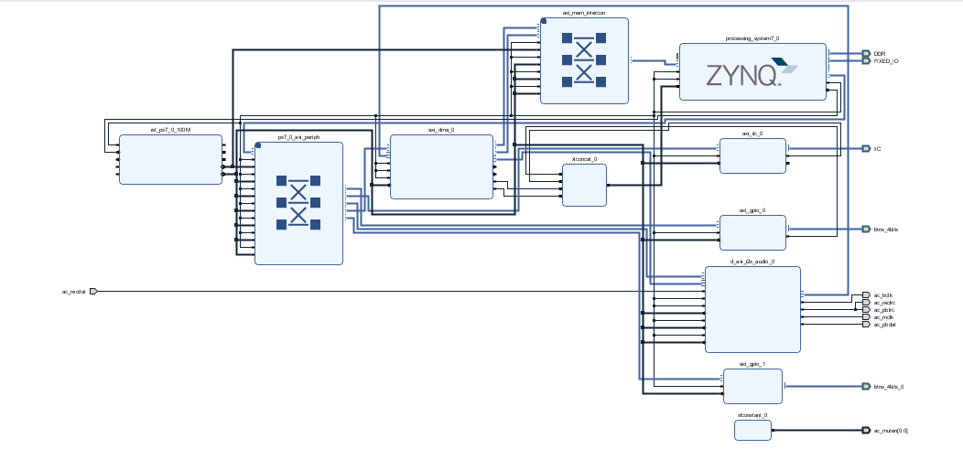
Implementation
Able to record and play audio as discussed in previous Introduction slide.
A new library was added xilffs.

Slide 5

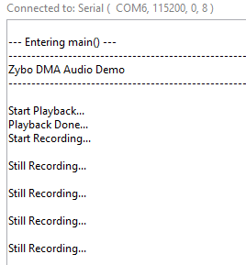
Old Challenges
There was problem implementing it because of the version mis-match issue.
The recording never stops. The playback was working fine but recoding never stops after the duration of 5 seconds.
One #define statement was missing in demo.h file.
The status of the IP has changed as it was created on the older version.

Slide 6
New Challenges
Problem in allocating appropriate memory for the recording.
How to read and write in memory card.

Slide 7
Solution to the ZYBO Z7 DMA Audio challenges
Used appropriate version of Vivado 18.3 for the project.
Upgraded IP to match the current version of project.
Set the J5 to JTAG to “recording never stops”. To do this I changed blue jumper cover up and off of the pins, then place it back down across the two right-most pins.
Added
#define DDR_BASE_ADDR XPAR_PS7_DDR_0_S_AXI_BASEADDR in demo.h file.
New Solution
.Allocated proper memory for the audio file by using Generate Linker Script.
Used xilffs library to read and write on SD card.

Slide 8
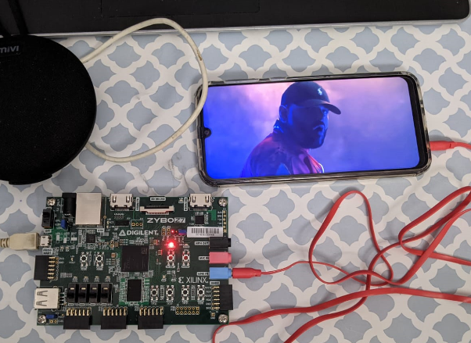
Current Status
As of now I can record an audio on SD card through Line In and play it back.

Slide 9
Future Plan
To record and save audio in an SD card using a GPIO switch.
Future work will include experimentation on how to get sounds to play on top of each other and storing the result into the microSD card for future playback.

Slide 10
References
https://forum.digilentinc.com/topic/21554-recording-never-stops-in-zybo-z7-10-in-zybo-z7-dma-audio-demo/#comment-62105 Atlys Board Reference Manual
https://forum.digilentinc.com/topic/19320-recording-never-stops-in-zybo-z7-20-dma-audio-demovivado-20182/

Slide 11
Thank You

