Slide 1
Group 3 Aggie S. Bresee Fnu Madiha Wahed Vivek Kumar Mishra Shiva Suhail Syed Ibrahim Mohammad
AI Lab
Notes:
The foundation of NutriFit AI began with brainstorming and research. Understanding user needs and nutritional data was essential to shape the core concept and ensure relevance to stakeholders.

Slide 2
The three responses all successfully used the initial context (23 y/o, 6x/week, strength + cardio) to create a 6-day structured plan. However, they differed significantly in their conversational approach and completeness.
Practice with LLM
Notes:
The foundation of NutriFit AI began with brainstorming and research. Understanding user needs and nutritional data was essential to shape the core concept and ensure relevance to stakeholders.

Slide 3
The first response was the most structured and direct, but it immediately repeated the data request after acknowledging the user's profile, making it the least conversational. The second response was the most efficient, immediately focusing on three quick, necessary points (Goal, Equipment, Duration) to finalize the plan The third response was the most detailed and proactive, not waiting for the final inputs but instead immediately generating a full, well-structured, sample 6-day split, including timing principles, nutrition advice, and periodization—making it the highest quality result as it provided immediate, actionable content.
Practice with LLM
Notes:
The foundation of NutriFit AI began with brainstorming and research. Understanding user needs and nutritional data was essential to shape the core concept and ensure relevance to stakeholders.

Slide 4
People struggle to find realistic, science-based fitness plans. Generic meal plans ignore factors like cycle, recovery, and lifestyle. Motivation drops when progress tracking isn’t personalized.
Problem Statement
Notes:
The foundation of NutriFit AI began with brainstorming and research. Understanding user needs and nutritional data was essential to shape the core concept and ensure relevance to stakeholders.

Slide 5

What is NutriFit AI?
An AI-powered chatbot designed to help users:
Understand the nutritional content of foods 🍎
Get personalized exercise recommendations 🏃‍♀️
Develop balanced, healthy habits 💪
Goal: To combine nutrition and fitness guidance in one simple, conversational interface.
Notes:
--- Our team focused on defining NutriFit AI's unique value proposition by exploring concepts that effectively combined nutrition guidance with accessible AI interaction. Image source: Microsoft 365 content library

Slide 6
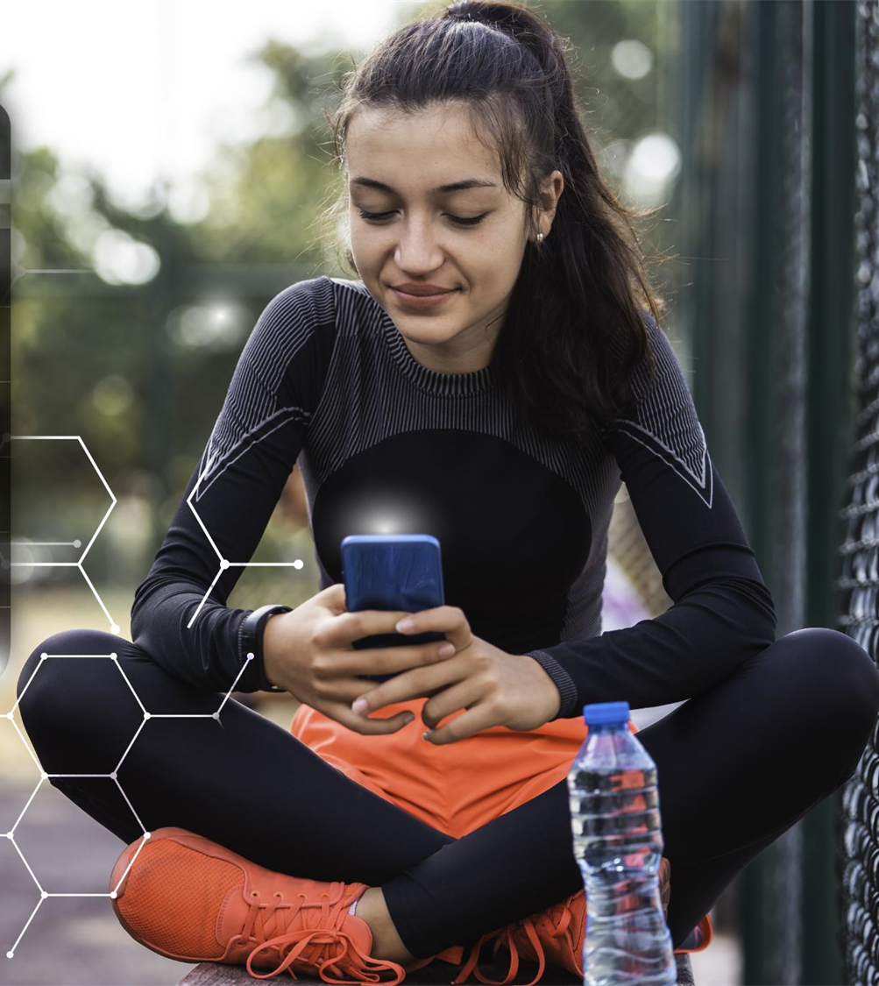
Ideas and Insights
Initial Idea: A chatbot that gives nutritional breakdowns (calories, protein, fats, etc.)
Key Insights:
Many users don’t know their meal’s nutritional value.
Balancing food and exercise can be confusing.
AI chatbots can deliver quick, customized feedback.
Inspiration Sources:
Peer feedback for fast, chat-style help
Research on healthy lifestyle habits
Platforms like MyFitnessPal and Fitbit Coach
Notes:
--- Engaging potential users and stakeholders early on helped us collect valuable feedback on expectations, preferences, and pain points to align the project with real-world needs. Image source: Microsoft 365 content library

Slide 7

Decisions and Rationales
NutriFit AI – combines Nutrition + Fitness Platform Used: Chatbase.co Enables AI training with custom data. Provides real-time, conversational responses.
Features: ✅ Nutritional breakdowns ✅ Exercise suggestions ✅ Motivational tips Rationale: To make health tracking feel like chatting with a virtual personal coach.
Notes:
--- Prioritizing nutritional information ensured NutriFit AI addressed the most pressing needs of users seeking personalized diet advice. Image source: Microsoft 365 content library

Slide 8

Final Outcome
NutriFit AI is an interactive chatbot that:
Helps users track nutrition and balance calories
Suggests personalized exercises
Encourages consistent, healthy habits
Outcome: A friendly, AI-powered assistant making fitness guidance simple and engaging for everyday users.
Notes:
--- Selecting an appealing name and cohesive branding helped position NutriFit AI effectively in the market and improved user recognition and trust. Image source: Microsoft 365 content library

Slide 9
https://jashankj.space/misc/usenet-cookbook/Cookbook.pdf https://www.ars.usda.gov/is/np/NutritiveValueofFoods/NutritiveValueofFoods.pdf
https://www.dhs.wisconsin.gov/publications/p4/p40109.pdf
Resources
Notes:
The foundation of NutriFit AI began with brainstorming and research. Understanding user needs and nutritional data was essential to shape the core concept and ensure relevance to stakeholders.

Slide 10
Link for our chatbot:
https://www.chatbase.co/5IkWfVGy4dXGuvJ5kjU-Z/help
Nutrifit ai
Notes:
The foundation of NutriFit AI began with brainstorming and research. Understanding user needs and nutritional data was essential to shape the core concept and ensure relevance to stakeholders.

