Slide 1


INSTITUTE FOR ADVANCED COMPUTING AND SOFTWARE DEVELOPMENT AKURDI, PUNE PPT On “ONLINE SHOPPING SYSTEM” E-DAC SEP- 2020 Submitted By: Group No: 99 Name: Vivek Narnolia Roll Number: 2211

Slide 2
Followings are the Features of the Online Shopping System.
Login
Logout
Registration
Admin
Add product
Update Product
Delete Product
View Product
Shopping Cart
Add product to cart
Place order
Payment Processing

Slide 3
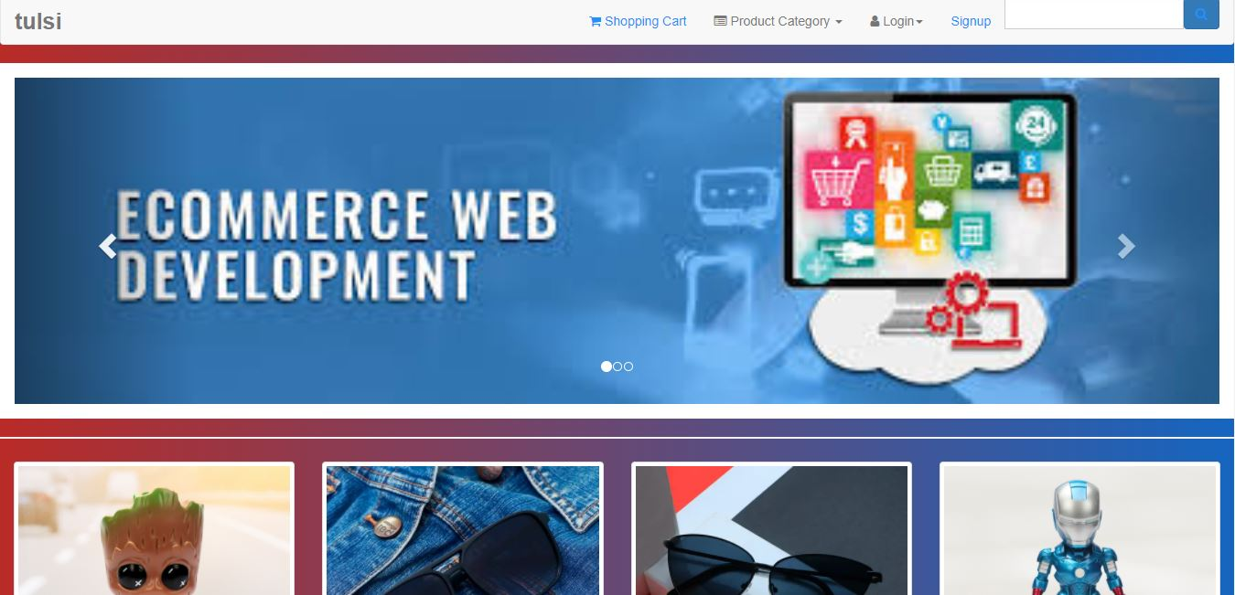
Header
Header contains website name, cart, category, login, signup and search function.
Login

Slide 4
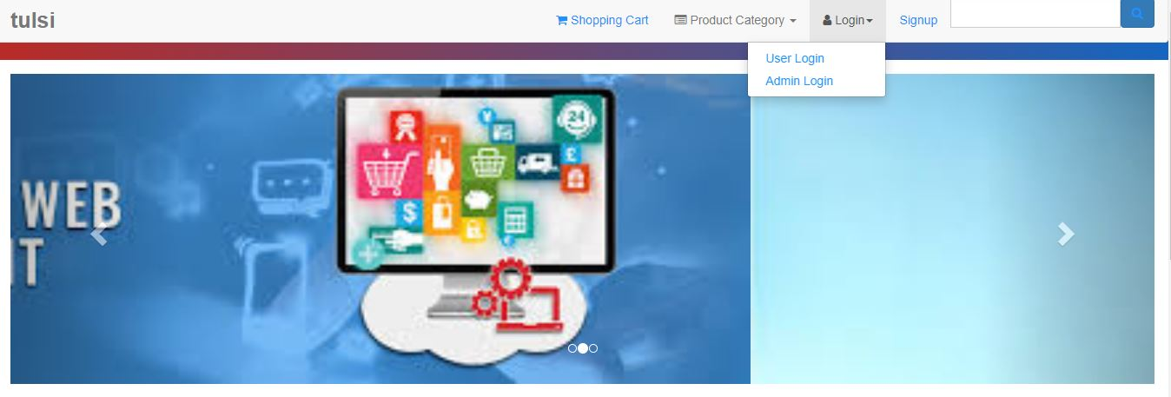
Login
It is a dropdown button type. Inside login there are two options : One for user login and
other for admin login. Pre registered users can login. Logout button will show only after we
will login as an user or admin.
Login

Slide 5

Login Page
Any existing user can login with their email and password.
Login

Slide 6
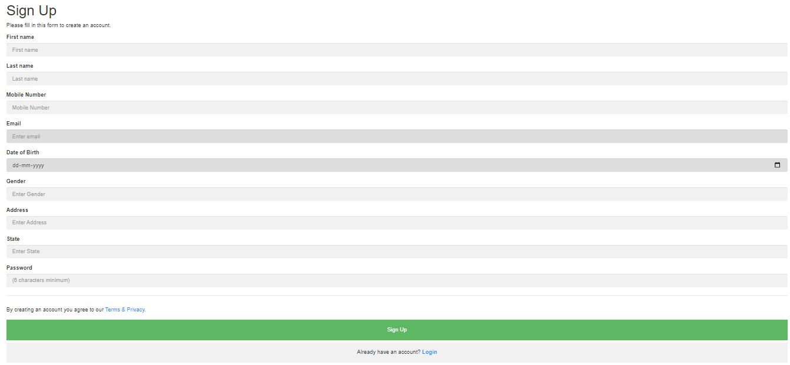
Register
To purchase products from the website we have to register first. Using this function a user
can register by providing details like name, email, phone no etc.

Slide 7
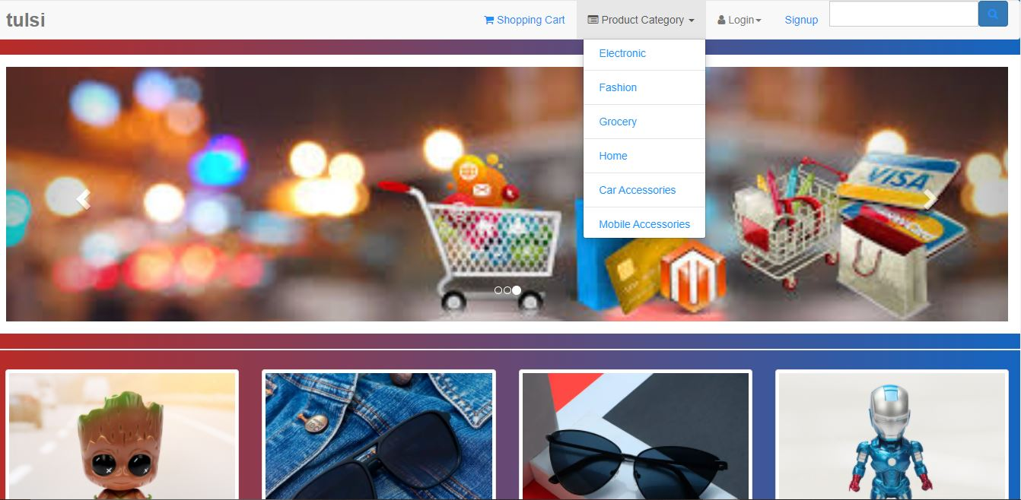
Category
It is also a dropdown button type. Using this dropdown we can search products according
to specific category like Electronic, Fashion , Home etc.

Slide 8
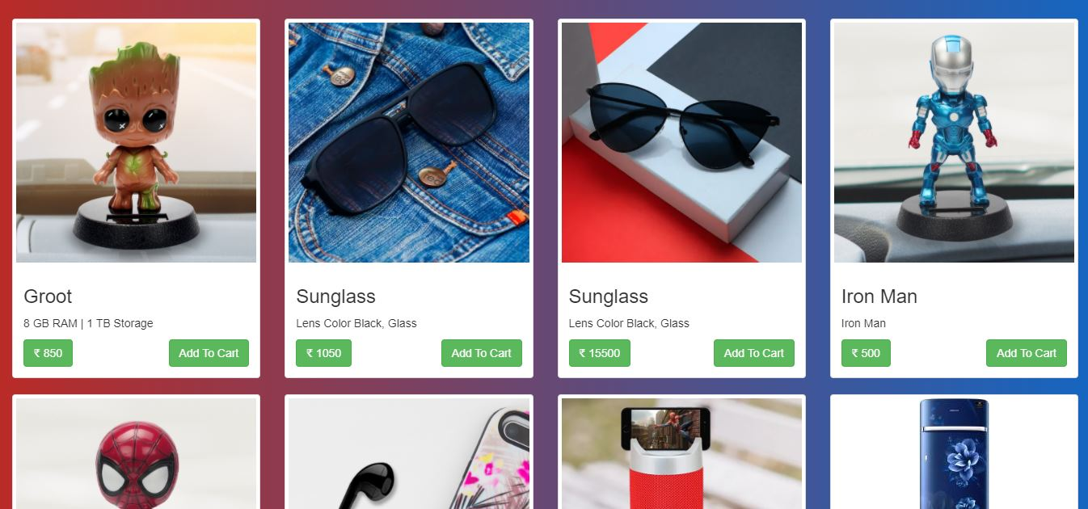
Product List
Product list contains different product in separate box. Each box contains product image,
name, description, price and add to cart button.

Slide 9
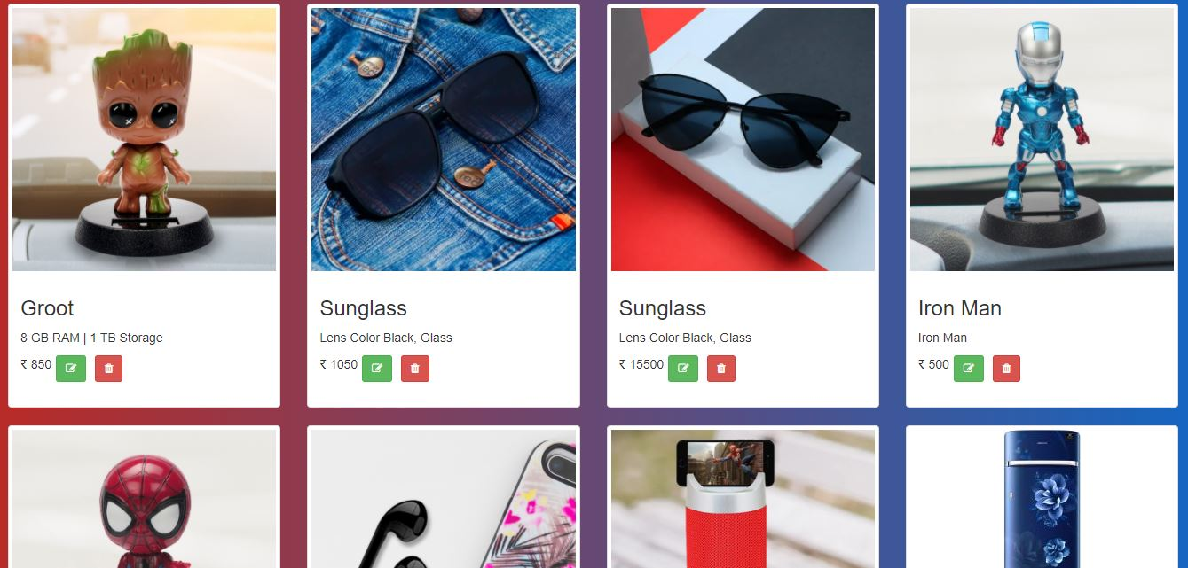
Admin Login
An admin can add product, delete product or update product.

Slide 10
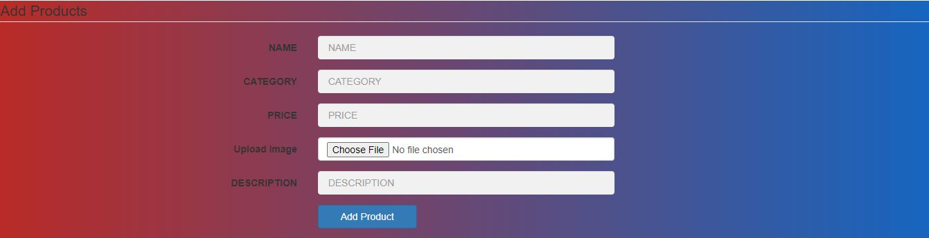
An admin can add product, delete product or update product.

Slide 11
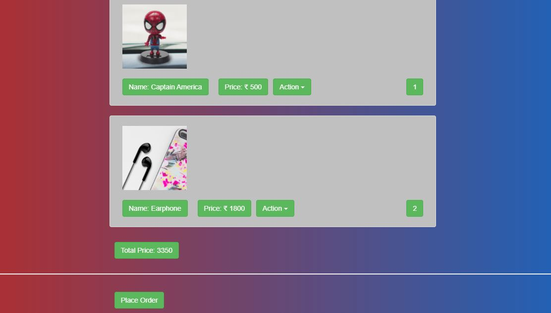
Add to cart
After adding products to cart the page will show products image, name, its price, quantity,
Total price of all the products and place order button.

Slide 12
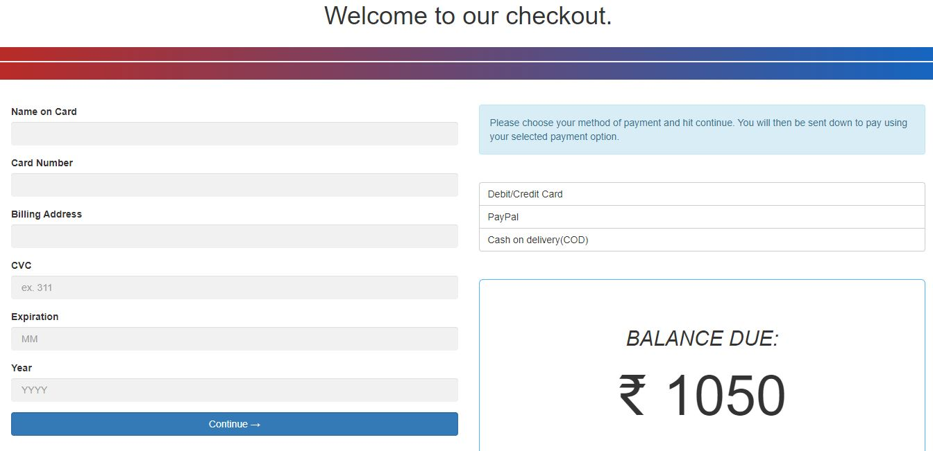
Payment
After placing order we can buy products by using debit or credit card, PayPal or COD.

Slide 13
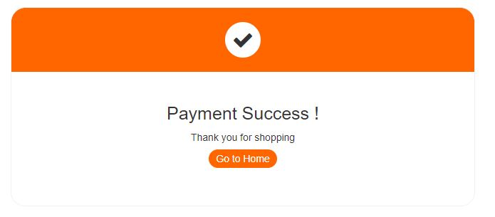
Success Message
After successful payment a “thank you” page will come. In this page, a link is there to
redirect to the home page of the website for further shopping.

