Slide 1
Adversarial Network Traffic
Obfuscation Detection
Catching malware that hides how it talks, not what it says
Vivek Neeralagi · Muhammad Shahbik · Aravind P Sagar · J Aditya
Deep Learning Mini Project (CS722T2C) · Dept. of CSE, Sahyadri College of Engineering & Management · Guide: Mrs. Varsha M
Notes:
Introduce the team and the one-line idea: signature-based DPI reads packet contents; modern malware evades it by reshaping traffic. We learn the shape instead.

Slide 2
The problem: DPI reads bytes, attackers reshape flows
Technique | What it does | Why DPI misses it
Padding | grow every packet to a block size | size signatures vanish
Timing jitter / shaping | randomise or flatten inter-arrival times | beacon periodicity vanishes
Fragmentation | split records below the MTU | signatures span boundaries
Tunnelling (VPN/TLS) | wrap the flow in encryption | payload unreadable
Protocol mimicry | look like video or web | statistically benign
What survives encryption and reshaping?
The shape of the flow:
• packet sizes
• directions
• inter-arrival times
• aggregate statistics
That is what we learn from.
Notes:
Each of these is a real evasion class from the DPI-evasion literature. None of them changes the payload semantics; they change the observable shape. Once traffic is encrypted, shape is all a defender has.

Slide 3
What we built
1
Simulate 12 traffic profiles
0 · benign
Ordinary traffic - including padded or tunnelled traffic (a VPN user is benign).
2
Apply 8 obfuscation transforms
1 · malicious, plain
3
Extract sequence + statistics views
Attack traffic making no attempt to hide.
4
Train CNN / MLP / GRU / hybrid + baselines
2 · malicious, obfuscated
5
Attack with constrained FGSM/PGD + packet-space search
Attack traffic reshaped to evade DPI. The class that matters: a signature engine already lets it through.
Harden with adversarial training
6
Notes:
Three classes, not two: separating plain from obfuscated malicious traffic is what lets us ask which evasion technique works. Then the adversarial ML loop on top.

Slide 4
Dataset: obfuscation is applied, not inferred
6 benign profiles
6 malicious profiles
8 transforms
web browsing · video streaming · VoIP · file download · DNS · interactive SSH
C2 beacon · data exfiltration · port scan · brute force · DDoS flood · reverse shell (deliberately overlaps SSH)
block / random padding · fragmentation · timing jitter · constant-rate shaping · dummy injection · tunnel encapsulation · protocol mimicry
Two decisions that keep the experiment honest
35% of benign flows are obfuscated too, and stay labelled benign. Otherwise the model learns 'obfuscated = malicious' and flags every VPN user.
Protocol mimicry preserves byte volume. An attacker can reshape traffic but cannot decide not to send the bytes - without this the problem is ill-posed, not merely hard.
Notes:
No public corpus annotates which flows were padded or tunnelled, so we generate: 20,000 flows, balanced thirds, every recipe recorded per flow. That is what makes the per-technique breakdown possible. Real captures are supported via tshark per-packet CSV.

Slide 5
Two views of a flow, four detectors
Sequence view (4 × 128)
Statistics view (51 features)
First 128 packets. Channels: signed size (size/MTU × direction), log inter-arrival time, direction, validity mask. Read by the 1D-CNN and GRU.
Volume, size and timing moments plus obfuscation probes: size-grid occupancy (padding), size diversity, timing regularity (beacons vs shaping). Read by the MLP and classical baselines.
1D-CNN
MLP
Bi-GRU
Hybrid CNN+MLP
1,25,827 params
55,555 params
35,331 params
1,49,315 params
test accuracy 94.1%
obfuscated recall 88.6%
test accuracy 96.2%
obfuscated recall 93.1%
test accuracy 92.9%
obfuscated recall 88.1%
test accuracy 96.9%
obfuscated recall 94.2%
Notes:
The CNN uses three conv stages because evidence lives at three scales: one padded packet, one exchange, the whole flow's cadence. Average and max pooling are both kept: 'how much looks padded' vs 'does anything look padded'. All models are under 200k parameters on purpose.

Slide 6
Adversarial threat model: pad-only, delay-only
Image FGSM perturbs every pixel in either direction. Traffic does not work that way.
An attacker controlling a malicious flow can PAD a packet (grow it, never shrink - the payload must fit) and DELAY a packet (later, never earlier - causality).
Direction cannot flip. Packets cannot be conjured at a fixed position.
So the feasible set is a one-sided box, not a symmetric ball. Statistics get the same treatment: proportions stay in [0,1], counts non-negative.
We keep the unconstrained attack too: the gap between the two measures how much a naive evaluation overstates the threat.
Channel | Allowed change
size | may only grow, up to MTU
log inter-arrival | may only increase
direction | frozen
validity mask | frozen
Plus a packet-space black-box attack: edit the raw packets with pad/delay, re-extract features, query only the output. Every adversarial flow it produces could actually be sent.
Notes:
Targeted attacks aim at the benign class - being mistaken for ordinary traffic is what an evader wants, not just misclassification. Evasion rate, not accuracy, is what an attacker optimises.

Slide 7
Clean results: the honest comparison
What the numbers say
Random forest on the 51 hand-built statistics reaches 97.2% - it beats the plain CNN (94.1%) on clean synthetic data.
Best deep model: Hybrid at 96.9%, obfuscated recall 94.2%.
The deep models have to earn their place on robustness, not clean accuracy. We say so.
Notes:
Be upfront: on this synthetic data the feature-engineered forest is the strongest clean classifier. The case for the deep models rests on the adversarial results that follow, and on the hybrid that combines both views.

Slide 8
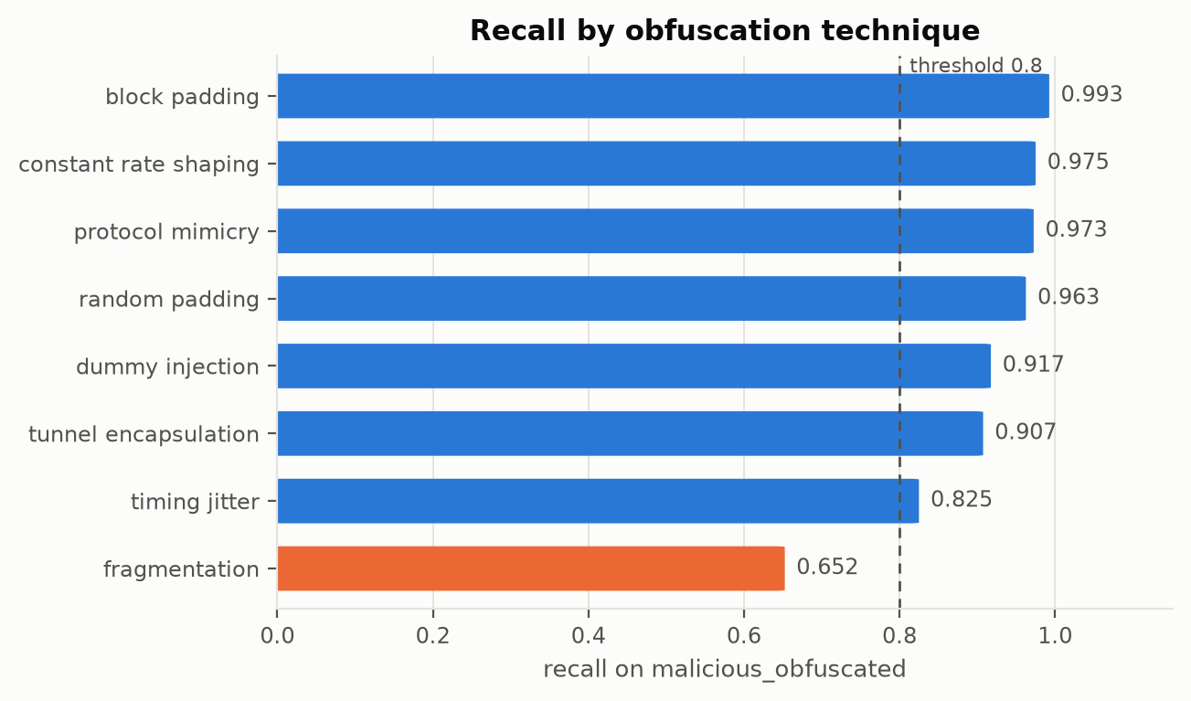
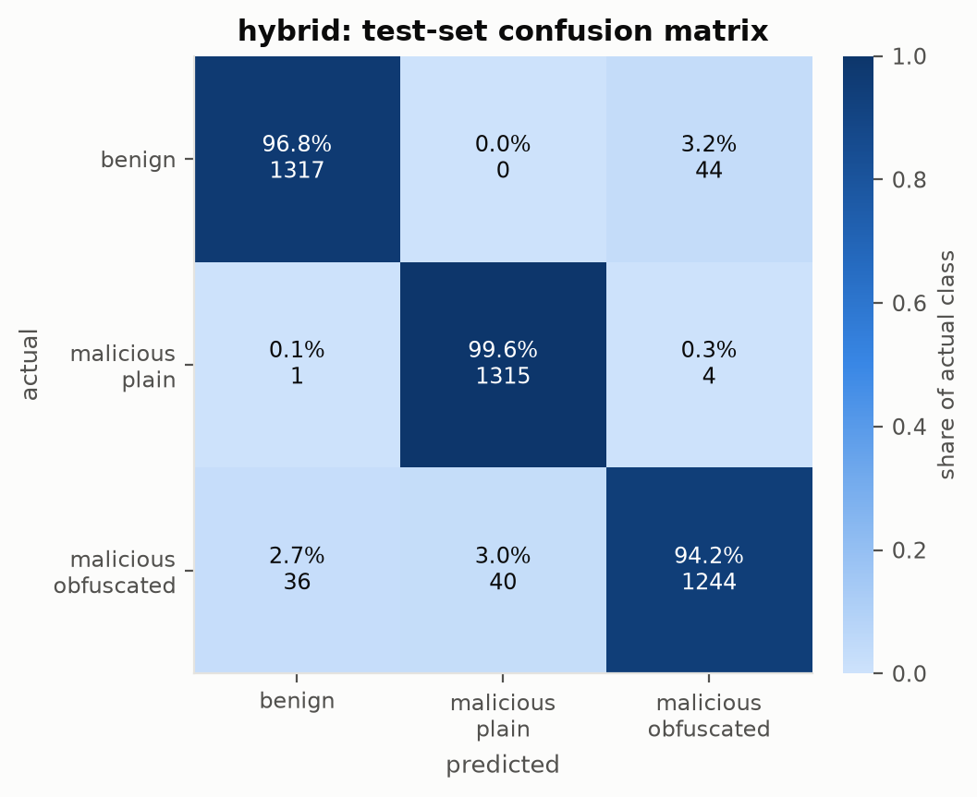
Which evasion techniques get through? (hybrid)
Hardest: fragmentation (65.3%)
Easiest: block padding (99.3%)
Notes:
Each bar is 400 freshly generated malicious flows obfuscated by exactly one transform, so a miss is attributed to a technique rather than a mixed recipe. This is the question an average cannot answer.

Slide 9
Robustness under attack
Reading the curves
Hybrid at ε=0.1: 72.8% constrained vs 64.8% unconstrained - ignoring physics overstates the threat.
Adversarial training: 72.8% → 93.8% at ε=0.1, at a clean-accuracy cost of 0.4%.
Targeted evasion (malicious read as benign) at ε=0.2: 16.9% for the undefended hybrid.
Notes:
The shape of the curve is the result: graceful decay and a cliff at the same midpoint are different security properties. Compare the defended and undefended hybrid: same architecture, same loop, same seed - the only difference is the defense.

Slide 10
Two reality checks
Packet-space black-box attack
Base-rate reality
11%
86%
18%
444
malicious flows walked to 'benign'
with legal pad/delay edits
extra bytes the attacker
had to pay, on average
precision when 99% of
traffic is benign
false alerts per
10,000 flows
hybrid_advtrain: 198 flows, <=150 queries each, 31 queries per successful evasion. Undefended hybrid: 10% - adversarial training did not help against this search, unlike gradient PGD.
The balanced test set has 34% benign traffic; real networks are >99%. The same FPR of 4.5% that looks harmless on a balanced set is what this becomes in deployment.
Calibration: temperature 0.74, ECE 0.043 → 0.006 after temperature scaling. Probabilities can now be used to set an alert threshold.
Notes:
Both of these are things a mini project usually skips. The packet-space attack is the strictly correct threat model - no feature-box approximation. The base-rate slide is why FPR matters more than accuracy for anything that will actually be deployed.

Slide 11
Limitations and what comes next
Limitations
Next
• Synthetic data: absolute accuracy is an upper bound; read the results relatively.
• Gradient attacks perturb features; the packet-space attack is the ground truth and is a lower bound on evasion (greedy search).
• Single attack config for adversarial training.
• Balanced classes - hence the base-rate slide.
• 128-packet window during training (sliding-window inference exists).
• Validate on real PCAPs (CIC-IDS2017 via tshark per-packet export - loader is ready).
• Three-seed variance for every claim (script is ready).
• Stronger black-box search (NES / SimBA).
• TRADES-style adversarial training, adv_ratio sweep.
• Transformer over the packet sequence.
• Certified smoothing bounds.
Notes:
Everything here is tracked in docs/FUTURE_WORK.md with what is done ticked off.

Slide 12
Learn the shape, not the bytes.
A three-class detector for obfuscated malicious traffic, with exact labels because we apply the obfuscation ourselves.
Attacks constrained to what an attacker can physically do - pad and delay - plus a packet-space attack with no approximation at all.
Reported honestly: where the forest wins, what adversarial training costs, and what the false-positive rate means at 99% benign.
github.com/VivekNeer/Adversarial-Network-Traffic-Obfuscation-Detection
Notes:
Close on the repository: everything reproduces from one config file and one seed.

