Slide 1

Mental Healthcare Management System
INFO 5100 Group 34 Final Project
Members : Reva Pethe 002310699
Neha Mahangade 002309351
Vivek Nikam 002051355

Slide 2

Introduction
The Mental Healthcare Management System revolutionizes healthcare by integrating data across multiple sectors, providing a unified platform for efficient care delivery. By empowering healthcare professionals with role-based access to essential tools, Swing UI improves communication, enhances service delivery, and streamlines workflows for a better patient experience.

Slide 3
Addressing Fragmentation in Healthcare
The Challenge
The Solution
Healthcare services are often fragmented across mental health, insurance, preventive care, medical research, and innovation, leading to inefficient data management and communication gaps.
Swing UI integrates data across multiple sectors into a unified platform, providing a comprehensive view of patient information and streamlined workflows.

Slide 4
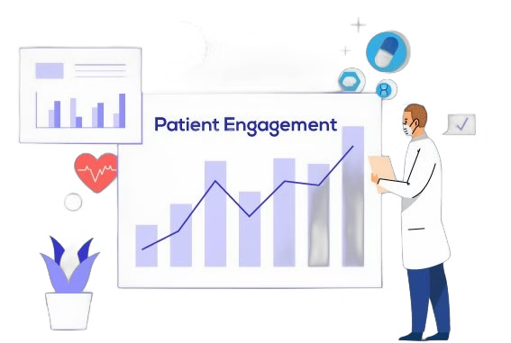
Empowering Mental Health Professionals
1
1. Patient Records
2
2. Session Management
Therapists can easily access, update, and manage patient records for a comprehensive view of their mental health journey.
Therapists can add, view, and edit detailed session notes, documenting progress and treatment plans.

Slide 5
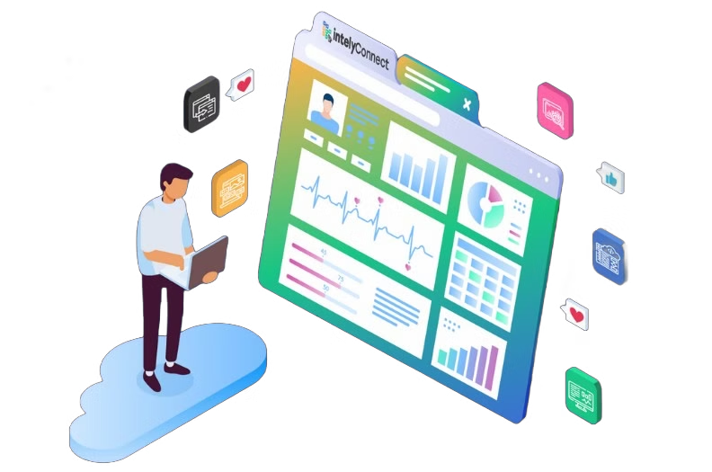
Streamlining Health Insurance Processes
Policy Management
Client Profile Management
Insurance agents can view and update policy details, ensuring clients have access to the right coverage and information.
Agents can manage client profiles and associated details, providing a centralized hub for all client information.

Slide 6
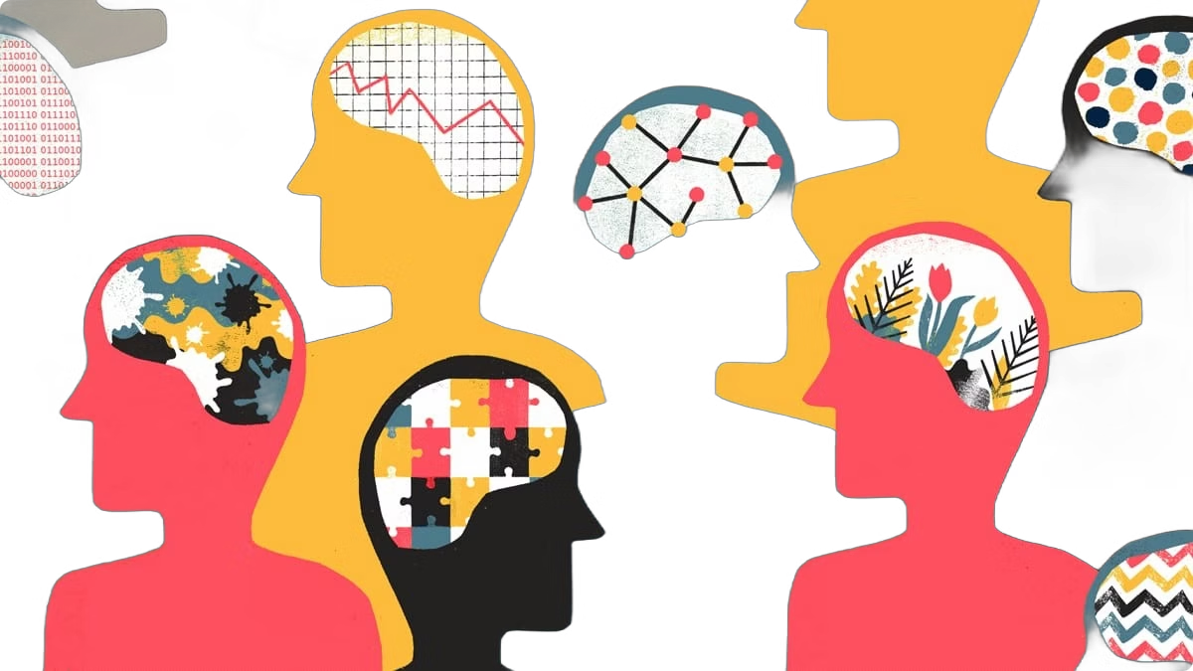


Enhancing Preventive Healthcare
Health Progress
Program Management
Wellness coaches can monitor client health metrics and goals, providing personalized guidance and support.
Coaches can manage wellness programs and milestones, ensuring clients stay on track with their health goals.

Slide 7
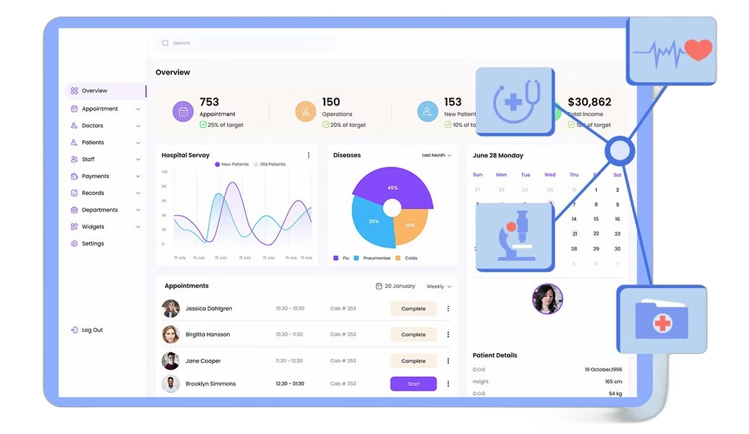
Accelerating Medical Research and Innovation
1
Dashboard
Researchers can access a comprehensive overview of active research projects and their status.
2
Research Logs
Researchers can update and manage detailed research logs, documenting every step of the process.
3
Innovation Tracker
Specialists can track contributions to ongoing research, showcasing individual impact on innovation.

Slide 8
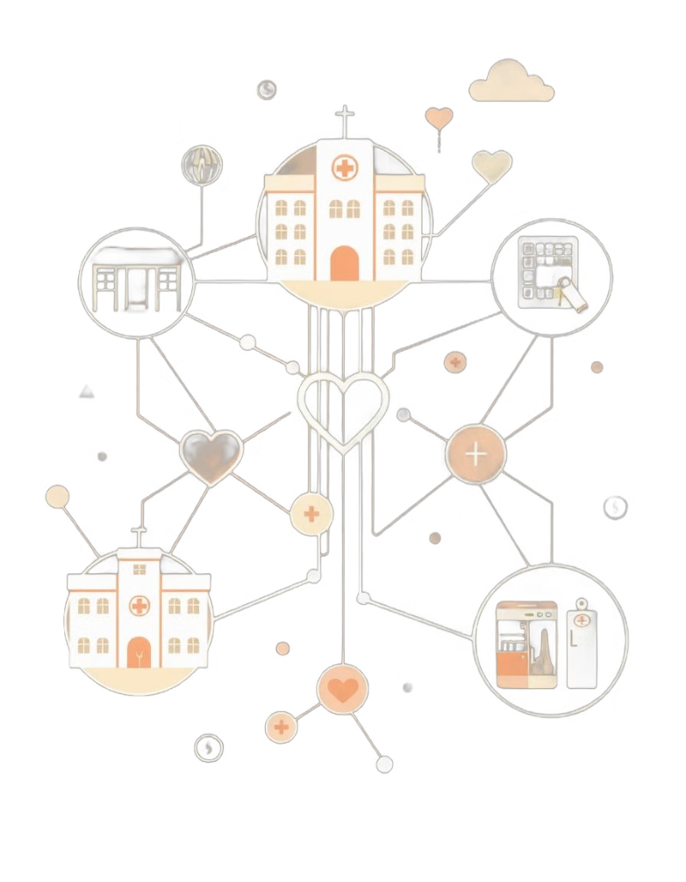



Swing UI: A Unified Approach
Improved Communication
The system facilitates seamless communication between professionals across sectors, ensuring a unified approach to care.
Enhanced Service Delivery
Swing UI streamlines workflows, reduces errors, and improves the overall efficiency of healthcare services.
Enhanced Patient Experience
Patients benefit from more informed and coordinated care, leading to improved outcomes and a positive healthcare experience.

Slide 9




Key Benefits of Swing UI
1
Improved Data Management
2
Enhanced Communication
3
Streamlined Workflows
4
Better Patient Care

Slide 10
Next Steps
Pilot Program
1
We'll launch a pilot program to test Swing UI in a real-world healthcare setting.
Feedback and Iteration
2
We'll gather feedback from users and iterate based on their experiences.
Full-Scale Implementation
3
Based on the pilot program results, we'll work towards a full-scale implementation of Swing UI.

Slide 11
Conclusion and Future Work
The Mental Healthcare Management System offers a transformative solution to the challenges posed by fragmented healthcare services across various sectors such as mental health, insurance, preventive care, medical research, and elderly care. By integrating data from diverse domains into a single, unified platform, the system not only streamlines communication and data sharing but also enhances efficiency at every level of healthcare delivery.
While the Mental Healthcare Management System has already made a significant impact in improving efficiency and communication within the healthcare sector, its potential for growth and innovation is immense. Looking ahead, several key areas offer promising opportunities for enhancement.

Slide 12
THANK YOU !!

