Slide 1


SMART INDIA HACKATHON 2026
197835
TITLE PAGE
Problem Statement ID – 26263
Problem Statement Title- Development of an APAAR ID-Based Student Data Management and Verification Platform for AICTE-Approved Institutions
Theme- Smart Automation
PS Category- Software
Team ID- 197835
Team Name - Team ARISE@2026

Slide 2
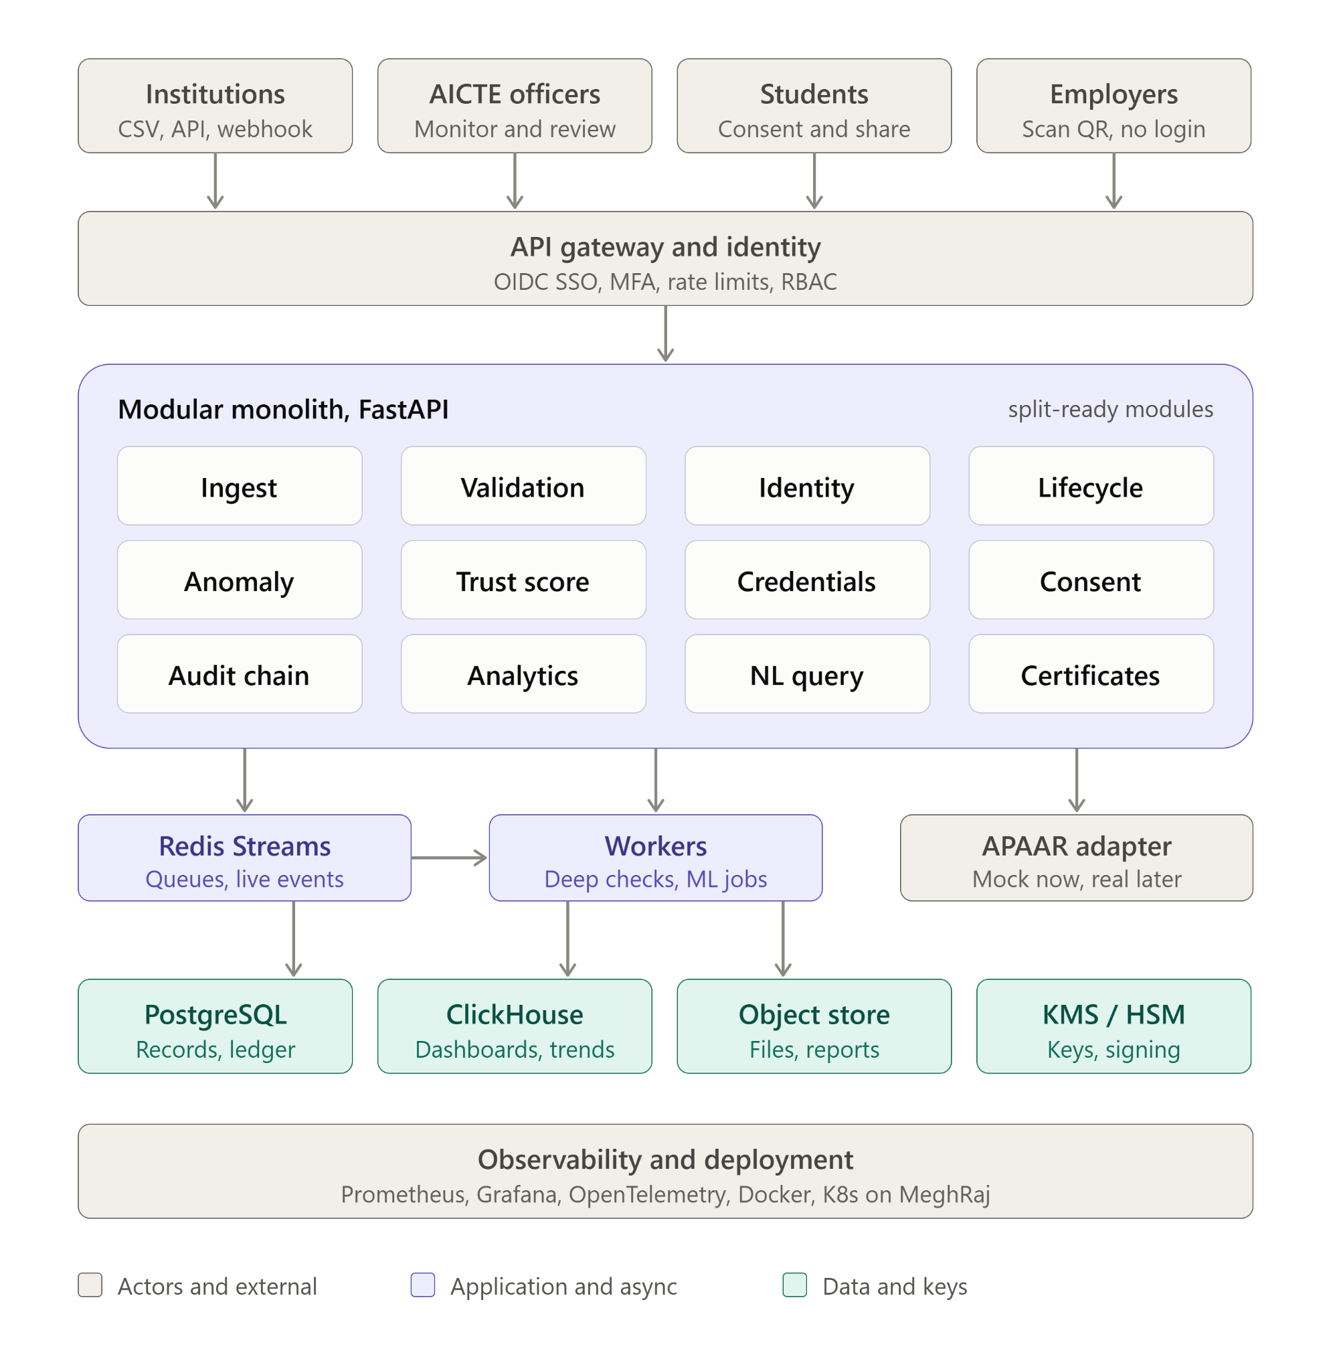


APAAR Setu (One Verified Record for Every AICTE Student)
Team ARISE@2026
Proposed Solution
Benefits
One verified record per student, keyed on APAAR ID
Errors caught at upload, not months later
Fewer manual cross-checks for AICTE
Alerts come with evidence, not just scores
Instant, forgery-resistant verification
Students control who sees their data
Fits existing AICTE login and institution systems
Impact
Governance: real-time view across 15,000+ institutions
Compliance: early detection of over-enrolment and double enrolment
Trust: employers can verify a record in seconds, not days
Privacy: verifiers see only what the student allows
Efficiency: less rework for institutions, faster review for AICTE
Scale: a base that can extend to UGC, NCVET, and state boards
Problem:
Student Data across 12,000+ institutions is fragmented and inconsistent (ranging from manual paper forms to basic aggregate counts,), making reliable tracking, duplicate detection, and fraud prevention nearly impossible.
Solution:
APAAR Setu introduces a secure,platform built on the national APAAR ID, featuring automated data validation, AI-powered anomaly detection, and tamper-proof QR verification.
APAAR Setu:
Data Upload: Colleges upload student admission data securely.
Instant Checks: System instantly validates file formats and APAAR IDs.
AI Detection: Automated workers and AI detect duplicates and over-intake.
Secure Storage: Clean, verified records are stored centrally with strict access controls.
Live Dashboards: Officers monitor admissions and errors in real time.
QR Verification: QR codes allow offline verification of credentials
Prototype

Slide 3
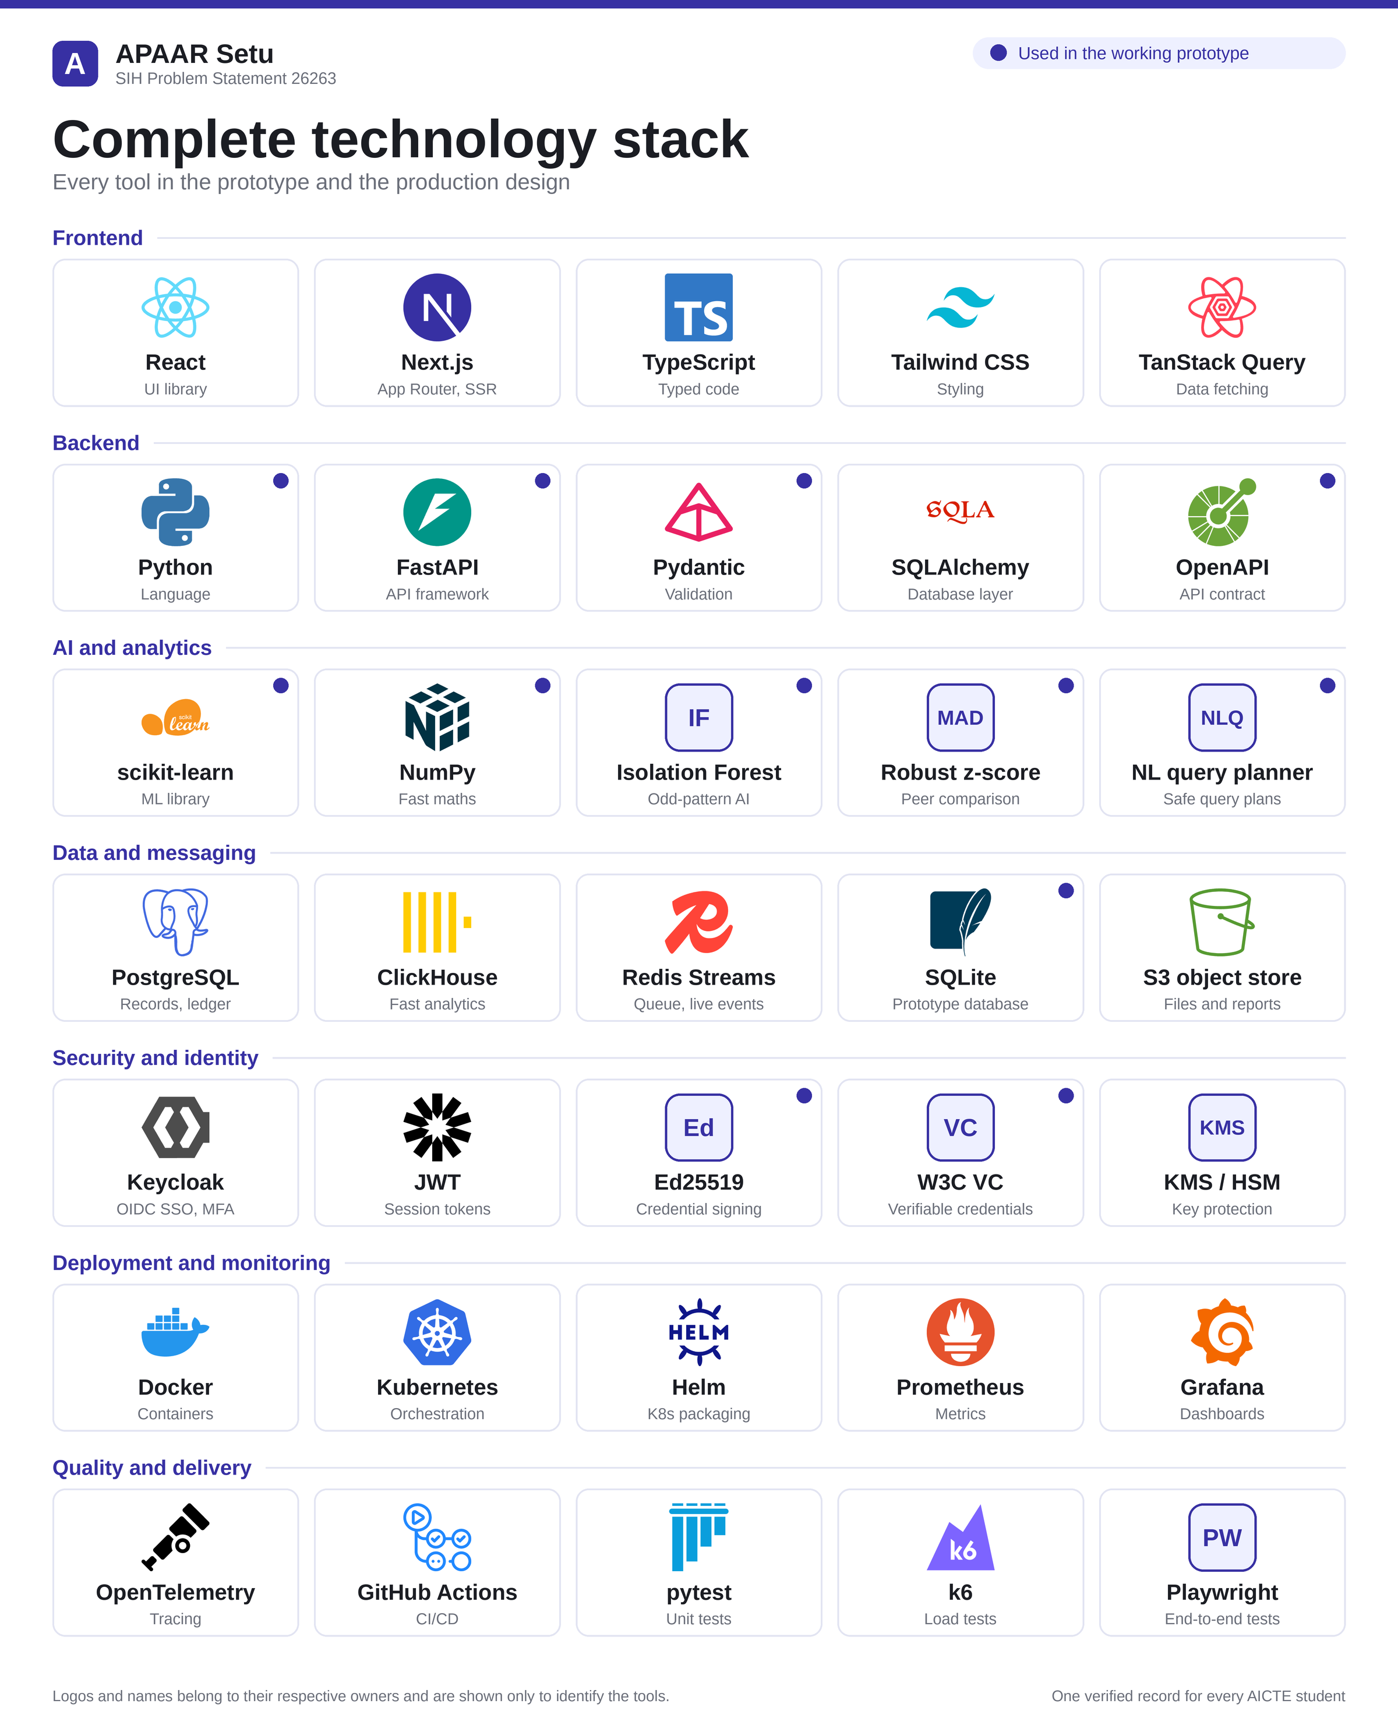
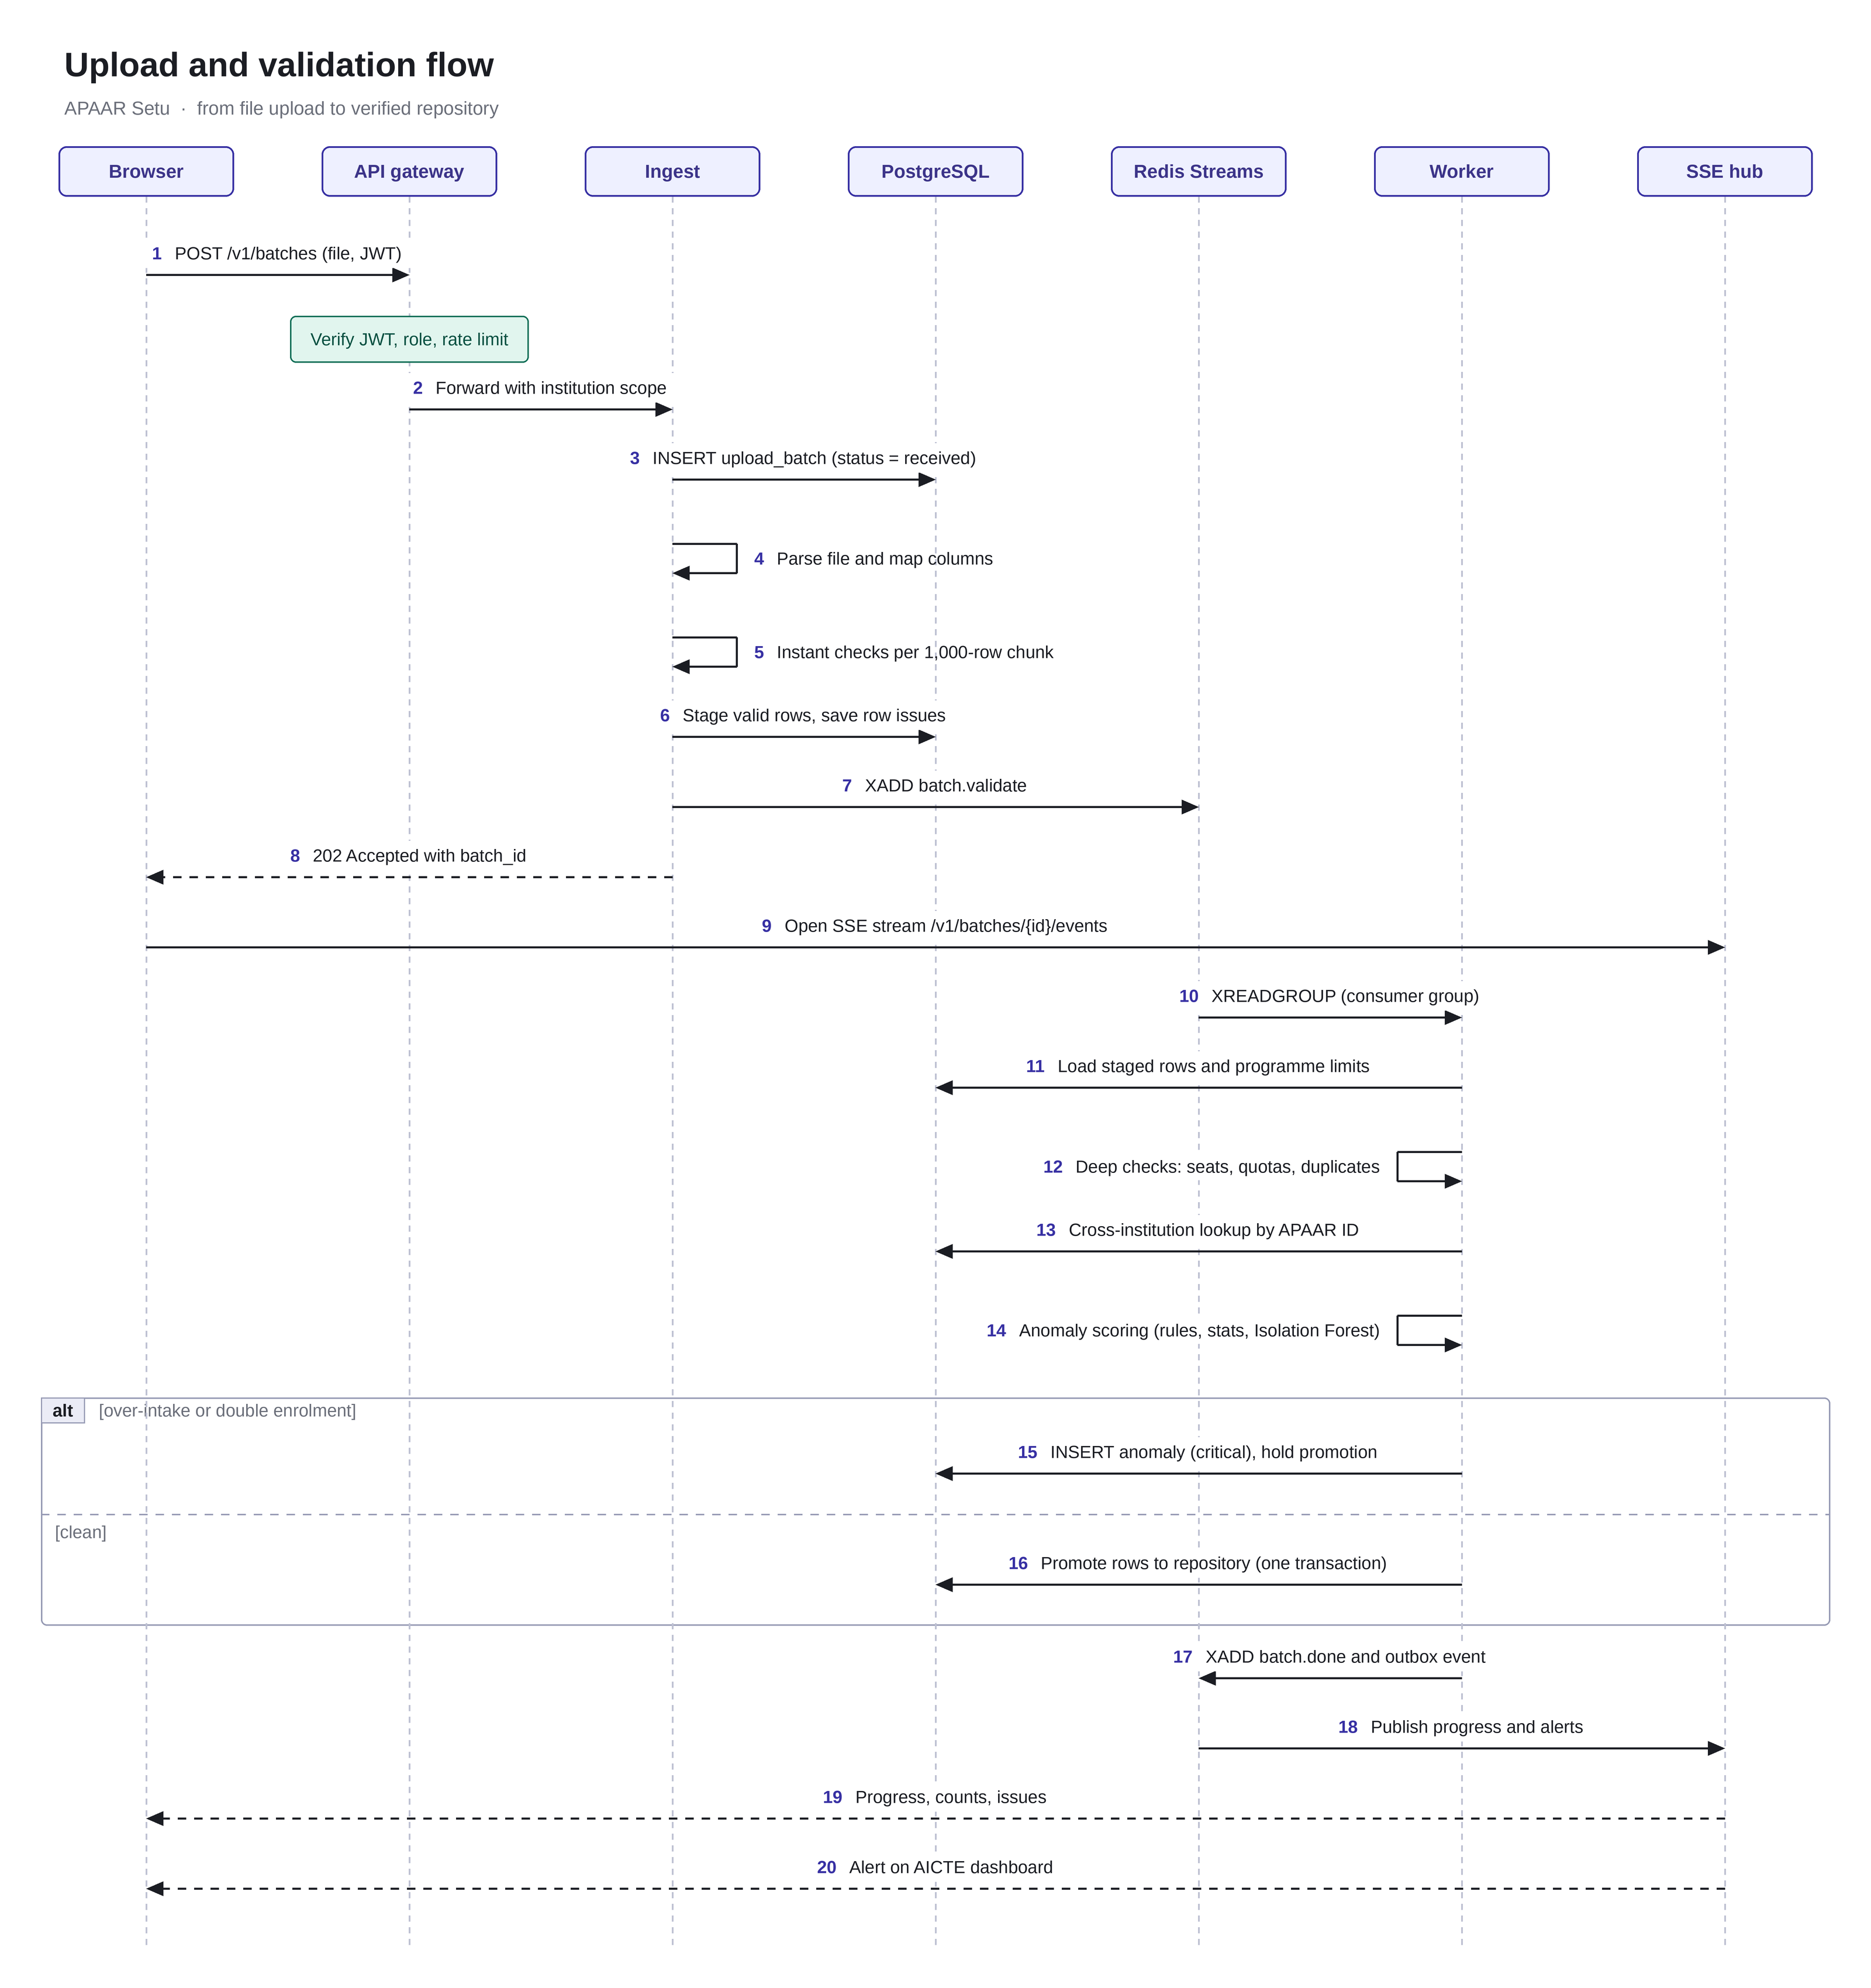
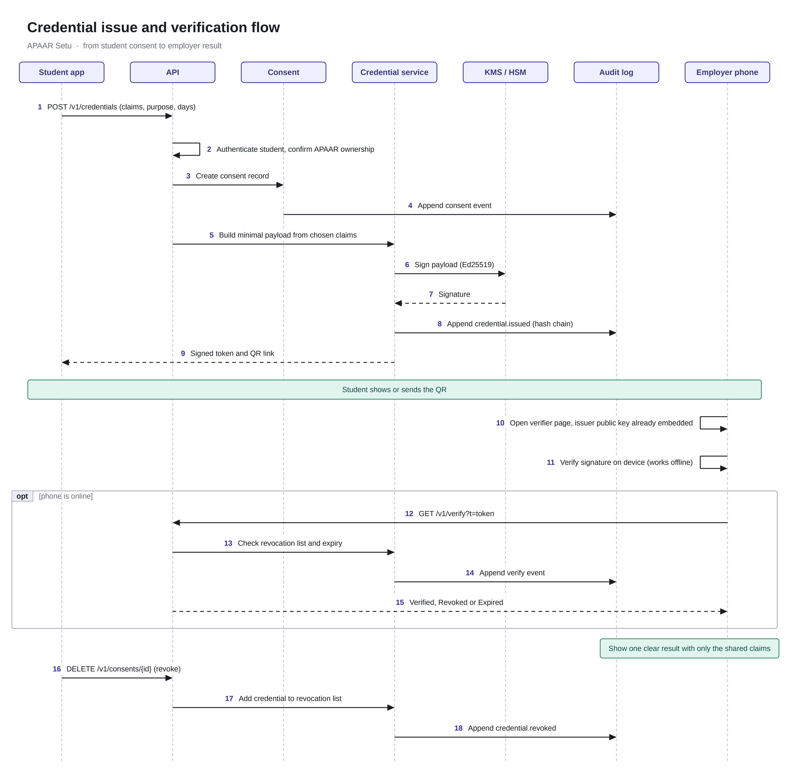
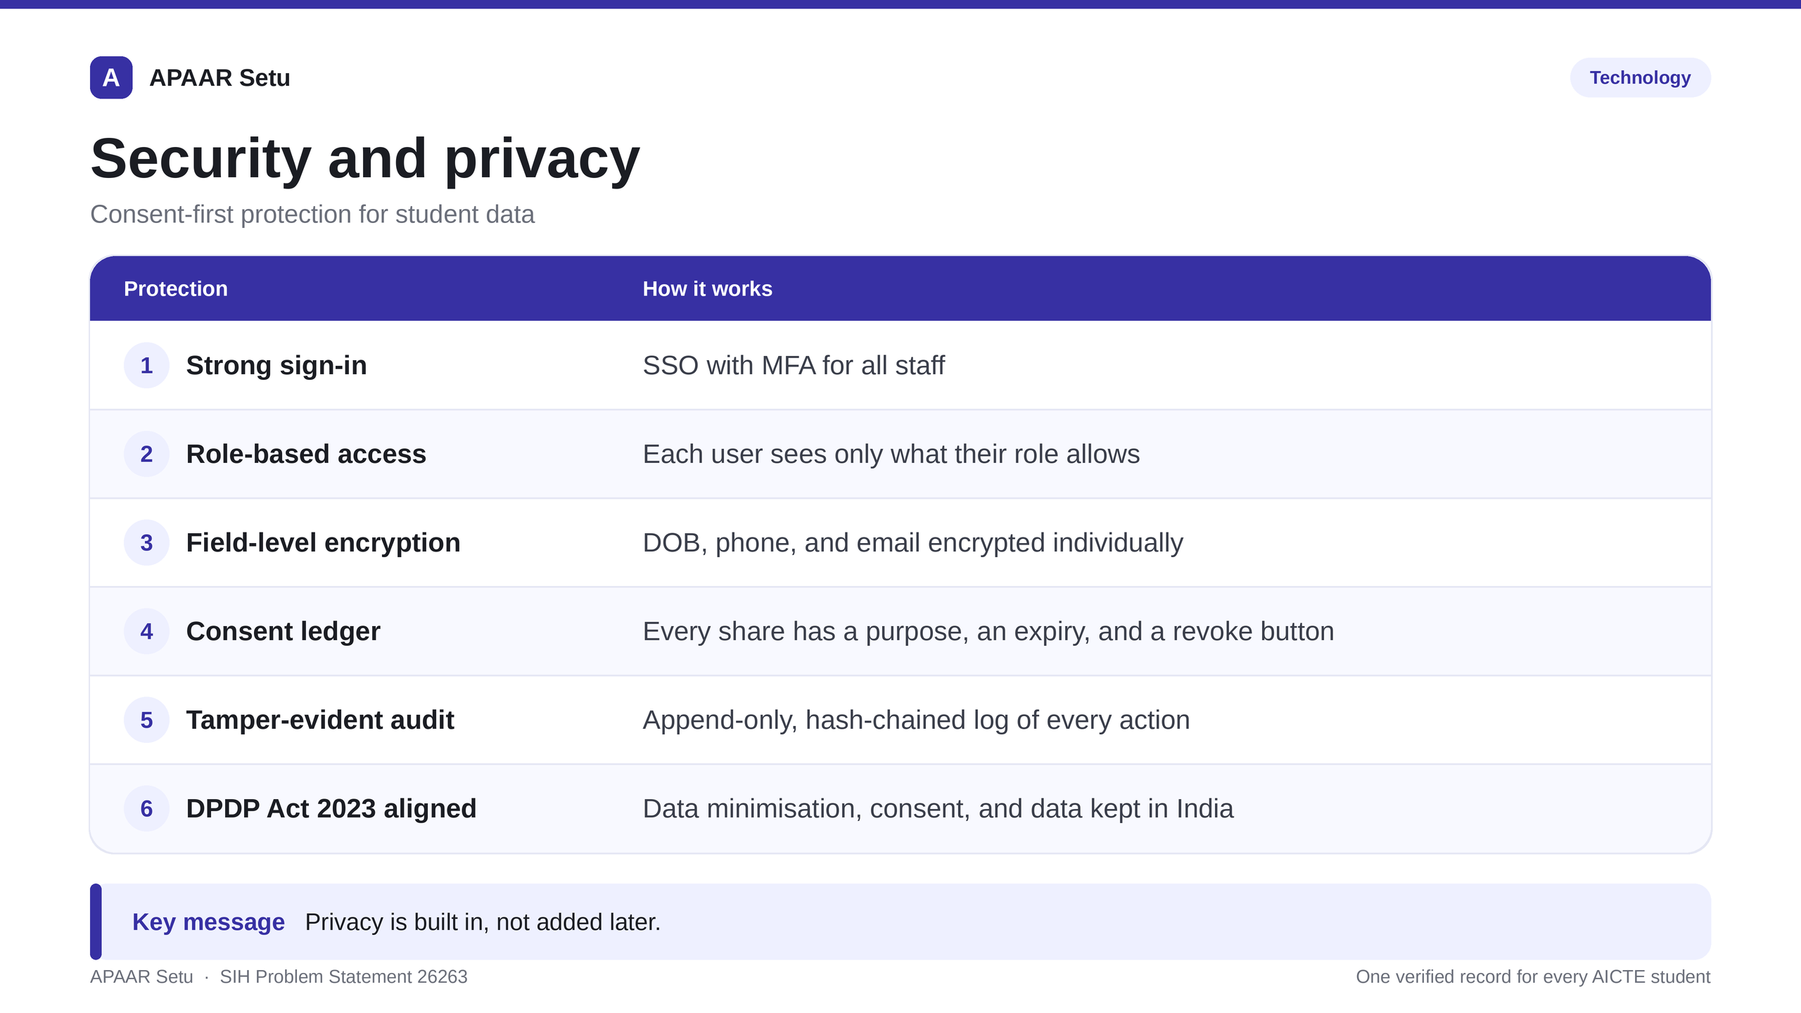
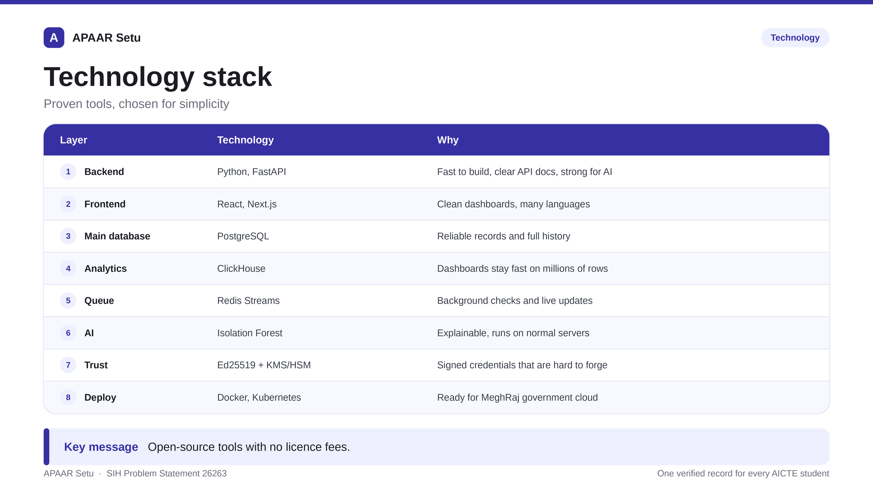
TECHNICAL APPROACH
Team ARISE@2026

Slide 4
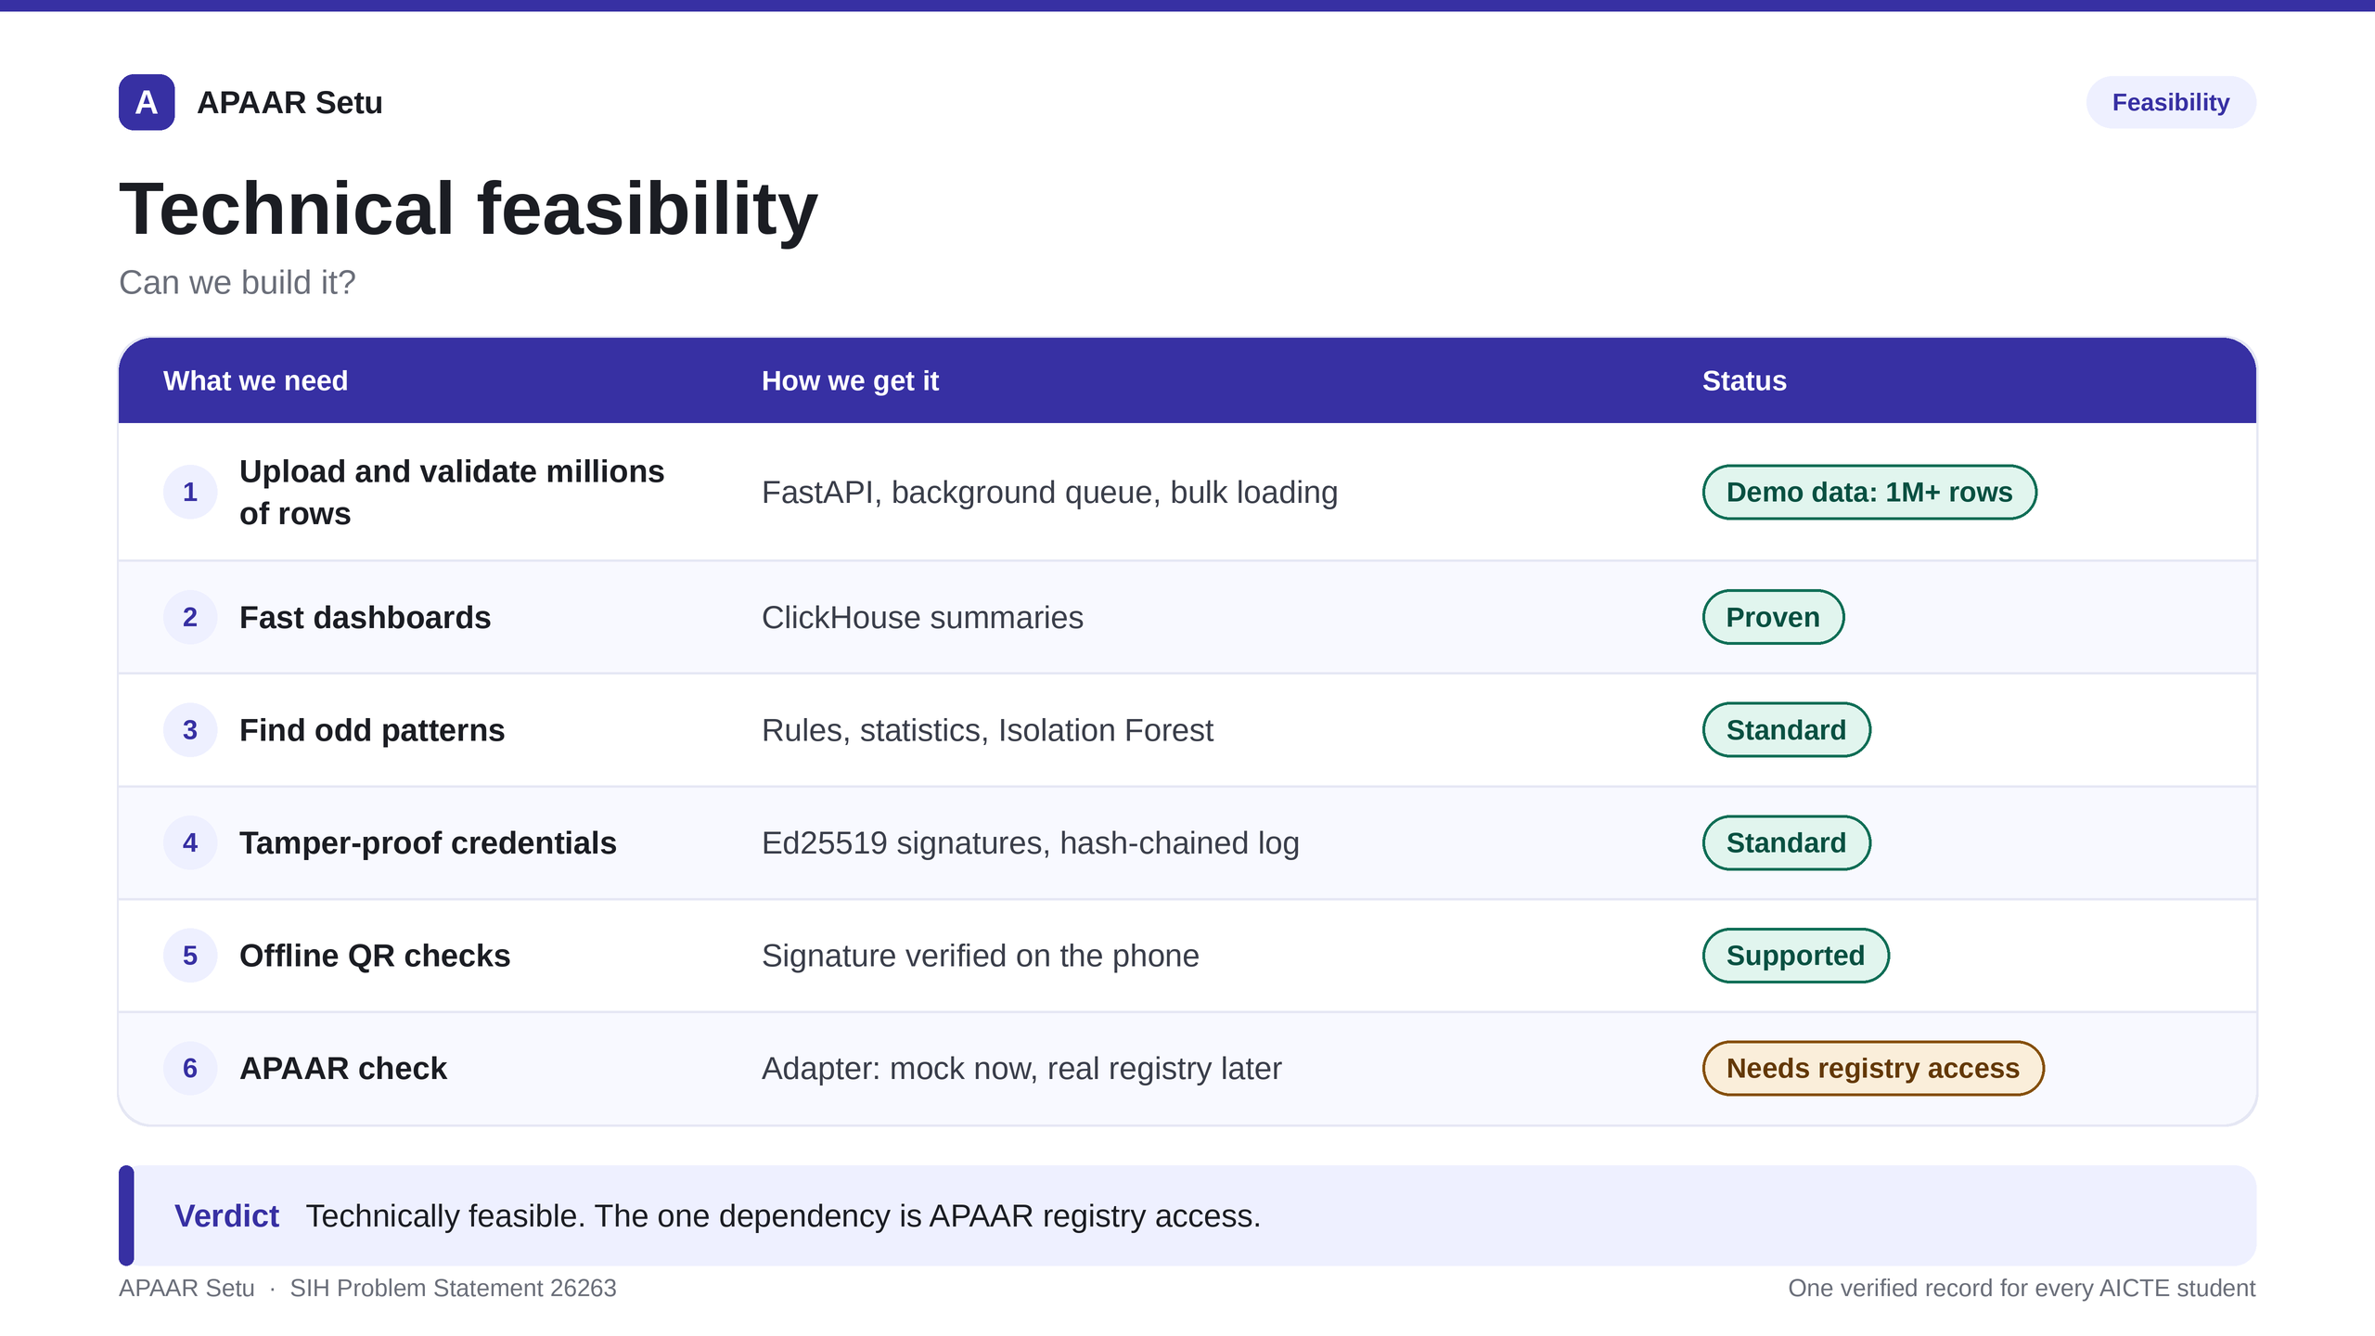
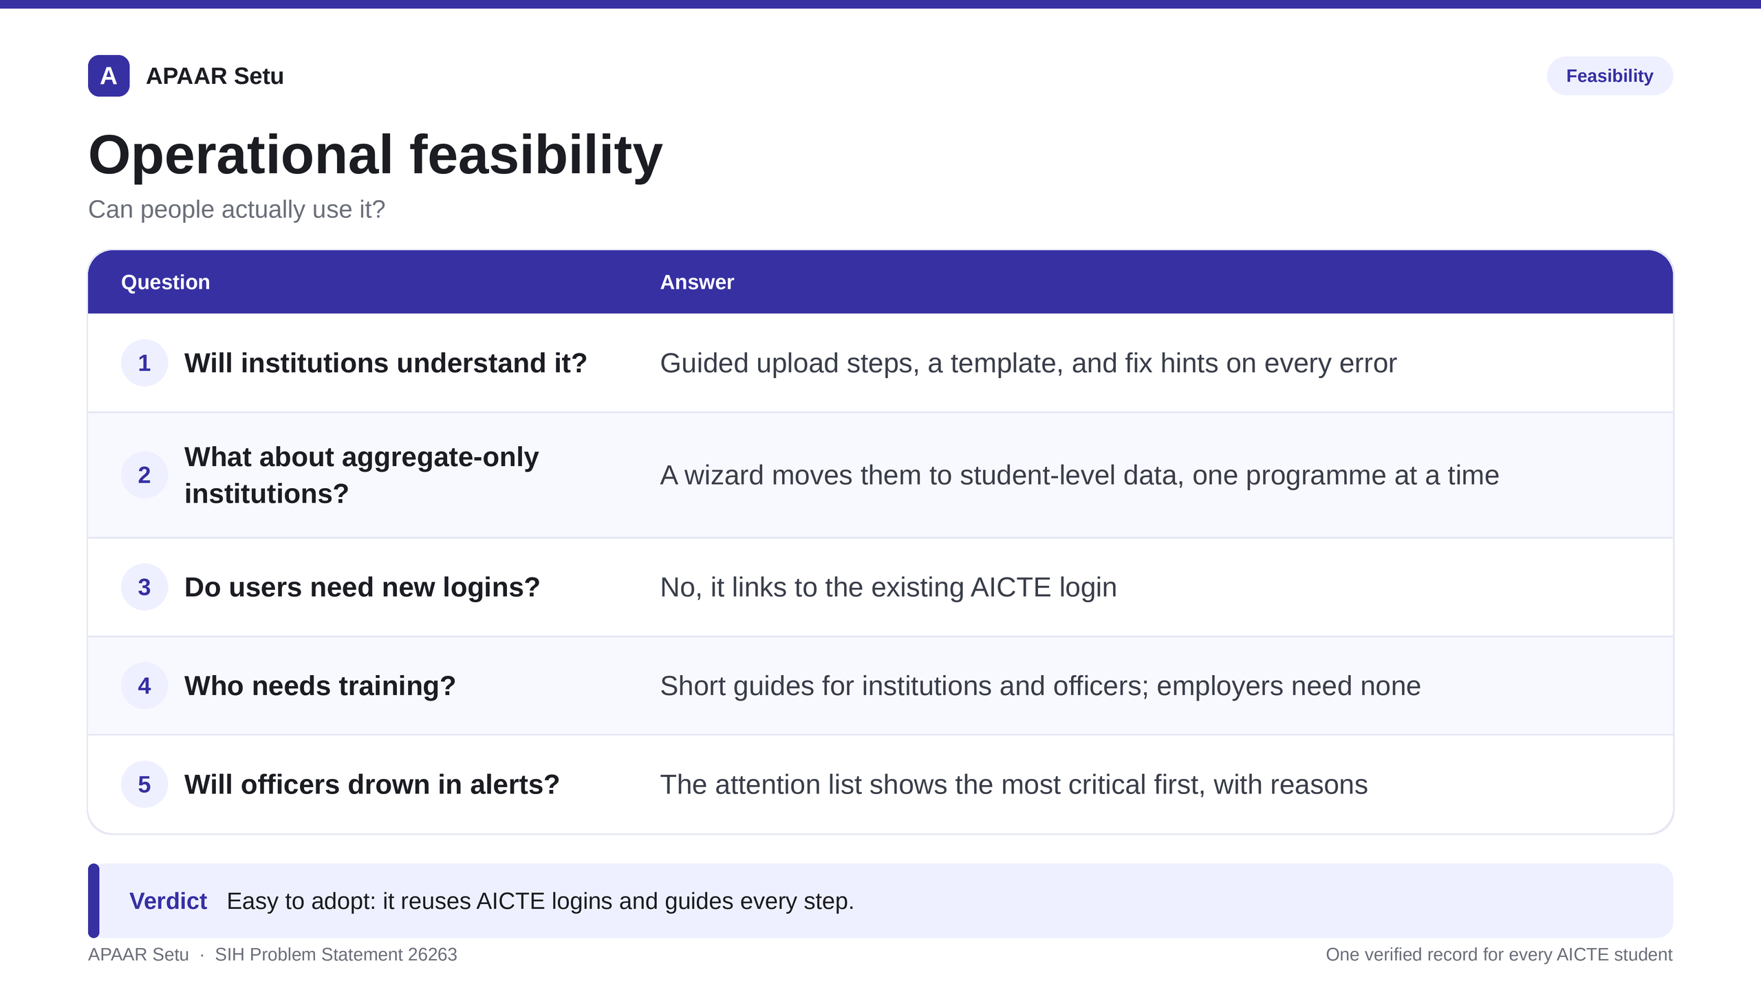
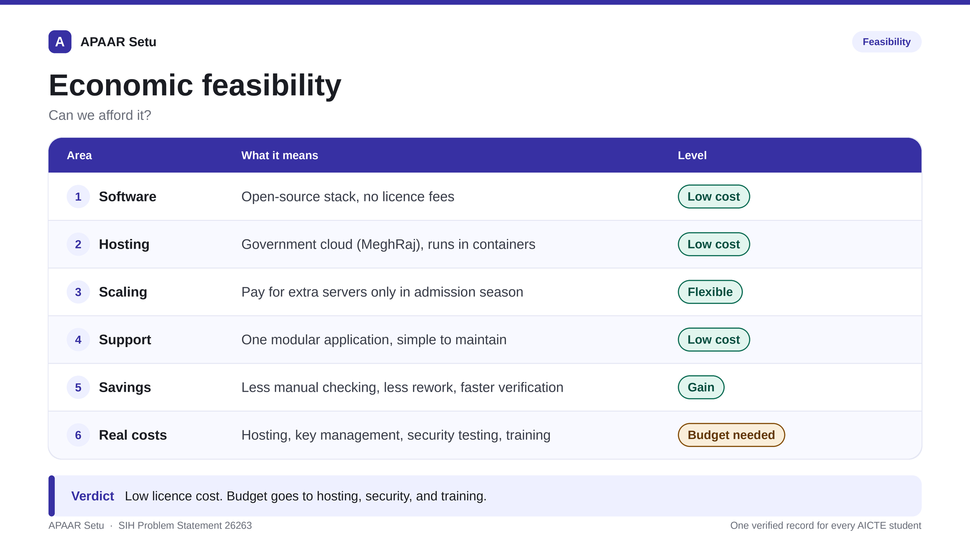
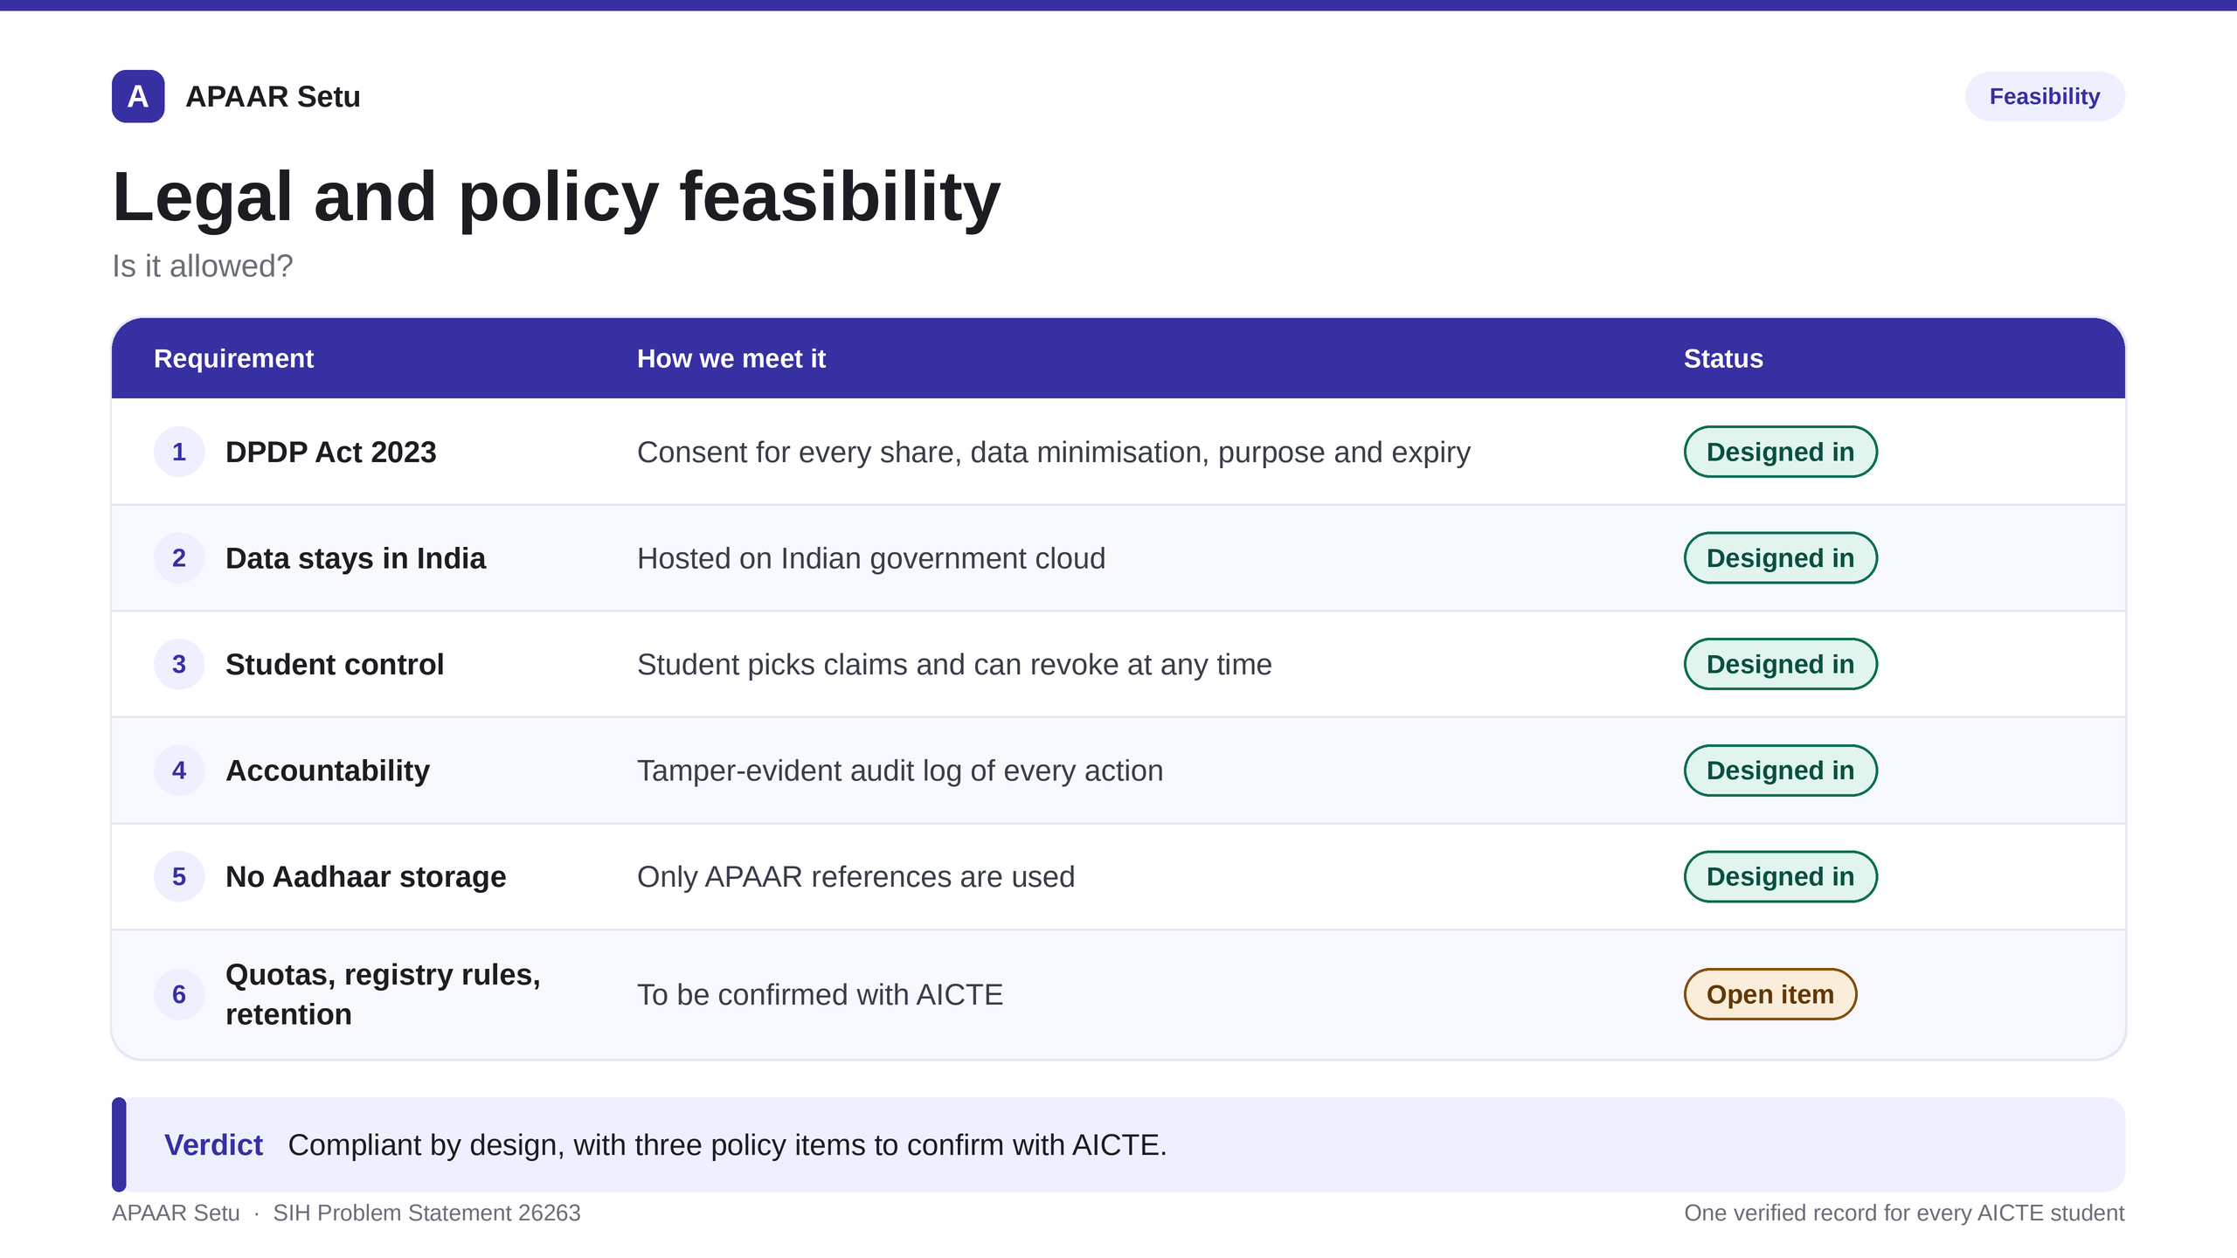
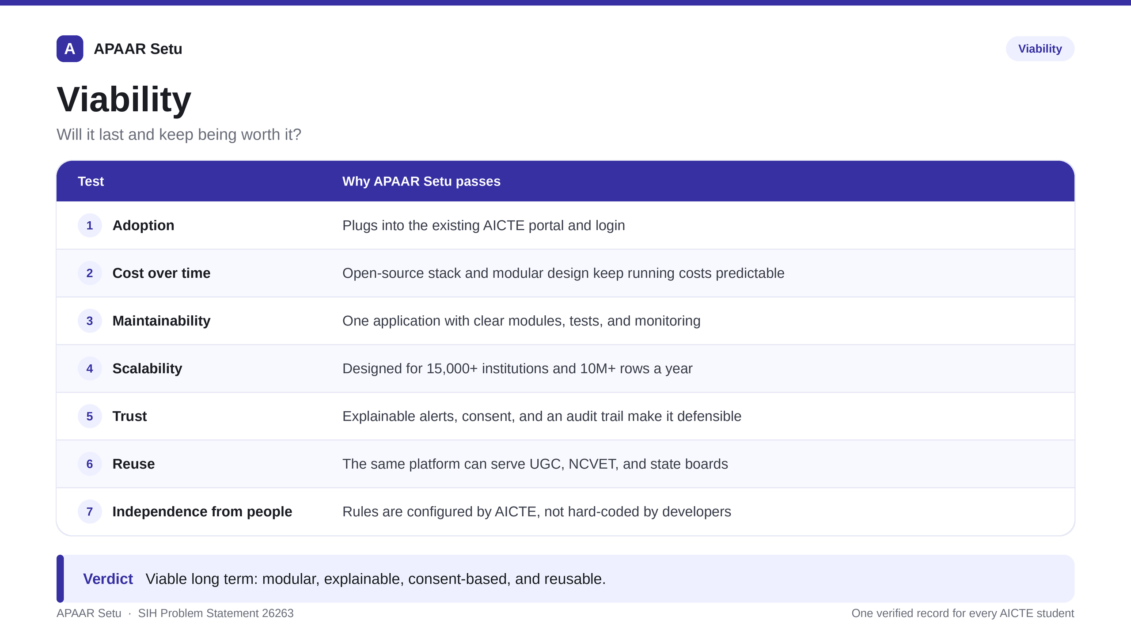
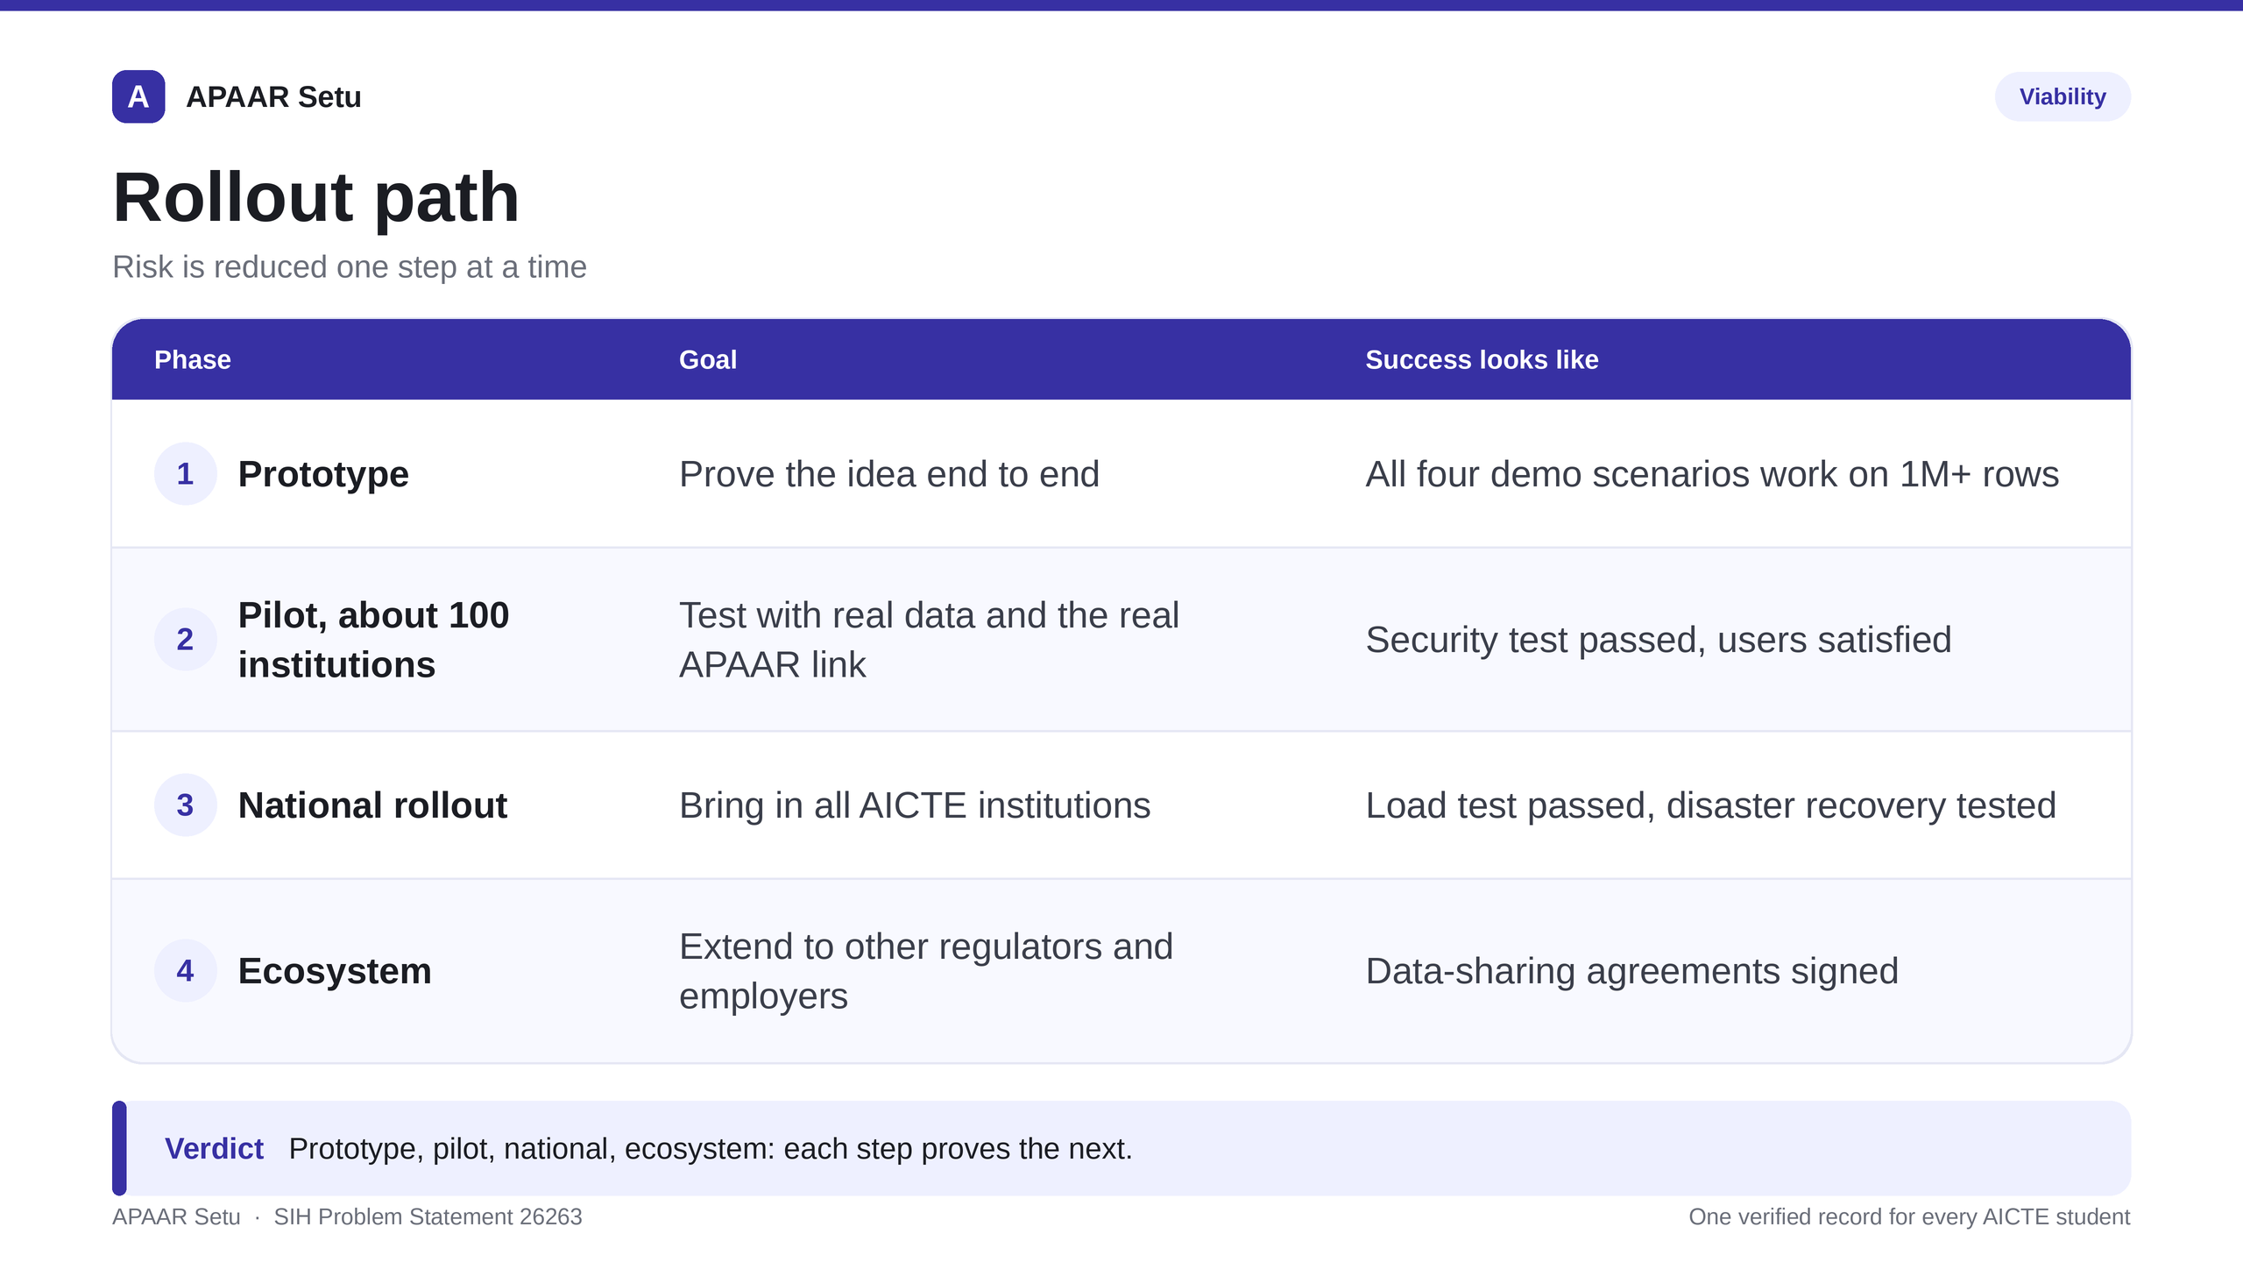
FEASIBILITY AND VIABILITY
Team ARISE@2026

Slide 5
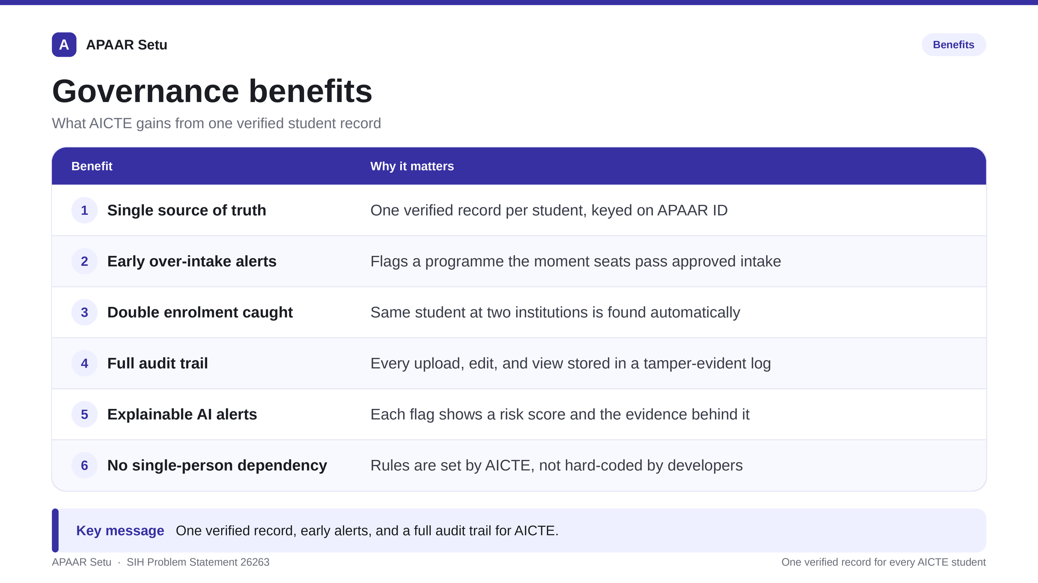
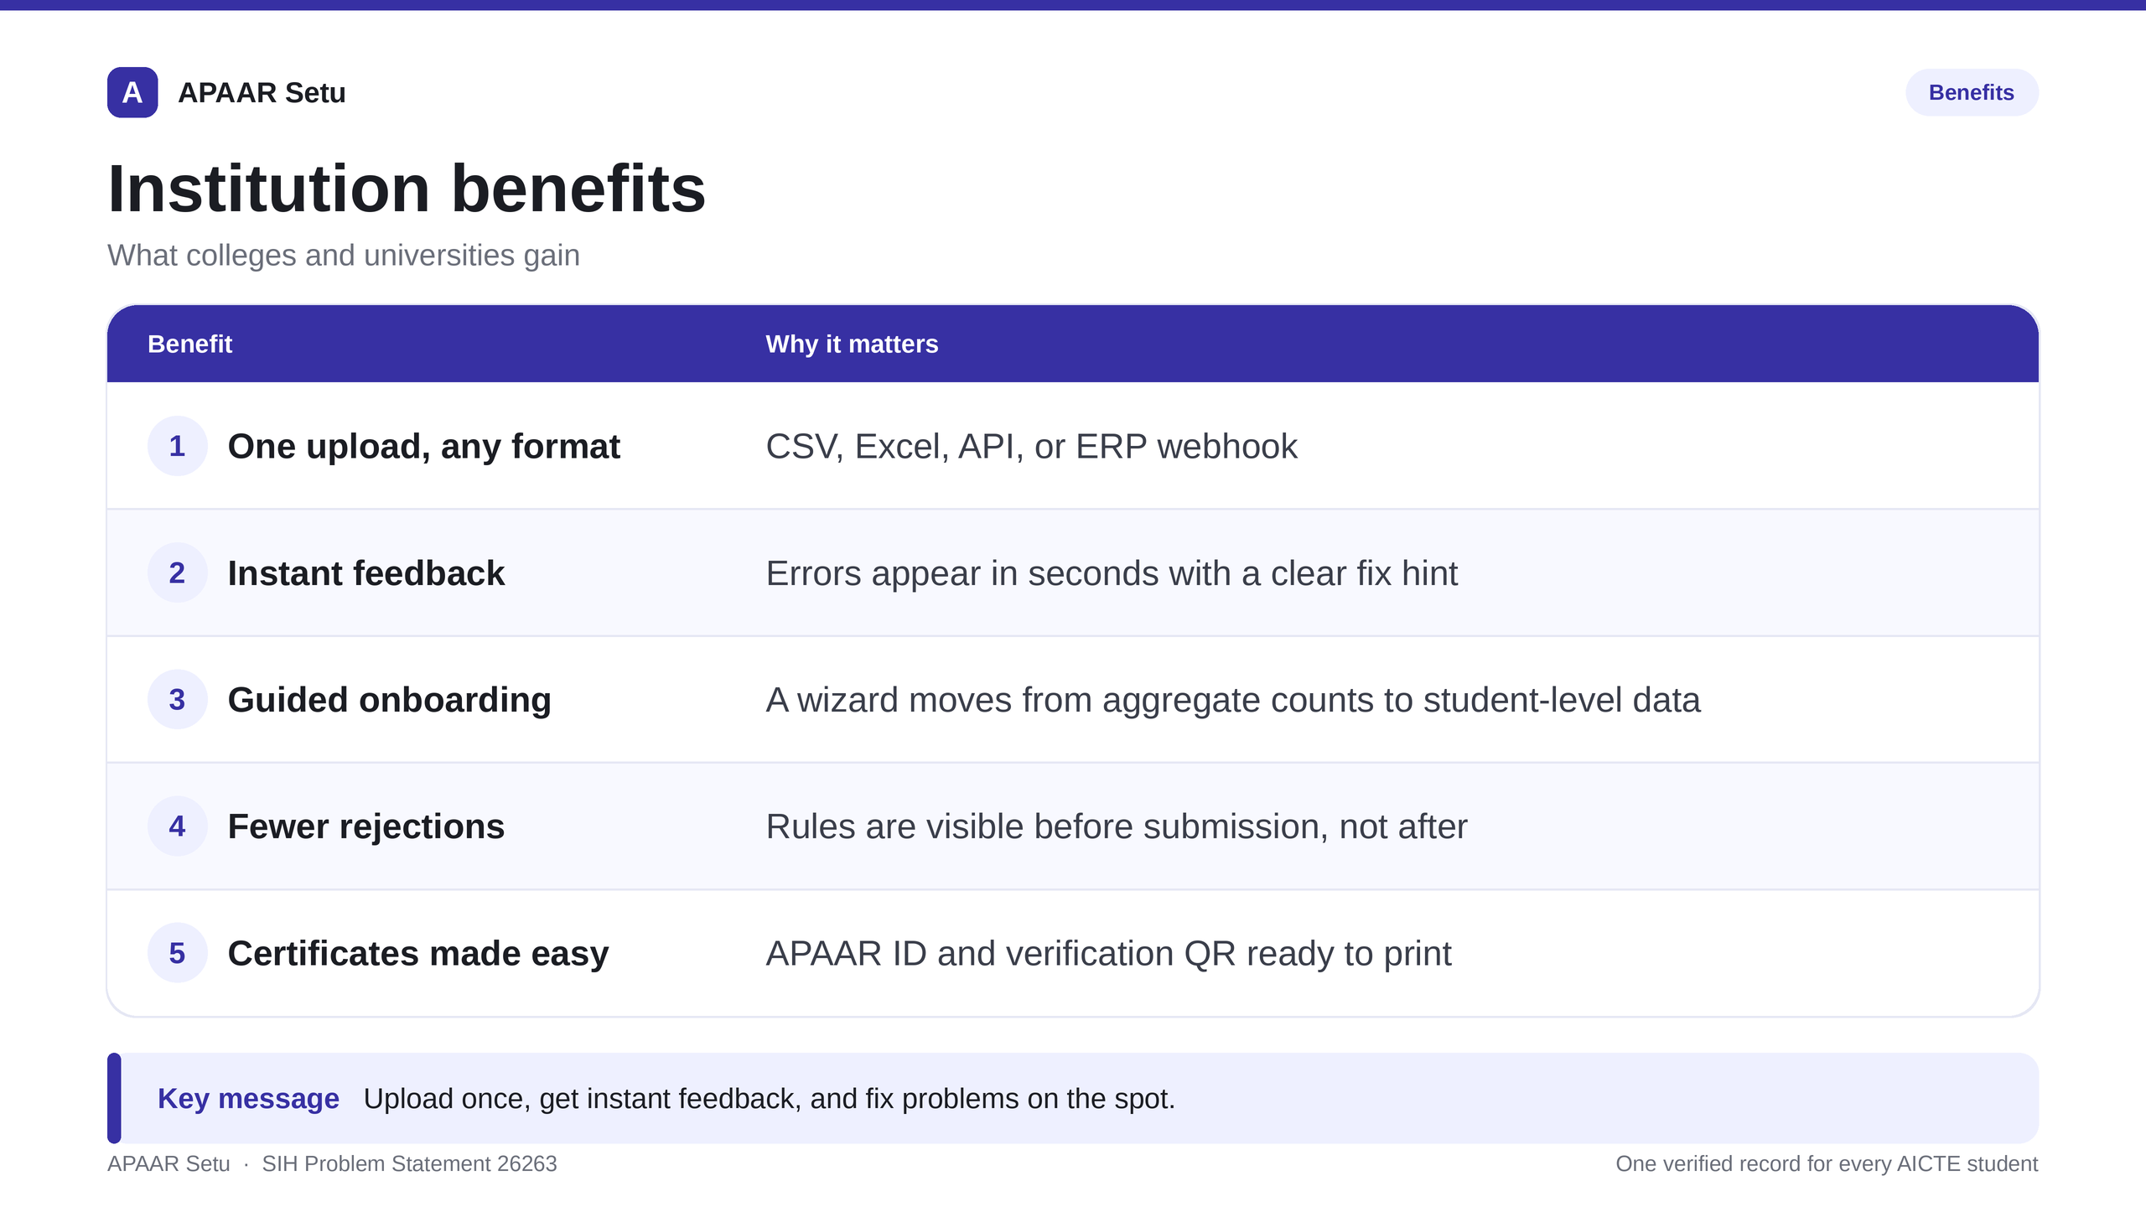
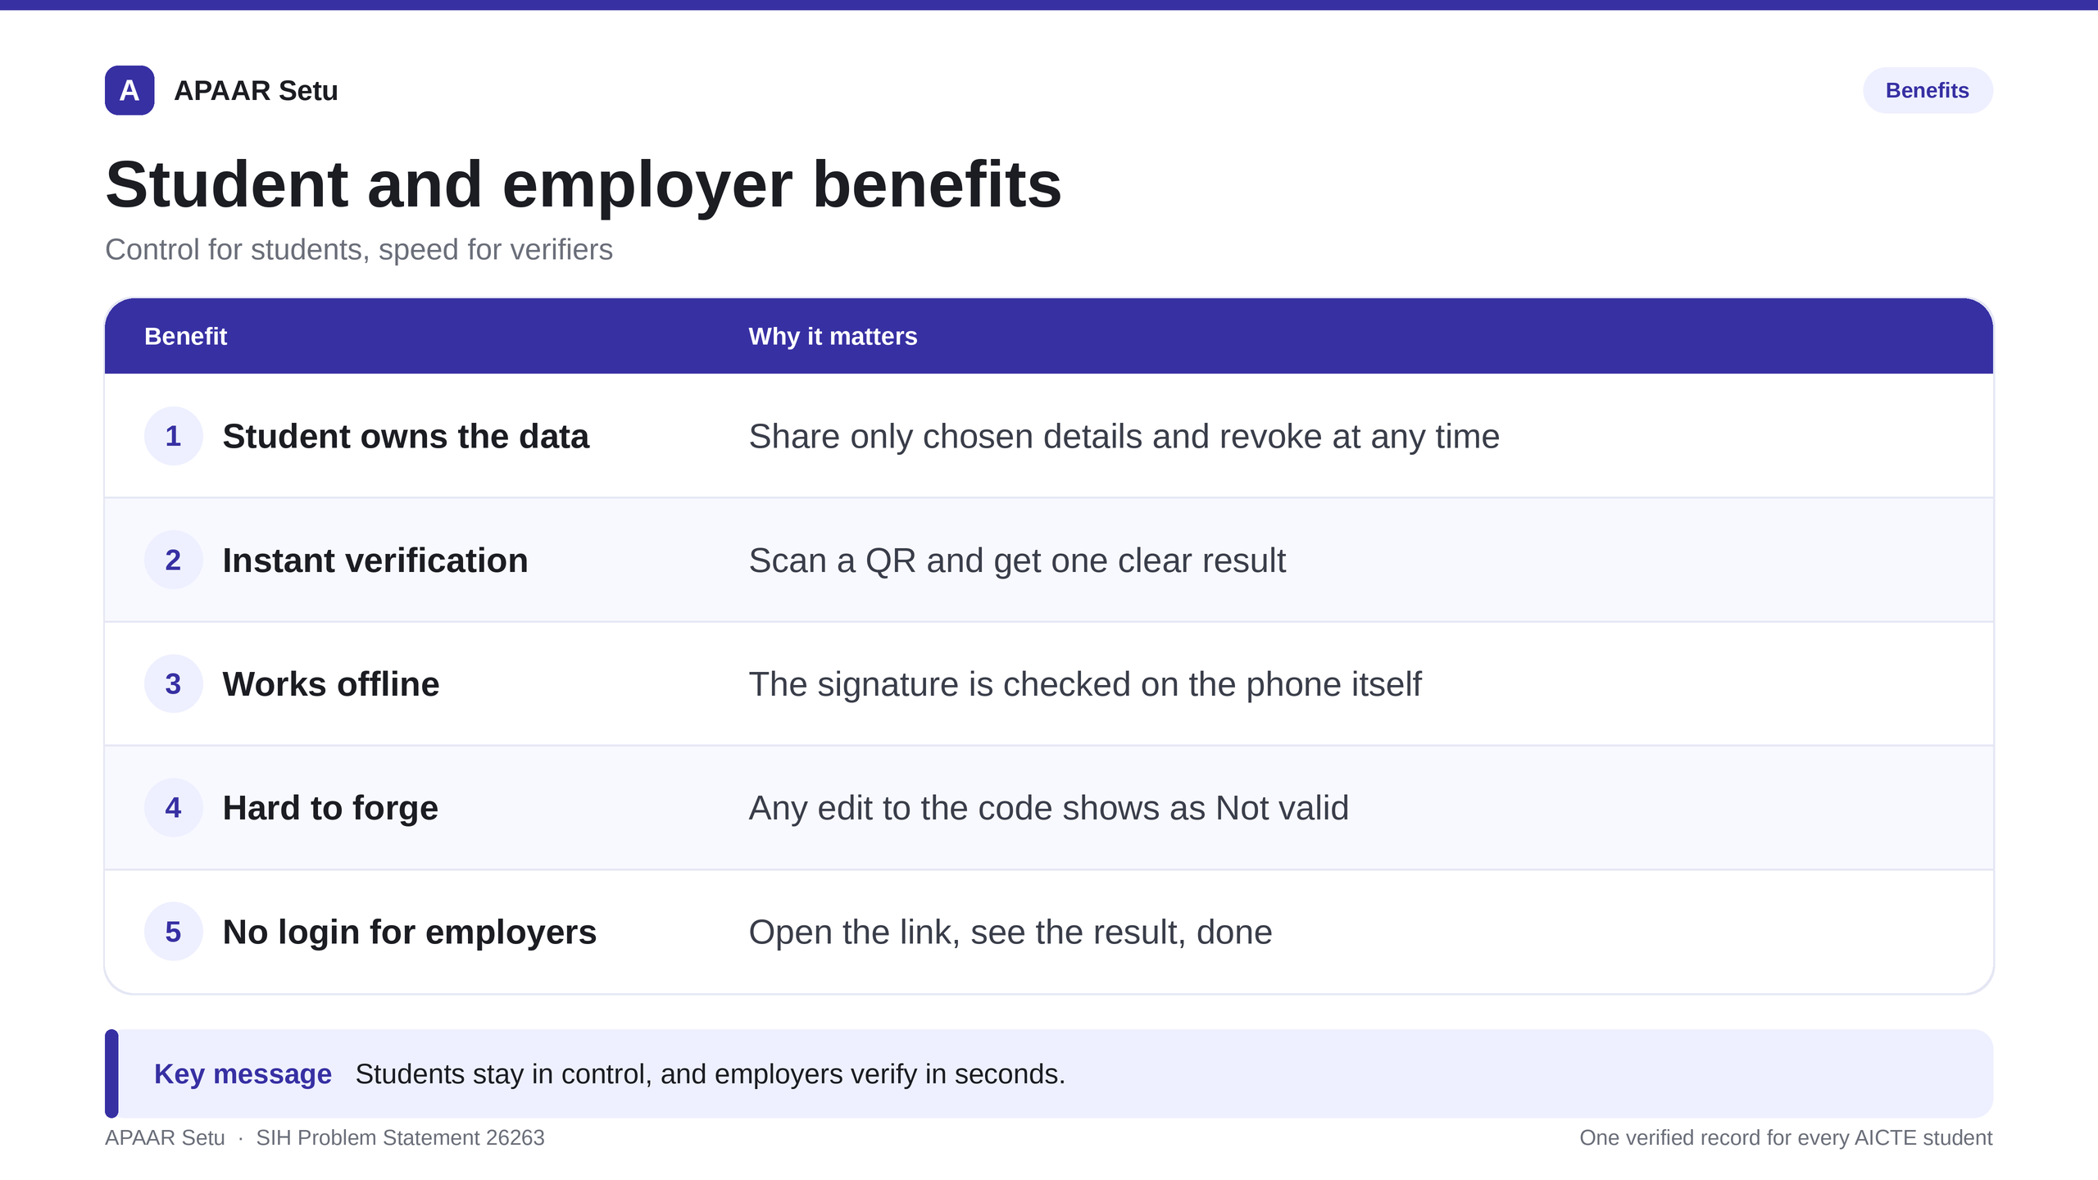
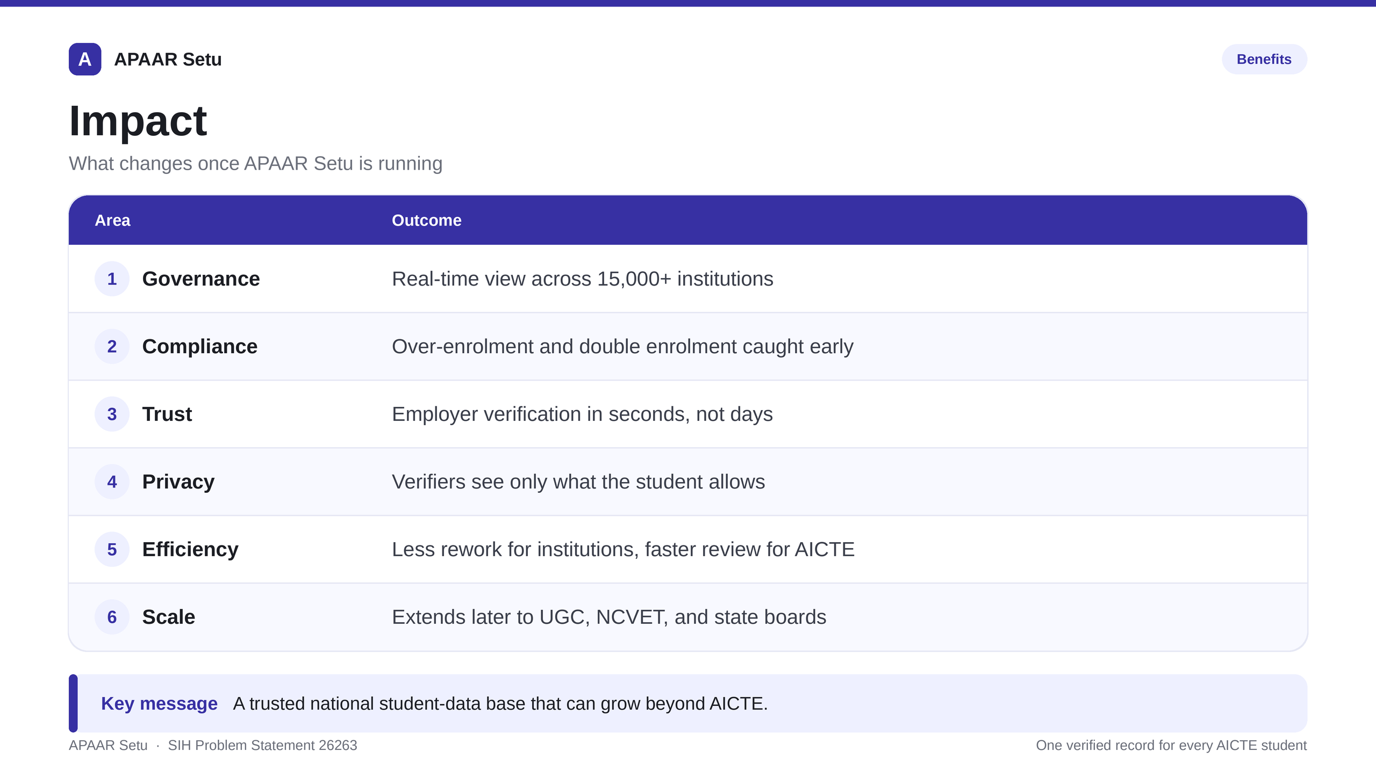
IMPACT AND BENEFITS
Team ARISE@2026

Slide 6
RESEARCH AND REFERENCES
Team ARISE@2026
REGULATORY & POLICY FOUNDATIONS
National Education Policy (NEP 2020) §4.3
Mandates automated lifelong academic registries and seamless student credit mobility across all higher education institutions in India.
AICTE Approval Process Handbook (APH 2025-26)
Statutory definitions for approved intake capacity, supernumerary caps (15%), NRI/OCI quotas (5%), and punitive guidelines for unapproved excess admissions.
Digital Personal Data Protection (DPDP) Act, 2023
Purpose-bound processing, lawful consent lifecycle, zero third-party disclosure without principal consent, and immutable audit compliance under Indian law.
STANDARDS & TECHNICAL PROTOCOLS
W3C Verifiable Credentials Data Model v2.0
Machine-verifiable, tamper-evident credential payload structures supporting selective attribute disclosure and cryptographic proof.
W3C Decentralized Identifiers (DIDs) v1.0
did:web method specification for trust federation and key resolution directly linked to AICTE's verified government domain root (aicte.gov.in).
RFC 8032 — Edwards-Curve Digital Signatures (Ed25519)
High-speed, collision-resistant public key cryptography enabling instant offline verification in under 5 milliseconds on standard mobile processors.
ALGORITHMIC & DETECTION RESEARCH
Isolation Forest Algorithm for Anomaly Detection
Liu, Ting, Zhou (ACM TKDD 2012). Multi-dimensional isolation tree scoring for detecting abnormal spot-round bursts, NRI ratio surges, and ghost student patterns.
Robust Z-Score & Median Absolute Deviation (MAD)
Rousseeuw & Croux (JASA 1993). Outlier resistance on skewed admission cohorts to minimize false-positive regulatory penalties across diverse peer institutions.
Cryptographic Hash Chaining & Forward Integrity
Bellare & Yee (IEEE S&P). Append-only tamper-evident audit logging ensuring non-repudiation across all regulatory and institutional data mutations.
PROTOTYPE IMPLEMENTATION & PILOT STATUS
Full Prototype Implementation (Smart India Hackathon 2026)
Tested on 1,000,000+ synthetic student enrolments across 1,600+ AICTE institutions. Sub-second validation latency and 100% plant-detection recall.
Live Demonstration System Available
Interactive multi-role web platform supporting AICTE Regulator, Institution Registrar, Student, and Public Offline Verifier modes.
Open API & MeghRaj Cloud Readiness
OpenAPI 3.1 specifications, containerized modular architecture, and zero Aadhaar storage compliance for instant NIC MeghRaj cloud deployment.

