Slide 1

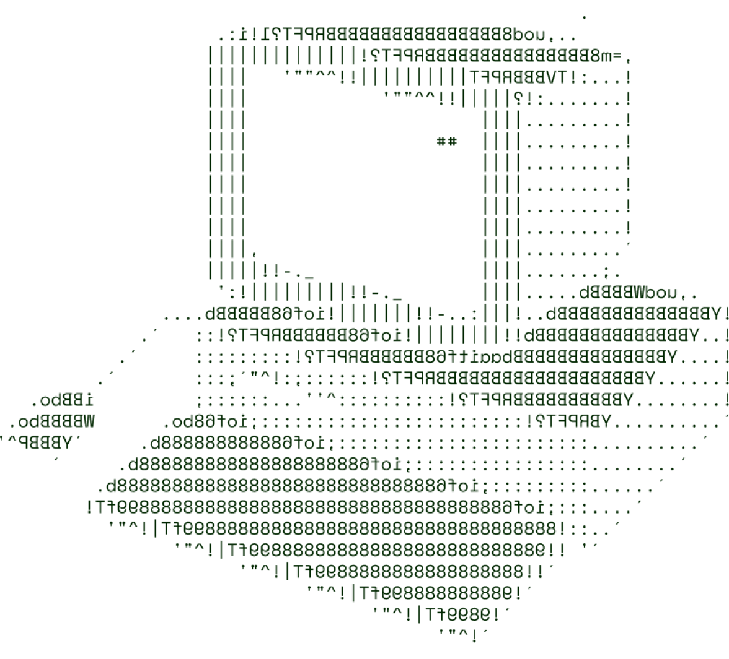

MedEx
(Beginners)

Slide 2

SOLUTION OVERVIEW
Our Decentralized Health Data Exchange is a blockchain-based platform that securely manages and shares patient health records while giving patients full control over their data. It addresses issues with privacy, unauthorized access, and data fragmentation by decentralizing storage and enabling patients to control who accesses their records.
Problem Addressed:
Traditional healthcare systems are centralized, vulnerable to privacy breaches, and inefficient at sharing records across providers. Our solution enhances security, privacy, and interoperability while ensuring compliance with regulations like GDPR and HIPAA.
Innovation and Uniqueness:
By leveraging blockchain, our platform offers tamper-proof, immutable storage and a patient-controlled access model. It also integrates a token-based incentive system for patients who share anonymized data for research, which is unique in incentivizing user engagement.

Slide 3
SOLUTION OVERVIEW
Key Features and Benefits:
Patient-Controlled Access: Patients grant or revoke access to healthcare providers through a user-friendly interface.
Tamper-proof Audit Trails: Immutable logs on blockchain for transparency.
Smart Contracts for Access Control: Secure, role-based data sharing.
Data Privacy & Compliance: Encrypted data storage and secure sharing ensure compliance with privacy laws.
Interoperability: Seamless integration with existing healthcare systems via FHIR APIs.
Incentivized Research Participation: Patients earn tokens for sharing anonymized data.

Slide 4
TECHNICAL ARCHITECTURE
Tech stack
Blockchain: Hyperledger Fabric, Ethereum (private network), or Corda (for permissioned access).
Smart Contracts: Solidity (for Ethereum) or Chaincode (for Hyperledger).
Encryption: RSA or ECC for key management, AES-256 for data encryption.
Frontend: React.js/Angular.js for web interface, Flutter/React Native for mobile.
Backend: Node.js, Django, or Spring Boot for API development.
Database: IPFS, MongoDB, or cloud storage for off-chain data storage.
Interoperability: FHIR-based APIs for EHR integration.

Slide 5
SCALABILITY AND FUTURE SCOPE
Handling Increased Load:
Use a hybrid blockchain model to store large files off-chain while keeping access control and metadata on-chain.
Implement load balancing for efficient resource distribution during high traffic.
2. Architecture Considerations:
Leverage cloud services (e.g., AWS, Azure) for scalable storage and compute power.
Utilize containerization(e.g., Docker, Kubernetes) for microservices to ensure easy scaling.

Slide 6
SCALABILITY AND FUTURE SCOPE
3. Technologies Supporting Scalability:
Microservices for modular, independent service management.
Containerization for efficient deployment and resource optimization.
API Gateways to handle seamless integration and external requests.
4. Future Functionalities:
AI-driven health insights for predictive analytics and personalized health recommendations.
Cross-border health data exchange to allow secure data sharing across global healthcare systems.
Decentralized clinical trials platform to recruit and manage participants with real-time data sharing.

Slide 7
FEASIBILITY
Challenges and Risks:
Data Privacy: Ensuring compliance with HIPAA/GDPR.
Interoperability: Integrating with diverse healthcare systems.
Scalability: Managing large-scale data and blockchain overhead.
User Adoption: Encouraging uptake among patients and providers.
2. Strategies:
Strong Encryption: End-to-end encryption (AES-256, RSA) for data security.
Standardized Protocols: Use FHIR for seamless system integration.
Hybrid Blockchain: Off-chain storage for efficiency, on-chain for access control.
User Education: Training and support to ease adoption.

Slide 8

>Team Details

Slide 9






Vivek Ravi
Jagadeep Mamidi
Student
VIT-AP University
Student
VIT-AP University

Slide 10

Thanks for Joining

