Slide 1


A PROJECT PRESENTATION ON “PREDICTING WHETHER THE FLIGHT WILL BE DELAYED USING MACHINE LEARNING”
By
ABHIJEET CHAVAN Roll No: 1309
VIVEK KUMAR SINGH Roll No: 1357
Under The Guidance of
Mr. AKSHAY TILEKAR
POST GRADUATE E-DIPLOMA IN BIG DATA ANALYTICS MAY-2021
INSTITUTE FOR ADVANCED COMPUTING AND SOFTWARE DEVELOPMENT, AKURDI, PUNE

Slide 2
INTRODUCTION
Flight delays has become a very important subject for air transportation all over the world because of the associated financial loses that the aviation industry is going through.
According to data from the Bureau of Transportation Statistics (BTS) of the United Stated, over 20% of US flights were delayed during 2018, which resulted in a severe economic impact equivalent to 41 billion US$.
By using Machine Learning (ML) Algorithms we try to predict if your flight will be delayed in many ways.

Slide 3
OBJECTIVE
The objective of this project is : "Design a Model that predicts flight delays before they are announced on the departure boards"

Slide 4
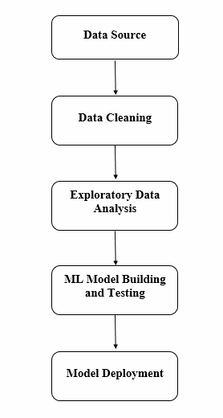
Block Diagram

Slide 5
DATASET DESCRIPTION
FL_DATE = Date of the Flight OP_CARRIER = Airline Identifier OP_CARRIER_FL_NUM = Flight Number ORIGIN = Starting Airport Code DEST = Destination Airport Code CRS_DEP_TIME = Planned Departure Time DEP_TIME = Actual Departure Time DEP_DELAY = Total Delay on Departure in minutes TAXI_OUT = The time duration elapsed between departure from the origin airport gate and wheels off WHEELS_OFF = The time point that the aircraft's wheels leave the ground WHEELS_ON = The time point that the aircraft'ss wheels touch on the ground TAXI_IN = The time duration elapsed between wheels-on and gate arrival at the destination airport CRS_ARR_TIME = Planned arrival time ARR_TIME = Actual Arrival Time = ARRIVAL_TIME - SCHEDULED_ARRIVAL ARR_DELAY = Total Delay on Arrival in minutes CANCELLED = Flight Cancelled (1 = cancelled) CANCELLATION_CODE = Reason for Cancellation of flight: A - Airline/Carrier; B - Weather; C - National Air System; D - Security DIVERTED = Aircraft landed on different airport that the one scheduled CRS_ELAPSED_TIME = Planned amount of time needed for the flight trip ACTUAL_ELAPSED_TIME = AIR_TIME+TAXI_IN+TAXI_OUT AIR_TIME = The time duration between wheels_off and wheels_on time DISTANCE = Distance between two airports CARRIER_DELAY = Delay caused by the airline in minutes WEATHER_DELAY = Delay caused by weather NAS_DELAY = Delay caused by air system SECURITY_DELAY = caused by security reasons LATE_AIRCRAFT_DELAY = Delay caused by security

Slide 6
DATA CLEANING/PREPROCESSING
Data cleaning refers to preparing data for analysis by removing or modifying data that is incomplete, irrelevant, duplicated, or improperly formatted.
The first step before going into the data cleaning was to define what I will be considering a delayed flight.
Each one of the columns within the main dataframe was analyzed individually with the exception of the following 5:
CARRIER_DELAY
WEATHER_DELAY
NAS_DELAY
SECURITY_DELAY
LATE_AIRCRAFT_DELAY
These 5 represent the different reasons why a flight is delayed. Unfortunately, for the 2018 dataset, 5,744,152 rows are missing, adding an 81% of the entire dataset. Therefore, a decision to drop those columns was also made.
After a brief look at the data, the key features that needed some immediate work were the Airline (OP_CARRIER), and departing (ORIGIN) and arrival city/airport (DEST). These needed to have their abbreviations and their IATA codes changed to the airline and airports names respectively

Slide 7
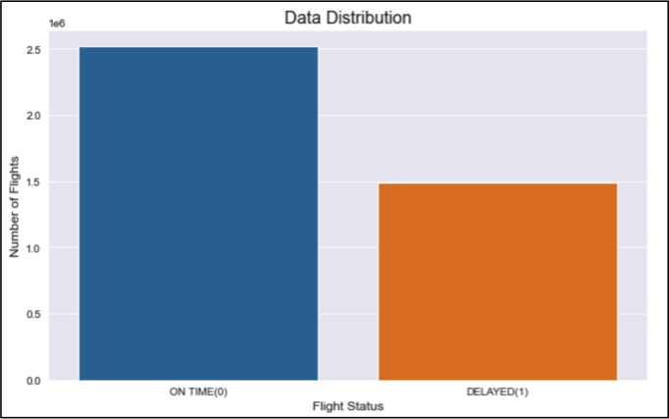
In terms of engineered features, the first one to be calculated was the target (FLIGHT_STATUS) which was the flight being delayed or not. This is a binary column, with a 0 for flights arriving on time, and a 1 for flights arriving late,
ENGINEERED FEATURES
With this column ready, the next step was a quick check for the data distribution, meaning, checking if the data is balanced or not. Results are plotted on Figure 3 and they suggest a severe imbalance dataset with an almost 2:1 ratio, this means right away that looking at accuracy on its own will not be enough to evaluate the models, but I will also need to look at other metrics such as Precision, Recall and F1.

Slide 8
EDA
It is a way of visualizing, summarizing and interpreting the information that is hidden in rows and column format. ... Once EDA is complete and insights are drawn, its feature can be used for supervised and unsupervised machine learning modelling.
Visualization on each EDAs is done by using libraries matplotlib and Seaborn

Slide 9
On the EDA notebook, the following questions were addressed:
Total Number of Flights by Airline
Number of Delayed Flights by Airline
Percentage of Delayed Flights by Airline
Total Minutes Delayed by Airline
Average Delay Time by Airline
30 Most Common Destination (Cities)
Worse and Best months to travel
Is there a Better day of the month to travel?
Best weekday to avoid delays
Impact of Delays (Departure vs Arrival Delay)
Most Popular Destinations with Average Arrival Delays
Number of Destination by Airline
Recommended airlines based on lowest delay times

Slide 10
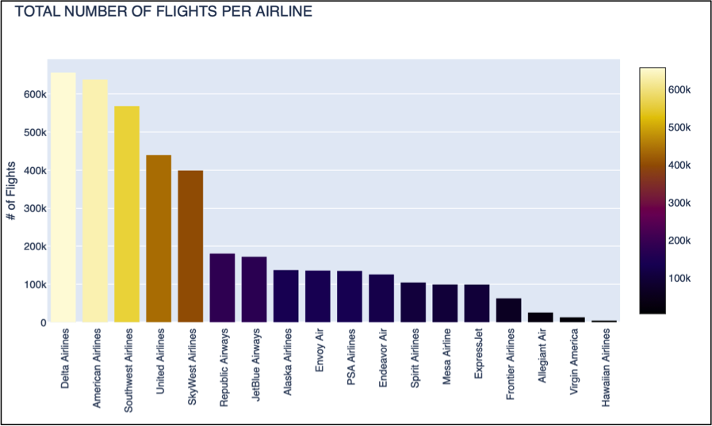
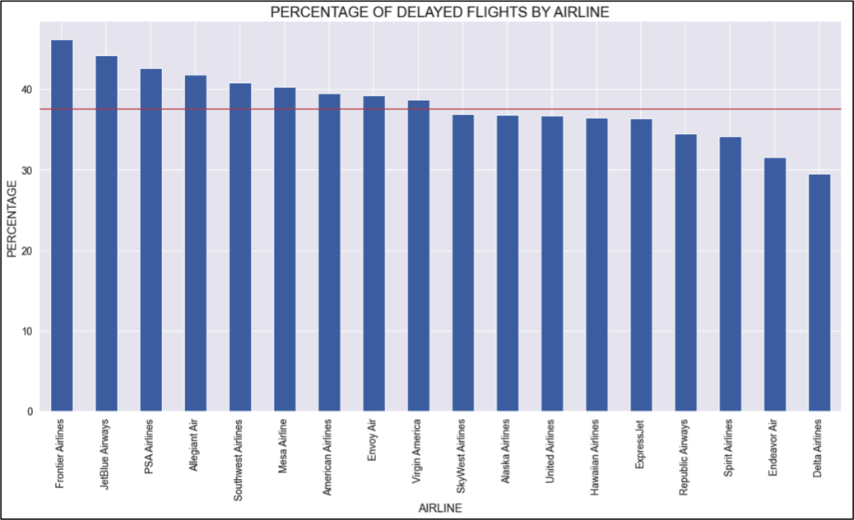
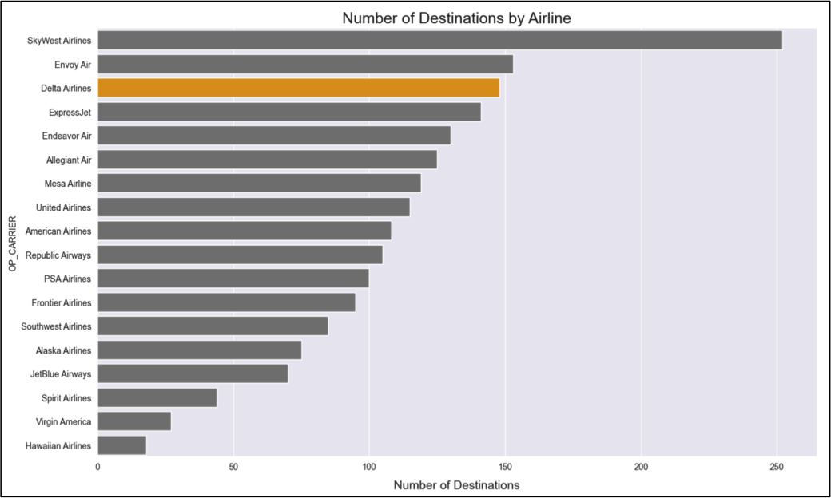
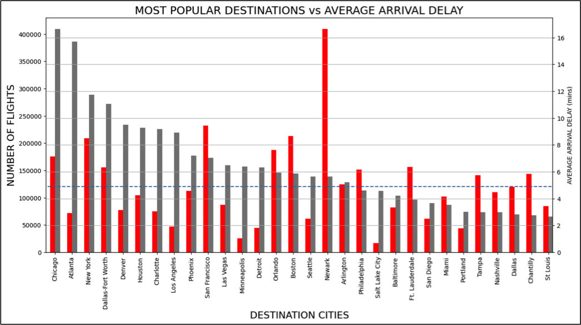

Slide 11
Model Building
Collecting data & analysing target variable
Data division into features and target columns
Encoding target column
Train & Test Splitting of dataset
Choosing ML model on basis of target variable. (Classification)
Train model on various classification techniques
Evolution of model
Hyper - Parameter tuning
Prediction on test dataset
This project Random forest is the Best classification Model amoung the Knn, Decision Tree,Xgboost Classifier.

Slide 12
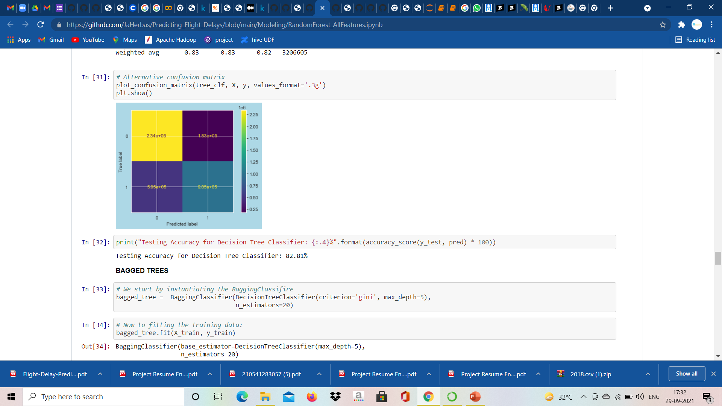
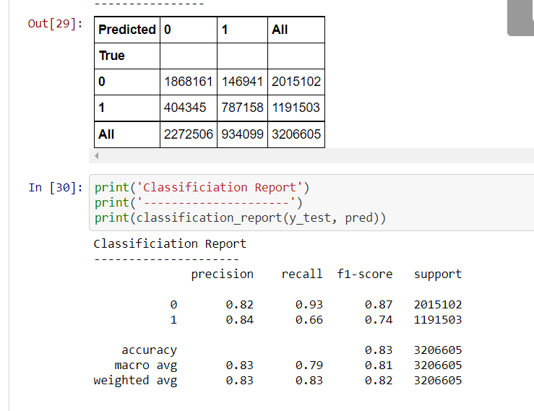

Slide 13
Future Scope
Engineer a “Time of the day” category to understand if there are any time windows during the day more prone than others to have delays
Re-do the EDA but with the 10 year historic data instead of only the 2018
Scrape weather information such as temperature, humidity, wind and precipitation and add it to the current dataset as it is known that these are major factors that affect the flight delays
Re-run the ML and Neural Networks models selected as the best performers with one departure city and top 20 destinations chosen by the number of arriving flights

Slide 14
THANK YOU

