Slide 1

CUSTOMER RETENTION PROJECT
By: Vivek Rai

Slide 2
INTRODUCTION
A customer is a person who receives, consumes or buys a product or service and can choose between different goods and suppliers.
The main goal of all commercial enterprises is to attract customers or clients, and make them purchase what they have on sale. They also try to encourage them to keep coming back.
Online sellers closely track the relationships they have with their customers ; often asking for feedback.
Online sellers do this because they want to improve their purchasing experience . Sellers online strive to tailor their offerings closely to the needs and preferences of their customers.

Slide 3
PROBLEM STATEMENT
Customer satisfaction has emerged as one of the most important factors that guarantee the success of online store ; it has been posited as a key stimulant of purchase , repurchase intentions and customer loyalty.
Five major factors that contributed to the success of an e-commerce store have been identified as: service quality , system quality , information quality , trust and net benefit .
The data is collected from the Indian online shoppers . Results indicate the e-retail success factors, which are very much critical for customer satisfaction.

Slide 4

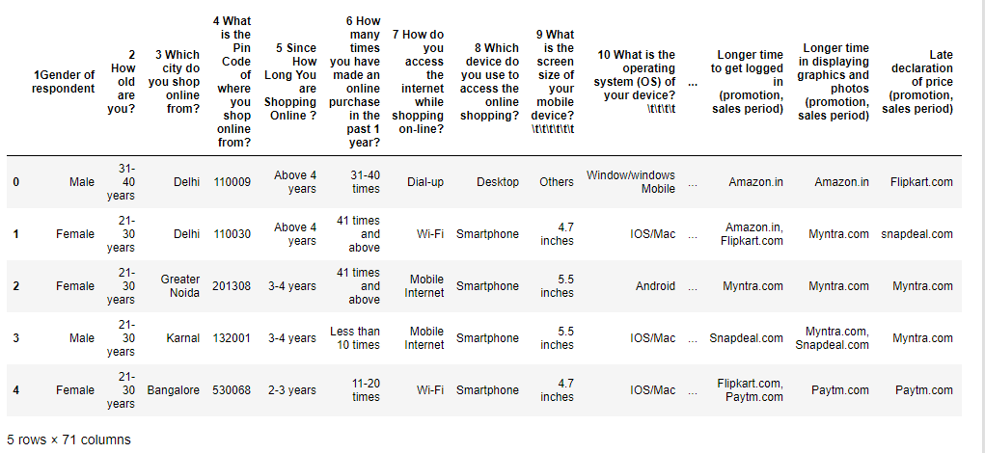
ANALYTICAL DATA ANALYSIS
We will be using the data provided by the client database in the Microsoft excel format(.xlsx). The sample data for the reference is as shown below

Slide 5
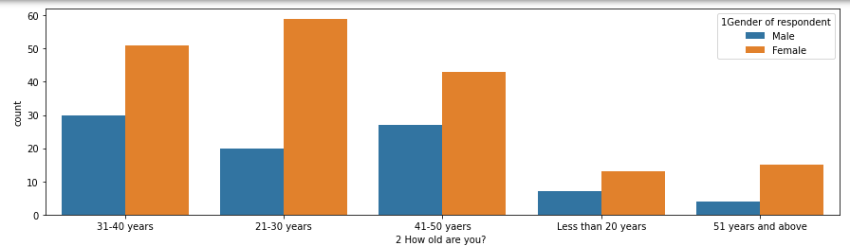
The data is deeply analyzed by finding a relationship between each attribute and the Consumer given details.
Age group of the customers: Customers by the age group of 31-40 years and 21-30 years have highly active online transactions compared to other lower and higher age groups.

Slide 6
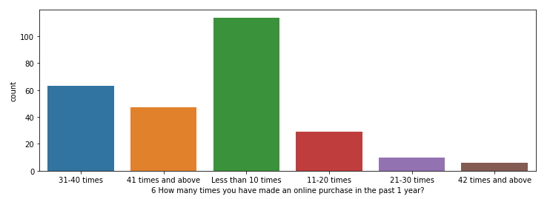
Number of times shopping is made in past one year: Highest number of people shopped online less than 10 times in the past one year.

Slide 7
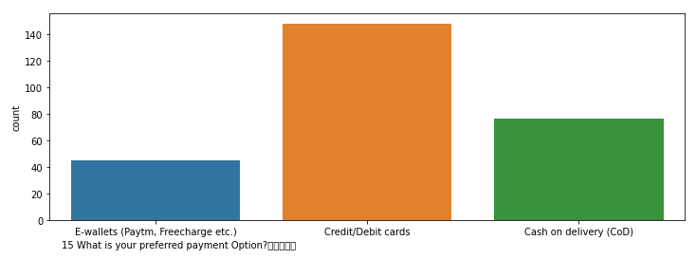
⦁ Customers preferred payment option: Most customers prefer Credit/Debit cards as a payment option, while some of the customers prefer Cash on delivery.

Slide 8
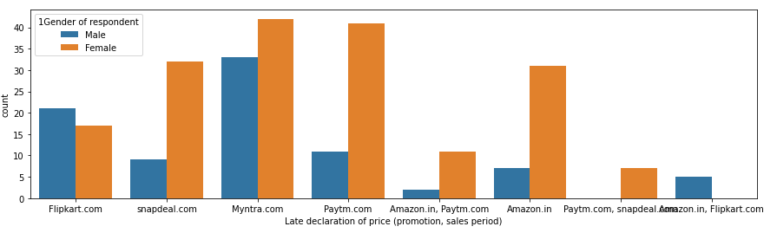
Late declaration of price: Many customers have agreed that Myntra.com and Amazon.in on late promotion and sales period.

Slide 9
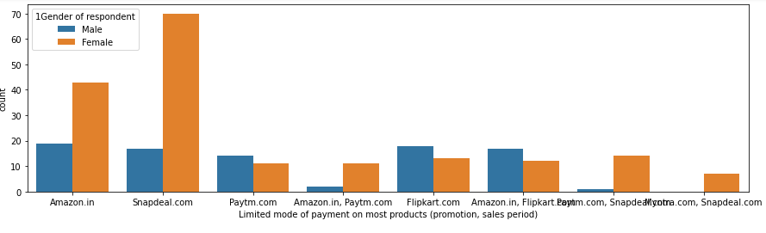
Limited mode of payment: It is being seen from the below analysis that Snapdeal.com has limited mode of payment on most of the products.

Slide 10
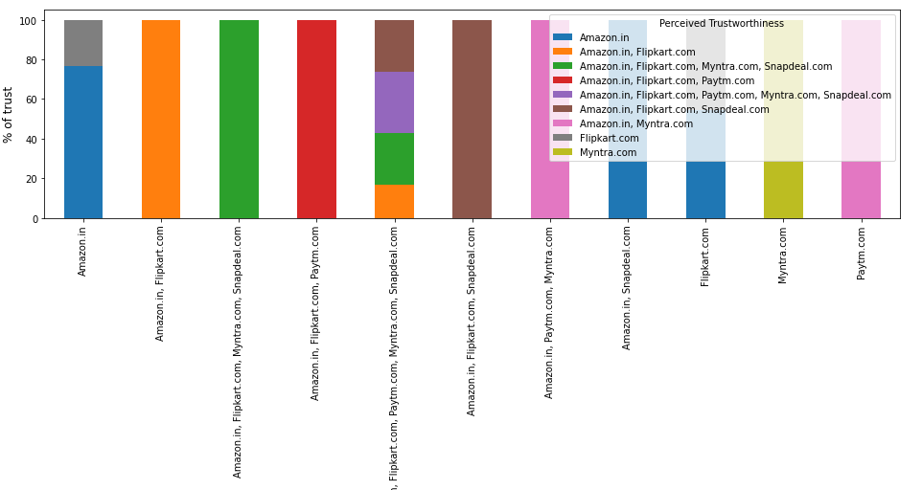
Perceived trustworthiness: The most trusted online shopping site by the customers.

Slide 11
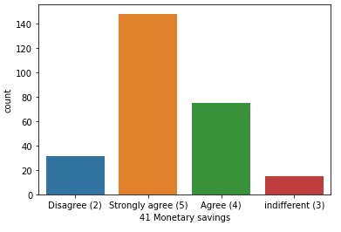
⦁ Monetary savings : Most customers strongly agree that money can be saved by shopping from online sites

Slide 12

CONCLUSION
There are ways to improving customer experience and customer satisfaction, they are to encourage repeat purchases and brand loyalty.
New customers find it a lot harder to trust you the first time because they haven’t practically experienced the value gain you provide. That’s why it’s even more important to provide a positive customer experience to meet up with customer expectations and help your customers’ businesses thrive.
By focusing on customer delight and meeting up with customer expectations, you can get more business from them and acquire new clients when they refer your business to their network. So retaining customers by focusing on a solid customer retention strategy opens unseen opportunities for new customer acquisition as well.

