Slide 1

Finance Tracker
School of Computing and Mathematical Sciences
CO7201 Individual Project
Vivek Prakash Shah
vps5@student.le.ac.uk
239062179
Project Supervisor: Dr. Babajide Afeni
Principal Marker: Dr. Craig Bower

Slide 2
Introduction
A mobile application to manage personal finances simply and effectively.
Helps users track expenses and income, set monthly budgets, and analyze financial behavior.
Built using Kotlin, Jetpack Compose, and Firebase following Clean Architecture principles.
Supports multi-currency transactions with live exchange rate conversion.
Offers data visualization using charts and graphs for better understanding of spending patterns.
Solves common problems in existing apps like high cost, ads, complex UI, lack of offline support, and limited customization.
Designed for students and individuals seeking a free, secure, and user-friendly financial management solution.

Slide 3
Aim & Objective of the project
To develop an intuitive expense tracking system that helps users manage their income and expenses efficiently.
To analyze spending patterns and provide insights with budgeting hints and alerts
To provide a visual representation of financial data through charts and graphs.
This project serves as the foundation for my career in app development, as I aim to build a fully functional, deployable, and live-ready application
“A budget is more than numbers on a page; it is an embodiment of our values.” — Barack Obama

Slide 4
Motivation
Why this project?
Faced challenges managing finances after moving abroad as a student.
Existing apps were either paid, complex, or cluttered with ads.
Wanted to build a lightweight and ad-free app tailored to personal needs.
Opportunity to apply knowledge of Kotlin, Jetpack Compose, and Firebase in a real project.
Aiming to strengthen app development skills and enhance career portfolio.

Slide 5
Tools and Techniques
Software Architecture: Clean Architecture with MVVM
Frontend: Jetpack Compose (Kotlin)
Backend: Firebase (Authentication, Firestore for cloud storage)
Local Storage: Room Database (for offline financial data storage)
Networking: Retrofit (for API calls)
Data Visualization: MPAndroidChart (for financial charts and graphs)
Version Control: Git and GitLab
Development Environment: Android Studio (IDE)
Deployment: Google Play Store (planned for future)

Slide 6
Clean Architecture
Data Layer
Domain Layer
Presentation Layer
Handles data operations (local DB, APIs, Firebase).
Implements repositories defined in the domain layer.
Uses sources like Room, Retrofit, Firebase, etc.
Can combine multiple sources (cache + remote).
Contains business logic and core use cases.
Completely independent of any platform or framework.
Defines interfaces for the data layer (Repository pattern).
Reusability.
Handles UI logic and user interaction.
Uses ViewModels to expose data to the UI.
Depends on the domain layer.
It does not interact directly with the Data Layer.

Slide 7
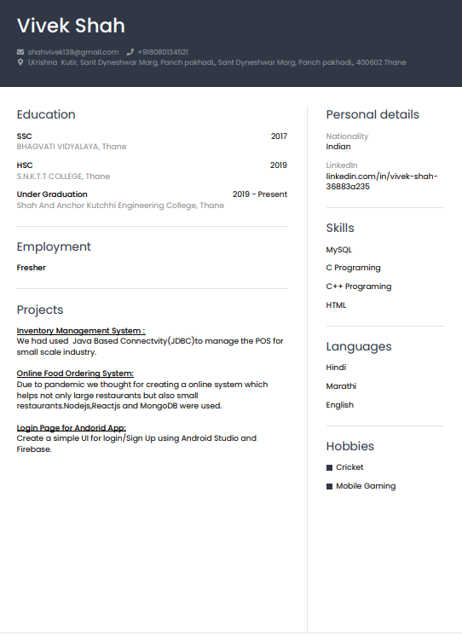
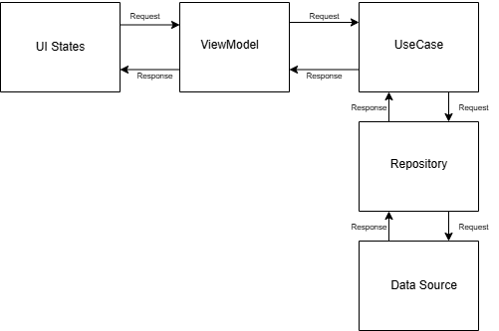
How does MVVM work?
Model - Represents the data layer and business logic. It provides the data to viewmodel.
View (UI) - Displays data and observes changes from ViewModel.The key used is unknown.
ViewModel - Acts as a bridge between View and Model

Slide 8
Implementation
Android mobile application developed using Kotlin and Jetpack Compose for a modern UI experience.
Secured Authentication using Firebase
Expense & Income Management: Add, edit, delete transactions with detailed fields.
Currency Conversion Module: Real-time exchange rate fetching and converted amount display.
Budget Management: Users can set and track monthly spending limits.
Financial Insights: Charts for data visualization using Jetpack Compose.
Offline Support: View and add transactions even without internet access (synced later).
Focused on helping finances of an individual in easy and effective way

Slide 9
Challenges
Clean Architecture Complexity: Ensuring proper separation between Domain, Data, and Presentation layers using MVVM.
Firebase Sync: Managing real-time data sync between local (Room DB) and Firebase without inconsistencies.
Currency Conversion Logic: Handling accurate conversions and exchange rates across multiple currencies.
Offline Support: Ensuring smooth operation and data integrity in offline mode, especially for transactions.
User Authentication: Implementing both Google Sign-In and Email/Password login securely with Firebase.
UI/UX in Compose: Designing responsive and intuitive screens using Jetpack Compose for better user experience.
Daily API request limit restricted real-time conversions.
External country API faced outages, disrupting profile setup.

Slide 10
Future Work
Recurring Transactions: Users can mark transactions as recurring
Advanced Visualization: Add line charts to display daily trends
Category-Based Budgeting: Set budgets for specific categories with alerts when limits are exceeded.
Refactor to Clean Architecture: Improve code modularity, separation of concerns, and maintainability.
Enhance Testability: Strengthen unit/UI testing with Dagger Hilt and decoupled components.
Modern UI/UX Redesign:Improve UI responsiveness, navigation flow, and animations using Jetpack Compose.
Custom Canvas Visuals:Use Canvas APIs to draw interactive and animated financial charts.
Custom Backend System:Move beyond Firebase to Spring Boot/Ktor for full backend control.

Slide 11
Project Demo

