Slide 1
Telecom Churn Case Study
Name : Swapnil Johri & Vivek Sharma

Slide 2
Background
In the telecom industry, customers are able to choose from multiple service providers and actively switch from one operator to another. In this highly competitive market, the telecommunications industry experiences an average of 15-25% annual churn rate.
Given the fact that it costs 5-10 times more to acquire a new customer than to retain an existing one, customer retention has now become even more important than customer acquisition.
There are two main models of payment in the telecom industry –
postpaid (customers pay a monthly/annual bill after using the services) and prepaid (customers pay/recharge with a certain amount in advance and then use the services). In the postpaid model, when customers want to switch to another operator, they usually inform the existing operator to terminate the services, and you directly know that this is an instance of churn.
In the postpaid model, when customers want to switch to another operator, they usually inform the existing operator to terminate the services, and you directly know that this is an instance of churn.

Slide 3
Defenition of Churns
There are various ways to define churn, such as:
Revenue-based churn: Customers who have not utilised any revenue-generating facilities such as mobile internet, outgoing calls, SMS etc. over a given period of time. One could also use aggregate metrics such as ‘customers who have generated less than INR 4 per month in total/average/median revenue’. The main shortcoming of this definition is that there are customers who only receive calls/SMSes from their wage-earning counterparts, i.e. they don’t generate revenue but use the services. For example, many users in rural areas only receive calls from their wage-earning siblings in urban areas.
Usage-based churn: Customers who have not done any usage, either incoming or outgoing - in terms of calls, internet etc. over a period of time. A potential shortcoming of this definition is that when the customer has stopped using the services for a while, it may be too late to take any corrective actions to retain them. For e.g., if you define churn based on a ‘two-months zero usage’ period, predicting churn could be useless since by that time the customer would have already switched to another operator.
In this project, you will use the usage-based definition to define churn.

Slide 4
Understanding customer behavior during churn
Customers usually do not decide to switch to another competitor instantly, but rather over a period of time (this is especially applicable to high-value customers). In churn prediction, we assume that there are three phases of customer lifecycle :
The ‘good’ phase: In this phase, the customer is happy with the service and behaves as usual.
The ‘action’ phase: The customer experience starts to sore in this phase, for e.g. he/she gets a compelling offer from a competitor, faces unjust charges, becomes unhappy with service quality etc. In this phase, the customer usually shows different behaviour than the ‘good’ months. Also, it is crucial to identify high-churn-risk customers in this phase, since some corrective actions can be taken at this point (such as matching the competitor’s offer/improving the service quality etc.)
The ‘churn’ phase: In this phase, the customer is said to have churned. You define churn based on this phase. Also, it is important to note that at the time of prediction (i.e. the action months), this data is not available to you for prediction. Thus, after tagging churn as 1/0 based on this phase, you discard all data corresponding to this phase.
In this case, since you are working over a four-month window, the first two months are the ‘good’ phase, the third month is the ‘action’ phase, while the fourth month is the ‘churn’ phase.

Slide 5
Implementation

Slide 6
Implementation Measures
Data Gathering : Loading & Observing the past data provided by the Company
Data Cleaning : Duplicate removal, null value treatment, unnecessary column elimination, etc.
Performing EDA : Univariate, Bivariate, and Heatmap for numerical and categorical columns
Data Preparation : Outlier Treatment, Feature-Standardization
Model Building : Performing pre-requisites for RFE and Logistic Regression
Feature Selection : Selection of top 25 features using RFE
Model Building : Model building using RFE for selected columns
Model Improvement : Reduction of columns and Model re-building
Final Model : Final Model Analysis and performance on Test Data
Verifying with PCA : Verifying our Final Model Accuracy etc. with model built with PCA

Slide 7
Plots Used

Slide 8
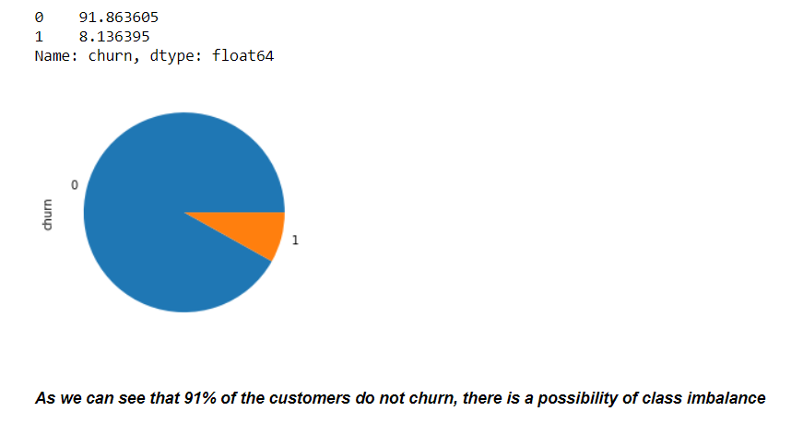
1. Churn/Non Churn percentage
Since this variable churn is the target variable, all the columns relating to this variable(i.e. all columns with suffix _9) can be dropped from the dataset.

Slide 9
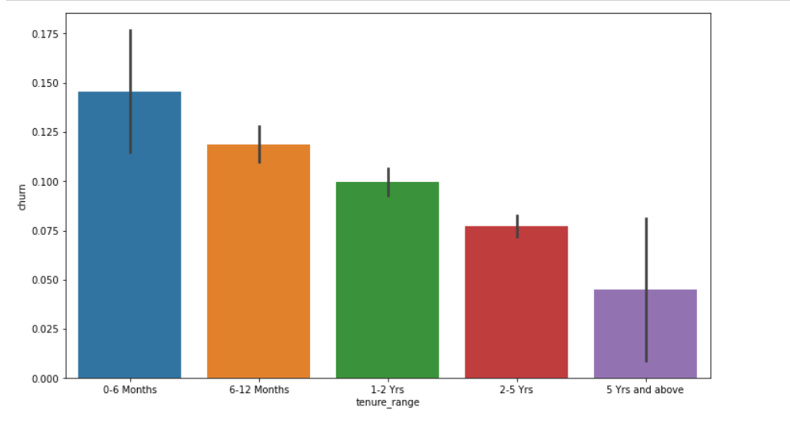
2. Tenure Range v/s Churn
It can be seen that the maximum churn rate happens within 0-6 month, but it gradually decreases as the customer retains in the network.
The average revenue per user is good phase of customer is given by arpu_6 and arpu_7. since we have two seperate averages, lets take an average to these two and drop the other columns.

Slide 10
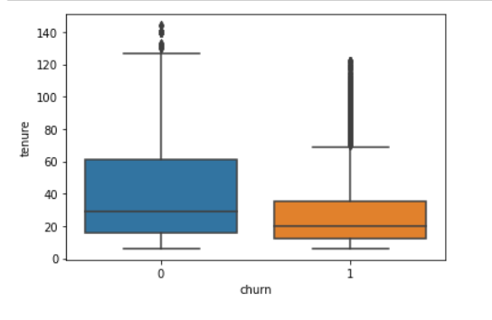
3. Churn v/s Tenure Boxplot
From the above plot , its clear tenured customers do no churn and they keep availing telecom services

Slide 11
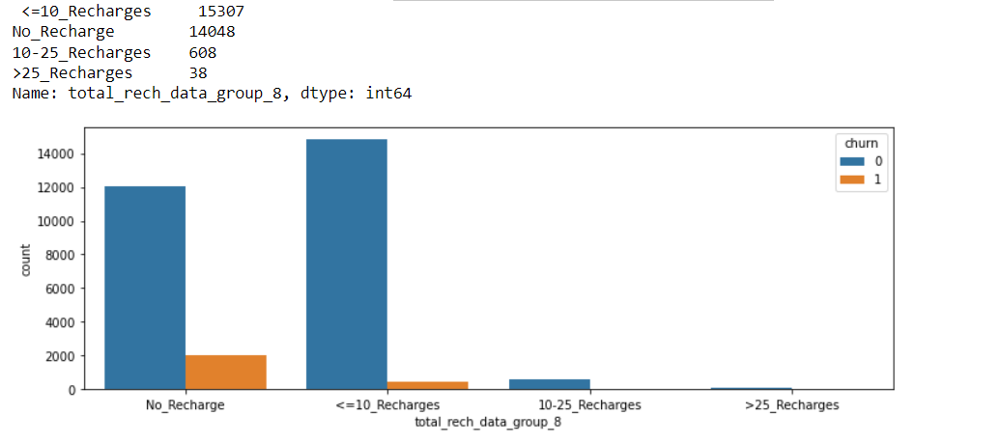
4. Distribution of total_rech_data_8 variable

Slide 12
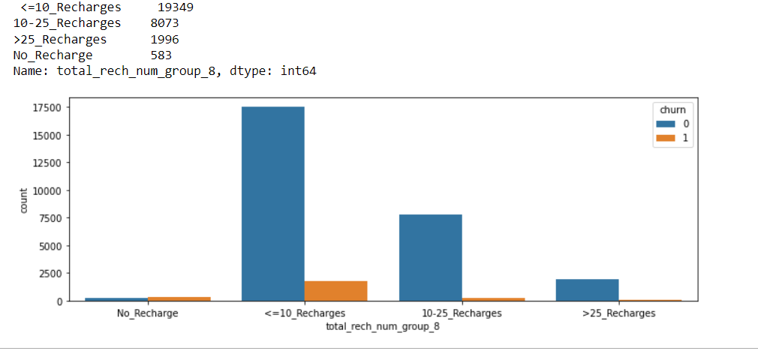
5. Distribution of total_rech_num_8 variable

Slide 13
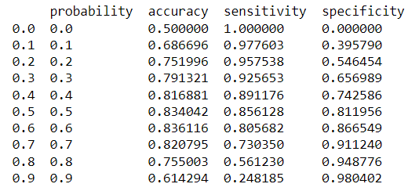
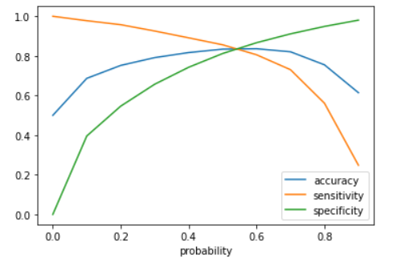
6. Accuracy sensitivity and specificity for various probabilities
Initially we selected the optimm point of classification as 0.5.
From the above graph, we can see the optimum cutoff is slightly higher than 0.5 but lies lower than 0.6. So lets tweek a little more within this range.

Slide 14
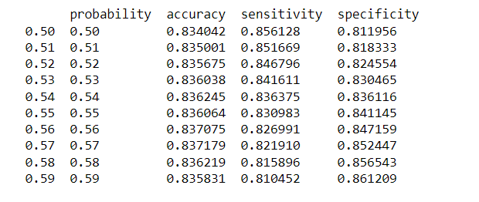
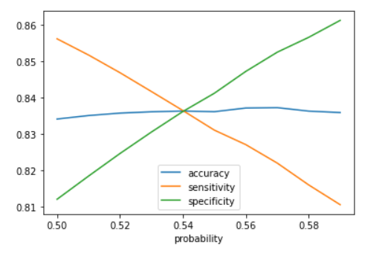
7. Accuracy sensitivity and specificity for various probabilities calculated above
From the above graph we can conclude, the optimal cutoff point in the probability to define the predicted churn variabe converges at 0.54

Slide 15
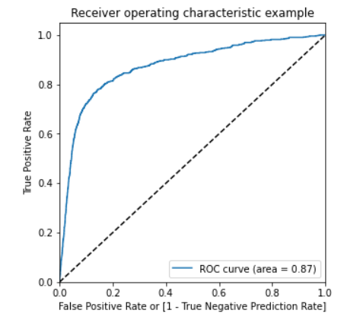
8. ROC Curve for Test Dataset
The AUC score for train dataset is 0.90 and the test dataset is 0.87.
This model can be considered as a good model.

Slide 16
Conclusion
Valuable Insights
The Sensitivity, Specificity, Accuracy, Precision and Recall score we got from test set are almost accurate.
Recall score is high than precision score which is a sign of good model.
In business terms, this model has an ability to adjust with the company’s requirements in coming future.

