Slide 1


Internship Presentation
on
”Foriegn Direct Investment”
Student:
Name: Vivek Singh
Usn: 1RN19IS179
Student:
Name: Sumant Kumar Yadav
Usn: 1RN20IS416
Department of Information Science and Engineering
RNS Institute of Technology
2021-22

Slide 2




FOREIGN DIRECT INVESTMENT DATA ANALYSIS

Slide 3



PROJECT DETAIL
Project Title | Investment analytics
Technology | Business intelligence
Domain name | Finance
Database | Kaggle
Tools | Tableau , Ms Excel

Slide 4





OBJECTIVE
The goal of this project is to understand the Foreign direct investment in India for the last 16 years from 2000-01 to 2015-16 in various sectors.

Slide 5












PROBLEM STATEMENT
• Investment is a game of understanding historic data of investment objects under different events but it is still a game of chances to minimize the risk we apply analytics to find the equilibrium investment.
• To understand the Foreign direct investment in India for the last 16 years from 2000-01 to 2015-16. This dataset contains sector and financial year-wise data of FDI in India
• Sector-wise investment analysis
• Year-wise investment analysis

Slide 6





DATASET INFORMATION
This dataset contains sector-wise and financial year- wise data of FDI in India.
It shows overall trend of foreign direct investment in India in Fiscal Year 2000-2016.

Slide 7
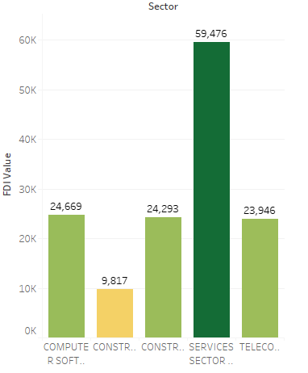
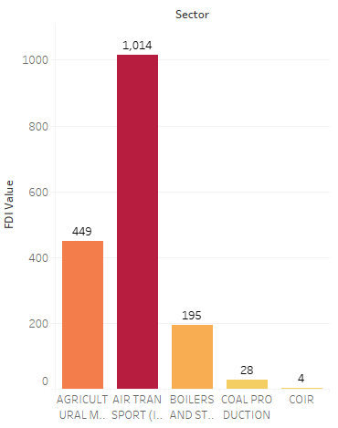
Max And MIN Direct Funding of a given Year
Graph shows the Total FDI value throughout the different sectors.
It gives clarity of service sector getting higher FDI and Air transport lower FDI among all sectors.

Slide 8
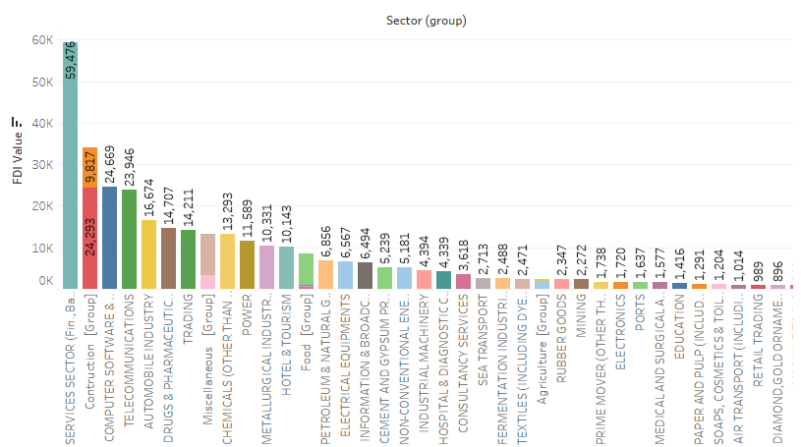
Sectors Group
Graph shows FDI received by different sectors .
Service sector received highest FDI with ₹59,476Cr and COIR with ₹4kCr.

Slide 9
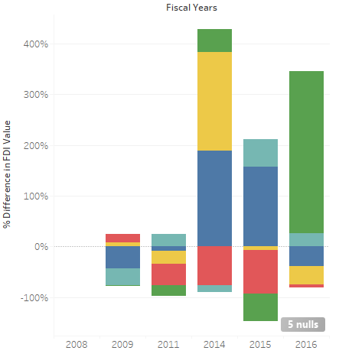
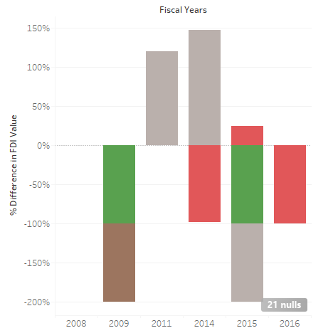
Highest Growth and Decline of FDI value
Graph shows highest growth and highest decline % difference in FDI value during Fiscal years.

Slide 10
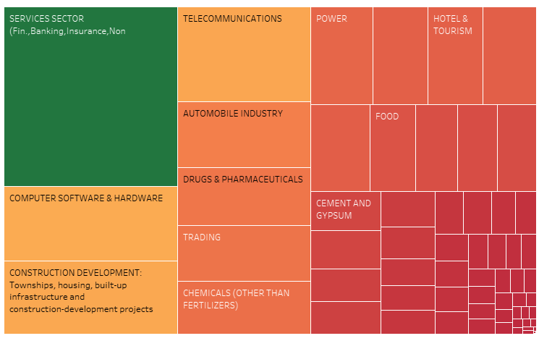
Proportion FDI
It shows the uneven proportion between the given sectors.

Slide 11
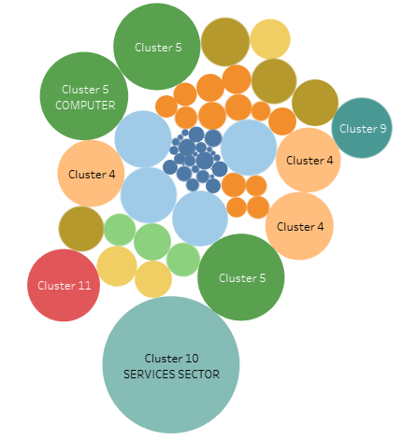
Cluster

Slide 12
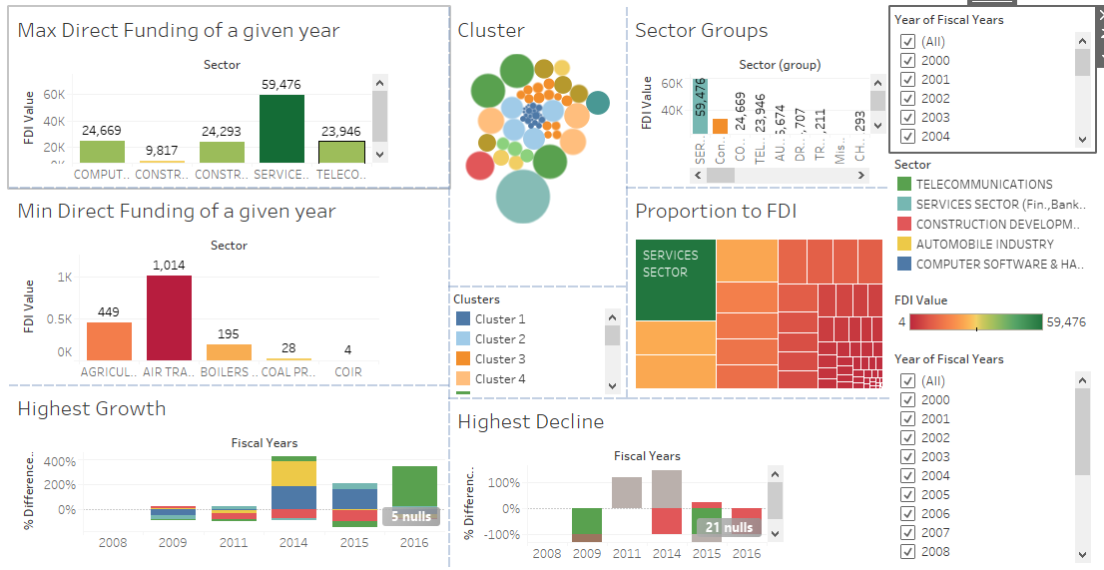
• Service Sector received around ₹2kCr FDI from FY 2000-01 to ₹44kCr in FY 2015-16
which was the highest, details regarding other sectors are also available.
• From the Sector group -chart we can see the trend of FDI Inflow.

Slide 13
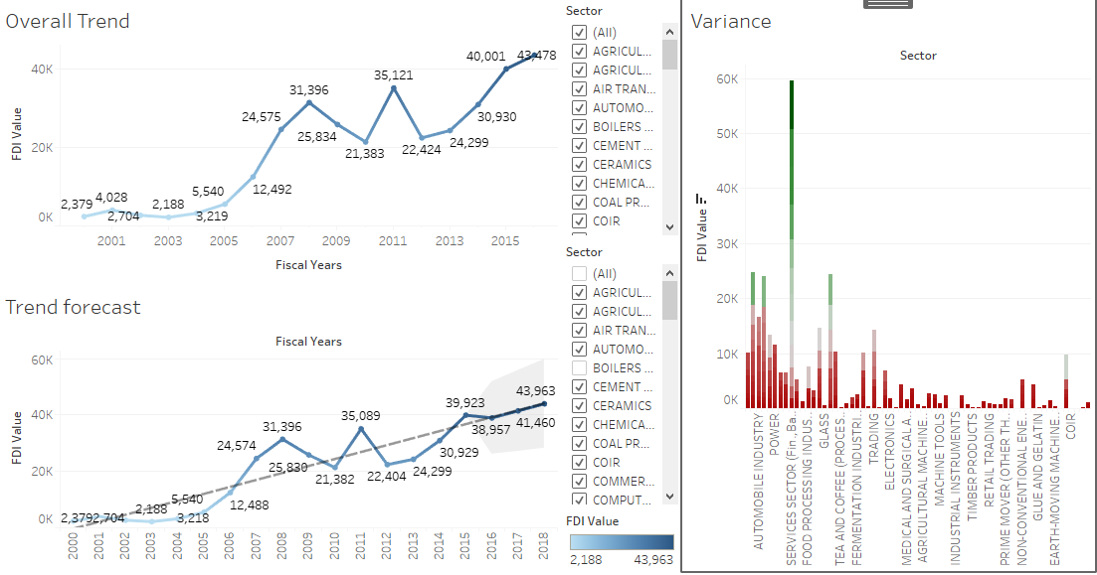
Among Top 5 Sectors Service sector has the highest FDI inflow having 17%, followed by the Computer Software and Hardware, Telecommunication,
Construction development, Automobile Industry sector having 7.12%, 6.53 %, 4.54%, 11.69% respectively.
Among Bottom 5 Sectors COIR has the lowest FDI Inflow 1.42%, followed by Defence Industries, (Mathematical, surveying and Drawing instruments), Coal Production, Photographic raw film and paper sector having 2.33%, 2.49%, 2.93%, 3.83%.

Slide 14
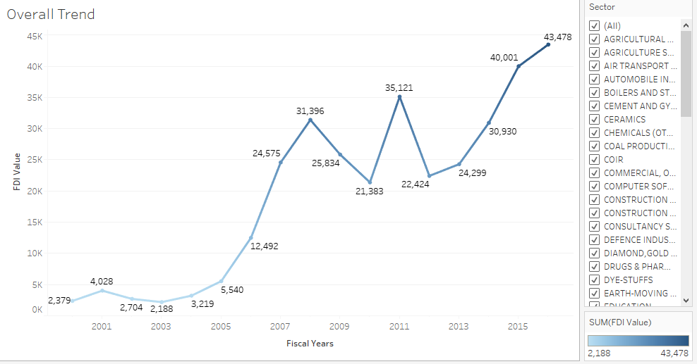
The above chart shows the total amount of FDI inflows in India during the last 16 years. The FDI inflow from 2000-2001 i.e.₹4,028Cr. in 2001-02 it was ₹2,704Cr.
It shows a Good result in the FDI inflows in India. Little bit ups and downs in FDI inflows, but after that great hike in the year 2006-07.
In 2007-2008 there was a huge investment in FDI in ₹31,396Cr and so on. But again there were some fluctuations in the inflow of FDI in the years between 2009-2014, soon giving the highest figures in the last 16 years ₹43,478Cr FDI in 2015-2016 So we can say that the foreign investors have been on rising in India.

Slide 15

CONCLUSION
SECTORAL COMPOSITION OF FDI:-
• The Sectoral composition of FDI over the period of April 2000 to June 2016, we can find that the largest recipient of such investment is Service sector (Financial and non-financial services). The share of this sector comparing to all sector is 17.65 % of the inflow total foreign direct investment.
• The foreign investors are interested in mainly financial services due to its profit generating advantage. This sector gives scope for the foreign investor to take back the profits to the home country. As service sector the services are consumed in the host country and there by generating outflow of funds from the host country.
• The second recipient is Computer software and Hardware sector which shares 7.66% of total FDI.
Construction development,Telecommunication, Automobile Industry sector having 7.31%, 6.43%
5.17% respectively
• The keys takeaways regarding global flows are – the increase in the relative share of developing countries as both destination and sources and flow to the sector gaining over manufacturing.

Slide 16
SUMMARY
India's total amount of FDI inflow during 16 years, i.e. 2000 to 2016. The FDI inflow from 2000-2001 i.e. ₹2,028Cr in 2005-2006 it was ₹5,540Cr. It shows a Good result in the FDI inflows in India.
A little bit of ups and downs in FDI inflows up to 2008-09 but after that great hike in the year 2009-10 i.e. ₹35,121Cr as compared to earlier years. In 2010-2011 there was a huge investment in FDI in ₹40,343Cr. But then there was a downfall in the Inflow of FDI in two consecutive years 2011-2012 and 2012-2013, with figures ₹22,424 Cr and ₹24,299Cr respectively.
We can Analyse from the graph that in the year 2014-2015 the inflow of FDI was second highest of last 16 years i.e. ₹40,003Cr. In the year 2013-14 the FDI inflow fluctuated from ₹22,424 to ₹30,930Cr respectively. In the last Financial Year i.e. 2015-2016 the amount of FDI Inflow were ₹43,478Cr which is the highest FDI inflow in the last 16 years.

Slide 17

PROJECT DEMONSTRATION

Slide 18
THANK YOU

