Slide 1
Envoy Proxy
Vivek S

Slide 2
Kinds of Proxying
There are various terms one comes across for proxies, in context of envoy at least the important ones are
Front Proxy
Reverse Proxy
Layer 3 (TCP) proxy
Layer 7 (HTTP) proxy
Layer 3/7 proxy is straightforward – at what layer, TCP or HTTP does envoy apply it’s proxying logic?
Front proxies are used by clients to connect to servers, ie, say all client requests to xy.com must go to proxyIP/xy.com, and front proxy will be forwarding the request onward.
Reverse proxies are used by servers to reply to clients, ie, a reverse proxy will have a DNS name or an external IP, and all external clients will hit that IP, and the reverse proxy will decide on which backend to send it to… hence reverse proxy is also where load balancing is done.

Slide 3
ENVOY TERMINOLOGY and THREAD MODEL
Envoy has it’s own basic terminology that users have to become familiar with
https://www.envoyproxy.io/docs/envoy/latest/intro/arch_overview/intro/terminology
At a more basic level, it’s also useful to understand envoy’s threading model:
https://www.envoyproxy.io/docs/envoy/latest/intro/arch_overview/intro/threading_model
Basically,
Each host in a cluster gets one or more connection pool
Each protocol gets one pool, like HTTP 1.1, HTTP2
More connection pools can be allocation as per priority or socket options
Each connection pool has an assigned worker thread, ie, the thread epolls the pool.
The envoy threading modelling is
Envoy is single process, multi threaded
Each thread is bound to a single connection
No IPC between threads (hence envoy load balancing doesn’t do round robin LB, envoy load balancing is random!)

Slide 4

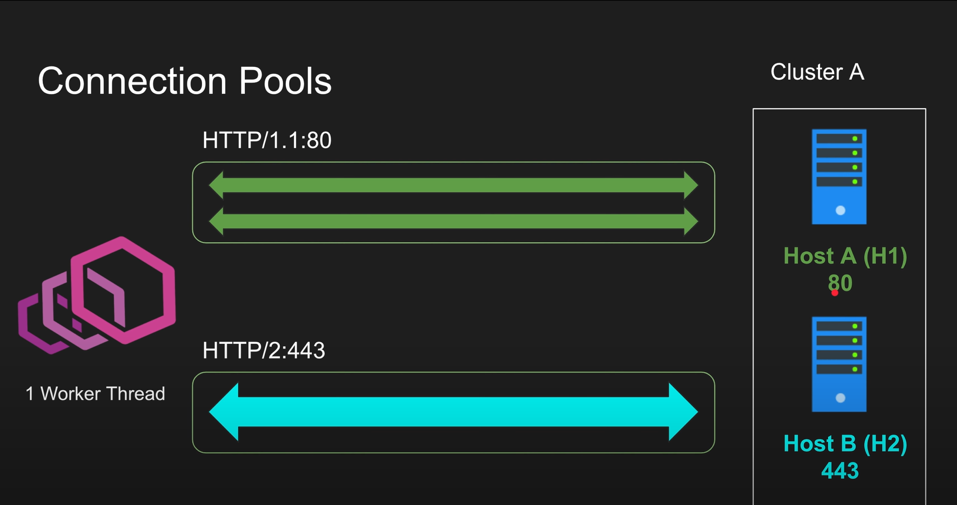
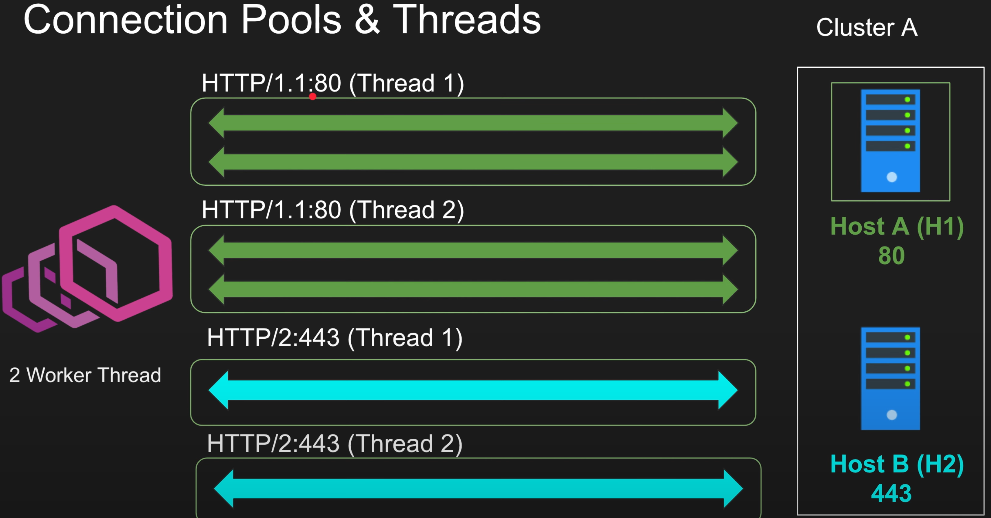
Connection POOLING
In the first example, we have a cluster with two hosts, hence two connection pools… one HTTP 1.1 and one HTTP2 with TLS. HTTP 1.1 of course, uses multiple tcp connections, whereas HTTP2 uses a single tcp connection.
The second example uses two worker threads, and each thread must have it’s own connection pools.
Note, in theory HTTP2 needs only one tcp connection, but in envoy it is actually one tcp connection per pool.

Slide 5
ENVOY CONFIGURATION
Envoy configuration is generation expressed as yaml or json, however, envoy itself defines it’s config is form of grpc proto files, which are referenced by the documentation, for eg:
https://www.envoyproxy.io/docs/envoy/latest/api-v3/config/listener/v3/listener.proto
In the coming examples, we will see how this translates to writing envoy configs.

Slide 6
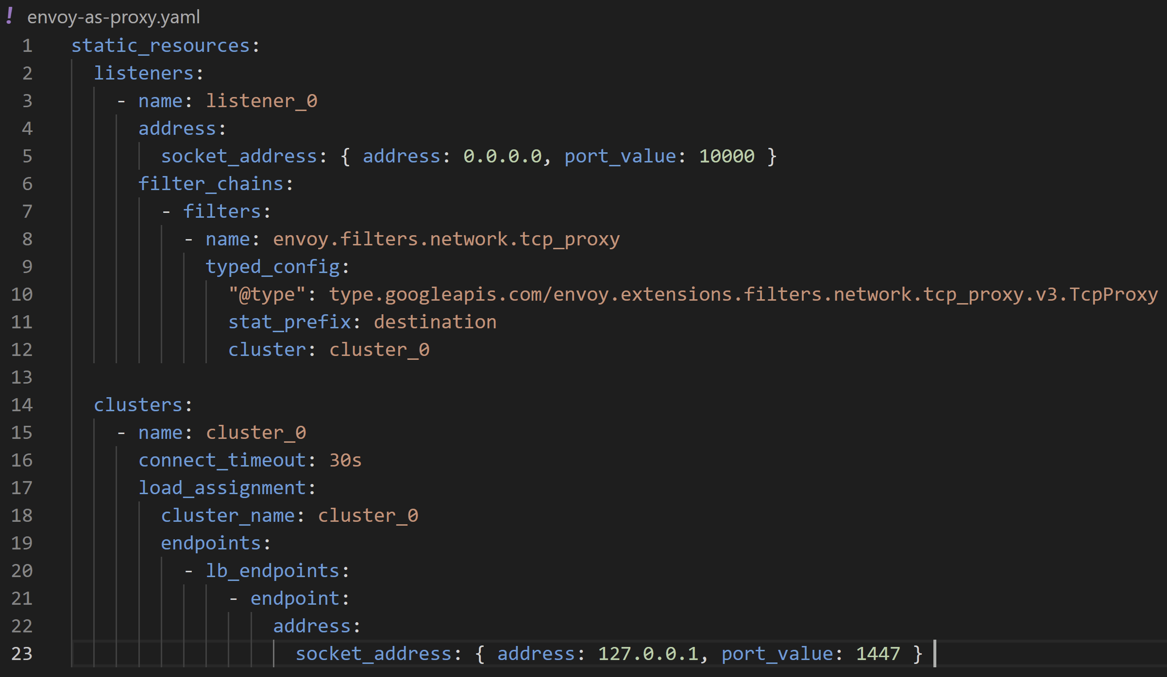
ENVOY Walkthrough – FRONT proxy
We’ll go though a simple configuration for envoy as a front proxy to understand envoy terminology better

Slide 7
In this config, we have one listener and one cluster. Lets go through some terminology –
Anything in front of envoy is upstream, anything behind envoy is downstream. Requests come from Downstream, responses go upstream.
A group of endpoints is called a cluster. Each cluster has load balancing baked in.
Listeners listen to downstream clients. Filters are applied to listeners.
Envoy listener doc: https://www.envoyproxy.io/docs/envoy/latest/intro/arch_overview/listeners/listeners
So, here the listener is bound to IP_ADDR_ANY:10000, and has a tcp filter which points at cluster_0, which has address localhost:1447. Hence we expect that any connection to any ip with port 10000 will be redirected to application at localhost:1447.
The actual functionality of this is mostly in the filter configured, tcp_proxy: https://www.envoyproxy.io/docs/envoy/latest/intro/arch_overview/listeners/tcp_proxy#arch-overview-tcp-proxy

Slide 8
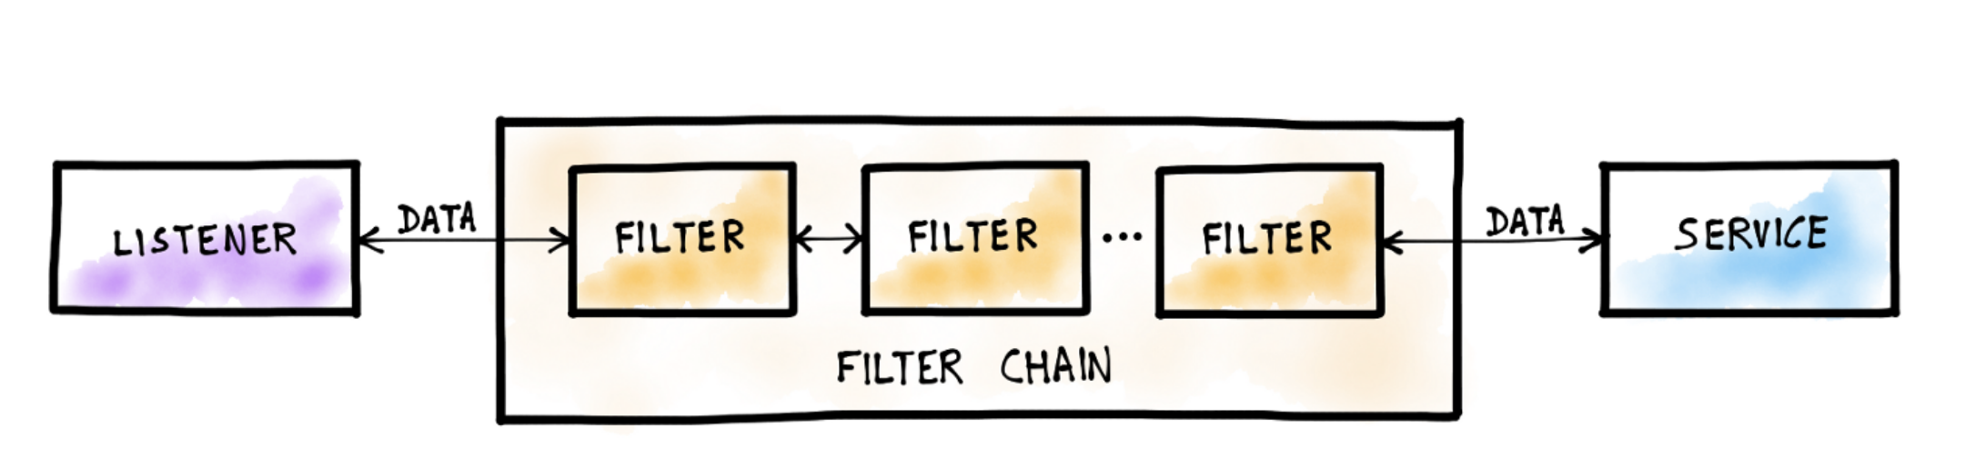
ENVOY FILTERS
Filters are how envoy maps listeners and clusters, and performs operations on dataflow. Filters can be chained together to form more complex logic.

Slide 9
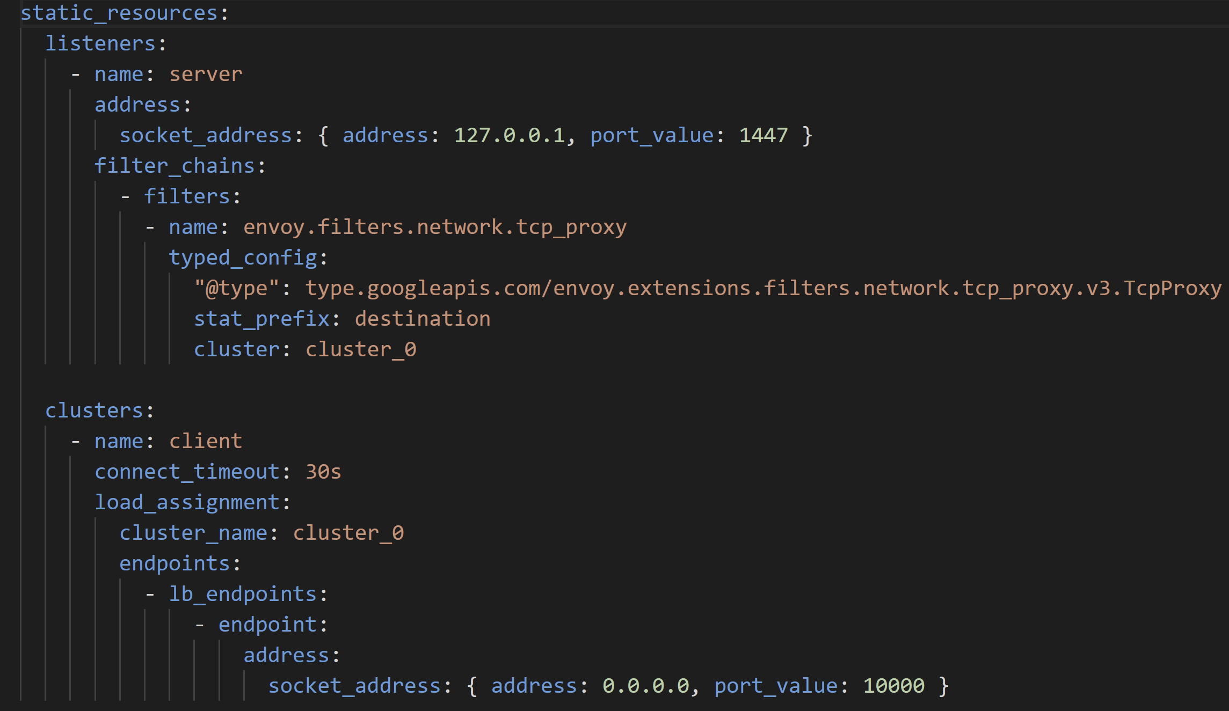
ENVOY Walkthrough – REVERSE PROXY
As can be seen, this is simply a reveral of addresses of the previous example.
In the previous example, the cluster had the server, here cluster is the client.

Slide 10
ENVOY WALKTHROUGH – LAYER 7 PROXY
Envoy as a HTTP proxy has somewhat more complex configuaration than the previous examples as TCP proxies, as can be seen in the attached yaml.
Walking though the yaml, we still have one cluster and one listener, but we now require two filters,
http connection manager: https://www.envoyproxy.io/docs/envoy/latest/configuration/http/http_conn_man/http_conn_man
http router
Here, we have the http connection manager filter, and a configured route table rule to forward all http traffic to cluster_0.
The action forwarding is done by the http router filter.

Slide 11
Configuring Envoy using xDS

Slide 12
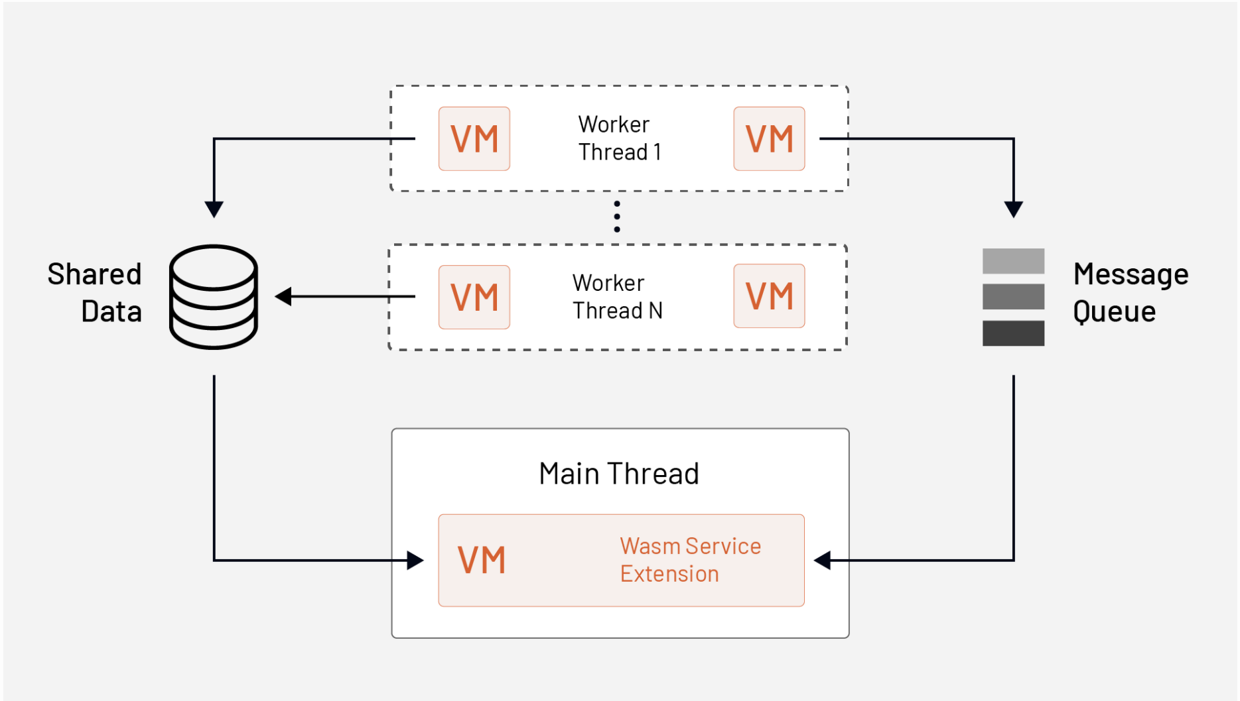
Extending ENVOY using Web ASSEMBLY
Webassembly is a compilation target, similar to Java Byte Code or C# CLR Byte code, that can be created from any supported language, and executes in a wasm VM.
Envoy embeds a wasm VM in itself, and since it’s worker threads don’t synchronize, each worker thread instantiates a wasm VM of it’s own, and the main thread runs the WasmService extension that can manage shared data between them.
One can write filters in any language for envoy,
Provided they compile into wasm, and can use
Envoy’s proxy-wasm framework:
https://github.com/proxy-wasm

