Slide 1

CPR Coach
Illustration
A phone that watches your CPR and tells you what to fix.
110 /min
Team Zero Flux Vivek · Pratham · Prabal · Moksh
ANVATHON 2026 · OPEN INNOVATION
Notes:
CPR Coach is a phone app that watches you do CPR on a practice manikin and tells you, out loud, what to fix. The line is the push rhythm the app reads: flat when nobody is pushing, steady at 110 a minute when someone is.

Slide 2
India's bystander CPR rate is a quarter of the US rate
India
one hospital, 205 patients
US
national registry
Fewer people nearby start CPR, and fewer patients leave hospital alive.
Karnataka is moving: in July 2025 the Health Minister announced CPR training for school and college students, teachers and gym trainers.
India: Bhat et al., Indian Heart Journal 2021, one tertiary hospital, 205 patients. Karnataka: NewKerala, 10 July 2025.
The two sources are not measured the same way: one hospital vs a national registry.
US: American Heart Association, Heart Disease and Stroke Statistics 2023. Bystander CPR: over 356,000 out-of-hospital arrests. Survival: 2021 US data, EMS-treated adult non-traumatic arrests.
Notes:
In an Indian Heart Journal study of 205 cardiac-arrest patients at one hospital, 9.8 percent got CPR from a bystander and 1.4 percent left hospital alive. The American Heart Association's US figures are 40.2 percent and 9.1 percent. The two sources are not measured the same way, one hospital against a national registry, so read it as a gap, not a precise ratio. Under 2 in 100 people in one survey said they knew CPR, and skills can start to fade within about three months of a course. Karnataka is moving: in July 2025 the Health Minister announced CPR training for school and college students, teachers and gym trainers (NewKerala, 10 July 2025).

Slide 3
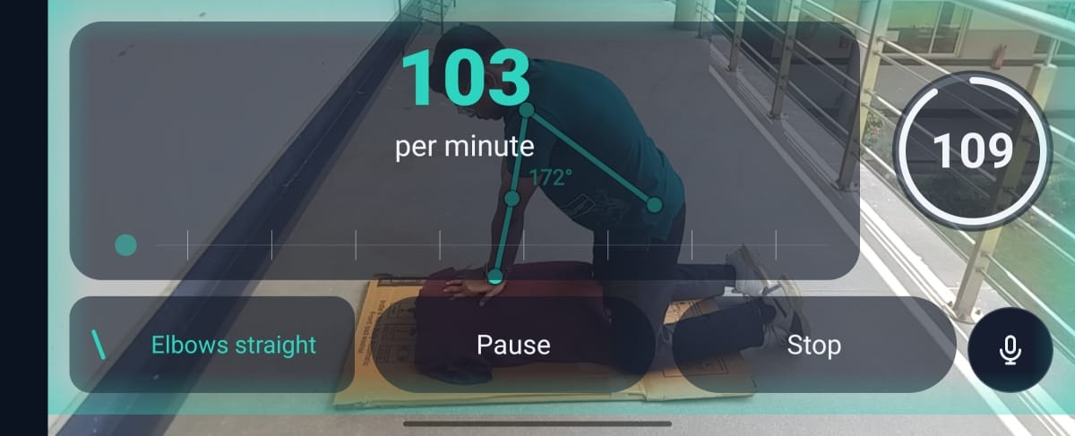
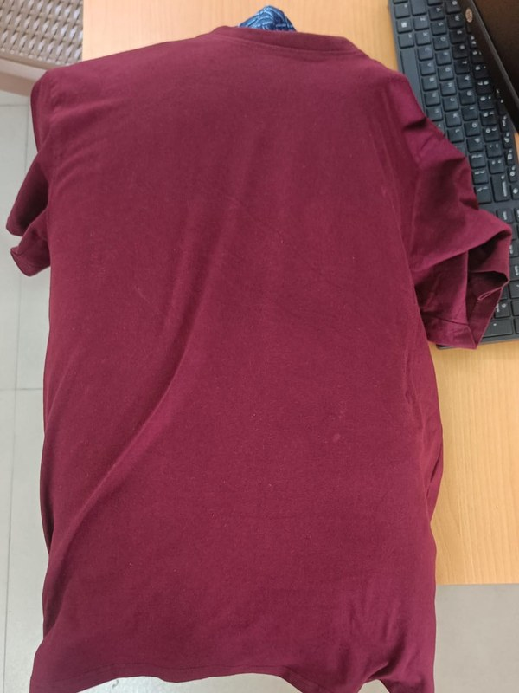
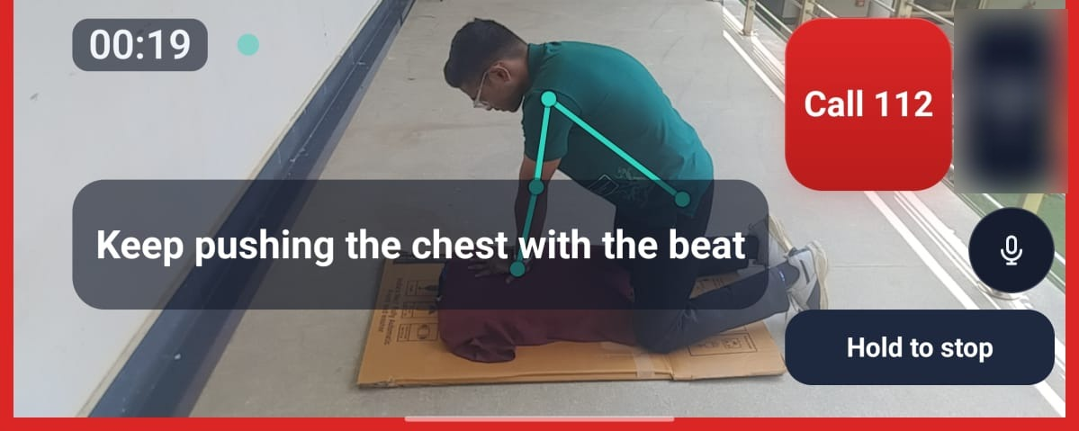
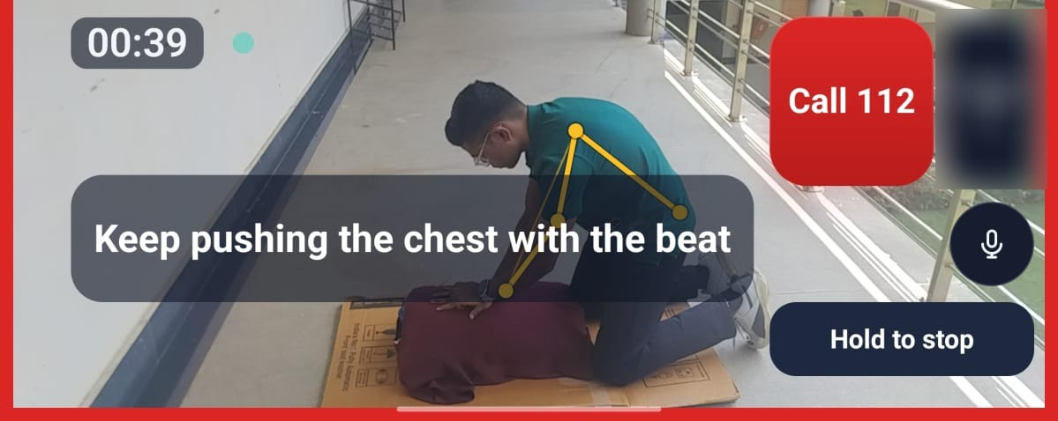
It watches your arms and says what to fix
Watch the camera finds shoulder, elbow and wrist
Count push rate, elbow angle and pauses
Speak one correction at a time, out loud
All you need: a phone and a home-made manikin.
Practise: 103 pushes a minute, elbows straight
Measures rate, elbows and shoulders over hands. Can't measure depth, force or hand placement.
Emergency: joints turn amber when posture needs fixing
Coaches in 10 languages, fully offline.
Notes:
These are screenshots from the real app on a phone this morning. In Practise it has counted 103 pushes a minute and says elbows straight; the line on the arm is the elbow angle it measured. In Emergency the joints are teal while posture is fine and turn amber when it needs fixing, with Call 112 always on screen. All you need is a phone and a home-made manikin: ours is a T-shirt over a padded bundle. It counts the push rate, elbow angle and pauses, checks shoulders over hands, and says one correction at a time. One camera can't measure depth, force or exact hand placement, and when it loses the arms it shows a dash instead of guessing. Coaching clips exist in ten languages; English is checked and the other nine are machine-translated and still need native-speaker review. Everything runs on the phone with no internet.

Slide 4
Camera to voice, every step runs on the phone
Camera
Pose
Rhythm
Rules
Voice
phone held side-on
MediaPipe finds the joints
rate, elbow angle, pauses
one correction at a time
recorded clips and a 110/min beat
No internet permission. Nothing is uploaded.
Kotlin · Jetpack Compose · CameraX · MediaPipe Pose · sherpa-onnx (Whisper, IndicConformer) · Silero VAD
Notes:
Five stages, all on the phone. CameraX frames go to MediaPipe's pose model. Our Kotlin code turns the wrist's up-and-down motion into a rate, and works out elbow angle and pauses. Rules wait for a steady reading, then play one pre-recorded clip over a 110 a minute beat. The app has no internet permission.

Slide 5

Built in 24 hours: 596 commits
Illustration
FROM
399
Our first real run on a phone crashed mid-session, and the recording was lost.
tests passing, 0 failing
TO
7
A working prototype: the crash fixed, camera load capped, and heat and battery logged on every run.
real phone recordings must replay byte for byte
Notes:
596 commits on the cpr-coach branch, built with four people and a swarm of AI coding agents across four PCs. The first time real motion went through the app on a phone, the rate code crashed mid-session when every correlation peak was negative, and that recording was lost. We fixed the crash so a failed reading shows no number instead of killing the session, made recordings save as they go, capped pose input near 15 frames a second at 640 by 480, and added an adaptive frame gap with thermal and battery logging on every trace. Today 399 unit tests pass, with 5 skipped, and seven real phone recordings must replay with byte-identical output before anything merges.

Slide 6


Live demo
Illustration
Next: hand-counted accuracy runs, review by CPR trainers, college pilots.
Not a medical device. In an emergency, call 112 (108 for an ambulance) and start CPR.
Code and test records
github.com/VivekTiwary-25/Zero_flux
Team Zero Flux Vivek · Pratham · Prabal · Moksh
Notes:
Demo: Practise on the manikin so you can hear the corrections, then Emergency: one tap, beat and spoken steps, Call 112 opens the dialer and we cancel it. Manikin only, never a person; no real call is placed. Next we count it by hand to get a real accuracy number, then put it in front of certified CPR trainers, then pilot it in colleges. This is not a medical device: in a real emergency, call 112 or 108 and start CPR.

