Slide 1
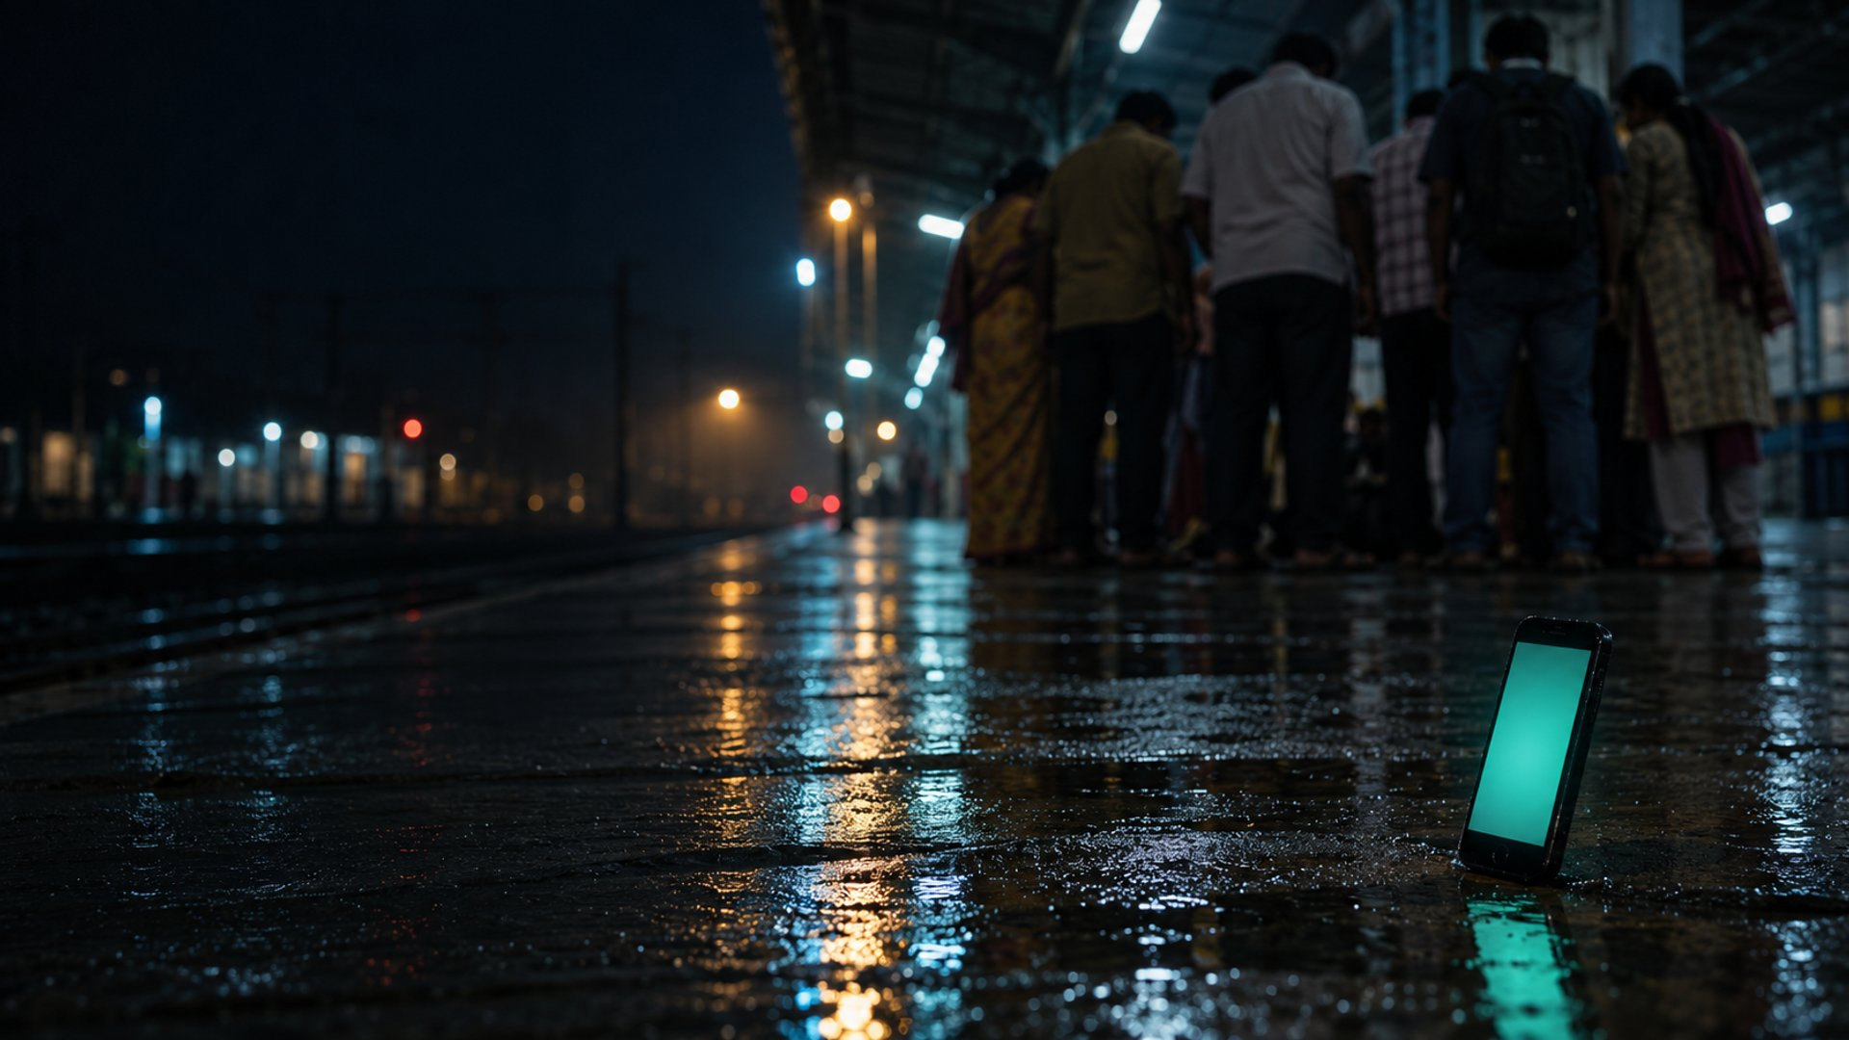
CPR Coach
Illustration
A phone that watches your CPR and tells you what to fix.
110 /min
Team Zero Flux Vivek · Pratham · Prabal · Moksh
ANVATHON 2026 · OPEN INNOVATION
Notes:
CPR Coach is a phone app that watches you do CPR on a practice cushion and tells you, out loud, what to fix. The line on screen is the push rhythm the app reads: flat when nobody is pushing, steady at 110 a minute when someone is.

Slide 2
Only 1 in 10 people who collapsed got CPR from someone nearby
9.8%
of 205 cardiac-arrest patients at one Indian hospital got CPR from a bystander.
1.4% left hospital alive.
0 /min
Bhat et al., Indian Heart Journal, 2021 · one tertiary hospital, 205 patients
Notes:
In a 2021 Indian Heart Journal study of 205 cardiac-arrest patients at one hospital, fewer than one in ten got CPR from anyone nearby, and 1.4 percent left hospital alive. The American Heart Association says immediate CPR can double or triple the chance of survival. The flat line is what most of these patients got.

Slide 3
India's bystander CPR rate is a quarter of the US rate
India
one hospital, 205 patients
US
national registry
Fewer people nearby start CPR, and fewer patients leave hospital alive.
India: Bhat et al., Indian Heart Journal 2021, one tertiary hospital, 205 patients.
The two sources are not measured the same way: one hospital vs a national registry.
US: American Heart Association, Heart Disease and Stroke Statistics 2023. Bystander CPR: over 356,000 out-of-hospital arrests. Survival: 2021 US data, EMS-treated adult non-traumatic arrests.
Notes:
Put next to the US numbers, the gap is stark: in the Indian hospital study under 10 percent got bystander CPR, against about 40 percent in the American Heart Association's US figures, and survival to discharge was 1.4 percent against 9.1. These two sources aren't measured the same way, one hospital against a national registry, so read it as a gap, not a precise ratio.

Slide 4
Under 2 in 100 people say they know CPR, and the skill fades in months
<2%
3 months
of about 1 lakh people surveyed in 20 Indian cities said they knew CPR
is how soon CPR skills can start to fade after a course
Lybrate survey, 2016 · AHA 2025 Guidelines, Part 12: Resuscitation Education Science
Notes:
Very few people say they know CPR, and the ones who learn it lose the skill fast: the 2025 AHA guidelines say skills can start fading within about three months. So training once isn't enough. People need to practise, and practice only helps if something tells you what you're doing wrong.

Slide 5
Feedback makes practice stick, but today it needs a sensor manikin
AHA 2025 recommends feedback devices in CPR training, including for lay rescuers (Class 1).
 | Sees your technique | Corrects you live | What you need
Video tutorial | No | No | A screen
Metronome app | No | Beat only | A phone
Feedback manikin | Yes | Yes | A sensor manikin
CPR Coach | Rate, elbows, pauses | Spoken, 10 languages | A phone
Notes:
Feedback during training is a top-grade recommendation in the 2025 AHA guidelines. But a video can't see you, a metronome only gives a beat, and real feedback today needs a sensor manikin. CPR Coach gives feedback on rate, elbows and pauses with just a phone.

Slide 6
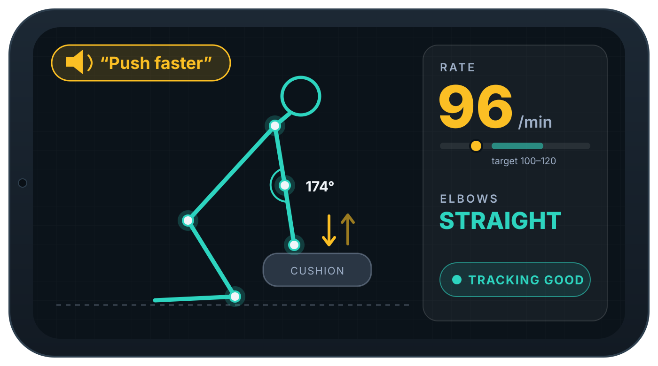
It watches your arms and says what to fix
01
Watch
the camera sees shoulder, elbow and wrist
02
Count
rate, elbow bend and pauses
03
Speak
one correction, in your language
Illustration · values are examples, not measurements
Notes:
The phone sits at the rescuer's side. It watches the arm joints, counts the push rate, elbow bend and pauses, and says one short correction at a time in the rescuer's language. Here it has seen 96 pushes a minute, below the 100 to 120 target, so it says push faster.

Slide 7
Camera to voice, every step runs on the phone
Camera
Pose
Rhythm
Rules
Voice
phone held side-on
MediaPipe finds the joints
rate, elbow angle, pauses
one correction at a time
recorded clips and a 110/min beat
No internet permission. Nothing is uploaded.
Kotlin · Jetpack Compose · CameraX · MediaPipe Pose · sherpa-onnx (Whisper, IndicConformer) · Silero VAD
Notes:
Five stages, all on the phone. CameraX frames go to MediaPipe's pose model. Our Kotlin code turns the wrist's up-and-down motion into a rate, and works out elbow angle and pauses. Rules wait for a steady reading, then play one pre-recorded clip over a 110 a minute beat. The app has no internet permission.

Slide 8
Practise teaches you; Emergency starts the beat in one tap
PRACTISE
EMERGENCY
Learn with feedback
Act in seconds
2-minute session, live readings
One spoken correction at a time
Scorecard shows how long rate was really measured
Beat and spoken steps start at once
Never waits for the camera
Call 112 opens the dialer; AED reminder at 30 s
Ran on a phone: 7 real recordings
Ran on a phone: steps, beat, dialer
Notes:
Practise is where you learn: a two-minute session with live readings, one spoken correction at a time, and a scorecard that says how long the rate was actually measured. Emergency is one tap: the beat and spoken steps start immediately and never wait for the camera. Call 112 only opens the dialer, and there's an AED reminder at 30 seconds.

Slide 9
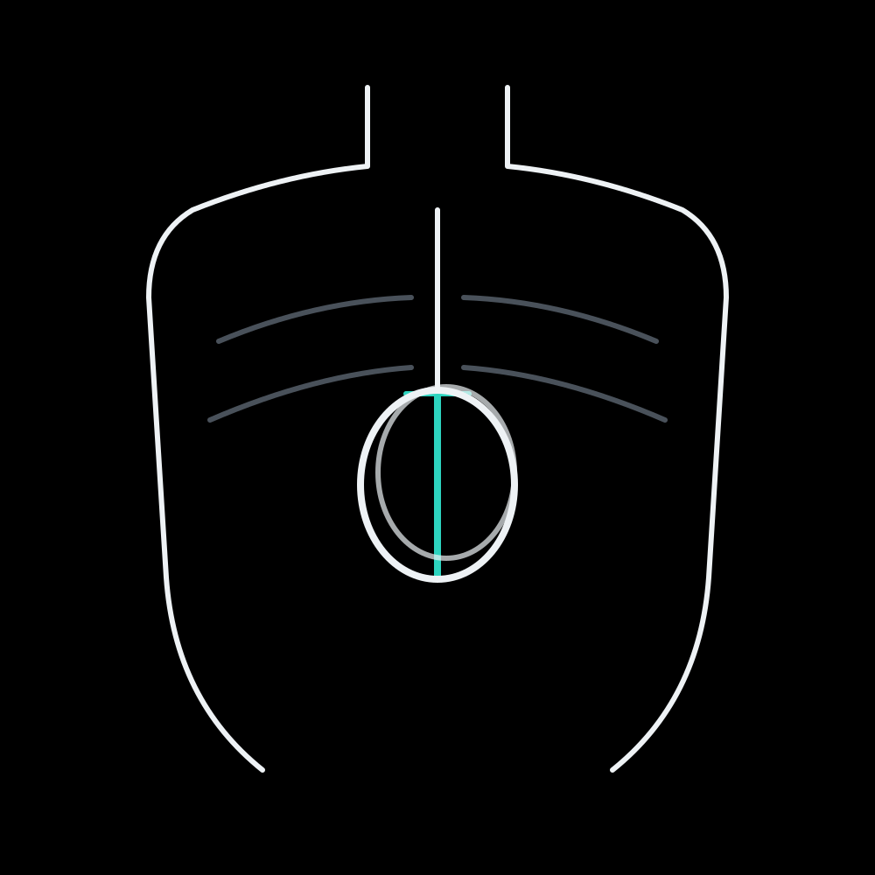

Push on the lower breastbone, arms straight, shoulders over hands
1
Hands on the lower half of the breastbone
One camera can't see this
3
2
Arms straight
1
2
The app measures this
3
Shoulders over hands
Illustration
Not measured by the app
Notes:
These are the three things a CPR trainer checks: hands on the lower half of the breastbone, arms straight, and shoulders directly over the hands. The app measures elbow bend, so it can tell you to straighten your arms. One camera can't see exact hand placement, and it doesn't measure shoulder position, so those are still on you.

Slide 10
It coaches in ten Indian languages, each in its own script
English
हिन्दी
ಕನ್ನಡ
मराठी
ગુજરાતી
বাংলা
ଓଡ଼ିଆ
தமிழ்
తెలుగు
മലയാളം
English is checked. The other nine are machine-translated and need native-speaker review.
Notes:
The picker lists ten languages, each in its own script, and coaching clips exist for all ten. English is the language we've checked; the other nine were machine-translated and still need native-speaker review before we'd call them ready.

Slide 11

Live demo
Illustration
Guide → Practise → Emergency → Crew summary
Rescuer pushes a cushion and listens. Holder keeps the phone side-on.
Cushion only, never a person. No real call is placed.
Notes:
Two-minute demo: the CPR guide and its AED explainer, Practise on a cushion so you can hear the corrections, then Emergency: one tap, beat and steps, Call 112 opens the dialer and we cancel it. Hold to stop shows the summary for the ambulance crew. A dash there means not measured, not zero.

Slide 12
It shows a dash, never a guess, for anything it can't see
IT MEASURES
ONE CAMERA CAN'T
Push rate
Elbow angle
Pauses
Tracking quality
Compression depth
Force and full recoil
Exact hand placement
Clinical effectiveness
—
Hand-counted accuracy runs come next. Until then, we quote no accuracy figures.
Notes:
The app estimates rate, elbow angle, pauses, and how good its tracking is. One camera can't measure depth, force, recoil or exact hand placement, so we don't pretend to. When it loses sight of the arms, it shows a dash instead of guessing. Hand-counted accuracy runs are next; until they're done we don't quote an accuracy number.

Slide 13
399 tests and 7 real recordings
gate every change
399
7
2
14
unit tests passing, 0 failing
real phone recordings must replay byte for byte
Android phones for on-device testing
AI agents on 4 PCs, one lead reviewing every diff
Built in 24 hours by four people and an AI agent swarm. No change merges without passing both gates.
Notes:
We built this in 24 hours with a swarm of AI coding agents across four PCs: one lead that reads every diff and thirteen workers. Nothing merges unless all unit tests pass, 399 right now, and seven real phone recordings replay through Practise with byte-identical output.

Slide 14
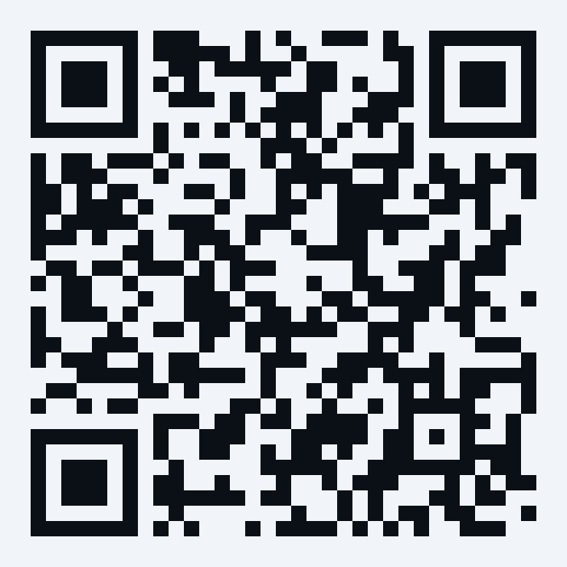
Next: count it by hand,
then test it with CPR trainers
Then pilot it with NSS units, first-aid clubs and schools.
Not a medical device. In an emergency, call 112 (108 for an ambulance) and start CPR.
Scan for the code and test records
github.com/VivekTiwary-25/Zero_flux
Team Zero Flux Vivek · Pratham · Prabal · Moksh
Notes:
Next, we count it by hand to get a real accuracy number, then put it in front of certified CPR trainers, then pilot it with NSS units, first-aid clubs and schools. The code and our test records are open: scan the code. And the line that matters most: this is not a medical device. In a real emergency, call 112 or 108 and start CPR. Thank you.

