Slide 1
SOLVING SUDOKU WITH MATLAB
Raluca Marinescu, Andrea Garcia, Ivan Castro, Eduard Enoiu
Mälardalen University, Västerås, 25.03.2011

Slide 2
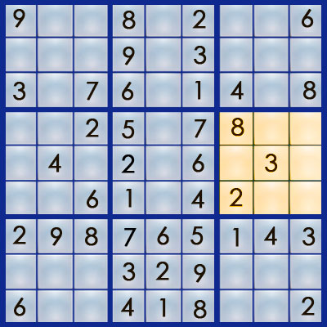
Background
From the Japanese: ”SU”, means ”number” and ”DOKU”, means ”single”. The board is composed by a 9x9 grid, sub-divided into 9 squares containing a 3x3 grid.
The purpose of the game is to insert numbers (1-9) in the board without repeating a number in each row, column or sub-square.
Sudoku is classified as an NP-complete problem, which means there is no known efficient algorithm to solve the puzzles.
It has led researchers to some advances in algorithm design and implementation.

Slide 3
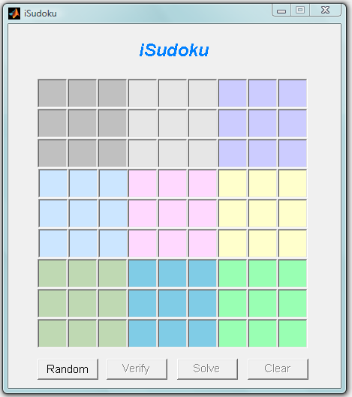
Graphical User Interface
9 subsquares
(different color)
81 Textboxes
Implemented using Matlab’s GUI Design Environment (GUIDE).
Used drag & drop components to create the layout.
Each component has:
A list of properties that can be edited (color, size, position, etc)
Callback functions to model its behavior.
4 Buttons

Slide 4
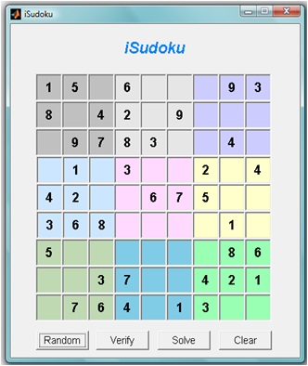
Random Button
Hint Cell (black)
Empty Cell
Objective
Creates and displays a random game on the board.
Selects a game from a database of several games.
Characteristics
The only button enabled when the application is started.
Once a game has been displayed, the remaining buttons get enabled.
Hint cells cannot be modified by the user.

Slide 5
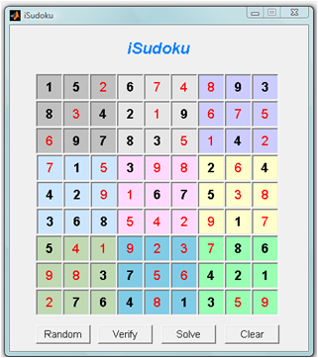
Solve Button
Solution Cell
(red)
Objective:
Solves the current game and displays the solution on the board.
Three main steps:
Read the current game from the board and generate a numerical matrix of 81 elements. Empty cells are substituted by zeros. A validation of the input data is performed.*
Execute the Sudoku solver function, iSudokuALG, using the numerical matrix as an input.
Retrieve the solution provided by the Sudoku solver function and populate the board.
*Only integer values from 1-9 can be inserted in the cells.

Slide 6
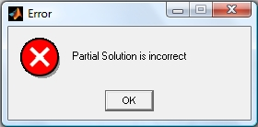
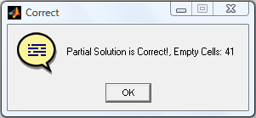
Verify Button
Objective
Examines the correctness of either a partial game or a complete game.
In case of an incorrect game, the program will display a pop-up window with an error message.
In case of a correct game a pop-up window will state this. In a partial game, the number of remaining empty cells will also be stated.

Slide 7
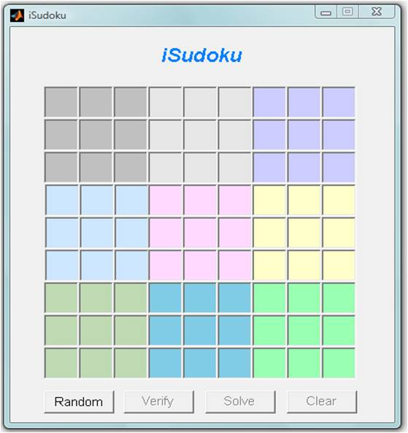
Clear Button
Objective
It clears the board and disables all the buttons except the random button, returning the program to its initial state.

Slide 8
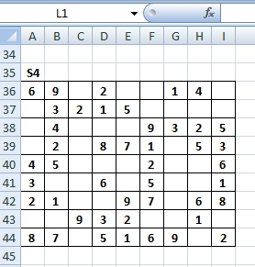
Game Database
Created in to have different games to be Microsoft Excel solved.
Includes games of different levels of difficulty.
The games are read when the GUI is initialized.
The reading process is performed by means of MATLAB's built-in function xlsread.
% Read predefined games from the input spreadsheet
[num, cellMat]= xlsread('sudoku.xls', 'Games');

Slide 9
VERIFICATION FUNCTION
correctness verification of the puzzle:
checks if the current element appears twice in the same line, column, or in the 3-by-3 grid.
Input: the cell matrix A which contains the current puzzle.
Output: variable val which can have two values:
0 if the puzzle is correct
1 otherwise
function [val]=verific(A)

Slide 10
ALGORITHM
Based on constraint propagation
The key internal function is:
When a value is assigned to a cell that same value cannot be used as a possible assignment in all related cells;
If a cell has only one single value for possible assignment, that value is immediately assigned.
% Read predefined games and outputs the solved puzzle
function [A]= iSudokuALG(A)

Slide 11
ALGORITHM
Steps:
Find all the possible values for all the empty cells;
If there is a single possible value, we assign that value to the cell;
Propagate constraints to other cells until you reach the end of the puzzle;
If all the cells have more than one possible value we fill in a tentative value for that cell.
START AGAIN (When do we stop?)

Slide 12
ALGORITHM
When do we stop?
When there are no more empty cells in the puzzle;
When for a cell we cannot place any possible value.

Slide 13
ALGORITHM TESTING
Experimental results for different Sudoku puzzles:

Slide 14
Conclusions
Implementing a Sudoku solver in MATLAB allowed us to use many tools and built-in functions presented during the course.
The combination of a simple, yet effective algorithm with a graphical user interface allowed us to generate games, solve them and verify the given solutions in a simple and quick way.
Good communication and coordination among the team members made possible the completion of the project before the established deadline.

