Slide 1

Baderia Global Institute of Engineering & Management, Jabalpur
Department of Electronics & Communication
Major Project on “Line Following Robot Using PID Algorithm ”
By: Vivek Vishwakarma :- 0225EC211134
Tarun Bisen :- 0225EC211127
Sohit Kushwaha :- 0225EC211124
Yuvraj Singh Lodhi :- 0225EC211138
Ankit Vishwakarma :- 0225EC211018
Yaman Kureel :- 0225EC211135

Slide 2
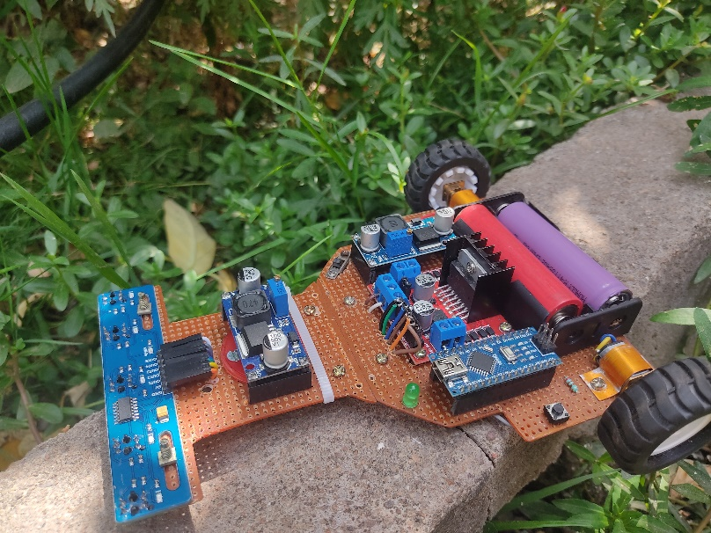
CONTENTS
OBJECTIVE
WHAT IS A LINE TRACER ?
ITS COMPONENTS
ARDUINO NANO.
BOOST CONVERTER.
BUCK CONVERTER / 7805 5v IC.
L298N MOTOR DRIVER.
N20 GEAR MOTER OF 600 RPM.
BLOCK DIAGRAM
WORKING

Slide 3
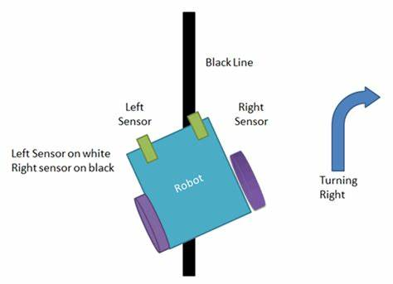
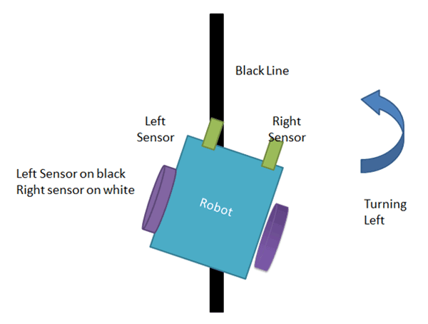
INTRODUCTION
What is a line follower ?
Line follower is a machine that can follow a path. The path can be visible like a black line on a white surface (or vice-versa) or it can be invisible like a magnetic field.
What is the need to build a line follower?
Sensing a line and maneuvering the robot to stay on course, while constantly correcting wrong moves using feedback mechanism forms a simple yet effective closed loop system.

Slide 4
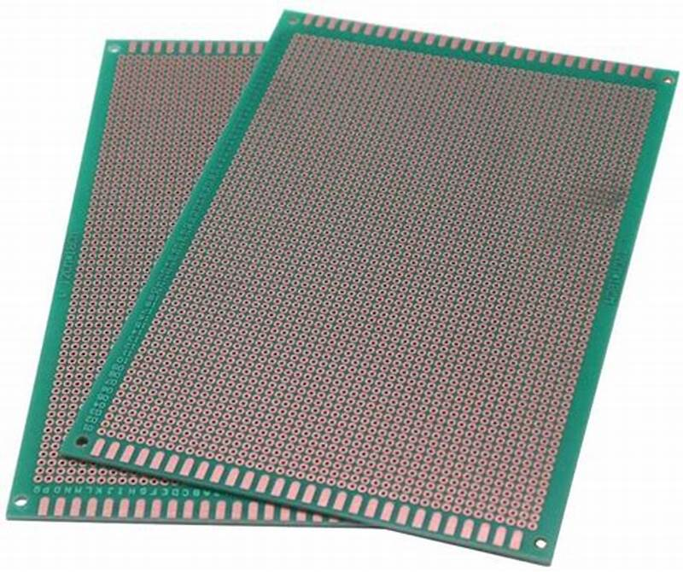
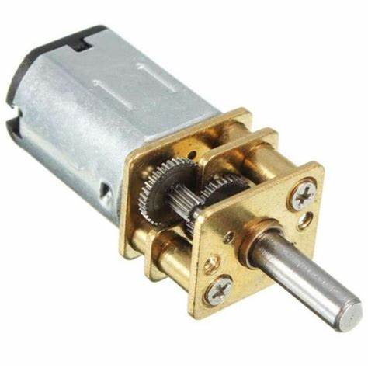
COMPONENT
12 by 10 cm Vero board
Veroboard is a printed circuit board that’s designed with rows of copper tracks with holes drilled in then for electronic components to be soldered to construct electronic circuits.
N20 Gear Motor 600 RPM
The N20 Micro Gear 12V 600 RPM DC Motor (High Torque) is lightweight, high torque, and low RPM motor. It is equipped with gearbox assembly so as to increase the torque of the motor. It has a cross-section of 10 × 12 mm, and the D-shaped gearbox output shaft is 9 mm long and 3 mm in diameter.

Slide 5
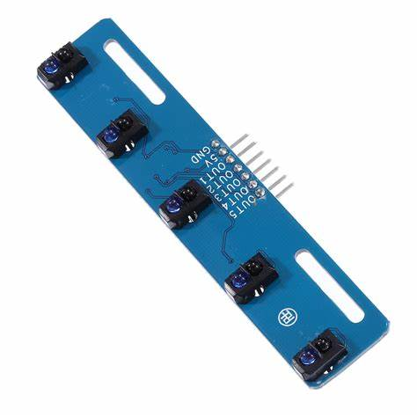
N20 Wheels
N20 Motor Mount Brackets
N20 Ball Caster
5 Channel Line Sensors IR Sensor
used to detect specific characteristics in its surroundings through emitting or detecting IR radiation. These sensors can also be used to detect or measure the heat of a target and its motion.

Slide 6
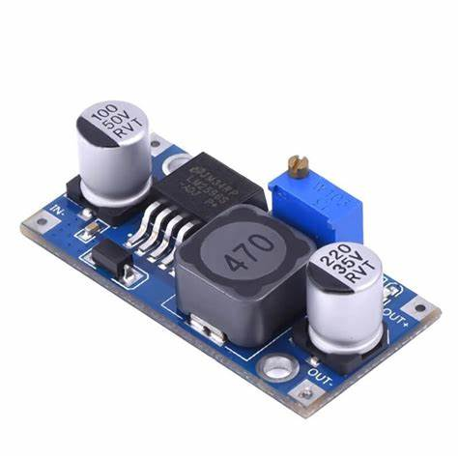
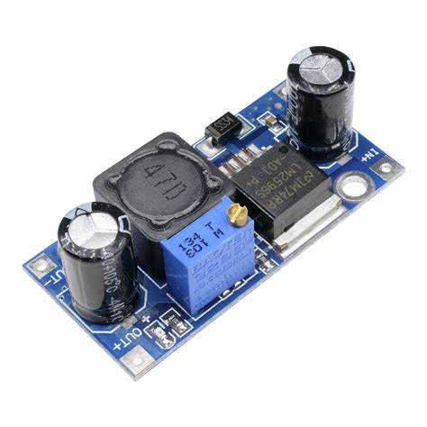
Buck Converter
A buck converter or step-down converter is a DC-to-DC converter which decreases voltage, while increasing current, from its input (supply) to its output (load)
Boost Converter
A boost converter or step-up converter is a DC-to-DC converter which increases voltage, from its input (supply) to its output (load)

Slide 7
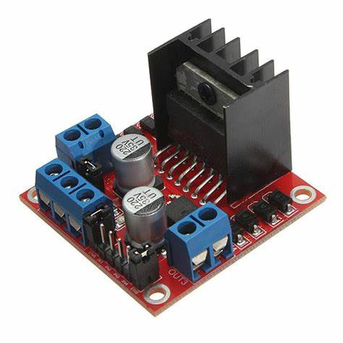
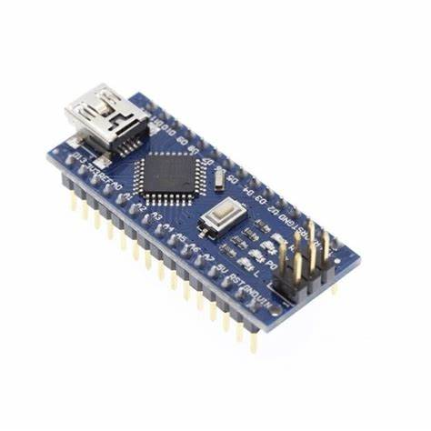
L298N motor driver
The motor driver IC is an integrated circuit chip used as a motor controlling device in autonomous robots and embedded circuits
Arduino NANO
The motor driver IC is an integrated circuit chip used as a motor controlling device in autonomous robots and embedded circuits

Slide 8
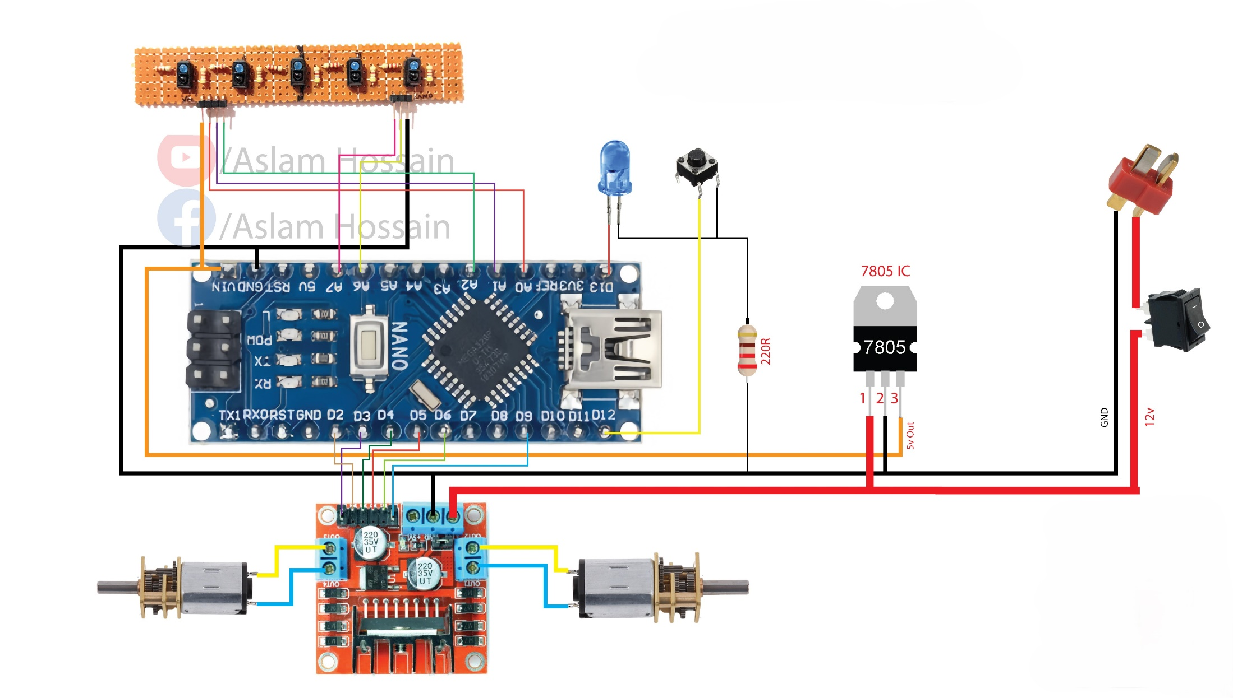
BLOCK DIAGRAM

Slide 9
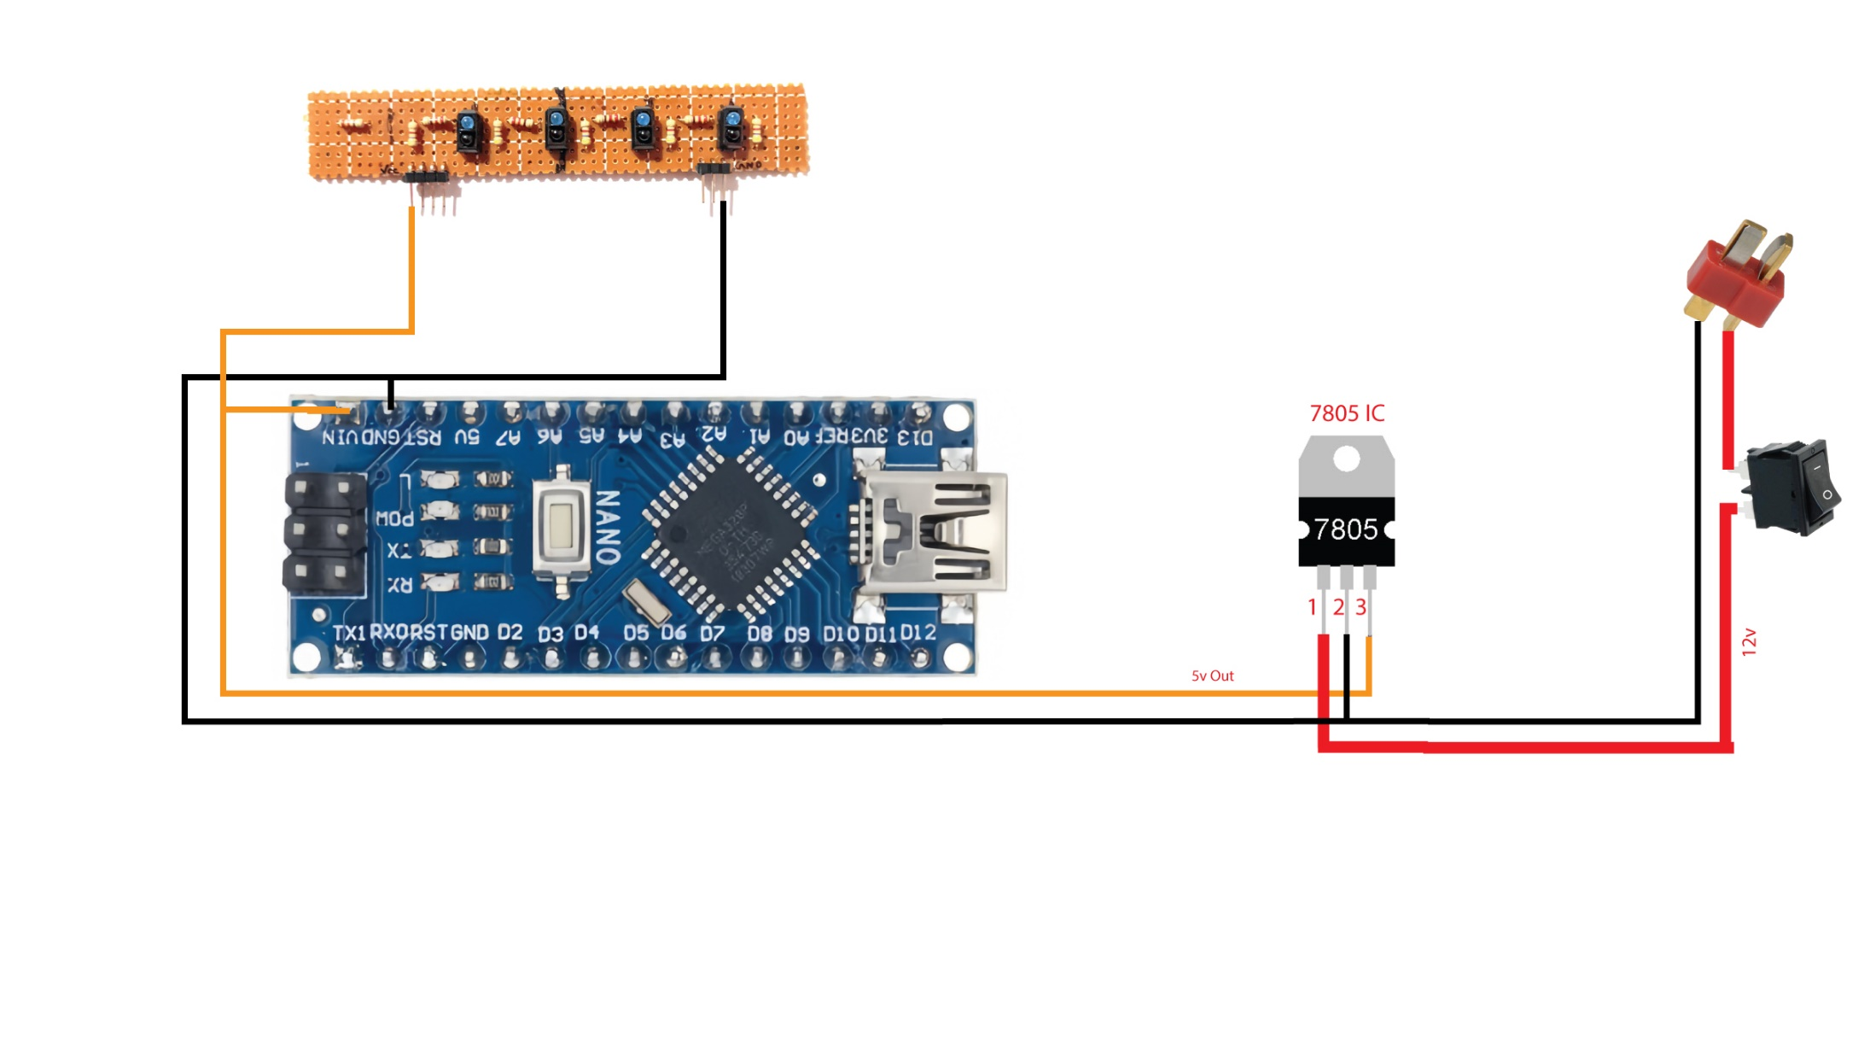

Slide 10
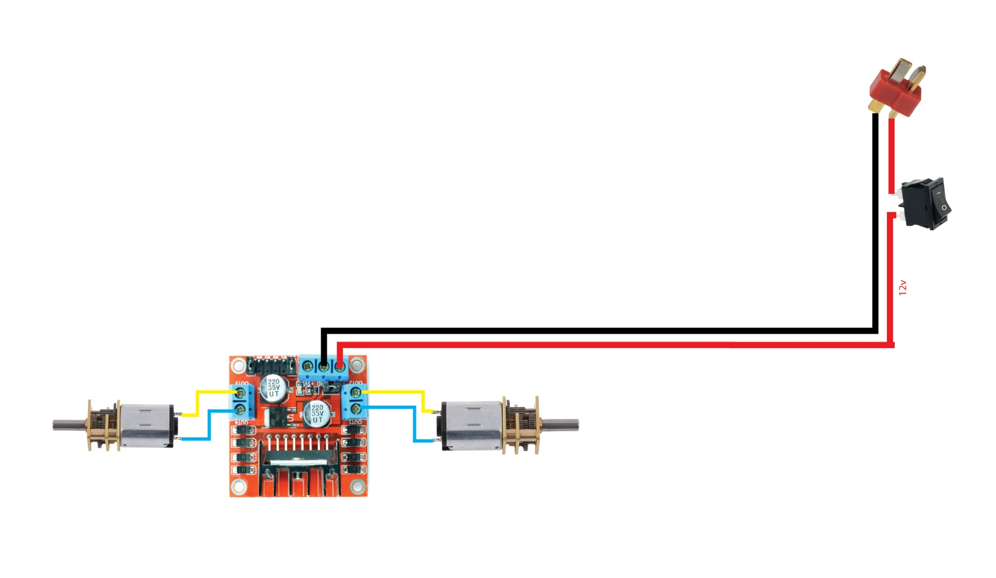

Slide 11
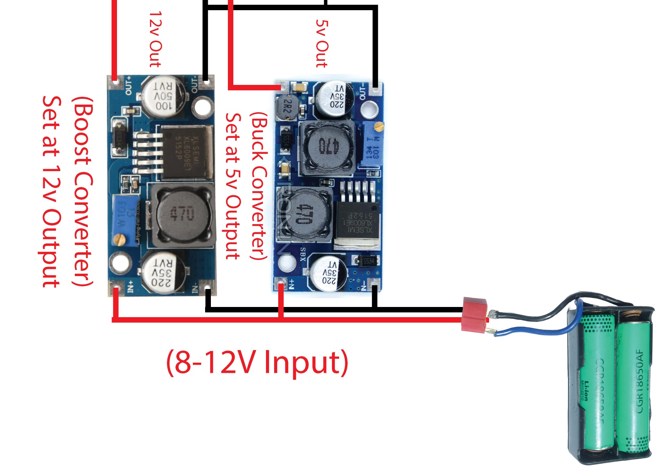

Slide 12
WORKING
Simple Line Follow
First off, we have the simple line follow, the general premise behind this type of line follow is that you have anywhere from one to a few sensors and you hard code a motor response based on which sensor sees the line. This is generally the first method people learn when line following because it’s simple to understand and simple to program. Let’s first review the typical sensor options.

Slide 13
Two Sensors
The general idea behind two sensor line following is that when one sensor sees the line, you slow down or stop the motor on the opposite side of the sensor that saw the line. The sensors work in tandem and keep the robot on track (pun intended). If you use this method, try to keep your sensors close together, the closer your sensors are the less wobble you’ll get in your robot when it drives which will give you a more straight driving appearance and waste less time as you are traveling less distance from your goal before adjusting.
Pros :-
Simple circuit
Easy to program
Cons :-
If you lose the line, it can be difficult to recover
Time is wasted traveling side to side
Not good for high speeds

Slide 14
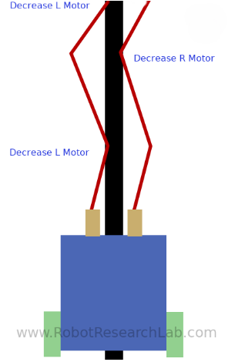

Slide 15
PID Line Follow
First of all, let’s discuss a little about what PID is. PID is stands for Proportional Integral Derivative
P
The first aspect of that adjustment is the P, which is simply a coefficient… that is it’s a number that you multiply your error by to then apply that as an adjustment
adjustment = P*error
I
it keeps track of your errors and accounts for external factors. If your P value doesn’t seem to be making the appropriate changes at decent rate, the I term is going to slowly grow to force your adjustment to be larger because it’s adding up every error and applying that to your adjustment. So, a PI controller algorithm
adjustment = P*error + I*sumOfErrors

Slide 16
D
The D value computes the difference between the last error and the current error. So if the first reading was an error of 5 and the new reading is an error of 1 then the derivative adjustment would be the D coefficient multiplied by the difference in error (1-5) or -4. If we add the D term to our PI controller, it would look like this:
adjustment = P*error + I*sumOfErrors + D*(error – lastError)

Slide 17
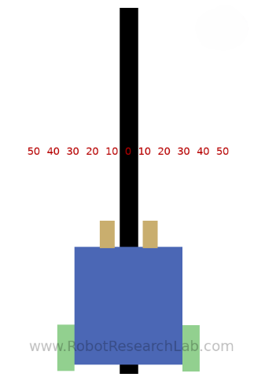

Slide 18
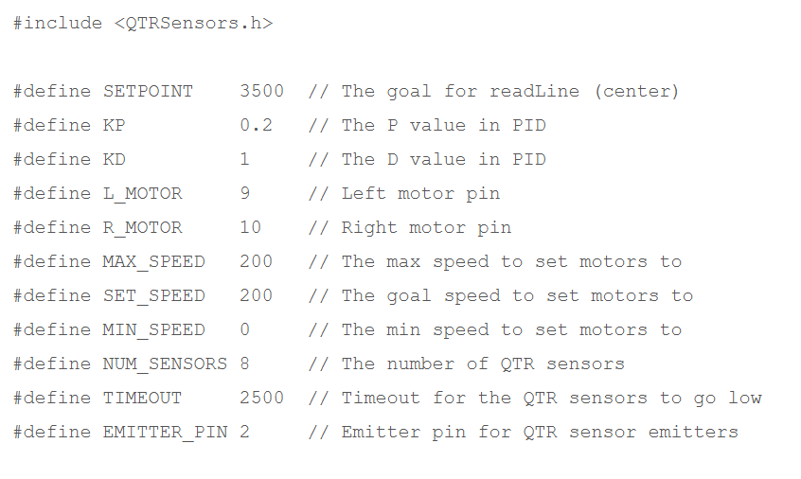

Slide 19
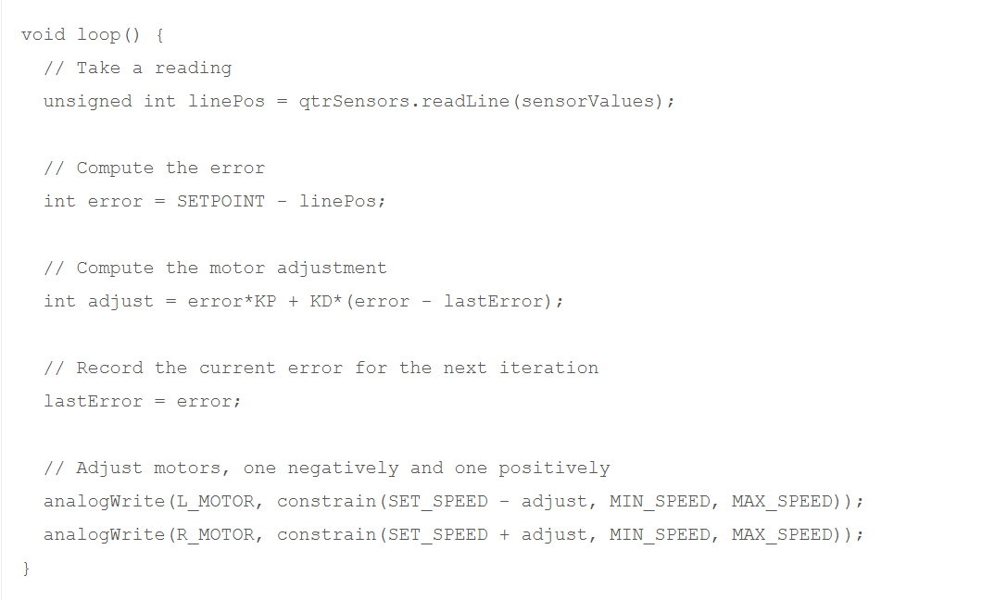

Slide 20
Pros :-
Very smooth and accurate line following
Can typically follow the line much faster than the “Simple” method
Greater flexibility if you want to follow along various positions (follow on center, to the left slightly, to the right slightly)
Cons :-
Requires tuning which can take time
More sensors will take more time to capture readings from

Slide 21


