Slide 1
SNACK SQUAD :A Custamizable Snack Ordering and Delivery App
Vivekadarchini.C
710422104049

Slide 2
DESCRIPTION
Customizable Snack Packs: Create your own snack packs by selecting from a diverse range of snacks.
Personalized Recommendations: AI-driven suggestions based on past orders and preferences.
Subscription Plans: Flexible plans for regular snack deliveries, customizable in frequency and contents.
Real-Time Tracking: Track your order from preparation to delivery.
Dietary Filters: Options for gluten-free, vegan, keto, and more.-
Exclusive Deals and Rewards: Enjoy discounts, loyalty rewards, and special offers.-
User Reviews and Ratings: Read reviews and ratings from other users.
Secure Payments: Multiple payment options with secure transactions.-
Intuitive Interface: User-friendly design for easy browsing and ordering.-
Quick Reordering: Easily reorder your favorite snacks.-
Target Audience: Ideal for busy professionals, students, health-conscious individuals, and snack lovers.-
Technology Stack: Built with React Native, Node.js, Express, MongoDB, and AI integration.

Slide 3
Main Activity.java:
package com.example.snackordering
import android.content.Context
import android.content.Intent
import android.os.Bundle
import androidx.activity.ComponentActivity
import androidx.activity.compose.setContent
import androidx.compose.foundation.Image
import androidx.compose.foundation.layout.*
import androidx.compose.material.*
import androidx.compose.runtime.*
import androidx.compose.ui.Alignment
import androidx.compose.ui.Modifier
import androidx.compose.ui.graphics.Color
import androidx.compose.ui.layout.ContentScale
import androidx.compose.ui.res.painterResource
import androidx.compose.ui.text.font.FontFamily
import androidx.compose.ui.text.font.FontWeight
import androidx.compose.ui.unit.dp
import androidx.compose.ui.unit.sp

Slide 4
import androidx.core.content.ContextCompat
import com.example.snackordering.ui.theme.SnackOrderingTheme
class LoginActivity : ComponentActivity() {
private lateinit var databaseHelper: UserDatabaseHelper
override fun onCreate(savedInstanceState: Bundle?) {
super.onCreate(savedInstanceState)
databaseHelper = UserDatabaseHelper(this)
setContent {
SnackOrderingTheme {
// A surface container using the 'background' color from the theme
Surface(
modifier = Modifier.fillMaxSize(),
color = MaterialTheme.colors.background
) {
LoginScreen(this, databaseHelper)
}
}
}
}
}

Slide 5
@Composable
fun LoginScreen(context: Context, databaseHelper: UserDatabaseHelper) {
Image(painterResource(id = R.drawable.order), contentDescription = "",
alpha =0.3F,
contentScale = ContentScale.FillHeight,
)
var username by remember { mutableStateOf("") }
var password by remember { mutableStateOf("") }
var error by remember { mutableStateOf("") }
Column(
modifier = Modifier.fillMaxSize(),
horizontalAlignment = Alignment.CenterHorizontally,
verticalArrangement = Arrangement.Center
) {

Slide 6
Text(
fontSize = 36.sp,
fontWeight = FontWeight.ExtraBold,
fontFamily = FontFamily.Cursive,
color = Color.White,
text = "Login"
)
Spacer(modifier = Modifier.height(10.dp))
TextField(
value = username,
onValueChange = { username = it },
label = { Text("Username") },
modifier = Modifier.padding(10.dp)
.width(280.dp)
)
TextField(
value = password,
onValueChange = { password = it },

Slide 7
label = { Text("Password") },
modifier = Modifier.padding(10.dp)
.width(280.dp)
)
if (error.isNotEmpty()) {
Text(
text = error,
color = MaterialTheme.colors.error,
modifier = Modifier.padding(vertical = 16.dp)
)
}
Button(
onClick = {
if (username.isNotEmpty() && password.isNotEmpty()) {
val user = databaseHelper.getUserByUsername(username)
if (user != null && user.password == password) {
error = "Successfully log in"
context.startActivity(

Slide 8
Intent(
context,
MainPage::class.java
)
)
//onLoginSuccess()
}
if (user != null && user.password == "admin") {
error = "Successfully log in"
context.startActivity(
Intent(
context,
AdminActivity::class.java
)
)
}
else {
error = "Invalid username or password"
}

Slide 9
} else {
error = "Please fill all fields"
}
},
modifier = Modifier.padding(top = 16.dp)
) {
Text(text = "Login")
}
Row {
TextButton(onClick = {context.startActivity(
Intent(
context,
MainActivity::class.java
)
)}
)
{ Text(color = Color.White,text = "Sign up") }
TextButton(onClick = {
})
{
Spacer(modifier = Modifier.width(60.dp))
Text(color = Color.White,text = "Forget password?")

Slide 10
}
}
}
}
private fun startMainPage(context: Context) {
val intent = Intent(context, MainPage::class.java)
ContextCompat.startActivity(context, intent, null)
}
MAIN PAGE.KT
package com.example.snackordering
import android.annotation.SuppressLint
import android.content.Context
import android.os.Bundle
import android.widget.Toast
import androidx.activity.ComponentActivity
import androidx.activity.compose.setContent
import androidx.annotation.DrawableRes
import androidx.annotation.StringRes

Slide 11
import androidx.compose.foundation.Image
import androidx.compose.foundation.background
import androidx.compose.foundation.layout.*
import androidx.compose.foundation.shape.CircleShape
import androidx.compose.foundation.shape.RoundedCornerShape
import androidx.compose.material.*
import androidx.compose.material.icons.Icons
import androidx.compose.material.icons.filled.*
import androidx.compose.runtime.Composable
import androidx.compose.ui.Alignment
import androidx.compose.ui.Modifier
import androidx.compose.ui.draw.clip
import androidx.compose.ui.graphics.Color
import androidx.compose.foundation.lazy.LazyColumn
import androidx.compose.foundation.lazy.items
import androidx.compose.material.Text
import androidx.compose.ui.unit.dp
import androidx.compose.ui.graphics.RectangleShape
import androidx.compose.ui.layout.ContentScale
import androidx.compose.ui.platform.LocalContext

Slide 12
import androidx.compose.ui.res.painterResource
import androidx.compose.ui.res.stringResource
import androidx.compose.ui.text.font.FontWeight
import androidx.compose.ui.unit.sp
import androidx.core.content.ContextCompat.startActivity
import com.example.snackordering.ui.theme.SnackOrderingTheme
import android.content.Intent as Intent1
class MainPage : ComponentActivity() {
override fun onCreate(savedInstanceState: Bundle?) {
super.onCreate(savedInstanceState)
setContent {
SnackOrderingTheme {
// A surface container using the 'background' color from the theme
Surface(
modifier = Modifier.fillMaxSize(),
color = MaterialTheme.colors.background
) {

Slide 13
FinalView(this)
val context = LocalContext.current
//PopularFoodColumn(context)
}
}
}
}
}
@Composable
fun TopPart() {
Row(
modifier = Modifier
.fillMaxWidth()
.background(Color(0xffeceef0)), Arrangement.SpaceBetween
) {
Icon(
imageVector = Icons.Default.Add, contentDescription = "Menu Icon",

Slide 14
Modifier
.clip(CircleShape)
.size(40.dp),
tint = Color.Black,
)
Column(horizontalAlignment = Alignment.CenterHorizontally) {
Text(text = "Location", style = MaterialTheme.typography.subtitle1, color = Color.Black)
Row {
Icon(
imageVector = Icons.Default.LocationOn,
contentDescription = "Location",
tint = Color.Red,
)
Text(text = "Accra" , color = Color.Black)
}
}
Icon(
imageVector = Icons.Default.Notifications, contentDescription = "Notification Icon",

Slide 15
Modifier
.size(45.dp),
tint = Color.Black,
)
}
}
@Composable
fun CardPart() {
Card(modifier = Modifier.size(width = 310.dp, height = 150.dp), RoundedCornerShape(20.dp)) {
Row(modifier = Modifier.padding(10.dp), Arrangement.SpaceBetween) {
Column(verticalArrangement = Arrangement.spacedBy(12.dp)) {
Text(text = "Get Special Discounts")
Text(text = "up to 85%", style = MaterialTheme.typography.h5)
Button(onClick = {}, colors = ButtonDefaults.buttonColors(Color.White)) {
Text(text = "Claim voucher", color = MaterialTheme.colors.surface)
}
}
Image(
painter = painterResource(id = R.drawable.food_tip_im),
contentDescription = "Food Image", Modifier.size(width = 100.dp, height = 200.dp)
)

Slide 16
)
}
}
}
@Composable
fun PopularFood(
@DrawableRes drawable: Int,
@StringRes text1: Int,
context: Context
) {
Card(
modifier = Modifier
.padding(top=20.dp, bottom = 20.dp, start = 65.dp)
.width(250.dp)
) {

Slide 17
Column(
verticalArrangement = Arrangement.Top,
horizontalAlignment = Alignment.CenterHorizontally
) {
Spacer(modifier = Modifier.padding(vertical = 5.dp))
Row(
modifier = Modifier
.fillMaxWidth(0.7f), Arrangement.End
) {
Icon(
imageVector = Icons.Default.Star,
contentDescription = "Star Icon",
tint = Color.Yellow
)
Text(text = "4.3", fontWeight = FontWeight.Black)
}
Image(
painter = painterResource(id = drawable),
contentDescription = "Food Image",
contentScale = ContentScale.Crop,

Slide 18
modifier = Modifier
.size(100.dp)
.clip(CircleShape)
)
Text(text = stringResource(id = text1), fontWeight = FontWeight.Bold)
Row(modifier = Modifier.fillMaxWidth(0.7f), Arrangement.SpaceBetween) {
/*TODO Implement Prices for each card*/
Text(
text = "$50",
style = MaterialTheme.typography.h6,
fontWeight = FontWeight.Bold,
fontSize = 18.sp
)
IconButton(onClick = {
//var no=FoodList.lastIndex;
//Toast.
val intent = Intent1(context, TargetActivity::class.java)
context.startActivity(intent)

Slide 19
}) {
Icon(
imageVector = Icons.Default.ShoppingCart,
contentDescription = "shopping cart",
)
}
}
}
}
}
private val FoodList = listOf(
R.drawable.sandwish to R.string.sandwich,
R.drawable.sandwish to R.string.burgers,
R.drawable.pack to R.string.pack,
R.drawable.pasta to R.string.pasta,

Slide 20
R.drawable.tequila to R.string.tequila,
R.drawable.wine to R.string.wine,
R.drawable.salad to R.string.salad,
R.drawable.pop to R.string.popcorn
).map { DrawableStringPair(it.first, it.second) }
private data class DrawableStringPair(
@DrawableRes val drawable: Int,
@StringRes val text1: Int
)
@Composable
fun App(context: Context) {
Column(
modifier = Modifier
.fillMaxSize()
.background(Color(0xffeceef0))
.padding(10.dp),

Slide 21
verticalArrangement = Arrangement.Top,
horizontalAlignment = Alignment.CenterHorizontally
) {
Surface(modifier = Modifier, elevation = 5.dp) {
TopPart()
}
Spacer(modifier = Modifier.padding(10.dp))
CardPart()
Spacer(modifier = Modifier.padding(10.dp))
Row(modifier = Modifier.fillMaxWidth(), Arrangement.SpaceBetween) {
Text(text = "Popular Food", style = MaterialTheme.typography.h5, color = Color.Black)
Text(text = "view all", style = MaterialTheme.typography.subtitle1, color = Color.Black)
}
Spacer(modifier = Modifier.padding(10.dp))
PopularFoodColumn(context) // <- call the function with parentheses
}
}

Slide 22
@Composable
fun PopularFoodColumn(context: Context) {
LazyColumn(
modifier = Modifier.fillMaxSize(),
content = {
items(FoodList) { item ->
PopularFood(context = context,drawable = item.drawable, text1 = item.text1)
abstract class Context
}
},
verticalArrangement = Arrangement.spacedBy(16.dp))
}
@SuppressLint("UnusedMaterialScaffoldPaddingParameter")

Slide 23
@Composable
fun FinalView(mainPage: MainPage) {
SnackOrderingTheme {
Scaffold() {
val context = LocalContext.current
App(context)
}
}
}
ORDER.KT
package com.example.snackordering
import androidx.room.ColumnInfo
import androidx.room.Entity
import androidx.room.PrimaryKey
@Entity(tableName = "order_table")
data class Order(
@PrimaryKey(autoGenerate = true) val id: Int?,
@ColumnInfo(name = "quantity") val quantity: String?,
@ColumnInfo(name = "address") val address: String?,
)

Slide 24
String?,
@ColumnInfo(name = "address") val address: String?,
)
ORDERDAO.KT
package com.example.snackordering
import androidx.room.*
@Dao
interface OrderDao {
@Query("SELECT * FROM order_table WHERE address= :address")
suspend fun getOrderByAddress(address: String): Order?
@Insert(onConflict = OnConflictStrategy.REPLACE)
suspend fun insertOrder(order: Order)
@Update
suspend fun updateOrder(order: Order)
@Delete
suspend fun deleteOrder(order: Order)
}

Slide 25
ORDERDATABASE.KT
package com.example.snackordering
import android.content.Context
import androidx.room.Database
import androidx.room.Room
import androidx.room.RoomDatabase
@Database(entities = [Order::class], version = 1)
abstract class OrderDatabase : RoomDatabase() {
abstract fun orderDao(): OrderDao
companion object {
@Volatile
private var instance: OrderDatabase? = null
fun getDatabase(context: Context): OrderDatabase {
return instance ?: synchronized(this) {
val newInstance = Room.databaseBuilder(

Slide 26
context.applicationContext,
OrderDatabase::class.java,
"order_database"
).build()
instance = newInstance
newInstance
}
}
}
}
ORDER DATABASE HELPER.KT
package com.example.snackordering
import android.annotation.SuppressLint
import android.content.ContentValues
import android.content.Context
import android.database.Cursor

Slide 27
import android.database.sqlite.SQLiteDatabase
import android.database.sqlite.SQLiteOpenHelper
class OrderDatabaseHelper(context: Context) :
SQLiteOpenHelper(context, DATABASE_NAME, null,DATABASE_VERSION){
companion object {
private const val DATABASE_VERSION = 1
private const val DATABASE_NAME = "OrderDatabase.db"
private const val TABLE_NAME = "order_table"
private const val COLUMN_ID = "id"
private const val COLUMN_QUANTITY = "quantity"
private const val COLUMN_ADDRESS = "address"
}

Slide 28
override fun onCreate(db: SQLiteDatabase?) {
val createTable = "CREATE TABLE $TABLE_NAME (" +
"${COLUMN_ID} INTEGER PRIMARY KEY AUTOINCREMENT, " +
"${COLUMN_QUANTITY} Text, " +
"${COLUMN_ADDRESS} TEXT " +
")"
db?.execSQL(createTable)
}
override fun onUpgrade(db: SQLiteDatabase?, oldVersion: Int, newVersion: Int) {
db?.execSQL("DROP TABLE IF EXISTS $TABLE_NAME")
onCreate(db)
}
fun insertOrder(order: Order) {
val db = writableDatabase
val values = ContentValues()

Slide 29
values.put(COLUMN_QUANTITY, order.quantity)
values.put(COLUMN_ADDRESS, order.address)
db.insert(TABLE_NAME, null, values)
db.close()
}
@SuppressLint("Range")
fun getOrderByQuantity(quantity: String): Order? {
val db = readableDatabase
val cursor: Cursor = db.rawQuery("SELECT * FROM $TABLE_NAME WHERE $COLUMN_QUANTITY = ?",
arrayOf(quantity))
var order: Order? = null
if (cursor.moveToFirst()) {
order = Order(
id = cursor.getInt(cursor.getColumnIndex(COLUMN_ID)),
quantity = cursor.getString(cursor.getColumnIndex(COLUMN_QUANTITY)),
address = cursor.getString(cursor.getColumnIndex(COLUMN_ADDRESS)),
)
}

Slide 30
cursor.close()
db.close()
return order
}
@SuppressLint("Range")
fun getOrderById(id: Int): Order? {
val db = readableDatabase
val cursor: Cursor = db.rawQuery("SELECT * FROM $TABLE_NAME WHERE $COLUMN_ID = ?", arrayOf(id.toString()))
var order: Order? = null
if (cursor.moveToFirst()) {
order = Order(
id = cursor.getInt(cursor.getColumnIndex(COLUMN_ID)),
quantity = cursor.getString(cursor.getColumnIndex(COLUMN_QUANTITY)),
address = cursor.getString(cursor.getColumnIndex(COLUMN_ADDRESS)),
)
}
cursor.close()
db.close()
return order
}

Slide 31
@SuppressLint("Range")
fun getAllOrders(): List<Order> {
val orders = mutableListOf<Order>()
val db = readableDatabase
val cursor: Cursor = db.rawQuery("SELECT * FROM $TABLE_NAME", null)
if (cursor.moveToFirst()) {
do {
val order = Order(
id = cursor.getInt(cursor.getColumnIndex(COLUMN_ID)),
quantity = cursor.getString(cursor.getColumnIndex(COLUMN_QUANTITY)),
address = cursor.getString(cursor.getColumnIndex(COLUMN_ADDRESS)),
)
orders.add(order)
} while (cursor.moveToNext())
}
cursor.close()
db.close()
return orders
}
}

Slide 32
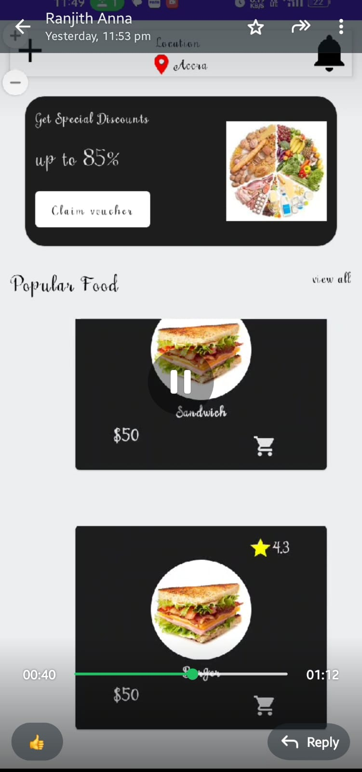
OUTPUT:

Slide 33
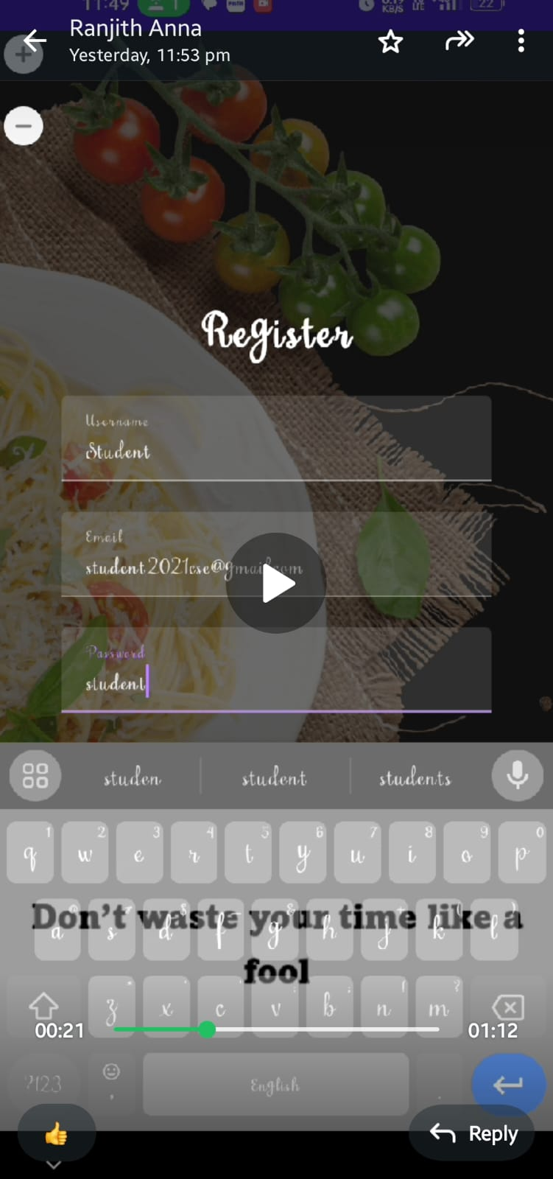

Slide 34
