Slide 1
HAPPIEST HEALTH DIGITAL TWIN CHALLENGE 2026
SwasthTwin
A personalised Digital Twin that forecasts the risk of a hyperglycemia event in the next two hours by fusing historical EHR data with wearable and CGM streams
Team Innovators
Institution Indian Institute of Technology Kharagpur
Team leader Yayavaram Vivekadithya
Research prototype · synthetic data only · not a medical device
Notes:
Introduce the team and the one-line idea: a per-patient digital twin that combines a person's medical history with live wearable data to estimate the chance of a high-glucose event in the next two hours. Say up front that everything shown runs on synthetic data and is a research prototype.

Slide 2
The problem: high-glucose episodes are seen after they happen
Adults with or at risk of type 2 diabetes generate rich CGM and wearable data, but it is reviewed retrospectively
1
2
3
Data without foresight
Context is split
Clinician time is short
CGM shows where glucose IS. Reports summarise where it WAS. Few tools estimate where it is heading for this specific person.
The EHR (HbA1c, diagnosis, medicines) and the wearable stream (glucose, activity, sleep) sit in different systems and are rarely read together.
A care team cannot watch every stream. They need a short, explained signal: who may be heading high soon, and why the model thinks so.
Specific use case
Every 30 minutes, estimate P(any CGM reading ≥ 180 mg/dL in the next 120 minutes) for one patient, explain the estimate and flag data-quality problems — for clinician review, not for automatic action.
SwasthTwin · research prototype on synthetic data · not a medical device
2
Notes:
Why this use case: hyperglycemia excursions are frequent in type 2 diabetes and CGM data is already collected, but it is mostly reviewed after the fact. A short-horizon, explained warning is a concrete, testable task. The 180 mg/dL / 120-minute rule is our prototype target, not a clinical definition. We avoid quoting prevalence statistics we have not verified.

Slide 3
Why it is a Digital Twin, not just a prediction model
Each patient has a persistent virtual state that is updated as new observations arrive
1
2
3
4
5
Observe
Update state
Forecast
Explain
Review
EHR profile + new sensor readings up to the twin's clock
Rebuild rolling features with the same code used in training
Saved model scores the 120-minute event risk
Top inputs, stream contributions, data-quality warnings
Clinician sees trend + history; tries what-if inputs
What makes it a twin
Honest scope
Patient-specific state object (EHR + observations + features + forecast history)
Advances in time: deterministic replay of the sensor stream, or manual readings
Every refresh is a real model call on updated inputs — no scripted percentages
What-if mode edits a copy of the inputs and re-scores; the twin itself is unchanged
Data-driven twin, not a mechanistic physiology model
No live wearable or hospital integration — the feed is a replay
What-if shows model sensitivity, not the body's response
SwasthTwin · research prototype on synthetic data · not a medical device
3
Notes:
A plain classifier scores rows. The twin keeps state per patient and is updated over time: in the demo we advance the clock, the twin ingests the next part of the stream, recomputes features and calls the model again, and keeps a history. Be clear about scope: this is a data-driven twin; there is no live device integration; and what-if results describe how the model responds, not physiology.

Slide 4
Two-stream fusion: sensors carry most signal, the EHR adds context
Same algorithm trained on different inputs, evaluated on held-out test patients
EHR · historical
Age, sex, BMI, diabetes status and duration, HbA1c, fasting glucose, eGFR, lipids, BP, medication class
Fusion features
Latest CGM minus the patient's EHR fasting glucose; HbA1c × logged carbs
Sensors · dynamic
CGM level, trend, variability, coverage; heart rate, HRV vs own 24 h; steps; last night's sleep; optional meal log
Adding the EHR to sensors: +0.002 PR-AUC overall, +0.015 during CGM gaps.
Small gain; confidence intervals overlap (fused 0.939–0.988 vs sensor 0.938–0.986). We do not claim fusion is proven to help.
SwasthTwin · research prototype on synthetic data · not a medical device
4
Notes:
Left: what each stream contributes. Right: an ablation run by the evaluation script, same algorithm, different inputs, both single-stream models also get time of day. Honest message: on this synthetic cohort the sensor stream carries most of the signal; adding the EHR helps a little, most during CGM gaps, and the intervals overlap. Real data could show a different picture; that is a question for validation.

Slide 5
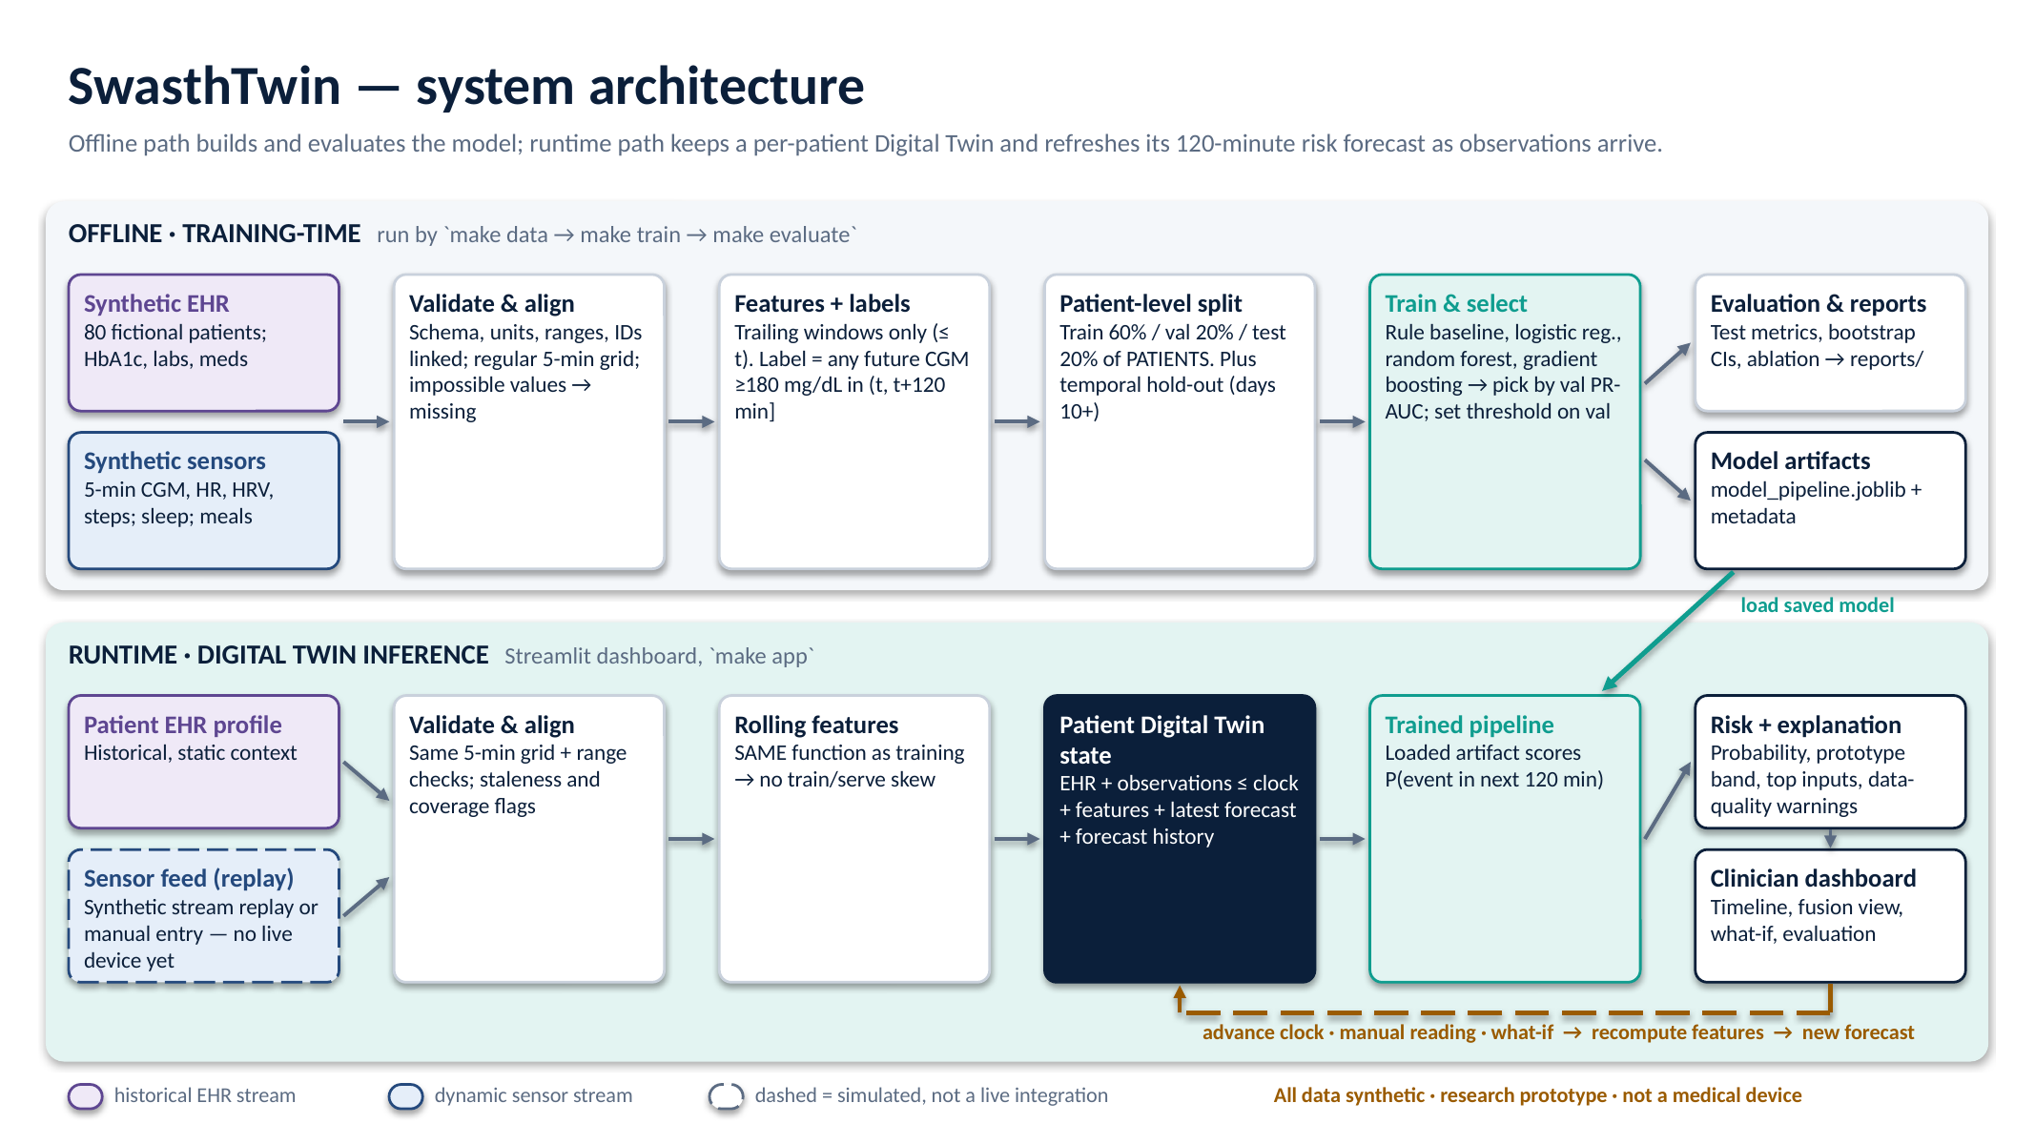
System architecture: offline training, runtime twin
SwasthTwin · research prototype on synthetic data · not a medical device
5
Notes:
Top lane: offline. Generate linked synthetic data, validate, build features using only past data and labels from the next two hours, split by patient, train and select on validation patients, save the pipeline, evaluate on test patients. Bottom lane: runtime. The twin rebuilds features with the same function, the saved model scores them, the dashboard shows risk, explanation and warnings. The dashed box is the honest bit: the sensor feed is a replay, not a live device.

Slide 6
Synthetic data, leakage-safe features, privacy by design
80 fictional patients × 14 days of 5-minute data, fully reproducible from one seed
Synthetic cohort
Features (all from the past)
Privacy & safety
EHR drives the simulator: higher HbA1c / BMI → larger meal spikes; meds damp them
Meals, walks, stress, short sleep and dawn rise shape glucose; HR/HRV respond
Realistic mess: CGM gaps, watch-off hours, noisy and incomplete meal logs
Hand-picked coefficients — documented, not fitted to real data
CGM: level, 15/30-min trend, mean / SD / min / max, time in range, coverage
Wearable: HR, HRV vs own 24 h, steps, active minutes; last night's sleep
Meals count only from the moment they are logged
Test: features identical whether or not future data exists
No real person's data; IDs are SYN-0001…
No names, phone numbers or government IDs anywhere
Runs fully offline; no API keys or cloud services
Prominent not-a-medical-device notice in every view
SwasthTwin · research prototype on synthetic data · not a medical device
6
Notes:
The generator is deterministic. The EHR is not decoration: it sets each patient's baseline and how strongly they respond to meals, so the two streams are genuinely linked. We added realistic problems: sensor gaps, watch-off periods, and patients who log only some meals with wrong carb estimates. All features use only past data and an automated test proves it. No real data and no identifiers are used.

Slide 7
ML approach and leakage-resistant evaluation
Simple baselines first; choose the model on validation patients; touch test patients once
Rule baseline
No ML: alert if current or 60-min trend-projected CGM ≥ 180
Evaluation design
Split by patient: 48 train / 16 validation / 16 test patients — nobody appears in two splits
Temporal check: train on days 0–9 of training patients, test on days 10+ of test patients
Selection: highest validation PR-AUC; alert threshold set on validation for ≥80% sensitivity
Uncertainty: 95% CIs from a patient-level bootstrap (300 resamples)
Harder subset: rows where glucose is not yet ≥ 180 — persistence alone cannot score well here
Also reported: Brier score, calibration curve, confusion matrix, prevalence, permutation importance
Logistic regression
Linear baseline ML model
Random forest
Nonlinear ensemble
Gradient boosting (selected)
Histogram gradient-boosted trees
scikit-learn pipelines: median imputation + missing-value indicators, one-hot encoding, model. Saved with joblib with feature list, threshold and version.
SwasthTwin · research prototype on synthetic data · not a medical device
7
Notes:
We compare against a non-ML rule and a linear model before trusting anything complex. Model choice uses validation patients only. The split is by patient, so the test measures performance on people the model has never seen; a second check also moves forward in time. We report the subset where glucose is not already high because there, simply saying 'it is high now' does not work.

Slide 8
Results on held-out synthetic patients
16 test patients · 10,275 forecasts · event prevalence 48% · all numbers from reports/metrics.json
0.975
0.880
Gradient boosting PR-AUC
95% CI 0.939–0.988
Rule baseline PR-AUC
95% CI 0.750–0.940
77%
98%
sensitivity at threshold 0.86
(target was 80% on validation)
specificity · precision 98%
What this does and does not show
Where glucose is not yet high, PR-AUC 0.867 vs 0.472 for the rule. Temporal hold-out PR-AUC 0.976. Test sensitivity 77% fell short of the 80% validation target. Scores are high partly because the generator is learnable (e.g. regular meal times make clock time predictive). This is agreement with our simulator, NOT clinical evidence.
SwasthTwin · research prototype on synthetic data · not a medical device
8
Notes:
Read the numbers carefully. Gradient boosting reaches PR-AUC 0.975 on test patients versus 0.880 for the no-ML rule and 0.943 for logistic regression. The more meaningful comparison is the subset where glucose is not already high: 0.867 versus 0.472. Sensitivity on test was 77%, below the 80% we targeted on validation, which shows that thresholds do not transfer perfectly. The biggest caveat: high scores reflect how learnable our own simulator is; time of day is a top feature because synthetic meals follow routines. None of this is evidence about real patients.

Slide 9
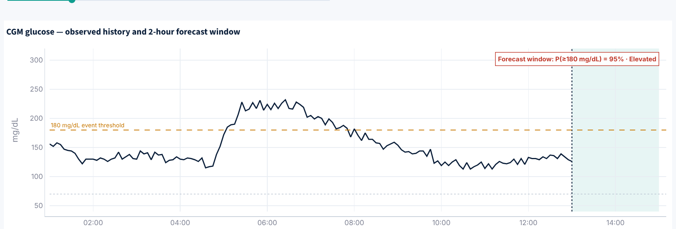
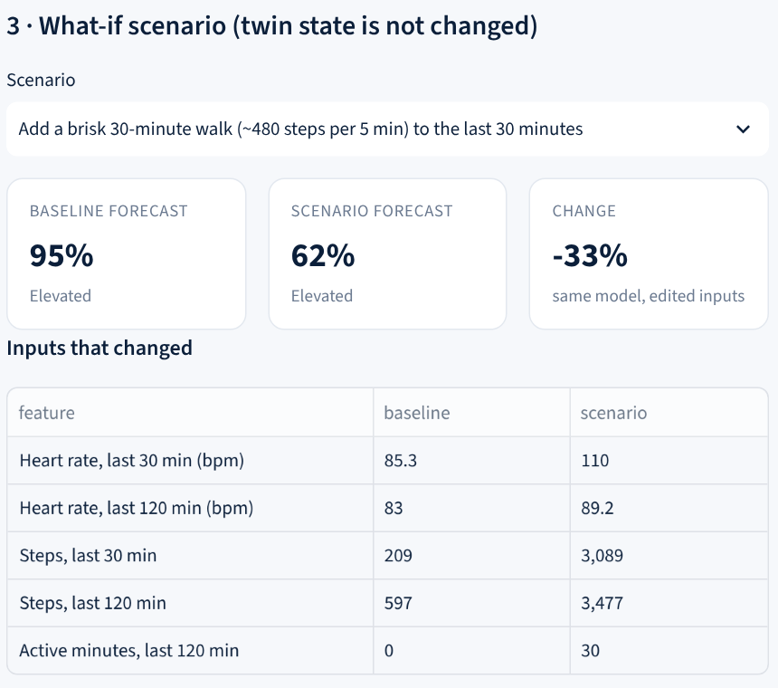
Live prototype: one synthetic patient, step by step
Held-out patient SYN-0002 · type2 diabetes · HbA1c 7.3% · values below produced by the saved model at build time
Twin replayed 12 half-hour updates; its risk estimate ranged 2%–100% as the stream changed — every value a fresh model call.
At Wed 13:00: latest CGM 126 mg/dL, P(event in 2 h) 95% (Elevated). The explanation shows time of day as a top driver — a known limitation of the synthetic routine.
What-if (model sensitivity, not advice): +30-min walk → 62%; logging 80 g carbs now → 95%.
SwasthTwin · research prototype on synthetic data · not a medical device
9
Notes:
Walk through the dashboard as in the demo video: pick a held-out patient, advance the clock, watch the risk history update, open the explanation, then run what-if scenarios. Point out that the shaded forecast window contains no invented glucose values, and that the explanation honestly shows time of day as a top driver, which is a limitation of synthetic routines. What-if results show the model's sensitivity, not what would happen to the patient.

Slide 10
Potential value, limitations and the road to validation
Potential value (unproven)
Key limitations
Roadmap
Earlier, explained flag for clinician review
One place to read EHR + wearable context
Data-quality warnings instead of silent guesses
Reusable twin pattern for other forecasts
Synthetic, hand-tuned simulator; results do not transfer
180 mg/dL / 2 h rule is a prototype target
Clock time over-predictive due to regular synthetic meals
Risk bands uncalibrated for clinical use
No device or EHR integration; no hypoglycemia target
1
Public de-identified CGM data (licence checked) — retrain, re-test
2
Clinicians co-define target, threshold and alert burden
3
Retrospective study with ethics approval
4
Silent prospective pilot; calibration and safety review
5
Regulatory pathway before any clinical use
Ask: feedback from clinicians on the target definition and alert threshold, and access routes to consented real-world CGM + EHR data for validation.
SwasthTwin · research prototype on synthetic data · not a medical device
10
Notes:
Close honestly. The value is potential, not demonstrated. Name the limitations plainly: synthetic data, a prototype target, clock-time shortcut, uncalibrated bands, no live integration. The roadmap moves from public de-identified data, to clinician-defined targets, to ethics-approved retrospective and then silent prospective evaluation, and only then regulatory review.

